Slide 1
Exploring Quantum-Resistant Signatures for
Ethereum’s Hybrid Blockchain
Master’s Thesis – University of Geneva
Dany A. Darghouth – June 2025

Slide 2
INTRODUCTION
Understanding the context, and why we’re here exactly..

Slide 3
INTRODUCTION CONTEXT - ETHEREUM
Second biggest blockchain in the world
Recently transitioned from PoW to PoS
  Signatures play a crucial role
Relies on ECDSA (Elliptic Curve Digital Signature Algorithm)
Supports dApps and smart contracts

Slide 4
INTRODUCTION CONTEXT – QUANTUM THREAT
Quantum computing will provide speedup (e.g. Grover’s algorithm) and new computing possibilities (e.g. Shor’s algorithm)
Shor’s algorithm breaks discrete log-based schemes (i.e. ECDSA)
  Ethereum private keys can be recovered from public keys
  Pending transactions can be intercepted and re-signed by attackers
Not a matter of “if” but a matter of “when”

Slide 5
INTRODUCTION CONTEXT - NIST
NIST started a search for new standards in 2016
3 Candidates were standardized in august 2024
  (ML-DSA, FALCON, SLH-DSA)
The search for signatures continues as of today (additional call for candidates launched in 2024)

Slide 6
CRYPTOGRAPHIC BACKGROUND
Signatures, Hash-Based signatures, Lattice-Based…

Slide 7
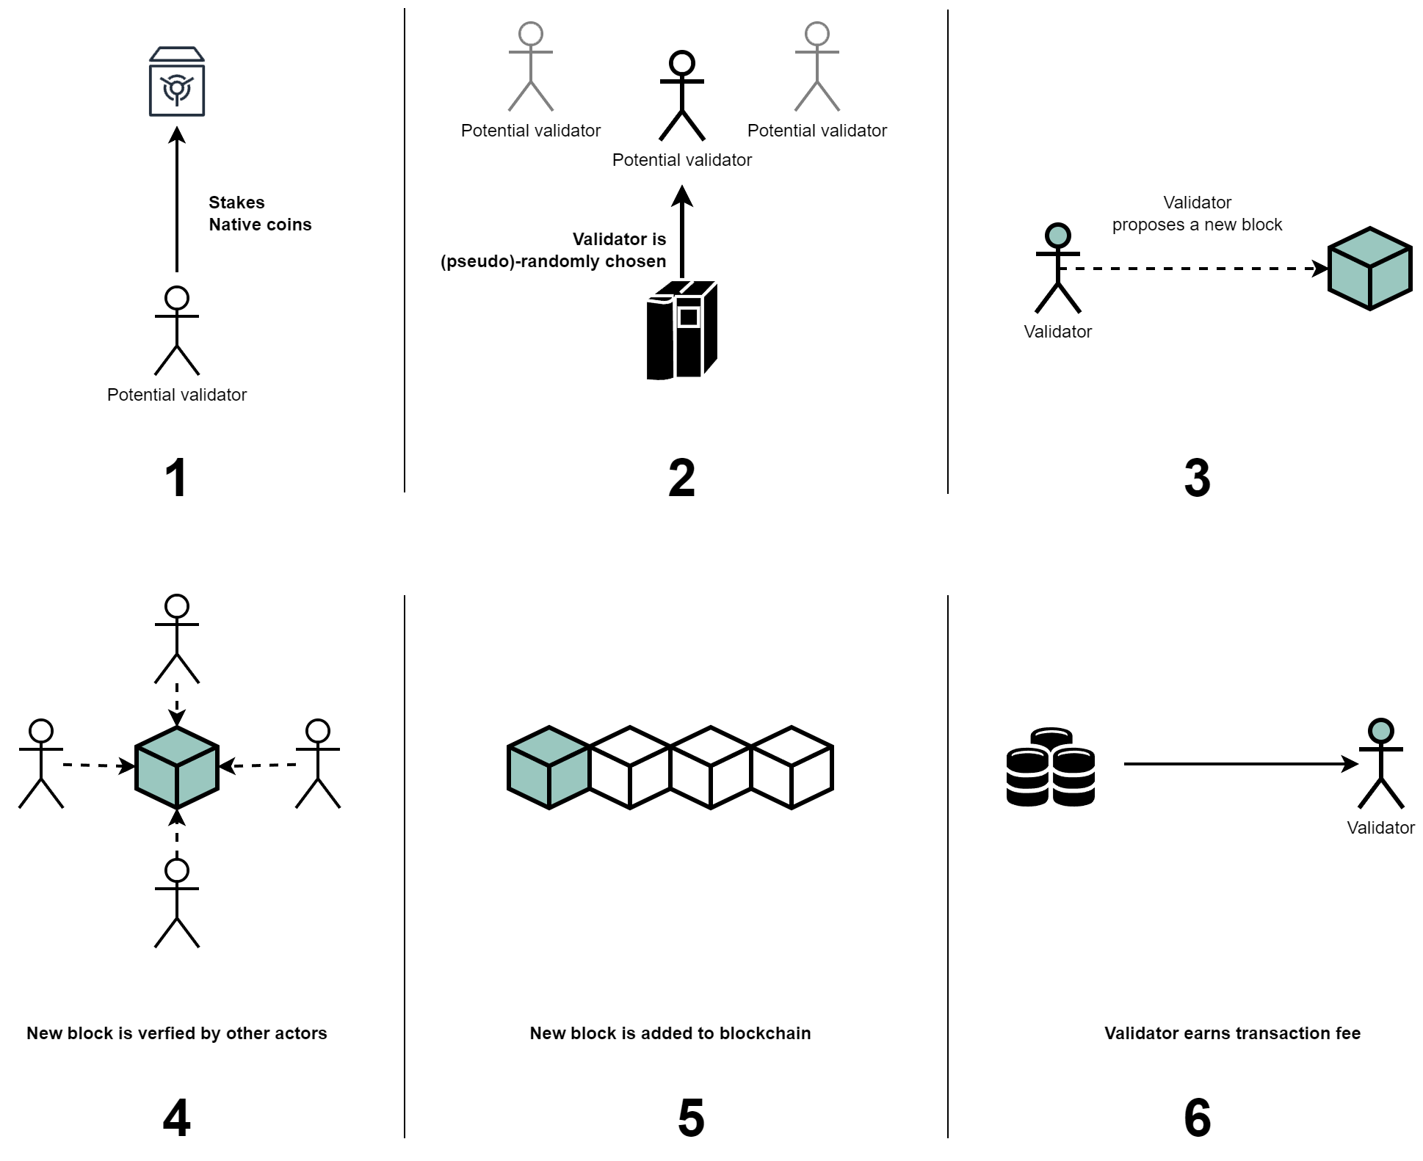
CRYPTOGRAPHIC BACKGROUND PROOF of STAKE

Slide 8



CRYPTOGRAPHIC BACKGROUND SIGNATURES
Proves ownership of a private key without revealing it ​
Used in Ethereum for :​
Currently, Ethereum uses ECDSA:​
Transaction signing ​
Validator Authentication​
Based on elliptic curve discrete logarithm problem
Efficient, but broken by Shor’s algorithm

Slide 9



CRYPTOGRAPHIC BACKGROUND LATTICE-BASED SIGNATURES
Lattices are discrete grids in n-dimensional space,
and serve as a base for hard problems Quantum computer can not solve
Fast verification
(important for Ethereum)
​
Requires EVM adaptation for efficient polynomial arithmetic​
Relatively large signature sizes

Slide 10



CRYPTOGRAPHIC BACKGROUND HASH-BASED SIGNATURES
Based on hash functions, rely on their inherent properties
(preimage and collision resistance)
Easily adaptable to resist quantum attacks
​
Slow signing and verification
Huge signature sizes
(up to 64KB)

Slide 11
NIST STANDARD SCHEMES
Understanding the candidates

Slide 12
NIST STANDARDS SLH-DSA
Based on One-time signatures
Organized in a Merkle tree
Security relies only
on collision-resistant hash functions

Slide 13
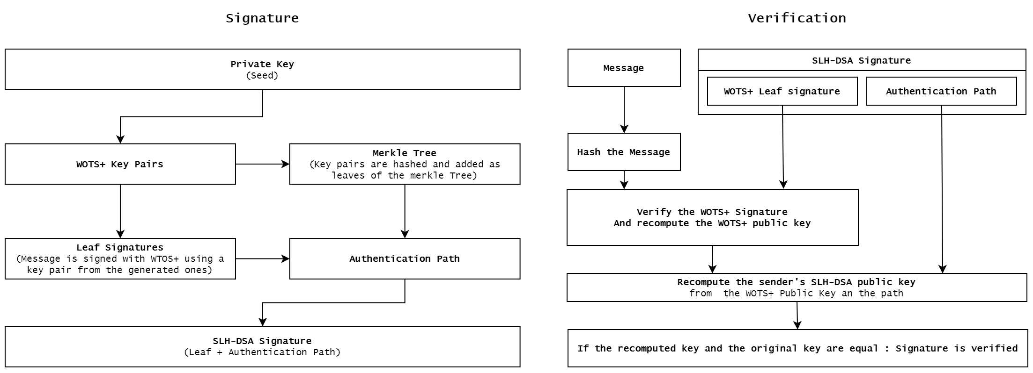
NIST STANDARDS SLH-DSA

Slide 14
NIST STANDARDS SLH-DSA
SIMPLE TO IMPLEMENT | HEAVY KEY (up to 32KB) AND SIGNATURE (up to 64KB) SIZE
SIDE CHANNEL RESISTANT | SLOW SIGNING AND VERIFICATION
NOT SUITED FOR BLOCKCHAIN ENVIRONNEMENTS

Slide 15
NIST STANDARDS FALCON
Based on NTRU Lattices and used Fast Fourier Transform
Security relies on
Hard NTRU lattice problems

Slide 16
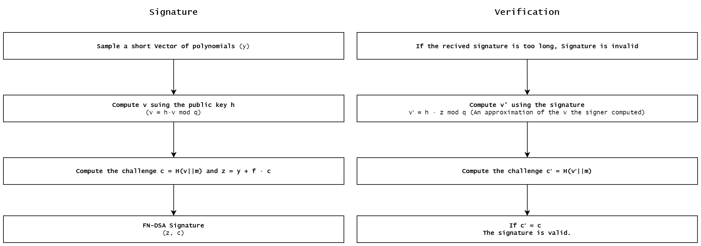
NIST STANDARDS FALCON

Slide 17
NIST STANDARDS FALCON
EFFICIENT SIGNING AND KEY GENERATION | VERIFICATION SLOWER THAN ML-DSA
SIDE CHANNEL RESISTANCE ACHIVEABLE THROUGH MASKING | NEED FOR EVM ADAPTIATION
 | SLIGHTLY MORE COMPLEX PARAMETER TUNING
COULD BE USED FOR BLOCKCHAIN ENVIRONNEMENTS,
BUT BETTER ALTERNATIVE EXIST

Slide 18
NIST STANDARDS ML-DSA
Based on Modular Lattices
Extension of CRYSTALS-Dilithium
Security relies on
Hard Modular lattice problems

Slide 19
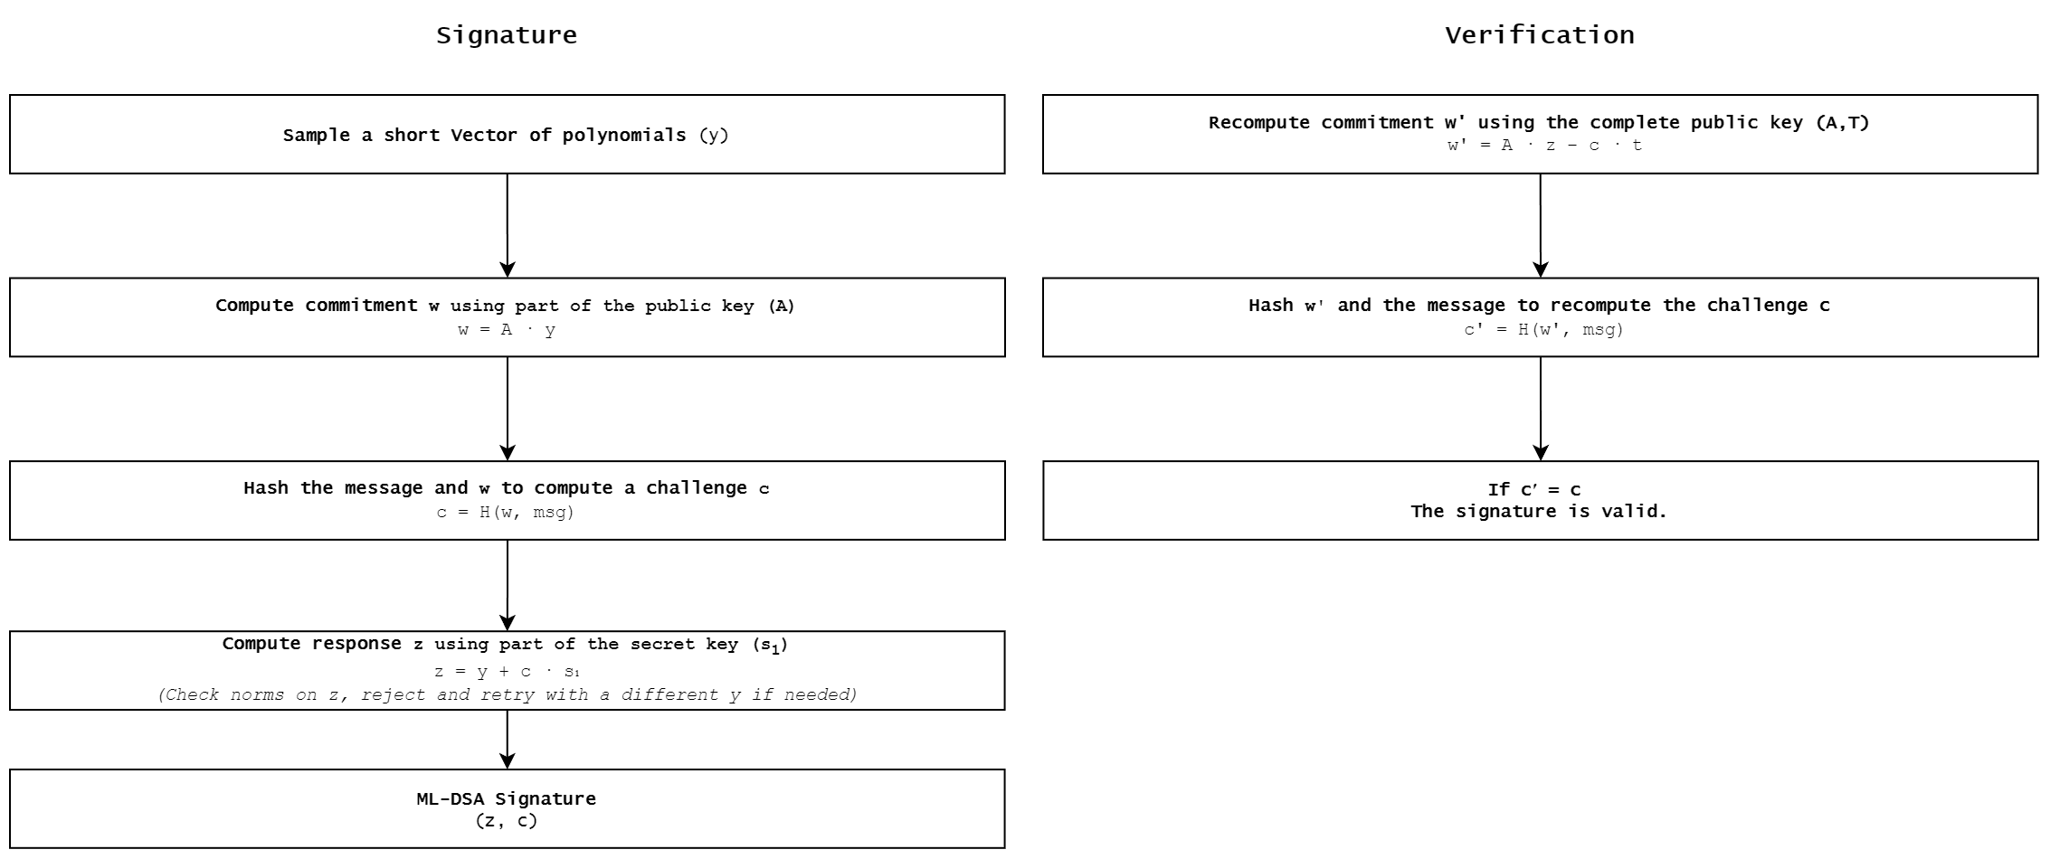
NIST STANDARDS ML-DSA

Slide 20
NIST STANDARDS ML-DSA
EFFICIENT SIGNING AND KEY GENERATION | NEED FOR EVM ADAPTIATION
ESPECIALLY EFFICIENT VERIFICATION | SLOW SIGNING AND VERIFICATION
MODERATE SIGNATURE (2.7–4.6 KB), AND KEYS SIZES (AROUND 1.3 KB)
MOST VIABLE CANDIDATE FOR ETHEREUM INTGERATION

Slide 21
IMPLEMENTATION
The implementation choices, transition process, timelines…

Slide 22
IMPLEMENTATION STRATEGY
Facilitate technical integration
Manage change
Enable user adoption
Renew trust

Slide 23
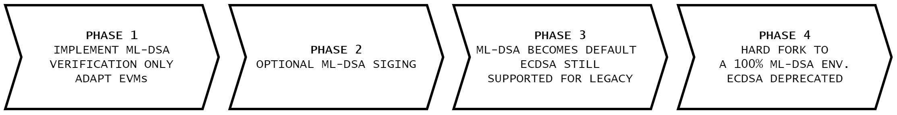
IMPLEMENTATION STRATEGY - PHASES

Slide 24
IMPLEMENTATION DETAILS
Already used and trusted packages
Simplified yet representative ETH blockchain model
Performance benchmarking and Gas cost estimation

Slide 25
IMPLEMENTATION SIMULATIONS
Simulate the state of the blockchain at each phase
Measure blocktime, signature and verification time over 1000 blocks
Quantum resistant PoW blockchains for comparison and insights

Slide 26
DEMONSTRATION
Prepare to be mildly impressed.

Slide 27
RESULTS

Slide 28
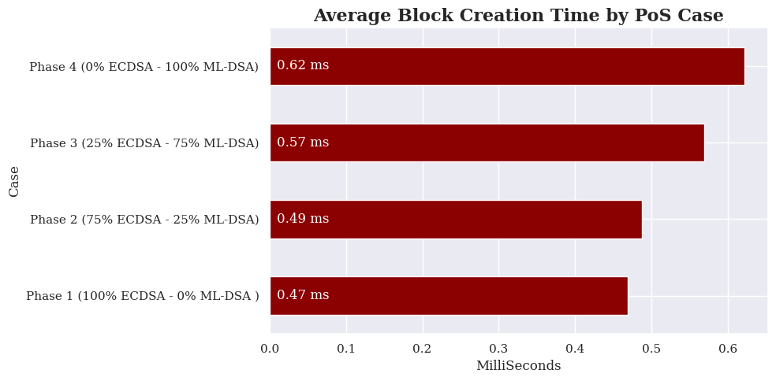
RESULTS BLOCK TIME

Slide 29
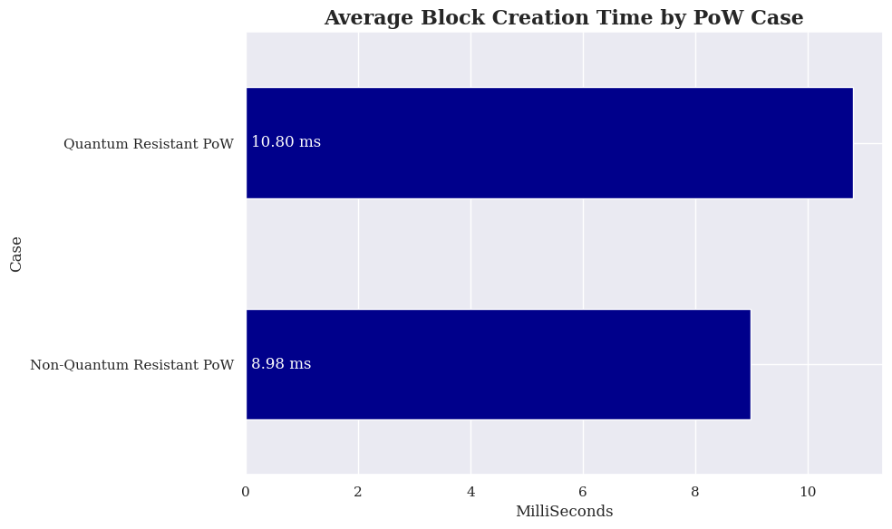
RESULTS BLOCK TIME

Slide 30
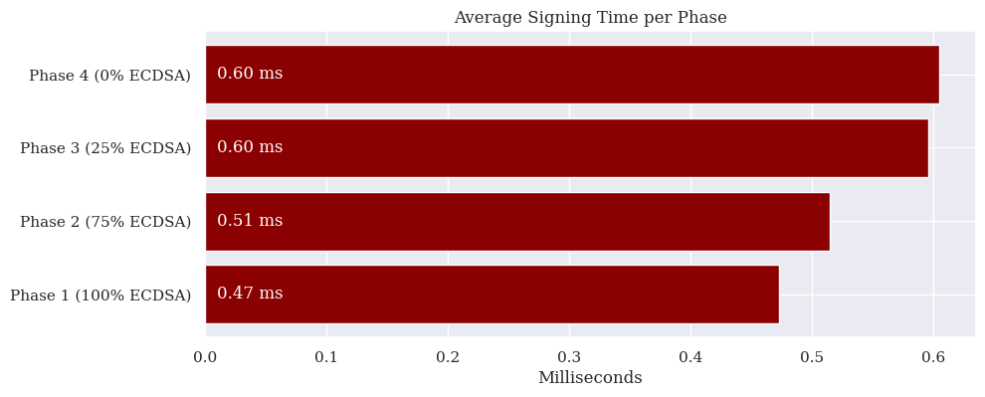
RESULTS SIGNING TIME

Slide 31
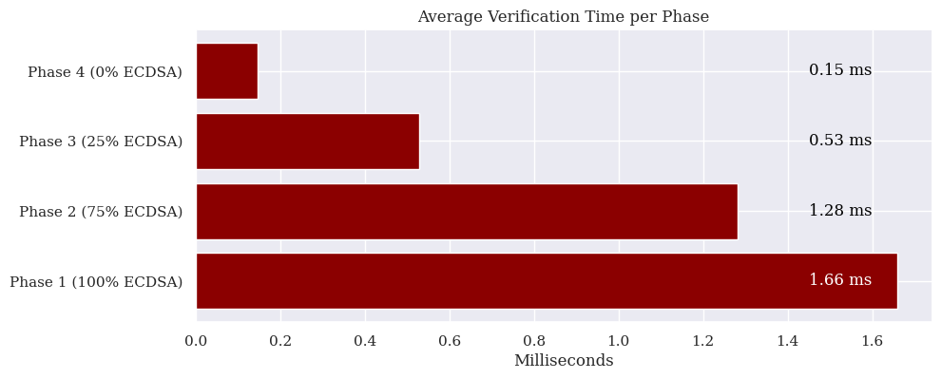
RESULTS VERIFICATION TIME

Slide 32
RESULTS GAS COST
PHASE | ESTIM. GAS COST | AVG. SIGNATURE SIZE
Phase 1 (ECDSA) | 1024.00 | 64.00
Phase 2 (Hybrid) | 13917.00 | 875.25
Phase 3 (Hybrid) | 39703.00 | 2497.75
Phase 4 (ML-DSA) | 52596.00 | 3309.00

Slide 33
OTHER PRIVACY AND SECURITY ENHANCEMENTS
Managing unlinkability, zero knowledge proofs…

Slide 34
PRIVACY AND SECURITY ENHANCEMENTS
Lattices can support the integration of quantum resistant ZKPs
ML-DSA helps manage linkability

Slide 35
PRIVACY AND SECURITY ENHANCEMENTS ZKPs IN ETHEREUM
Some of the currently used ZKPs are not quantum resistant (zk-SNARKs)
Some solution are being studied
(Lattice-based zk-SNARKs, zk-STARKs)

Slide 36
CONCLUSION
If you weren’t listening it’s okay, I’m going to summarize (almost) everything.

Slide 37
CONCLUSION FINAL THOUGHTS
ML-DSA offers best balance between security, performance and integrability
PQC migration seems feasible, but induces overhead and increases gas cost
Biggest challenge will likely be adapting EVMs

Slide 38
THANK YOU
Any questions? Remarks ?

