Slide 1
Understanding Proof-of-Stake and its Security Implications through the Example of Ethereum 2.0
Advanced Security – Semester Project
14X040 - Advanced Security
Dany A. Darghouth – May 2024

Slide 2
INTRODUCTION
Understanding the context, and why we’re here exactly..

Slide 3
INTRODUCTION CONTEXT - BLOCKCHAINS
Blockchain based systems’ popularity keep expanding
Their roles become more critical
Need for better performances and reduced costs

Slide 4
INTRODUCTION CONTEXT
Consensus Mechanisms are vital to a blockchain
Proof of Work Raising concerns
Ethereum’s recent transition from Proof of Work to Proof of Stake

Slide 5
CONSENSUS MECHANISMS
Proof of work, proof of stake…

Slide 6
CONSENSUS MECHANISM KEY CONCEPTS
Essential for maintaining the uniform agreement on the state of the system across all nodes.
Ensures all transactions are valid and prevents fraud (e.g., double spending).
Maintains the integrity and security of the blockchain.

Slide 7
CONSENSUS MECHANISM Proof of Work
Miners solve complex mathematical problems to validate transactions and create new blocks.
Energy-intensive and leads to potential centralization due to high computational requirements.

Slide 8
PROOF OF STAKE
A more efficient, faster and cheaper consensus process ?

Slide 9
PROOF OF STAKE MAIN CONCEPTS
Validator are
(pseudo-)randomly chosen
Staking is introduced (placing coins in a staking pool as a security for the block validation)
Choice is influenced by how much a potential validator stakes

Slide 10
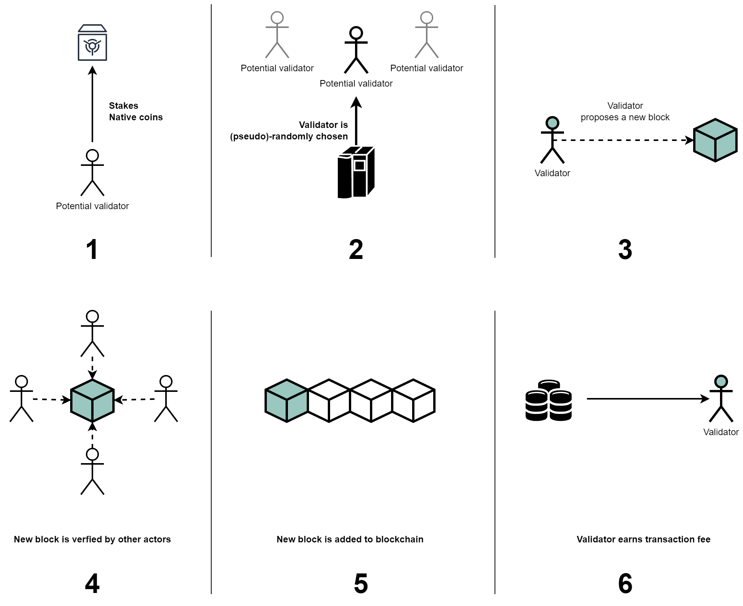
PROOF OF STAKE IN SUMMARY

Slide 11





PROOF OF STAKE DIFFERENCES WITH P.O.W.
More energy (and therefore cost) efficient
Significantly reduced centralization risk (bias at most)
Lower entry barrier
Increased transaction speed and scalability
Different security implications

Slide 12
PROOF OF STAKE IN ETHEREUM 2.0
The implementation choices, transition process, timelines…

Slide 13
PROOF OF STAKE IN ETH 2.0 BEACON CHAINS
First ETH 2.0 component
Manages the P.o.S. protocol, organizes validators.
Choses validators
Composes validation committees

Slide 14
PROOF OF STAKE IN ETH 2.0 SHARD CHAINS
Each shard represents a separate chain processing its own transactions and smart contracts independently.
Operates in parallel of the beacon chain
Periodically submits a summary of their state (crosslink), to the Beacon Chain
Ultimately reducing network congestion

Slide 15
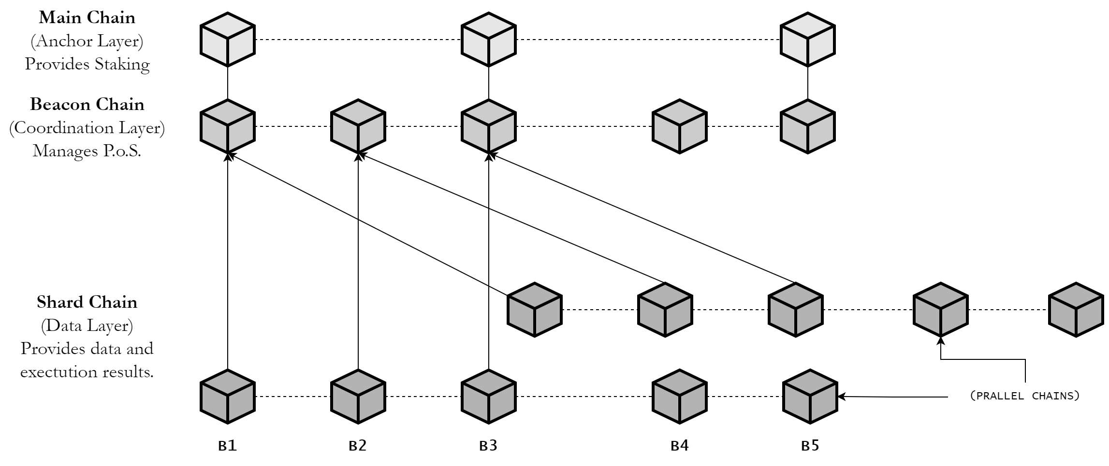
PROOF OF STAKE IN ETH 2.0 FINAL STRUCTURE

Slide 16
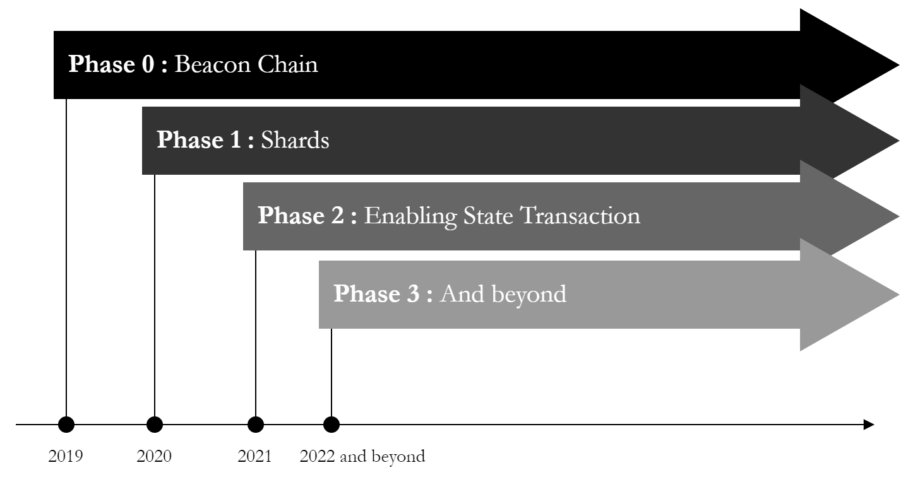
PROOF OF STAKE IN ETH 2.0 PHASES

Slide 17
SECURITY IMPLICATIONS
Vulnerabilities, risks…

Slide 18
SECURITY IMPLICATION NOTHING-AT-STAKE
Validators can support different conflicting version (forks) of the blockchain alive to ensure reward, with no consequence.
Maintaining forks is very easy
Reliability and Consistency are impacted

Slide 19
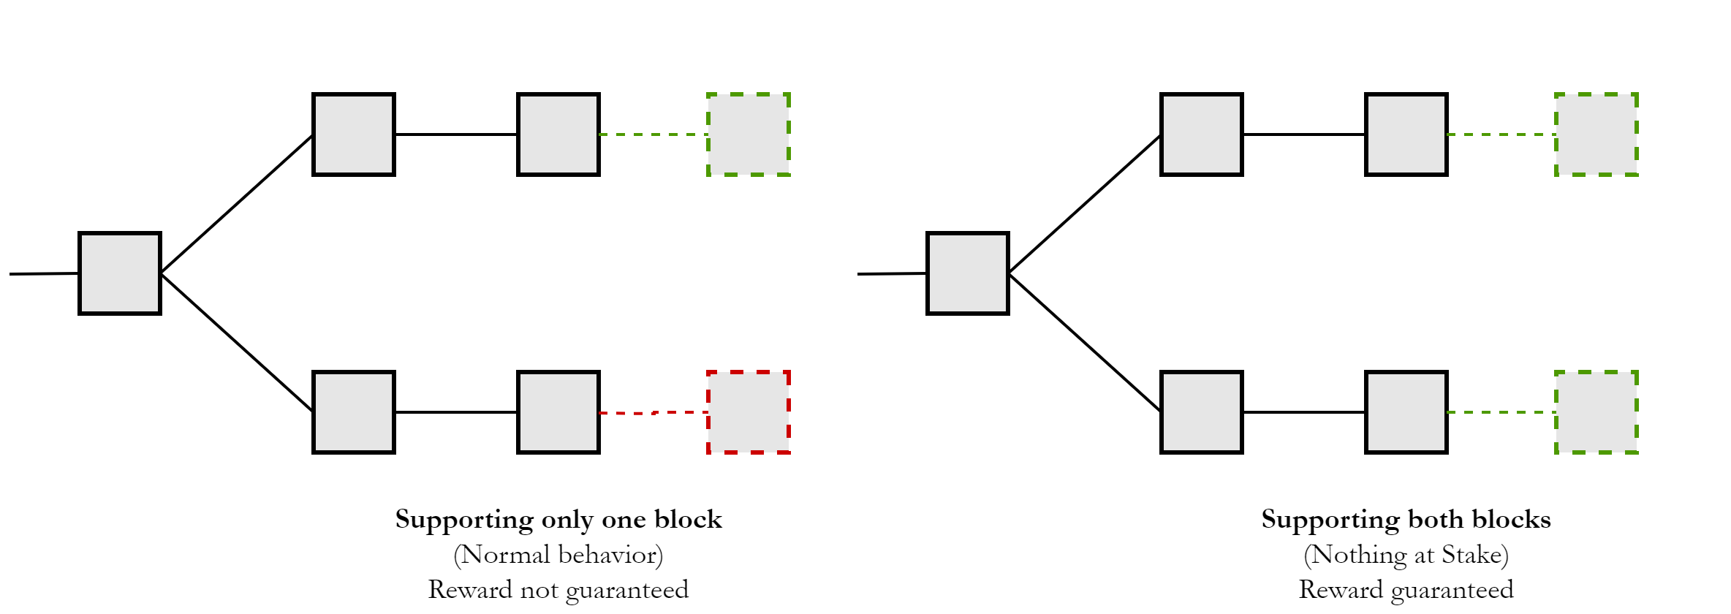
SECURITY IMPLICATION NOTHING-AT-STAKE

Slide 20
SECURITY IMPLICATION LONG RANGE ATTACKS
Exploiting old staking keys to create an alternative blockchain history.
Once old keys are accessed, creating new block is very cheap
When chain is long enough it is released.
Because of blockchain protocols illegitimate chain has chances of being accepted

Slide 21
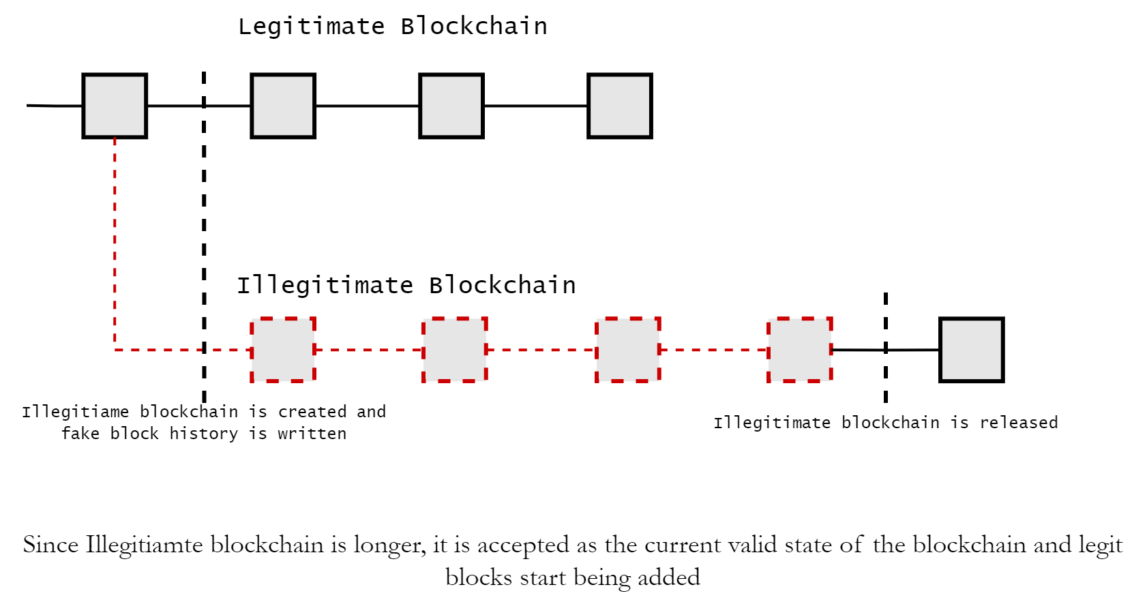
SECURITY IMPLICATION LONG RANGE ATTACKS

Slide 22
SECURITY IMPLICATION BRIBE ATTACKS
Validator behavior can be influenced by bribes
Does not revolve around a particular technical vulnerability
Centralization risk
Trust in blockchain heavily impacted

Slide 23
SECURITY IMPLICATION OTHER IMPLICATIONS
Stake Centralization
Validator Collusion
Software specific risks

Slide 24
DEMONSTRATION
Prepare to be mildly impressed.

Slide 25
MITIGATION STRATEGIES
Some ways to prevent or reduce the impact of the problems.

Slide 26
MITIGATION STRATEGIES NOTHING-AT-STAKE
Slashing, penalizing validators showing malicious behavior
Implementing checkpoints, forcing validators to commit to a fork

Slide 27
MITIGATION STRATEGIES LONG RANGE ATTACKS
Key evolving cryptography (KEC), periodically changing private keys by design.
Weak subjectivity mechanism, involving trustworthy sources to determine correct blockchain history

Slide 28
MITIGATION STRATEGIES BRIBE ATTACKS
Enhancing validator accountability and transparency
Decentralizing staking pools (hence decentralizing power and influence)

Slide 29
MITIGATION STRATEGIES MANAGING OTHER IMPLICATIONS
Technical enhancements
Community engagement
Procedural changes

Slide 30
CONCLUSION
If you weren’t listening it’s okay, I’m going to summarize (almost) everything.

Slide 31
CONCLUSION PROS & CONS
FASTER VALIDATOR SELECTION | MORE IMPACTED BY COMMUNITY BEHAVIOR
LESS GREEDY THAN P.O.W. | NOHING-AT-STAKE ATTACKS
SAFE FROM THE 51% PROBLEM | LESS DISSENTIVE FOR MALICIOUS BEHAVIOR
BETTER SCALLABILITY | MALICIOUS BEHVIOR MADE EASY BY LOW ENERGY DEMANDS

Slide 32
CONCLUSION FINAL THOUGHTS
Different Consensus mechanisms bring different security implications
Choice depends on requirement
Technical difficulty vs. managing human behavior

Slide 33
THANK YOU
Any questions? Remarks ?

