Slide 1
Capstone Project - 2
Bike Sharing Demand Prediction By-Dany Chitturi

Slide 2
Let’s Catch The Defaulters
1. Defining problem statement
2. Exploratory Data Analysis
3. Feature engineering
4. Preparing dataset for modelling
5. Model Building
6. Hyperparameter tuning
7. Model validation and Selection

Slide 3


Problem Statement
Nowadays Rental bike sharing is becoming popular because of the increased comfortableness and availability. It is necessary to make rental bikes available and accessible to the public at the right time as it lessens the waiting time. So providing a stable supply of rental bikes to the public will be a very big challenge. The idea of this project is to create a predictive model that predicts the Rental Bike Count. To accomplish this, We organized the whole series into five parts as follows :

Slide 4
Data Pipeline
• Data processing-1: In this part we’ve checked and handled the null values
and also checked for duplicated records
• Data processing-2: In this part, we performed outlier detection, encoded
the categorical features, and changed the column containing date values
• EDA: In this part, we do some exploratory data analysis(EDA) on all the
features in our dataset to uncover the relationship between dependent and
independent variable(s).
• Feature Engineering: In this part, we’ve created day, month and year columns
from date column, And also applied square root transformation on dependent
variable to make it as close to Normal distribution
• Model building : Finally, we create five different models. We start
with a simple model , then use hyperparameter tuning to get the best optimal
parameters.

Slide 5
Data Summary
Date: day-month-year
Hour: the hour of the day
Temperature: temperature in Celsius at particular hour
Humidity(%): percentage of humidity in air at particular hour
Wind speed(m/s): wind speed at particular hour
Visibility(m): the distance one can see as determined by weather conditions
Dew point temperature: dew point temperature in Celsius
Solar radiation: the amount of solar radiation (MJ/m2)
Rainfall: total rainfall depth in mm
Snowfall: depth of snowfall in cm
Seasons: winter, spring, summer, autumn
Holiday: holiday/no holiday
Functional Day: yes/no

Slide 6
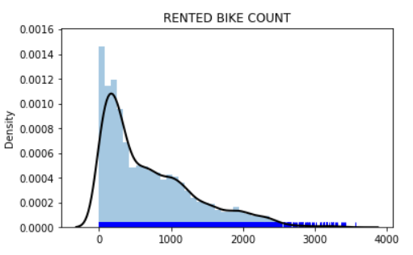
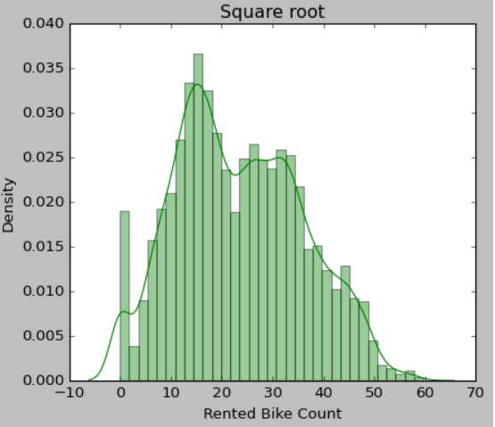
Define Dependent Variable
Rental Bike Count : count of bikes rented at each hour

Slide 7
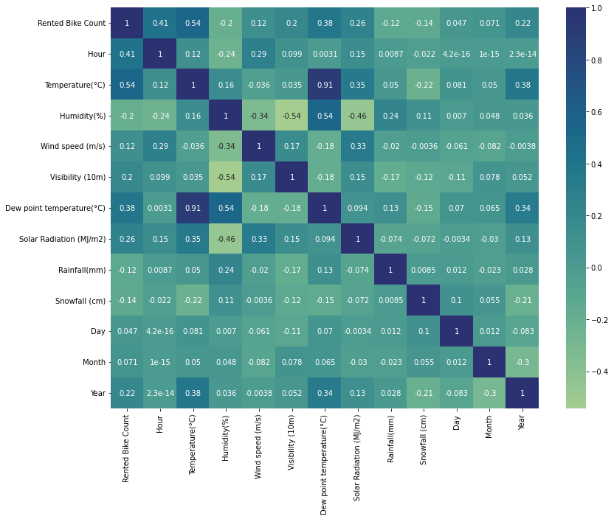
EDA
• From the correlation heatmap we can see
that Temperature and Dew point temperature
are highly correlated to each other
• To avoid multicollinearity, remove
Dew point temperature, because it has
weak correlation with the dependent variable
when compared with Temperature.

Slide 8

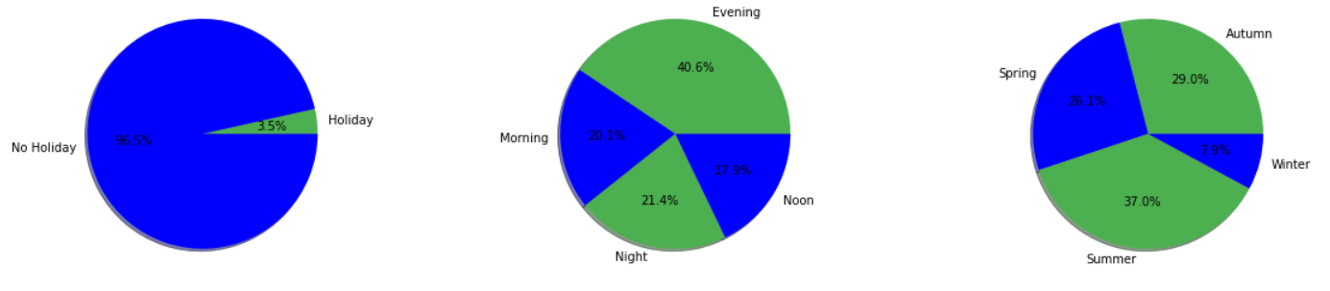
EDA
• Demand for rental bikes is high on working days and very low on holidays
• The highest number of bike rents occur in summer while the least bike rents occur in winter
• Demand for rental bikes is high in the evening

Slide 9
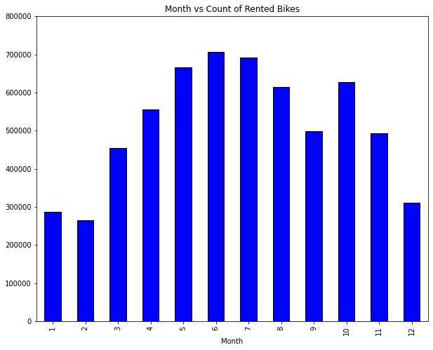
EDA (continued)
• We can see that most numbers of rental bike bookings are during the month’s May, June and
July
• Months November, December, January and February have the least number of bookings

Slide 10
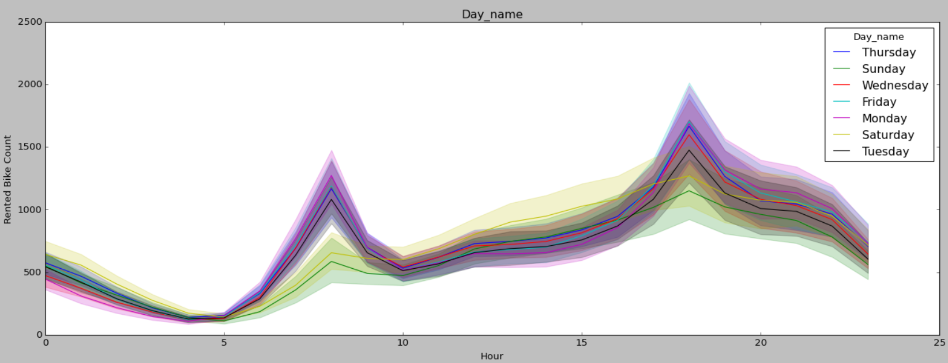
EDA (continued)
• Demand is high during weekdays, But during weekends the number of bike rents is more between
12.00 to 16.00 hrs than weekdays. On day to day basis, the trend of bike rents is almost similar with
slight peaking demands on Thursday while drops on Sunday.

Slide 11
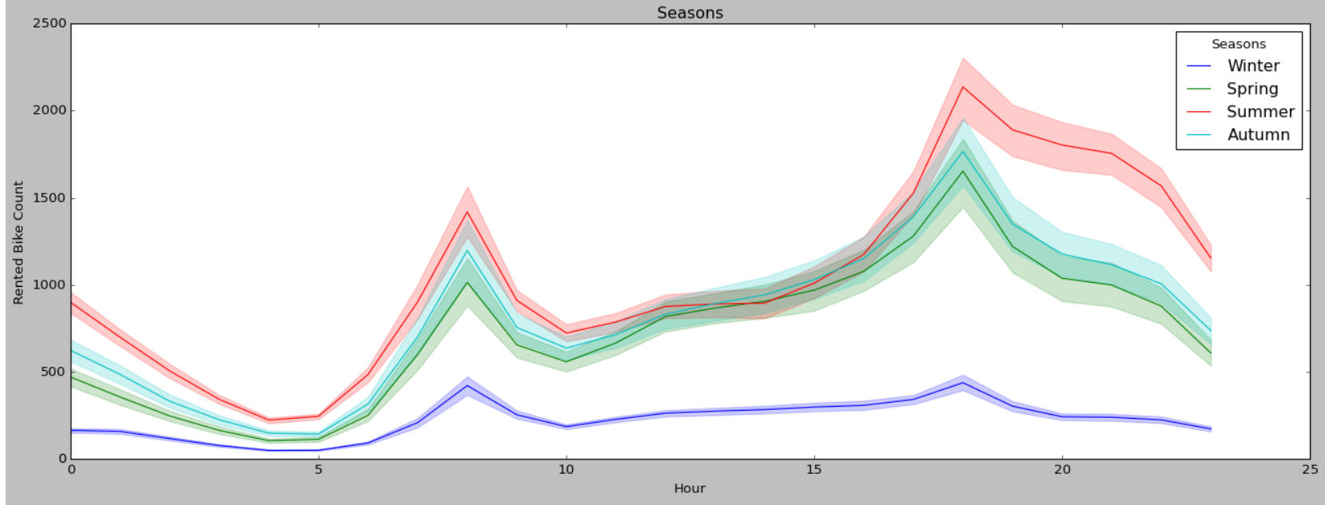
EDA (continued)
• The number of bike rents peaked at 8’o clock in the morning and 6’o clock in the evening, this
may be because of employees who go to work in the morning and return from work in the evening

Slide 12
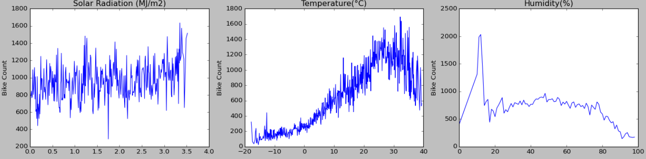
EDA (continued)
• The 1st plot shows that Rented Bike Bookings and Solar Radiation are positively correlated. From
the 2nd plot we can see that in general, more people tend to prefer biking at moderate to high
temperatures. however, if the temperature is too hot there is a slight decline in rental bike
bookings. The bike counts peak in the afternoon when temperature is the highest, with the most
visibility and least humidity

Slide 13
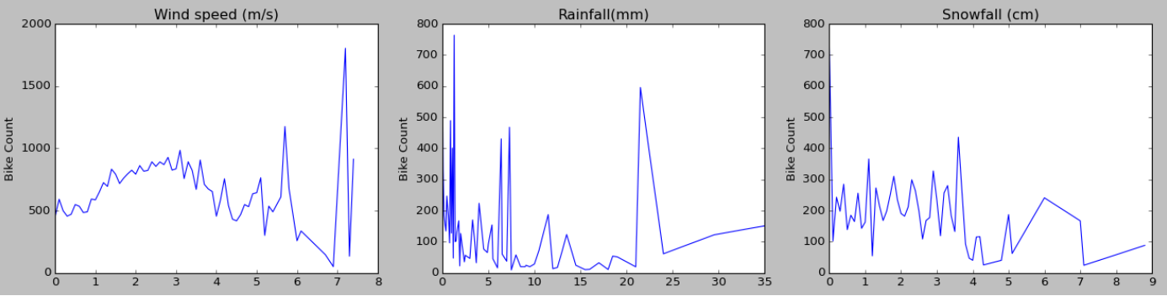
EDA (continued)
• The movement of snowfall and rainfall negatively correlates with rental bike bookings. The bike
counts peak when there is minimal rainfall, minimal snowfall, and good windspeed.

Slide 14
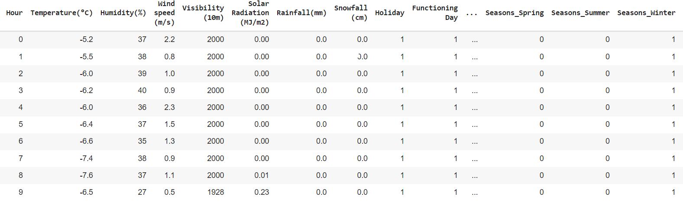
Preparing dataset for modelling
Selected_features= Hour, Temperature(°C), Humidity(%), Wind speed (m/s), Visibility (10m),
Solar Radiation (MJ/m2)‘, 'Rainfall(mm)‘, 'Snowfall (cm)‘, 'Holiday', 'Functioning Day', 'Month‘, 'Year‘ ‘Seasons_Autumn‘, 'Season_Spring‘, 'Season_Summer', 'Season_Winter‘, 'Day_name_Friday‘,
'Day_name_Monday','Day_name_Saturday','Day_name_Sunday','Day_name_Thursday‘, ’Day_name_Tuesday‘ , 'Day_name_Wednesday‘.
Train Set:- (7008, 23) , Test Set:- (1752, 23) , Response:- Count of Rental bikes

Slide 15
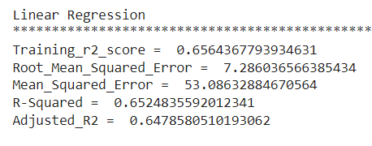
Model Building (Baseline Model)

Slide 16
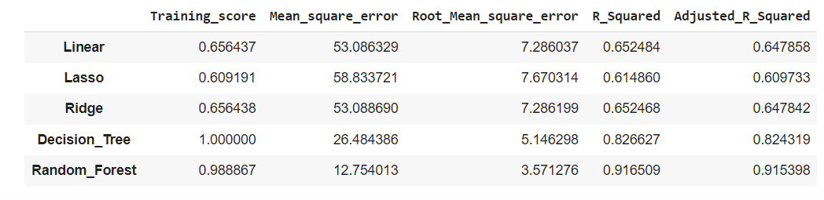
Model Validation and Selection
Models Used: Linear Regression, Lasso Regression , Ridge Regression ,Decision Tree and Random Forest

Slide 17

Model Validation and Selection (continued)
Observation 1: As seen in the table above linear regression is not giving great results, Lasso had low R2 score than linear regression this is because of the shrinking of coefficients of some features to zero.
Observation 2: Linear regression and Ridge regression performed equally in terms of R2 score
Observation 3: The Training R2 score of Decision tree is 1 , whereas the test R-squared is 0.82. So we can say that the Decision Tree is overfitting the data.

Slide 18

Model Validation and Selection (continued)
Observation 4: Finally, The ensemble model Random Forest is performing very well with Train R2 Of 0.97 and Test R2 of 0.91
Observation 5: From the above observations, we concluded that we would choose our model from Random Forest Regressor.

Slide 19
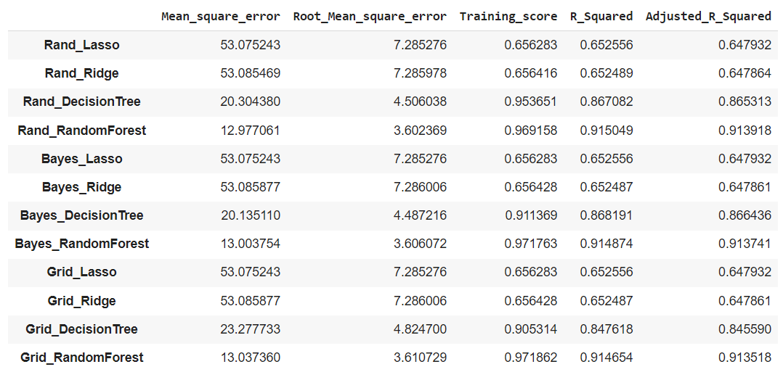
Model Validation and Selection (Hyperparameter tuned)

Slide 20

Model Validation and Selection (continued)
We had chosen Random Forest Regressor for our prediction, and the best hyperparameters obtained are below.
n_estimators= 250
criterion = ”squared_error”
max_depth= 25
max_features= 18
min_samples_split= 10
max_leaf_nodes = None
Max_samples = None
min_impurity_decrease = 0.0
min_samples_leaf = 1
min_samples_split = 2
min_weight_fraction_leaf = 0.0

Slide 21
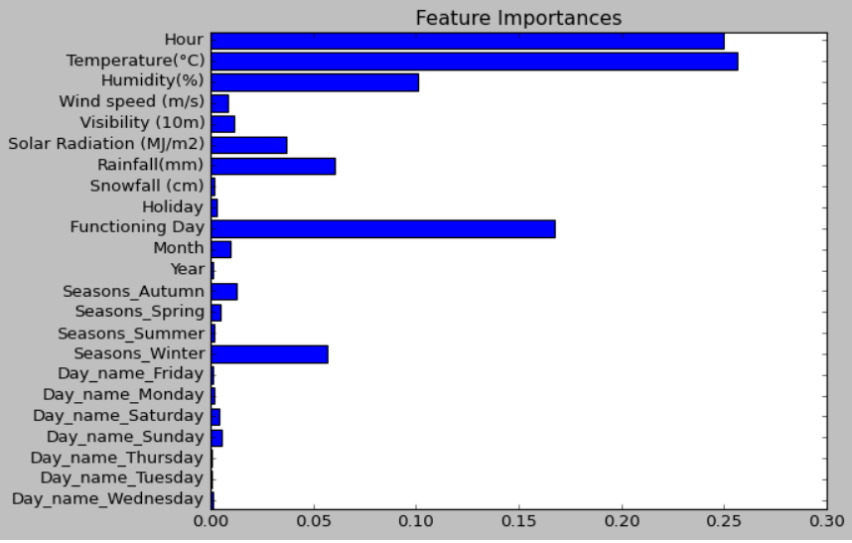
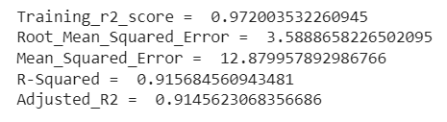
Model Evaluation
Random Forest

Slide 22
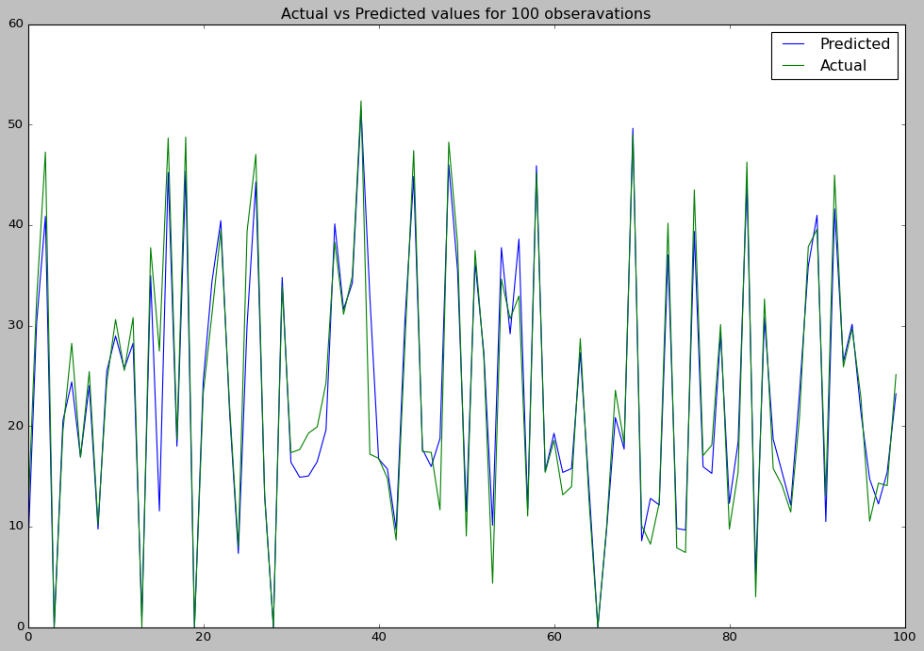

Slide 23
Conclusion
• On an hourly basis, the bike counts peak in the afternoon (from 15.00 to 20.00). There are two peak
occurrences, at 8.00 and 18.00, which are most likely to be caused by workers going to the office in
the morning and going back home in the evening
• The demand for bikes will be lower on a rainy day compared to a sunny day. Similarly, higher
Snowfall will cause lower demand and vice versa. The bike counts peak in the afternoon
when the temperature is at it’s highest, with the most visibility, wind speed, and least humidity
• Based on the analysis, we built five models to predict the count of Rented bikes. All the models
performed decently, but the tree and ensemble models outperformed all the linear
models (Linear Regression, Lasso, Ridge)
• Previously, the Decision Tree is overfitting the data. But after hyperparameter tuning, we avoided
the problem of overfitting
• The Hour, Temperature, and Humidity are the most relevant features for predicting the count of
Rental bikes.
• Only Decision Tree and Random Forest models are used. But there are many good ones out
there even neural network models can be improved further by tuning on hyperparameters.

Slide 24
Thank You

