Slide 1
Microservicios
Microservices
Consulting, Transformation, Technology and Operations
June ‘25

Slide 2
Spring application context
<bean id=“inventoryService”
class=“com.example.InventoryService”/>
<bean id=“productService”
class=“com.example.productService”/>
<constructor-arg ref=“inventoryService” />
</bean>

Slide 3
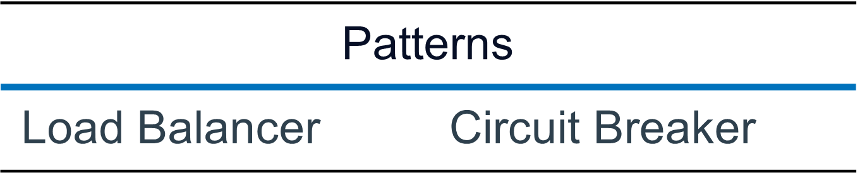
Authorization Server
Edge Server
Config Service
API Service
API Service
API Service
API Layer
Microservices
Business Services
Business Services
Composition Layer
Data Layer
Data Service
Data Service
Data Service
Registry Service

Slide 4
Punto de venta
Punto de venta
Punto de venta
Punto de venta
Modulo Inventarios
Modulo Contable

Slide 5
Windows/web
productos
inventarios
ventas
Linux
transporte
Pedidos
contable
Windows / Desktop

Slide 6
JDK
Package Jar / War
JDK
JDK
.Net Core
JDK
JDK

Slide 7
Teoria
Load Balancer

Slide 8
Modulo / Dominio / Microservicio
inputs
Outputs

Slide 9
Reporte
Fecha
PDF
Ordenamiento

Slide 10
<bean id=“inventoryService” class=“com.example.InventoryService” /> <bean id=“productService” class=“com.example.ProductService”> <constructor-arg ref=“inventoryService” /> </bean> @Configuration public class ServiceConfiguration { @Bean public InventoryService inventoryService() { return new InventoryService(); } @Bean public ProductService productService(){ return new ProductService(inventoryService()); } }
Autowiring and component scanning
The following XML code declares two beans, an InventoryService bean, and wires the InventoryService bean into Product-Service via constructor argument.
In recent versions of Spring, however, a Java–Based configuration is more common. The following Java-based configuration class is equivalent to the XML configuration

Slide 11
The @Configuration annotation Indicates to Spring that this is a configuration class that will provide beans to the Spring Application context. The Configurations methods are annotated with @Bean, indicating that the Objects they return should be added as beans in the Application context(where, by default, their respective bean Ids Will be the same as the names of the methods that define them). Java-based configuration offers several benefits over XML-based configuration, including benefits over XML-based configuration, including greater Type safety and inproved refactorability. Even so, explicit configuration with either Java or XML is necessary Only if Spring is unable to automatically configure the components.
Autowiring and component scanning
@Configuration public class ServiceConfiguration {
@Bean public InventoryService inventoryService() { return new InventoryService(); } @Bean public ProductService productService(){ return new ProductService(inventoryService()); } }

Slide 12
Automaticconfiguration has its roots in the Spring techniques know as autowiring and component scanning. With component scanning, Spring can automatically discover components from an applicatio’s classpath and créate them as beans in the Spring Application context. With autowiring, Spring automatically injects the components with the other beans that they depend on. More recently, with the introduction of Spring Boot, automatic configuration has gone well beyond component scanning and autowiring. Spring Boot is an extensión of the Spring Framework that offers several productivity enhancements. The most well know of these enhancements is autoconfiguration, where Spring Boot can make reasonable guesses at what components need to be configurated and wired together, based on entries in the class-path, environment variables, and other factors. Spring Boot autoconfiguration has dramatically reduce the amount of explicit configuration (whether with XML or JAVA) required to Build an Application. In fact, by the time you finish the example in this chapter, you’ll have a working Spring Application that has Only a single line of Spring configuration code !
Autowiring and component scanning

Slide 13
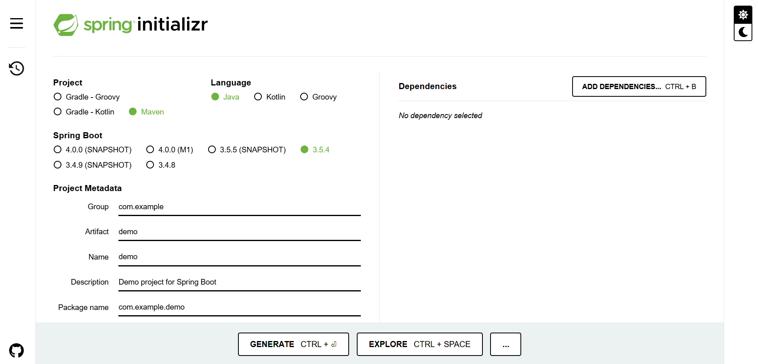
Initialize the app with the components

Slide 14
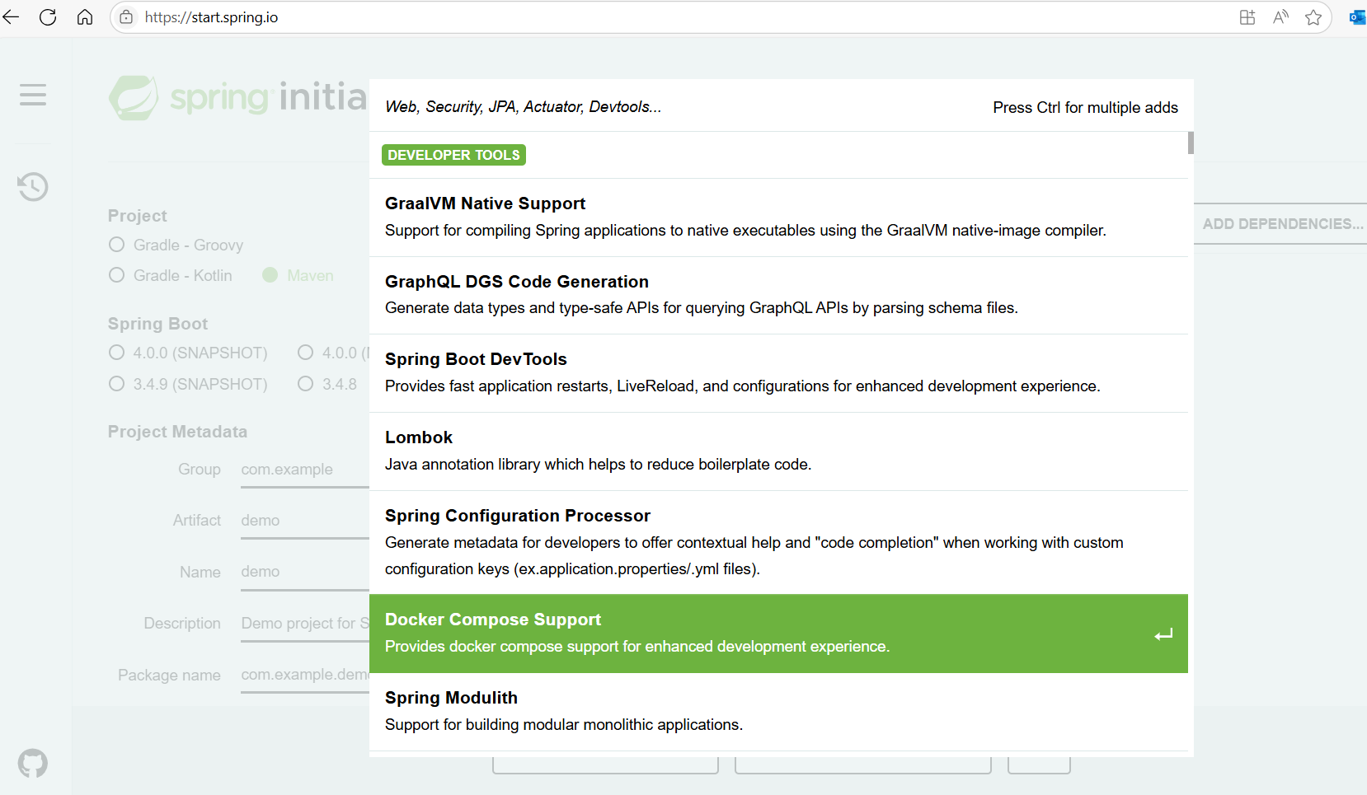
Initialize the app with the components
Add the next Dependencies
Spring Boot Dev Tools
Spring Web
Thymeleaf

Slide 15
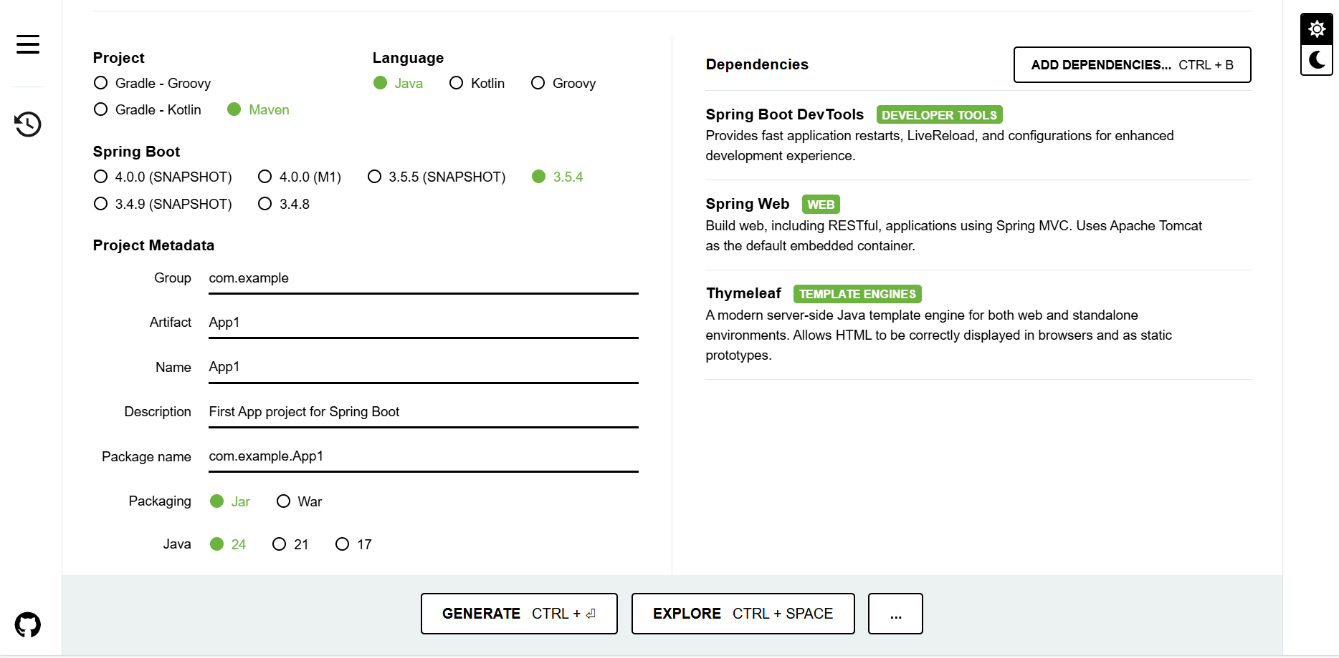
Initialize the app with the components

Slide 16
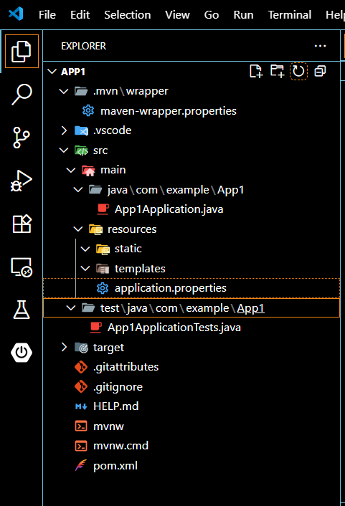
mvn and mvn.cmd – These are Maven wrapper scripts . You can use this scripts to Build your Project, even if you don’t have scripts to Build your Project, even if you don’t have Maven installed on your machine. Pom.xml – This is the Maven Build specification. We´ll look deeper into in the next slide App1Aplication.java – This is the Spring Boot main classthat boot-straps the Project. We´ll take a closer look at this case in the next slides Application.properties –This file is initially empty but offers a place where you can specify configuration properties. We´ll tinker with this file more forward, but i´ll postpone a detailed Explanation of configuration properties. Statis –This folder is where you can place any static content (images, stylessheets, JavaScript, and so forth) that you want to serve to the browser. It’s initially empty. Templates – This folder is where you’ll place template files that Will be used to render content to the browser. It’s initially empty, but you’ll add more tests to the mix as you develop the Application.
Autowiring and component scanning

Slide 17
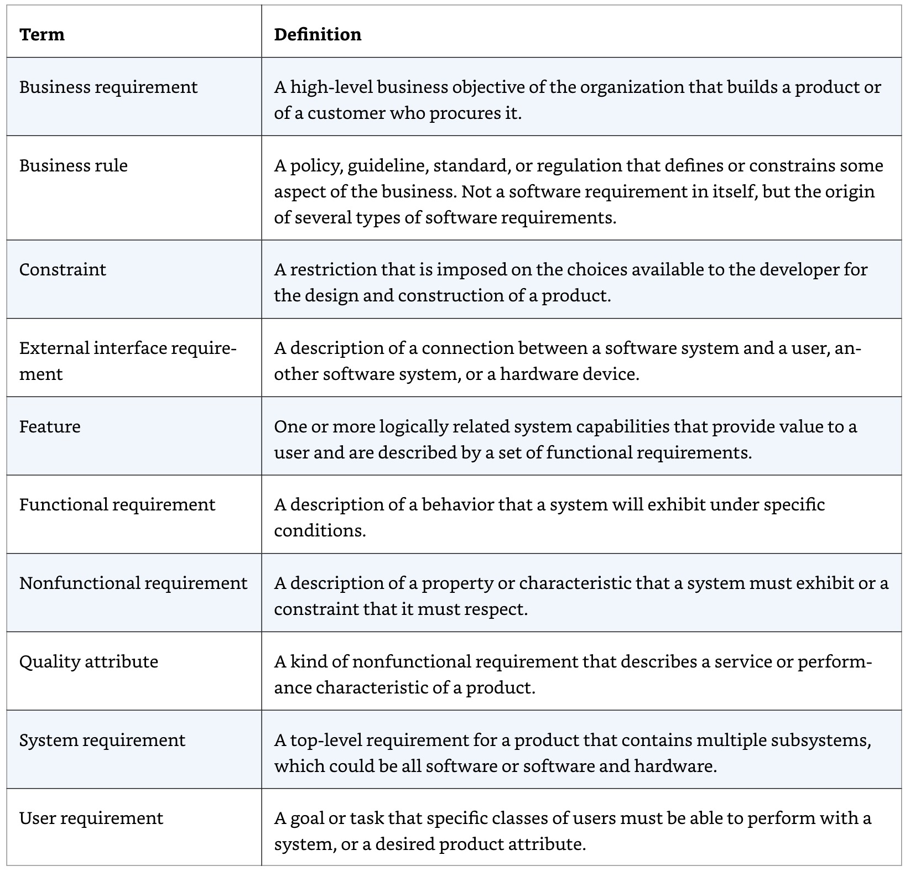
Requerimientos – Historias de usuario – SOP Software Requirements (third Edition Karl Wiegers & joy Beatty)

Slide 18
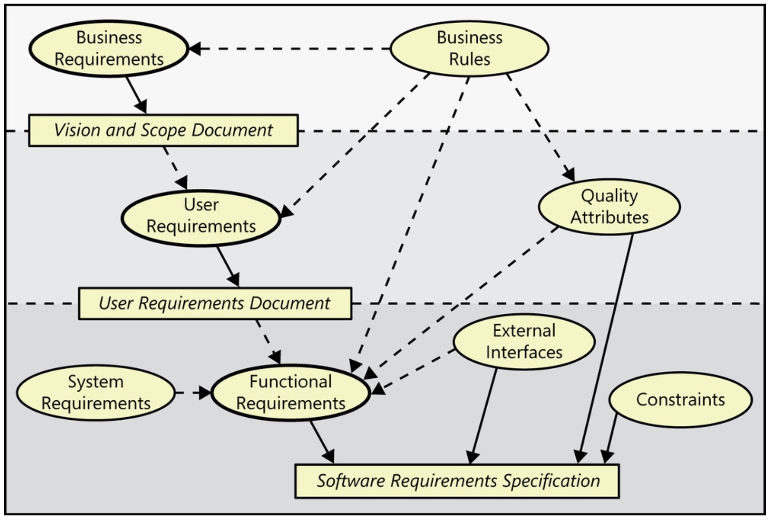
Software Requirements (third Edition Karl Wiegers & joy Beatty)

Slide 19
Problema
Planteamiento
Hipotesis
Pruebas
Solucion

Slide 20
Math (+,/,*,-) Variables (declaration, initialize) Type(String, int, double) Explanation of “Classes” testscore = x :: grade x = 100 ; x=0 grade A-F testscore = 90 < 100 :: grade A testscore = 70 < 90 :: grade B testscore = 60 < 70 :: grade C testscore = 50 < 60 :: grade D testcore < 50 :: grade F

Slide 21
Facade , Observer, Factory , Abstract Factory, Syngleton Factory
Patrones

Slide 22
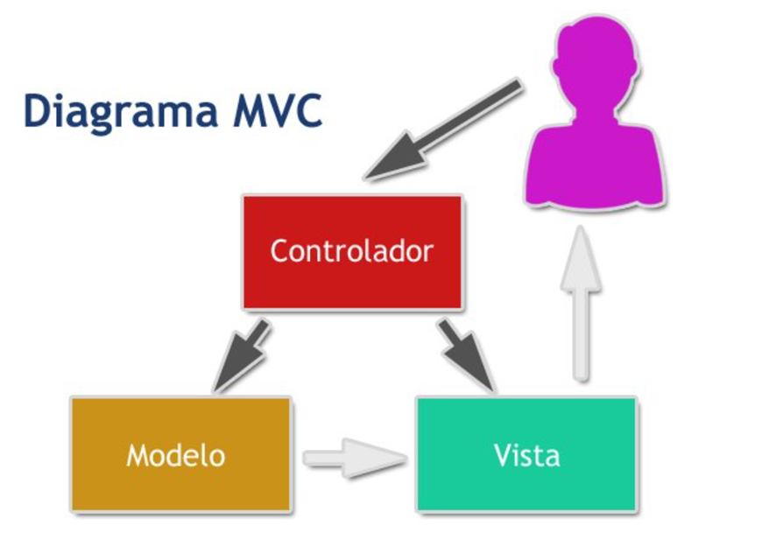

Slide 23
API Rest Empleados
Controller
Logica
Prestaciones
Dias trabajados * salario = sueldo
Dominio Nominas
Salario $
Descuentos
Dias
Microservice
Puesto
Dias
Puesto
Employe
Sueldo
Salario

Slide 24
Calculo Nomina
Retenciones
Ahorro
1
2
3
Process
Input
Output

Slide 25
Planteamiento
Calculo Nomina
1
Process
Input
Output

Slide 26
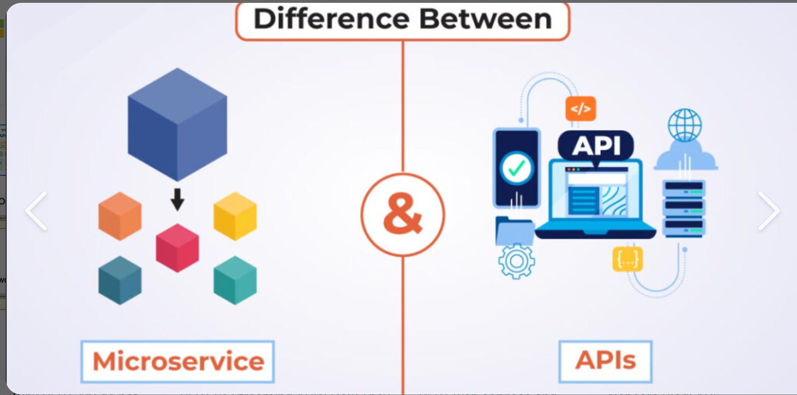

Slide 27
dummy
fx=i Lim> row
Int row=78;
In
Out
i=0
yes
i>row
No
Kan
i++

Slide 28
From spredsheet”example” do { until rows >0 do { codigo=b.value; FechaRegistro=h.value; } }

Slide 29
Automatic Application Restart Automatic Browser Refresh and Templates cache disable Built-In H2 Console (H2-Console : H2 Database ) link to Access H2 Console : localhost:8080/h2-console
Spring Boot Dev Tools

Slide 30
Spring MVC framework Embedded Tomcat Thymeleaf and the Thymeleaft layout dialect
Pom.xlm

Slide 31
Usuarios
Control parental
API
Suscripcion
Nuevos Titulos
Clientes
Titulos Reproduciendo

Slide 32
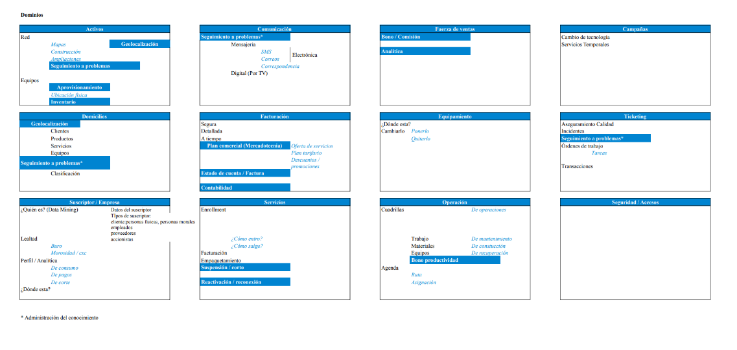
Establishing the Domain

Slide 33

Request
Design Controller
Activos
Request
HTML
Esta foto de Autor desconocido está bajo licencia CC BY
Design View
A typical Spring MVC Request Flow

Slide 34
Request
Design Controller
Domicilios
Request
HTML
Esta foto de Autor desconocido está bajo licencia CC BY
Design View
A typical Spring MVC Request Flow

Slide 35
Request
Design Controller
Suscriptor
Request
HTML
Esta foto de Autor desconocido está bajo licencia CC BY
Design View
A typical Spring MVC Request Flow

Slide 36
The Hamburger Cloud domain
Orden
deliveryName:string
deliveryStreet:String
deliveryCity:String
delivreyState:String
deliveryZip:String
ccNumber:String
ccExpiration:String
ccCVV:String
Hamburger
Name:String
1
N
<<enumeration>>
Ingredient.Type
WRAP
PROTEIN
VEGGIES
CHEESE
SAUCE
N
N
Ingredient
Id:String
name:String
type:String
N
1

Slide 37
HTTP GET Request where the Request path is/design Buil a list of ingredients Hand off the Request and the ingredient data to view template to be rendered as HTML and send to the requestiong web browser
REST API

Slide 38

Gracias
horopeza@emeal.nttdata.com

