Slide 1
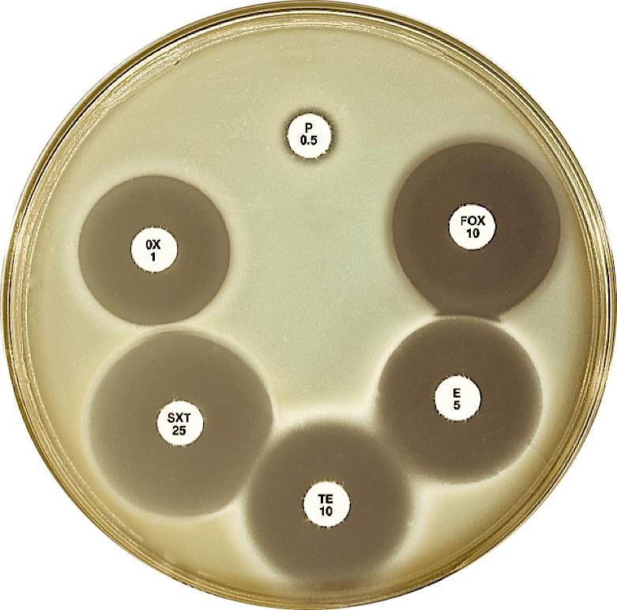
Data Structures WG:
AMR Gene Detection
Finlay Maguire (Dalhousie/Sunnybrook, Canada)
Inês Mendes (Instituto de Medicina Molecular, Portugal)
Emma Griffiths (Simon Fraser University, Canada)

Slide 2
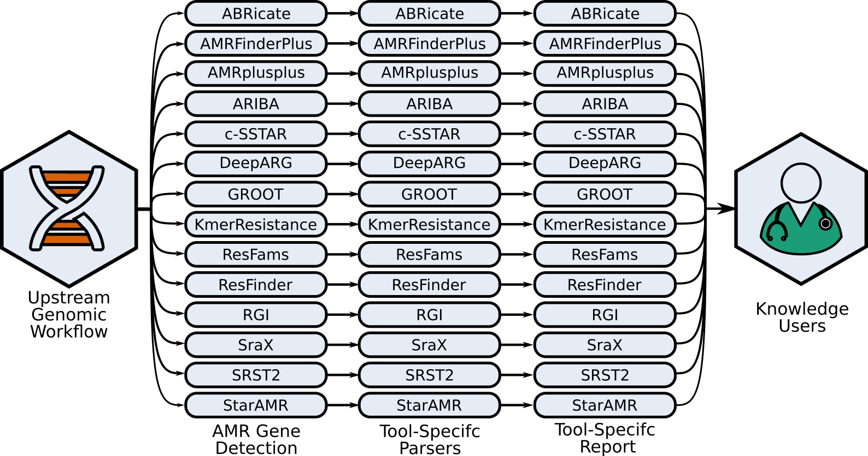
AMR Gene Detection Tool Selection

Slide 3
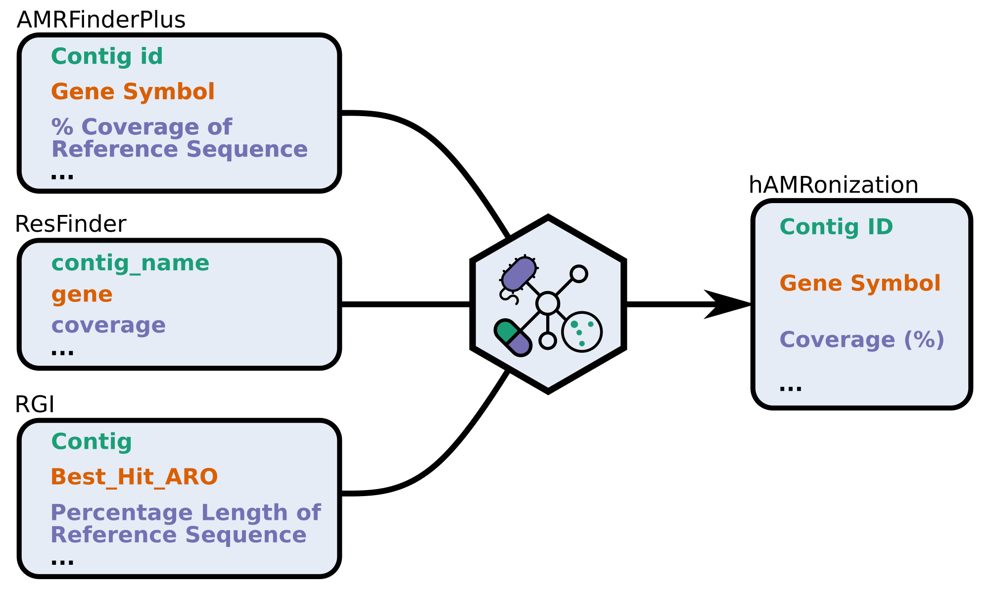
hAMRonization Specification

Slide 4
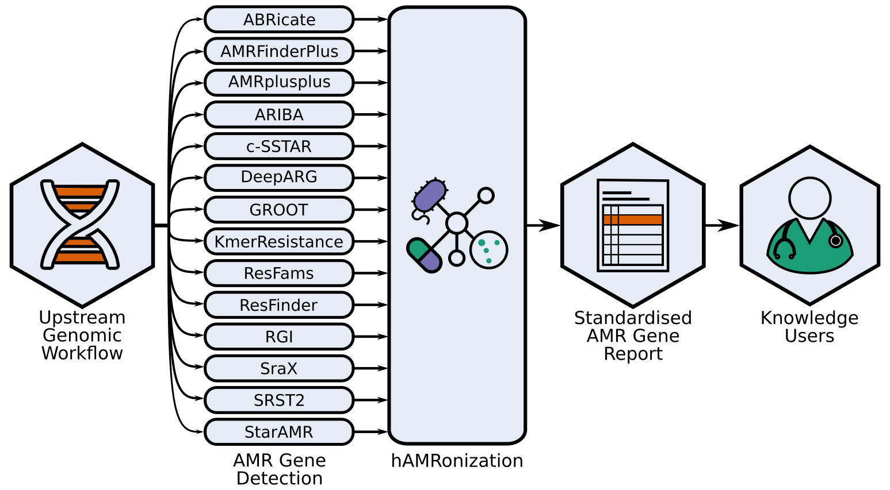
hAMRonization Package
https://github.com/pha4ge/hAMRonization

Slide 5
hAMRonization Package
hAMRonizing abricate results::
> hamronize abricate <report> --reference_database_version <version> \ --analysis_software_version <version> --format json
Applies hAMRonization specification to output from abricate (OUTPUT.tsv)
Generating a comparison report:
> hamronize summarize --summary_type interactive <list of reports>
Summary output formats:
TSV
Json
Interactive HTML
https://github.com/pha4ge/hAMRonization

Slide 6
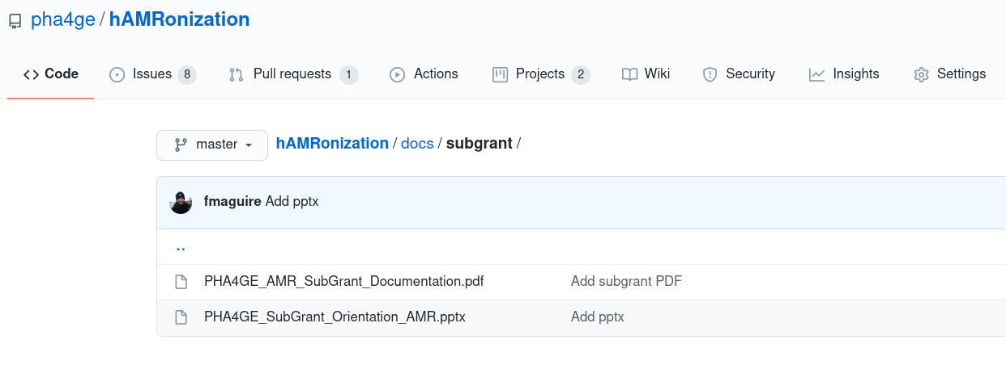
Detailed Materials
hAMRonization github repository: github.com/pha4ge/hAMRonization
Subgrant 2-page Summary: `hAMRonization/docs/subgrant`
https://github.com/pha4ge/hAMRonization

