Slide 1
Information About geometries of the PISA/IIT Soft Hand and its ADAMS model
Autor: Manuel Bonilla
05/02/2015

Slide 2
This geometries were taken from the assembly of the Pisa/IIT softhand. The file hand_geometries_modified.zip contains all geometries.
If you want to modify them, you must use the same reference frame and save them with the same name. Then you must substitute the old geometry files and import the PISAIIT_HAND.cmd in ADAMS to generate the .bin file.

Slide 3
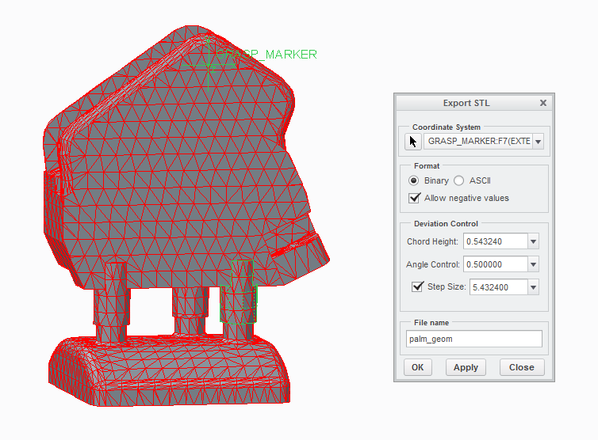
Palm
ADAMS name: palm.shl

Slide 4
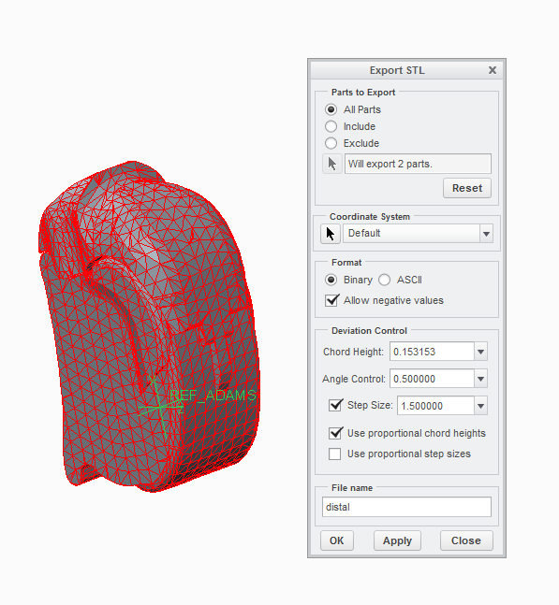
Distal falange
ADAMS name: distal.shl

Slide 5
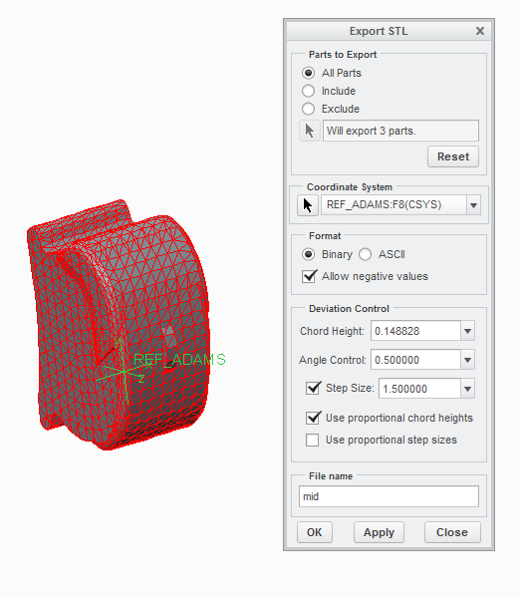
Middle falange
ADAMS name: mid.shl

Slide 6
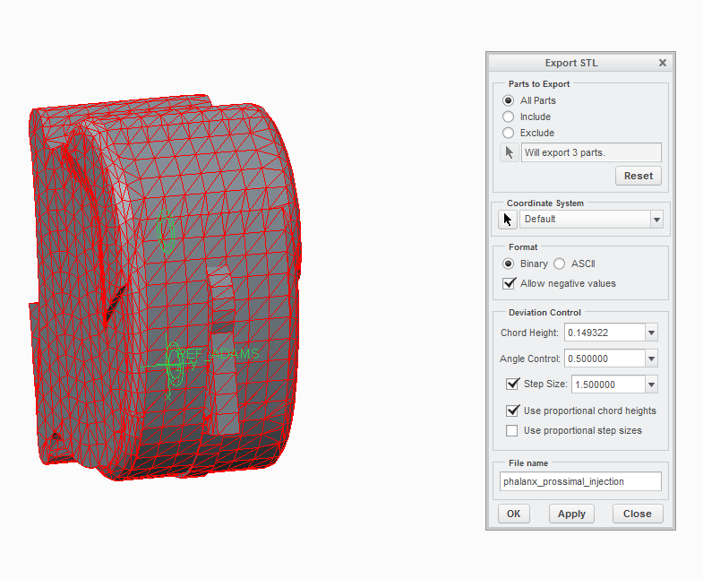
Proximal falange
ADAMS name: prox.shl

Slide 7
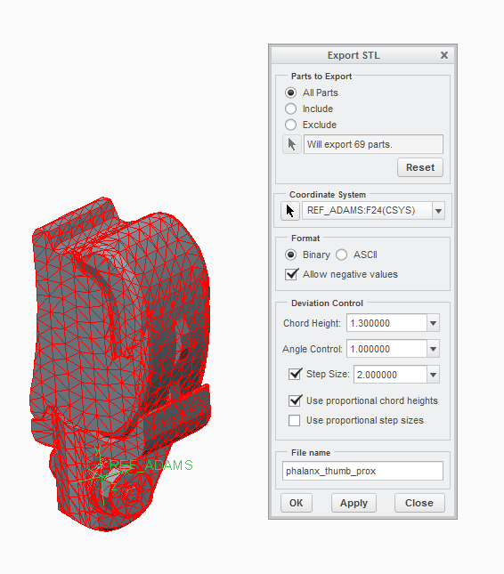
Proximal falange for the thumb
ADAMS name: prox_thumb.shl

Slide 8
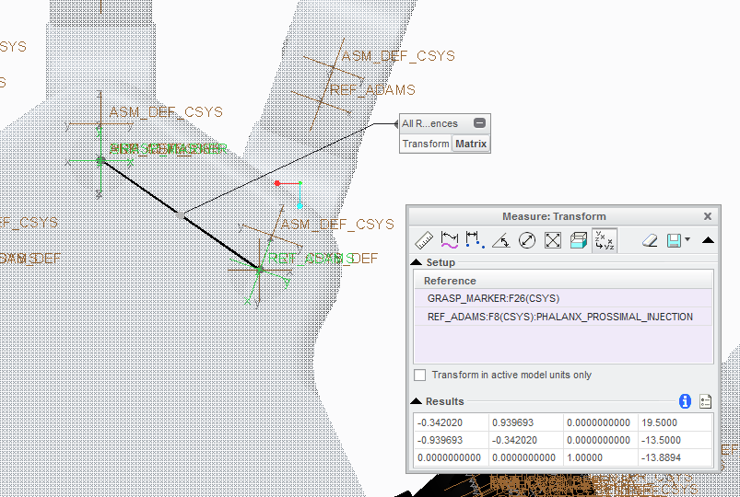
Index finger

Slide 9
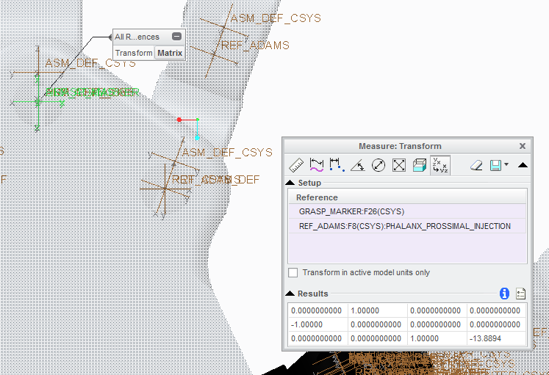
Middle finger

Slide 10
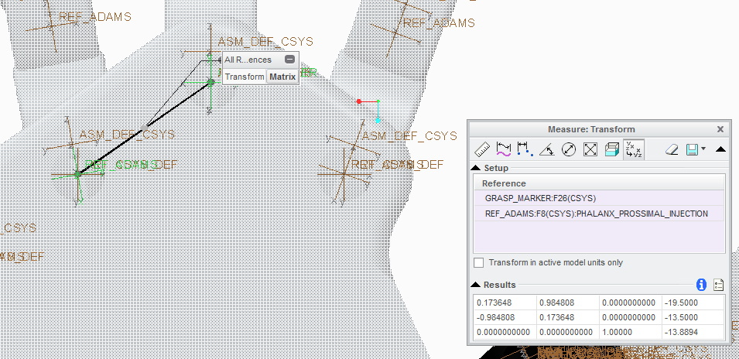
Ring finger

Slide 11
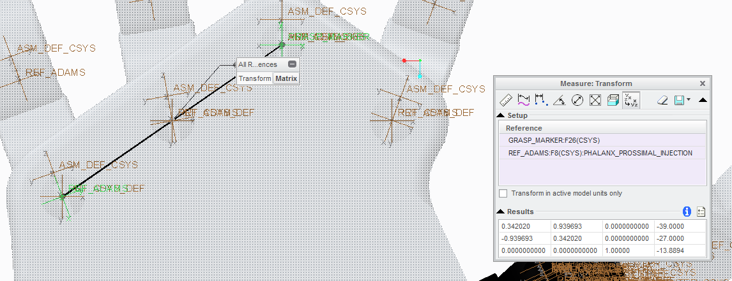
Little finger

Slide 12
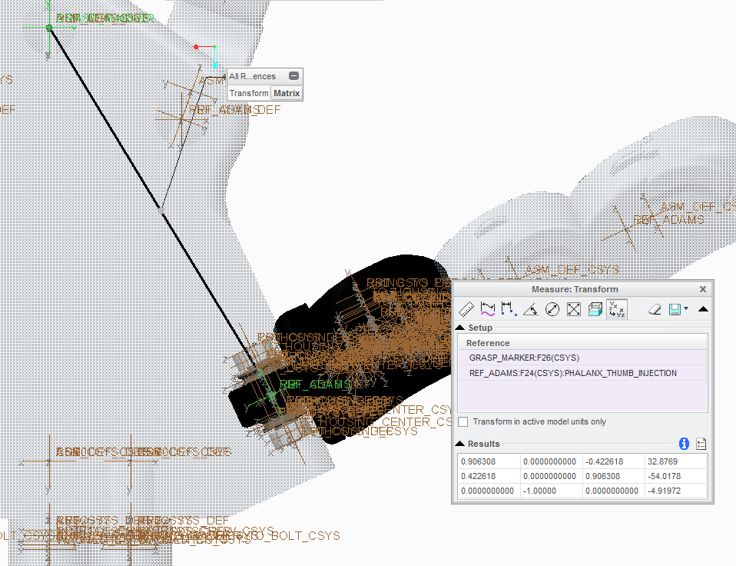
Thumb finger

