Slide 1
Sentiment Behind Tweets
Supervisor: Dr.Mohamed Hussein
Name: Esraa Anwer

Slide 2
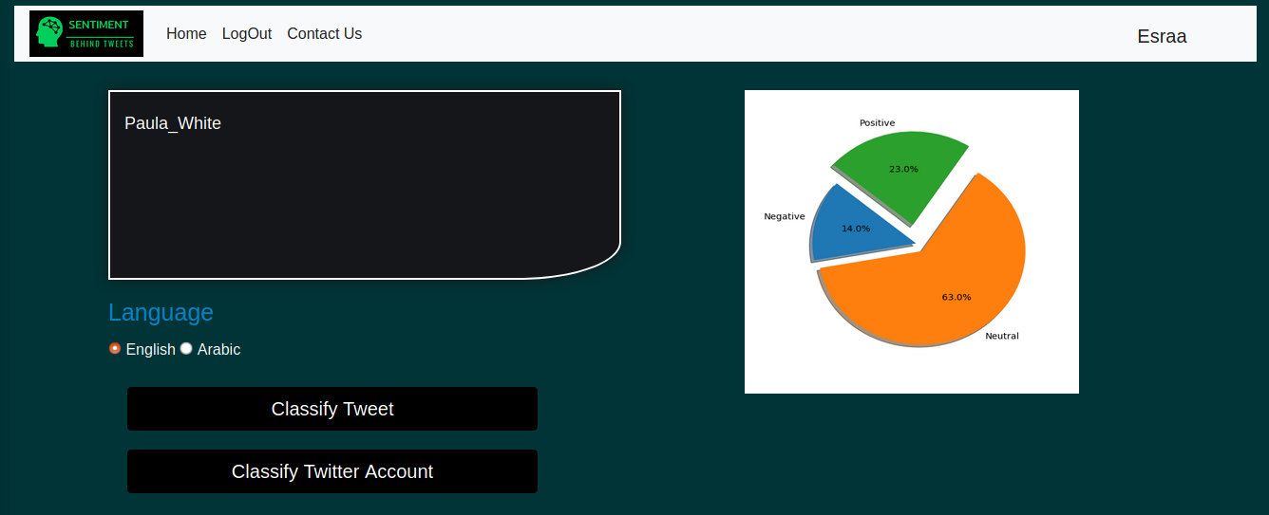

Slide 3
Agenda
Introduction
What is Behind sentiment
Problem & Solution
Project Aims
System Diagram
Conclusion
Future Work

Slide 4
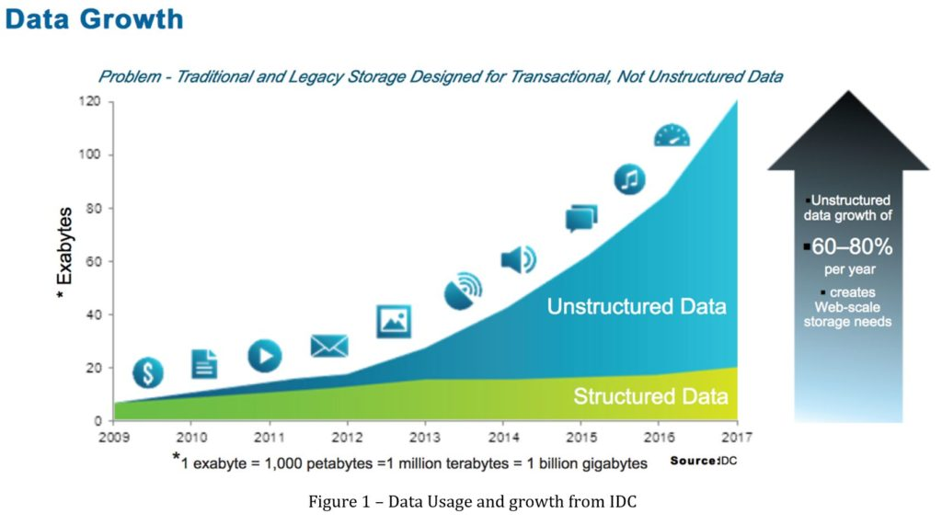
Introduction
For years ago we still deal with structured data, too. It actually represents about 20% of the data, but now the scaling happens of data and new data that is generated by the growth of applications it generates with time new types of data that can help us make new progress if we can discover.

Slide 5
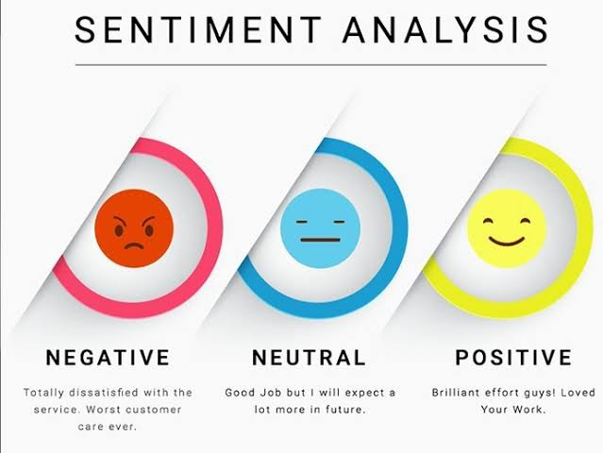
What is Behind Sentiment

Slide 6
Problem & Solution
It's difficult that Company knowing what is behind their marketing tweets on their social media and monitor their changes in a simple way.
Our solution is to help those to get a quick overview about the tweets they wrote and the tweets that they will write in the future using the natural language processing with web application that we can display our results on.

Slide 7
Project Aims
Extract sentiments, and subjectivity from the tweets.
Improve customer experience.
Based on the tweets sentiment showing the result of different classification by graphs.
Provide an approximate sentiment analysis results.
Ensure that client can contact us from our form for new features they need.
Client can test the tweets they write on their timeline.
Clients are able to use our platform for free.

Slide 8
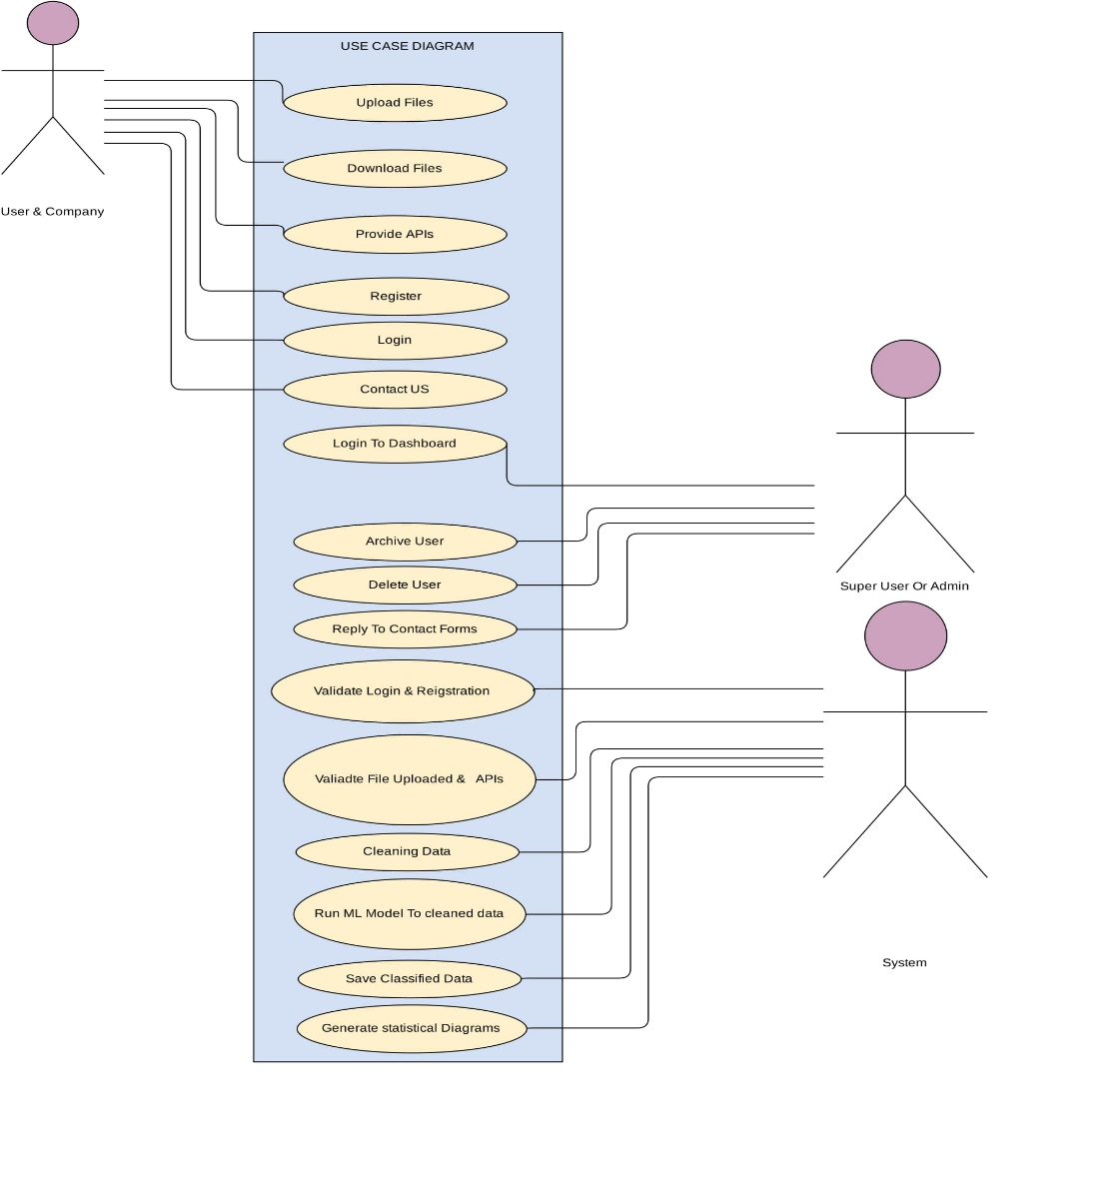

Slide 9
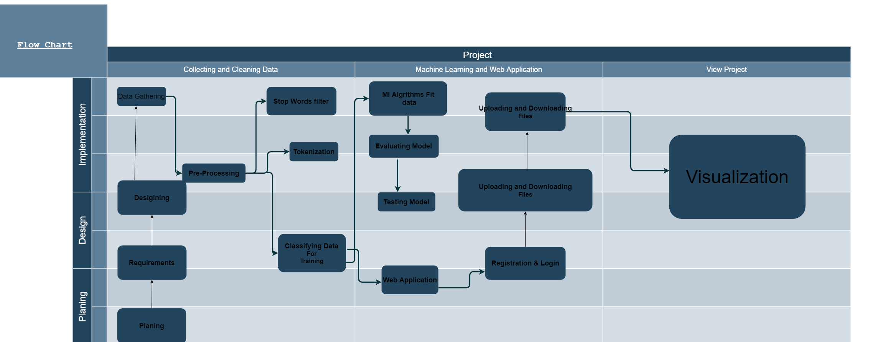

Slide 10
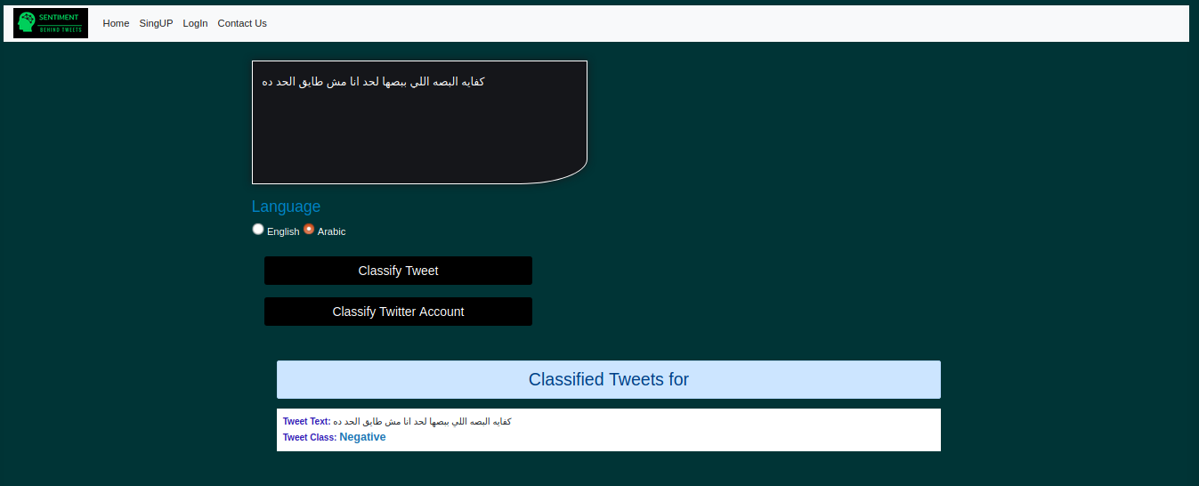
Conclusion
The Sentiment behind tweets aims to let the user get a quick overview of the tweets they write on their twitter timeline. Besides tht they show a Piegraph that displays how they tweets related to each other from positive to negative or neutral, also it helps the user to test their tweet before providing on the timeline.

Slide 11
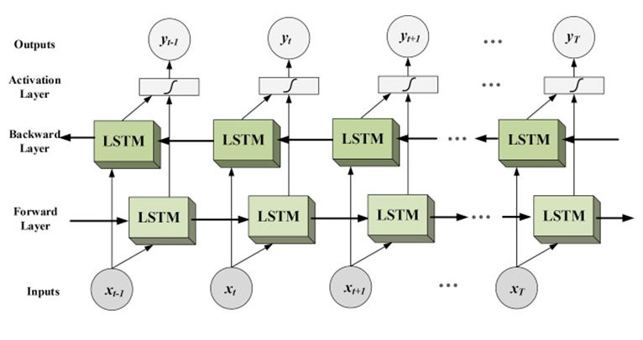
Future Work
Design Enhance
More Than one site
Deep BI-RNN

Slide 12


