Slide 1
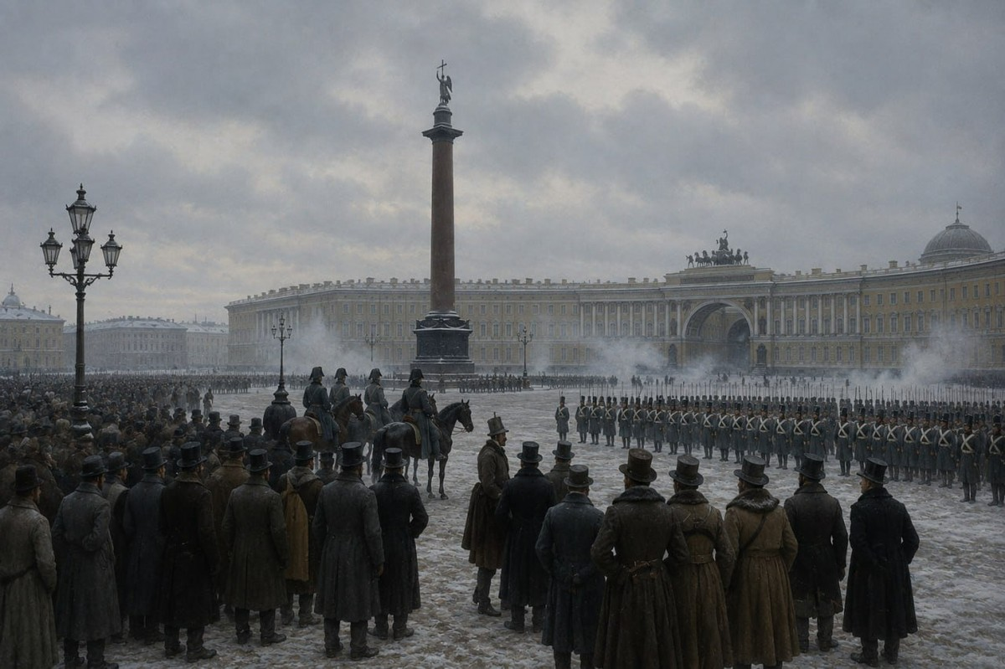
HISTORY PROJECT · 2025
SOCIAL MOVEMENTS
DURING THE RUSSIAN EMPIRE
The Decembrist Uprising · December 14, 1825
Saint Petersburg, Russia
Yunin Daniil · Chekh Vladimir · Turetsky Mark · Keil Daniel · Tutynin Alexey · Airapetyan Mark

Slide 2
WHAT WE WILL COVER
Structured for 15 minutes of presentation:
01
02
03
04
05
Historical
Context
Secret
Societies
Dec 14th
The Uprising
Aftermath &
Legacy
Our
Analysis
2 min
2 min
3 min
4 min
2 min
Russia 1815–1825, Napoleon's shadow, Enlightenment ideas, succession crisis
The Northern & Southern Societies — ideology, membership, and their constitutional programs
Senate Square: timeline of events, Trubetskoy's absence, Miloradovich's death, defeat
579 arrested · 121 exiled · 5 executed — and the long shadow over Russian history
Failure or first step? Our evaluation of the uprising's historical significance

Slide 3
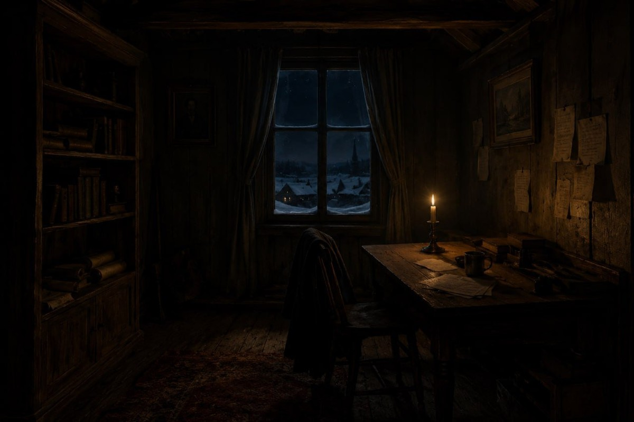
Historical Context
Why did young Russian officers turn against the Tsar?
The Napoleonic Wars (1812–1815)
Russian officers who marched through Europe witnessed constitutional governments, abolition of serfdom, and civil freedoms — in stark contrast to conditions at home. The contrast was radicalising.
The Enlightenment Reaches Russia
Works of Voltaire, Rousseau, and Montesquieu circulated among educated nobility. The American Revolution and the French Declaration of Rights inspired calls for a Russian constitution.
The Succession Crisis, November 1825
Alexander I died on November 19 in Taganrog. His brother Constantine had secretly renounced the throne in 1822. The resulting uncertainty — and forced re-oath — created the conspirators' window.
St. Petersburg, winter 1825

Slide 4
The Secret Societies
Two organisations. One goal. Very different visions.
NORTHERN SOCIETY
SOUTHERN SOCIETY
St. Petersburg · Founded 1821
Ukraine · Founded 1821
Leader:
Kondratiy Ryleev + Nikita Muravyov
Leader:
Pavel Pestel — radical reformer
Goal:
Constitutional monarchy — not a republic
Goal:
Full republic — abolish the monarchy entirely
Document:
Muravyov's draft constitution: federalism, civil rights, bicameral parliament
Document:
Pestel's Russkaya Pravda: centralised republic, universal male suffrage
Method:
Military coup — force the Senate to accept the Manifesto
Method:
Simultaneous military uprising from the south
Serfdom:
Abolish immediately, grant land to freed serfs
Serfdom:
Abolish immediately, large land redistribution

Slide 5
Key Figures
The men who shaped the uprising — and paid its price
KR
PP
ST
SM
PK
Kondratiy
Ryleev
Pavel
Pestel
Sergei
Trubetskoy
Muravyov-
Apostol
Pyotr
Kakhovsky
Northern leader
Southern leader
Appointed dictator
Southern Society
Northern member
Poet and publisher. Organised the St. Petersburg uprising. Executed July 13, 1826.
Wrote Russkaya Pravda — a republican constitution. Arrested Dec 13, the day before. Executed.
Chosen to command Senate Square. Lost his nerve and never appeared — a fatal blow.
Led the Chernigov Regiment mutiny in Ukraine. Executed alongside Ryleev.
Shot Governor-General Miloradovich during the uprising. One of five executed.

Slide 6
December 14, 1825
The day the uprising lived — and died — on Senate Square
7:00 AM
11:00 AM
12:00 PM
1–3 PM
4:00 PM
Oath to Nicholas I
Senate Square
Miloradovich Shot
Trubetskoy Absent
Cannon Fire
Rebel officers refuse the oath. The Moscow Regiment marches to Senate Square — ~3,000 men.
Soldiers form a hollow square and shout 'Constantine and Constitution!' — many thought 'Constitution' was Constantine's wife.
Hero of Borodino, Count Miloradovich, rides unarmed to negotiate. Kakhovsky shoots him at close range.
The appointed commander never appears — he is found in the General Staff, paralysed with fear. No one takes command.
Nicholas orders grapeshot. The rebels are dispersed in minutes. The Neva ice cracks. Men drown. It is over.

Slide 7
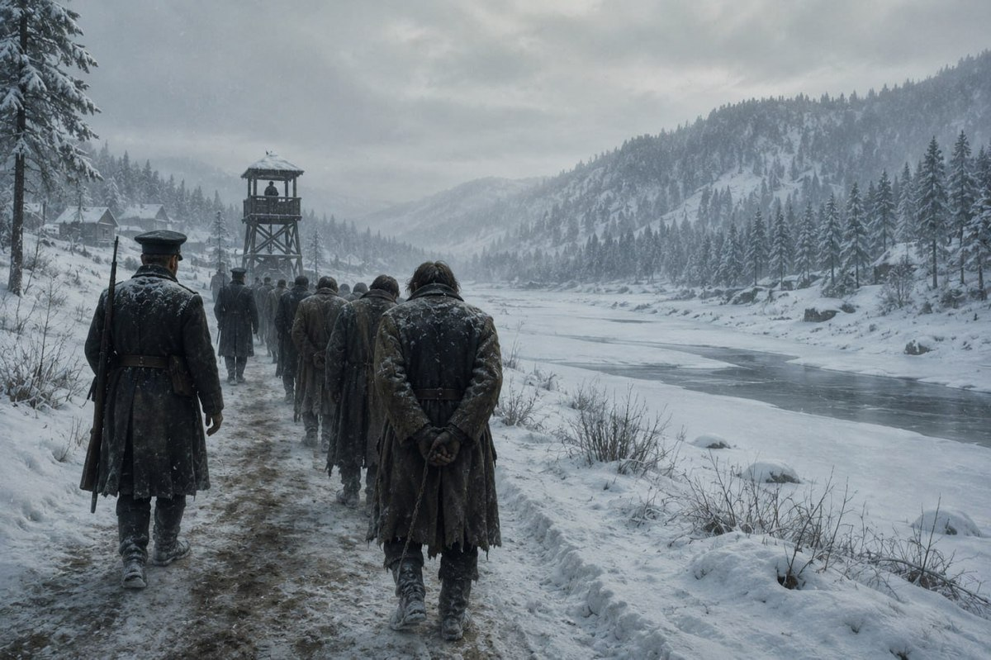
AFTERMATH
The price of failure — and the beginning of legend
579
People Arrested
Detained and interrogated for months
121
Exiled to Siberia
Hard labour, some for 20+ years
5
Executed
Ryleev · Pestel · Muravyov-Apostol · Bestuzhev-Ryumin · Kakhovsky
Wives (Dekabristki) followed husbands to Siberia, surrendering noble titles — icons of Russian culture.

Slide 8
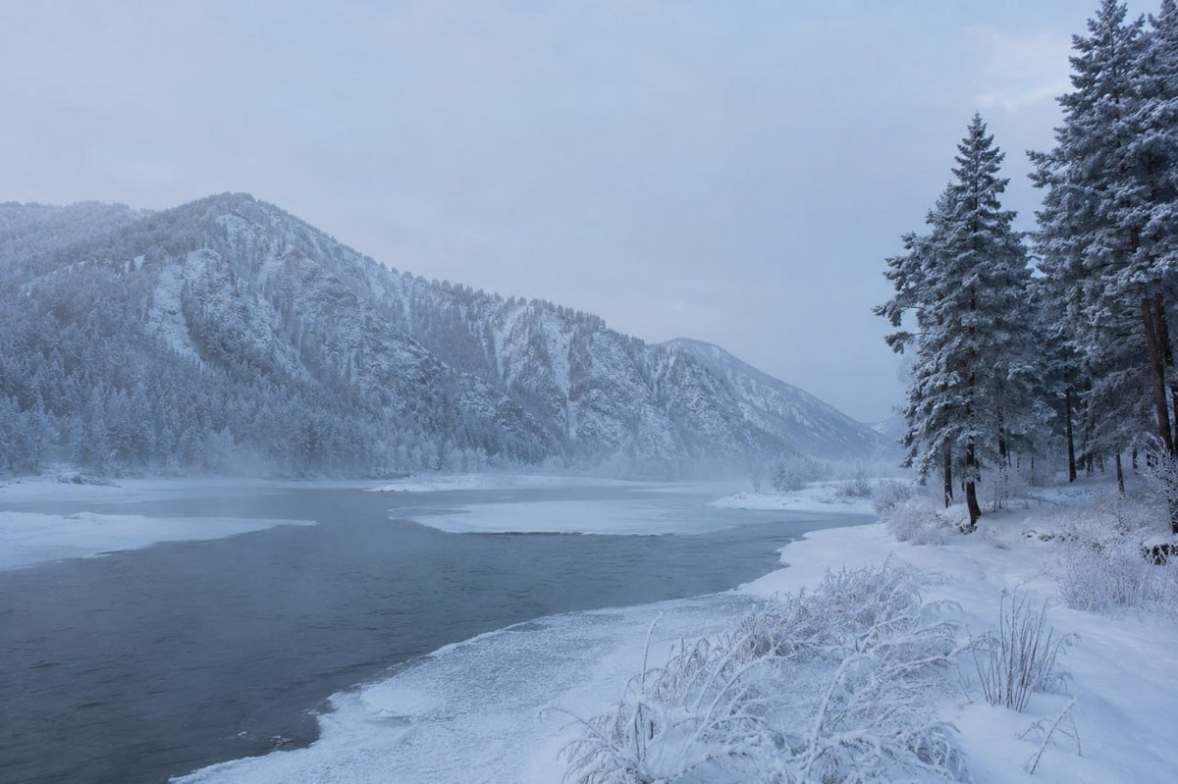
Legacy & Historical Impact
"The Decembrists woke up Herzen, Herzen developed revolutionary agitation..." — V.I. Lenin
Inspired Future Revolutionaries
Herzen, the Populists, Social Democrats, and ultimately 1917 — all traced a direct line back to Senate Square.
The Great Reform of 1861
Alexander II abolished serfdom — the Decembrists' core demand — 36 years later, partly driven by the pressure they created.
Shaped Russian Literature
Pushkin, Tolstoy, and Turgenev drew on their legacy. The Dekabristki became icons. Their story lives in Russian culture.
First Organised Opposition
Before 1825, resistance was individual. The Decembrists built the template: secret society, written program, collective action.
Siberia — where 121 Decembrists were sent

Slide 9
Our Analysis
Was the uprising a failure — or the first step?
WHY IT FAILED
WHY IT MATTERS
Trubetskoy — the commander — never appeared
Pestel was arrested one day before the uprising
Northern and Southern Societies failed to act simultaneously
No popular support — the serfs were not mobilised
Nicholas I acted decisively from the first hour
First organised political opposition in Russian history
Created a martyrology that inspired every reform movement after 1825
Their demands (constitution, end of serfdom) were eventually achieved
Demonstrated that the autocracy could — and should — be challenged
Alexander Herzen, Lenin, and others all cited them as the beginning

Slide 10
CONCLUSION
A Defeat That
Changed Russia
The Decembrists failed on December 14, 1825. But they succeeded historically. They planted the idea that autocracy was not inevitable, that serfdom was unjust, and that educated citizens had a duty to act. Every major reform and revolution that followed owed something to their sacrifice. They were — as Herzen wrote — "the awakeners of Russia."
Thank you · Questions & Discussion
Yunin Daniil · Chekh Vladimir · Turetsky Mark · Keil Daniel · Tutynin Alexey · Airapetyan Mark

