Slide 1

TailDaam — Pakistan fuel prices, with receipts
TailDaam | Energy demand / Data Science Hackathon 2026

Slide 2
Problem Statement
THE PROBLEM
1
Who is affected?
Pakistani petrol and diesel prices are administered at fortnightly reviews, but the evidence is scattered across weekly PBS reports, city-level annexes and global benchmark feeds. Most tools repeat a headline or generate an answer without showing where it came from.
Households, transport and industry, journalists, analysts and policymakers in Pakistan.
2
Why does it matter?
Fuel prices affect inflation, transport cost and import-bill risk. TailDaam covers 91,672 clean rows from 62 raw files.
3
Our goal
Build a governed fuel-price record, a baseline-beating volatility model, and a refusal-first cited insight agent.

Slide 3
Dataset Declaration
Dataset name | TailDaam governed fuel-price warehouse
Source / link | PBS, U.S. EIA, World Bank Pink Sheet; github.com/DanyalAbbas/hack-insight
Size | 91,672 clean rows from 62 raw files; ~144 MB data directory
Time period | PBS weekly 2025-05 to 2026-10; city monthly Jan-Sep 2026; EIA daily; WB monthly
Format & license | CSV/Parquet; Government open publication, public domain, CC BY 4.0
Key features / target | Petrol/HSD prices by week and city; model target: next-month Brent realised volatility
91,672
Rows / records
12+
Columns / features
144 MB
Dataset size

Slide 4
Pipeline Used
1
2
3
4
5
Data Collection
Data Cleaning
Analysis / EDA
Modeling
Dashboard / App
PBS 41 weekly + 9 city annexes, EIA 11 daily series, World Bank Pink Sheet
Typed long tables with stable row IDs; no invented observations
Quality agent: 14 rules, 1 fix, 4 flags
HAR ridge vs persistence; 7.269% lower MAE; 89.25% interval coverage
FastAPI API + static Hugging Face Space; no login
62 publisher files -> 91,672 clean rows -> cited fuel-price insights and Brent risk

Slide 5
Pipeline Details & Tools
Stage | Tools / Libraries | What we did
Collection | requests, PBS/EIA/WB endpoints | Download and SHA-256 hash 62 original publisher files
Preprocessing | pandas, openpyxl, clean.py | Normalise weekly, city and global tables; stable row IDs
Analysis / EDA | quality.py | 14 deterministic rules; every FIX/FLAG/FAIL logged
Modeling | scikit-learn, pandas | HAR ridge vs persistence; 7.269% MAE win; 89.25% coverage
Dashboard / App | FastAPI, Prefect, Hugging Face | API, static UI, hourly pipeline, no login

Slide 6
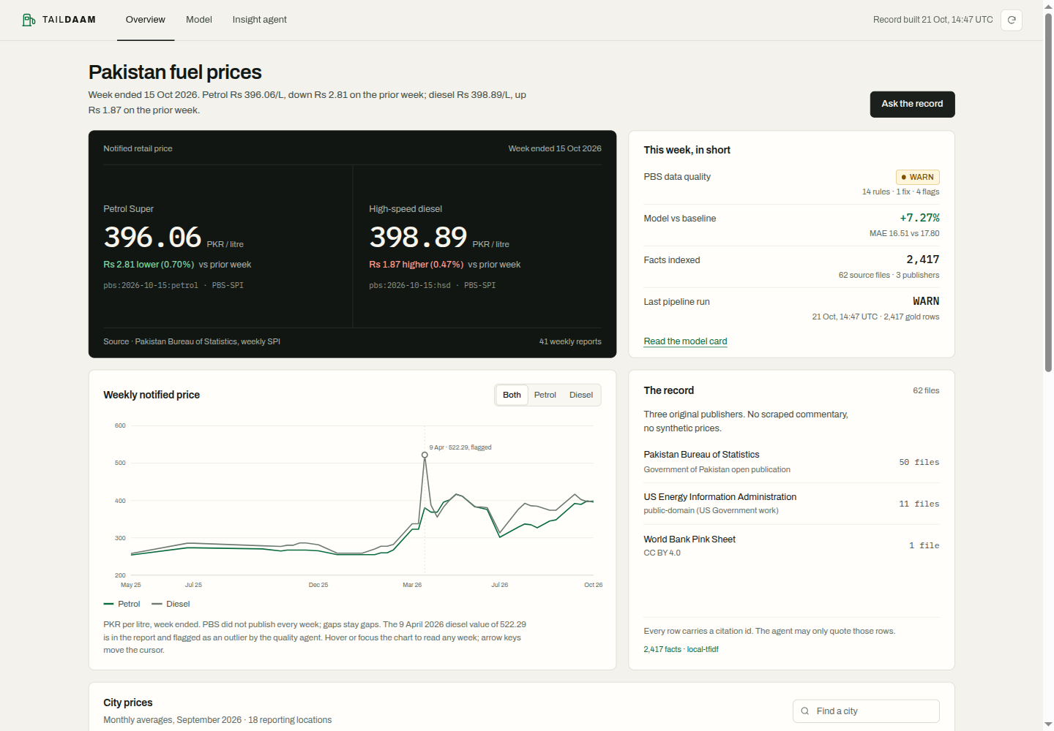
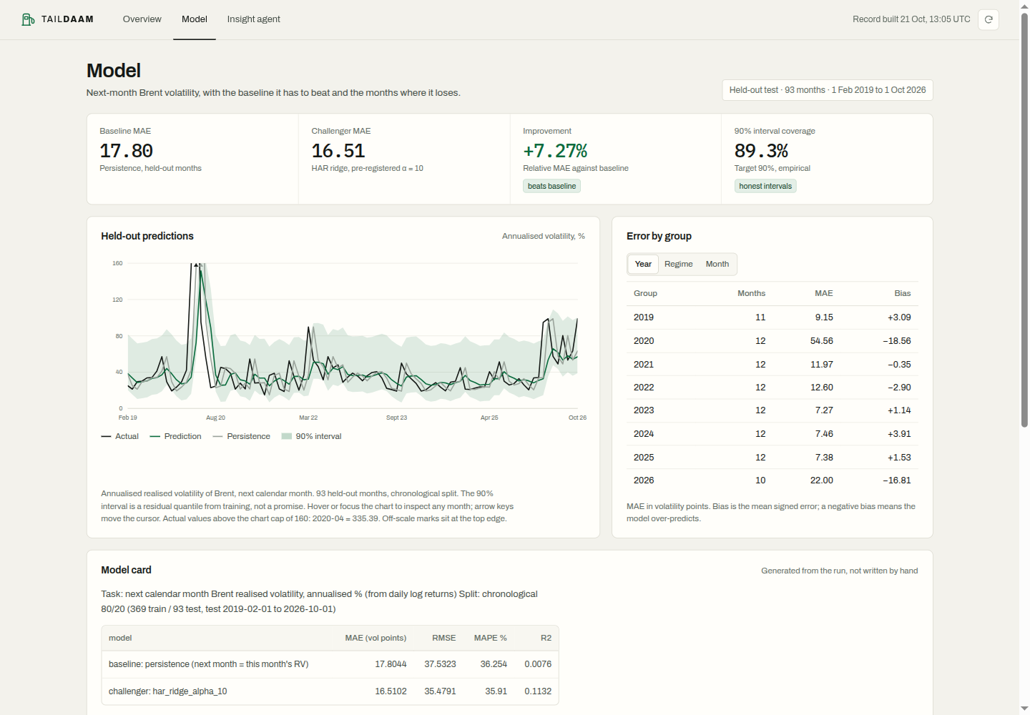
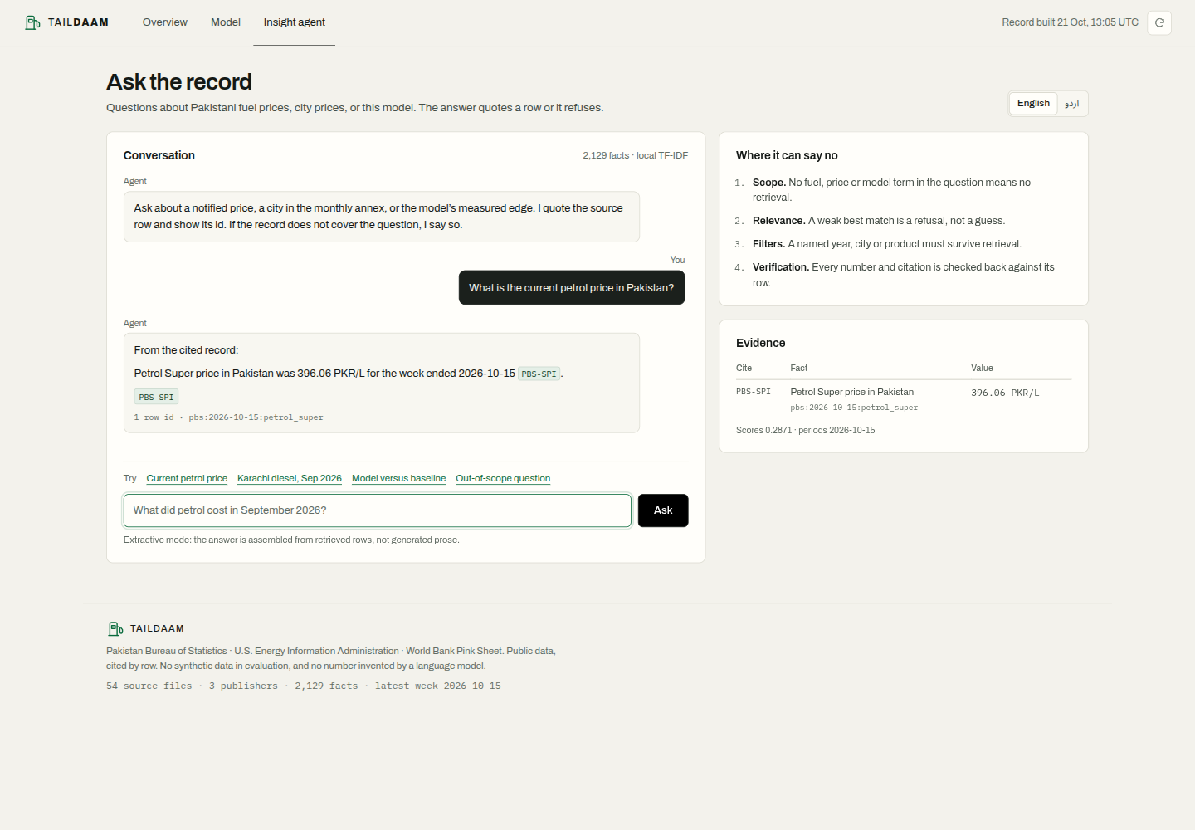
Dashboard / App Views
Page 2 - Model
Page 1 - Overview
Page 3 - Insight agent
Live: https://danyalabbas-hack-insight.static.hf.space | Repo: https://github.com/DanyalAbbas/hack-insight

Slide 7
Conclusion
Model beats persistence by 7.269% MAE
IMPACT
1
MAE 17.8044 -> 16.5102; 89.25% interval coverage.
Journalists, analysts and policymakers get traceable fuel-price evidence.
2
Agent refuses unsupported questions
Cited answers with row IDs; weather and unsupported periods are refused.
FUTURE WORK
OGRA city prices, more monthly annexes, semantic retrieval, reliability monitoring.
3
Quality status WARN: 14 rules, 1 fix, 4 flags
No backfilled runs; weekly gaps and the April 2026 HSD outlier are flagged.

Slide 8
Team & Credits
TailDaam
AB
AB
AB
AB
Danyal Abbas
Open contributor slot
Open contributor slot
Open contributor slot
Data, model, agent, pipeline, deployment
Reserved for hackathon team
Reserved for hackathon team
Reserved for hackathon team
Mentor / Supervisor: none declared | Contact: github.com/DanyalAbbas/hack-insight
Thank you!

