Slide 1
Процессы и потоки
Операционные Системы
кафедра ИУС ФТК СпбГПУ
Коликова Т.В.

Slide 2
О чем
Процесс
Поток

Slide 3
Процессы и потоки
В разных ОС процессы различаются:
  представлением (структурами данных)
  способами именования и защиты
  отношениями между собой
Процессы Windows NT:
  реализованы как объекты, и доступ к ним осуществляется посредством объектных сервисов;
  в адресном пространстве процесса может исполняться несколько потоков;
  объект-процесс и объект-поток имеют встроенные возможности синхронизации

Slide 4
Windows Processes
Per-process
address space
What is a process?
  Represents an instance of a running program
    you create a process to run a program
    starting an application creates a process
  Process defined by:
    Address space
    Resources (e.g. open handles)
    Security profile (token)
Every process starts with one thread
  First thread executes the program’s “main” function
    Can create other threads in the same process
    Can create additional processes
Thread
Thread
Thread
Systemwide Address Space
Notes:
Although programs and processes appear similar on the surface, they are fundamentally different. A program is a static sequence of instructions, whereas a process is a container for a set of resources used when executing the instance of the program. At the highest level of abstraction, a Windows process comprises the following:
A private virtual address space, which is a set of virtual memory addresses that the process can use
An executable program, which defines initial code and data and is mapped into the process’s virtual address space
A list of open handles to various system resources, such as semaphores, communication ports, and files, that are accessible to all threads in the process
A security context called an access token that identifies the user, security groups, and privileges associated with the process
A unique identifier called a process ID (internally called a client ID)
At least one thread of execution

Slide 5
Single and Multithreaded Processes
code
data
files
code
data
files
registers
stack
registers
registers
registers
stack
stack
stack
Thread
Thread
Thread
Thread
single-threaded
multi-threaded

Slide 6
Процесс
Процесс
  Исполняемая программа (код и данные)
  Виртуальное адресное пространство
  Системные ресурсы
  Обязательно хотя бы один поток управления (Thread)

Slide 7
Per-Process Data
Each process has its own…
  Virtual address space (including program code, global storage, heap storage, threads’ stacks)
  processes cannot corrupt each other’s address space by mistake
  Working set (physical memory “owned” by the process)
  Access token (includes security identifiers)
  Handle table for Windows kernel objects
  Environment strings
  Command line
  These are common to all threads in the process, but separate and protected between processes

Slide 8
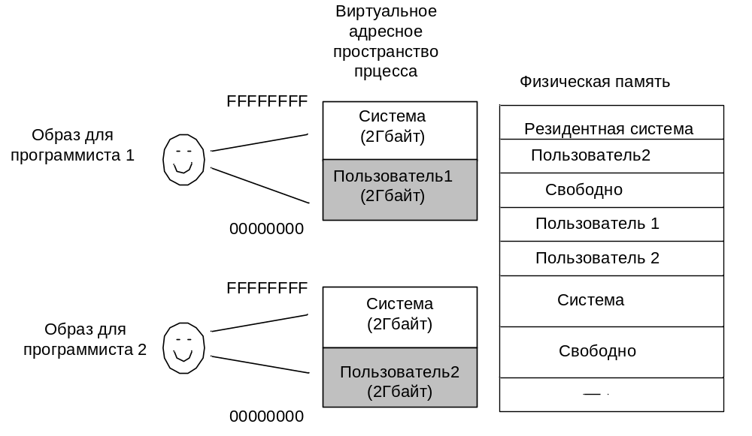
Адресное пространство

Slide 9
Processes & Threads
Internal Data Structures
Access Token
Process
Object
VAD
VAD
VAD
Virtual Address Space Descriptors
Handle Table
object
object
Thread
Thread
Thread
. . .
Access Token
Notes:
In addition to a private address space and one or more threads, each process has a security identification and a list of open handles to objects such as files, shared memory sections, or one of the synchronization objects such as mutexes, events, or semaphores, as illustrated in this slide. Every process has a security context that is stored in an object called an access token. The process access token contains the security identification and credentials for the process. By default, threads don’t have their own access token, but they can obtain one, thus allowing individual threads to impersonate the security context of another process—including processes running on a remote Windows system—without affecting other threads in the process. (See Chapter 8 for more details on process and thread security.) The virtual address descriptors (VADs) are data structures that the memory manager uses to keep track of the virtual addresses the process is using. These data structures are described in more depth in the Memory Management unit (Book Chapter 7).

Slide 10
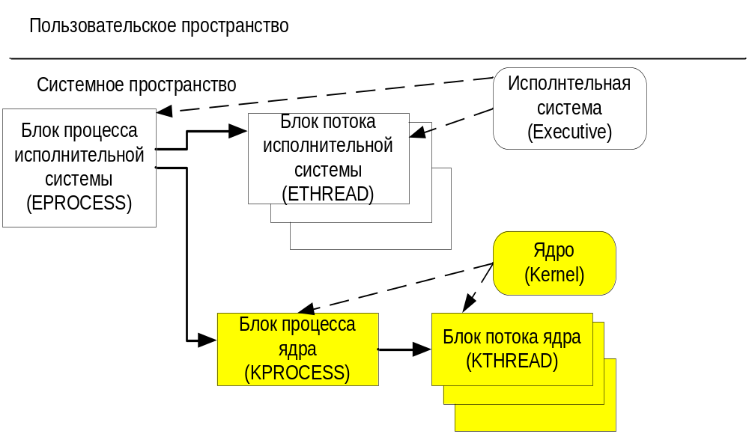
Process and Thread Manager

Slide 11
Process Block Layout
Kernel Process Block (or PCB)
Process ID
Parent Process ID
Dispatcher Header
Exit Status
Process Page Directory
Create and Exit Time
Kernel Time
Next Process Block
EPROCESS
User Time
Inwwap/Outswap List Entry
Quota Block
KTHREAD
. . .
Memory Management Information
Process Spin Lock
Exception Port
Processor Affinity
Debugger Port
Resident Kernel Stack Count
Primary Access Token
Process Base Priority
Default Thread Quantum
Handle Table
Process State
Process Environment Block
Thread Seed
Image File Name
Disable Boost Flag
Image Base Address
Process Priority Class
Win32 Process Block
Notes:
For details on these structures, see Book p.291-295

Slide 12
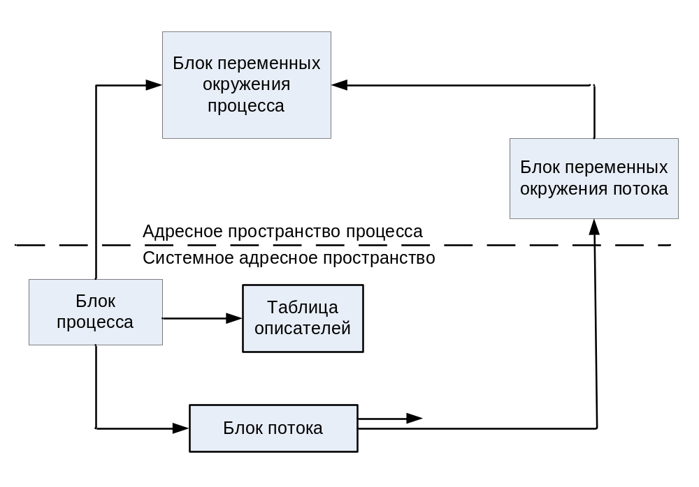
Блоки переменных окружения

Slide 13
Объект процесс
Атрибуты
  Идентификатор процесса
  Маркер доступа
  Базовый приоритет
  Процессорное сродство
  Размер квоты
  …
  Код завершения

Slide 14
Объект процесс
Сервисы
  Создать процесс - CreateProcess
  Открыть процесс
  Текущий процесс
  Завершить процесс - TerminateProcess
  …

Slide 15

Process Windows APIs
CreateProcess
OpenProcess
GetCurrentProcessId - returns a global ID
GetCurrentProcess - returns a handle
ExitProcess
TerminateProcess - no DLL notification
Get/SetProcessShutdownParameters
GetExitCodeProcess
GetProcessTimes
GetStartupInfo
Notes:
The following are the process-related functions (the description of the mechanism behind system calls is in Unit OS2):
CommandLineToArgvW Parses a Unicode command-line string.
CreateProcess Creates a new process and its primary thread.
CreateProcessAsUser Creates a new process and its primary thread. The new process runs in the security context of the specified user.
CreateProcessWithLogonW Creates a new process and its primary thread. The new process then runs the specified executable file in the security context of the specified credentials (user, domain, and password).
CreateProcessWithTokenW Creates a new process and its primary thread. The new process runs in the security context of the specified token.
ExitProcess Ends a process and all its threads.
FreeEnvironmentStrings Frees a block of environment strings.
GetCommandLine Retrieves the command-line string for the current process.
GetCurrentProcess Retrieves a pseudo handle for the current process.
GetCurrentProcessId Retrieves the process identifier of the calling process.
GetEnvironmentStrings Retrieves the environment block for the current process.
GetEnvironmentVariable Retrieves the value of the specified variable from the environment block of the calling process.
GetExitCodeProcess Retrieves the termination status of the specified process.
GetGuiResources Retrieves the count of handles to graphical user interface (GUI) objects in use by the specified process.
GetLogicalProcessorInformation Retrieves information about logical processors and related hardware.
GetPriorityClass Retrieves the priority class for the specified process.
GetProcessAffinityMask Retrieves a process affinity mask for the specified process and the system affinity mask for the system.
GetProcessHandleCount Retrieves the number of open handles that belong to the specified process.
GetProcessId Retrieves the process identifier of the specified process.
GetProcessIdOfThread Retrieves the process identifier of the process associated with the specified thread.
GetProcessIoCounters Retrieves accounting information for all I/O operations performed by the specified process.
GetProcessPriorityBoost Retrieves the priority boost control state of the specified process.
GetProcessShutdownParameters Retrieves shutdown parameters for the currently calling process.
GetProcessTimes Retrieves timing information about for the specified process.
GetProcessVersion Retrieves the major and minor version numbers of the system on which the specified process expects to run.
GetProcessWorkingSetSize Retrieves the minimum and maximum working set sizes of the specified process.
GetProcessWorkingSetSizeEx Retrieves the minimum and maximum working set sizes of the specified process.
GetStartupInfo Retrieves the contents of the STARTUPINFO structure that was specified when the calling process was created.
OpenProcess Opens an existing process object.
NeedCurrentDirectoryForExePath Determines whether the current directory should be included in the search path for the specified executable.
SetEnvironmentVariable Sets the value of an environment variable for the current process.
SetPriorityClass Sets the priority class for the specified process.
SetProcessAffinityMask Sets a processor affinity mask for the threads of a specified process.
SetProcessPriorityBoost Disables the ability of the system to temporarily boost the priority of the threads of the specified process.
SetProcessShutdownParameters Sets shutdown parameters for the currently calling process.
SetProcessWorkingSetSize Sets the minimum and maximum working set sizes for the specified process.
SetProcessWorkingSetSizeEx Sets the minimum and maximum working set sizes for the specified process.
TerminateProcess Terminates the specified process and all of its threads.

Slide 16
Windows Threads
What is a thread?
  An execution context within a process
  Unit of scheduling (threads run, processes don’t run)
  All threads in a process share the same per-process address space
    Services provided so that threads can synchronize access to shared resources (critical sections, mutexes, events, semaphores)
  All threads in the system are scheduled as peers to all others, without regard to their “parent” process
System calls
  Primary argument to CreateProcess()
  is image file name (or command line)
  Primary argument to CreateThread()
  is a function entry point address
Notes:
A thread is the entity within a process that Windows schedules for execution. Without it, the process’s program can’t run. Although threads have their own execution context, every thread within a process shares the process’s virtual address space (in addition to the rest of the resources belonging to the process), meaning that all the threads in a process can write to and read from each other’s memory. Threads cannot accidentally reference the address space of another process, however, unless the other process makes available part of its private address space as a shared memory section (called a file mapping object in the Windows API) or unless one process has the right to open another process to use cross-process memory functions such as ReadProcessMemory and WriteProcessMemory.
In addition to a private address space and one or more threads, each process has a security identification and a list of open handles to objects such as files, shared memory sections, or one of the synchronization objects such as mutexes, events, or semaphores, as illustrated in Figure 1-2.

Slide 17
Per-Thread Data
Each thread has its own…
  User-mode stack (arguments passed to thread, automatic storage, call frames, etc.)
  Kernel-mode stack (for system calls)
  Thread Local Storage (TLS) – array of pointers to allocate unique data
  Scheduling state (Wait, Ready, Running, etc.) and priority
  Hardware context (saved in CONTEXT structure if not running)
    Program counter, stack pointer, register values
    Current access mode (user mode or kernel mode)
  Access token (optional -- overrides process’s if present)
Notes:
A thread includes the following essential components:
The contents of a set of CPU registers representing the state of the processor.
Two stacks, one for the thread to use while executing in kernel mode and one for executing in user mode.
A private storage area called thread-local storage (TLS) for use by subsystems, run-time libraries, and DLLs.
A unique identifier called a thread ID (also internally called a client ID—process IDs and thread IDs are generated out of the same namespace, so they never overlap).
Threads sometimes have their own security context that is often used by multithreaded server applications that impersonate the security context of the clients that they serve.
The volatile registers, stacks, and private storage area are called the thread’s context. Because this information is different for each machine architecture that Windows runs on, this structure, by necessity, is architecture-specific. The Windows GetThreadContext function provides access to this architecture-specific information (called the CONTEXT block).

Slide 18
Поток
Основные составляющие потока
  Уникальный идентификатор
  Набор регистров
  Два стека (User mode & Kernel mode)
  Собственная область памяти

Slide 19
Thread States
Five-state diagram for thread scheduling:
  init: The thread is being created
  ready: The thread is waiting to be assigned to a CPU
  running: The thread’s instructions are being executed
  waiting: The thread is waiting for some event to occur
  terminated: The thread has finished execution
interrupt
quantum expired
init
terminated
admitted
ready
scheduler
dispatch
running
exit
waiting
I/O or event
completion
waiting for
I/O or event
Notes:
Newly created threads start there live in “init” state. After appropriate data structures are initialized (thread control block - TCB), the thread’s state is changed to “ready”. From “ready” state, a thread may get selected for execution and its state is changed by the scheduler to “running”. For a given system, there is exactly one thread in “running” state per processing unit (note that a CPU might have multiple processing units - multicore/hyperthreading).
When the “running” thread issues an I/O request, it might block and change its state into “waiting”. Alternatively, a “running” thread’s time slice (quantum) may expire, in which case the thread’s state is changed back to “ready”. A “waiting” thread can move into “ready” state once the reason for its blocking disappears (I.e.; the I/O operation completes). Finally, a “running” thread might execute its last instruction - in which case its state changes to “terminated”.
Operating systems often use heuristics to determine which one of the threads in “ready” state to select for execution. The Windows OS uses a priority-based scheme and maintains 32 ready queues of different priorities.

Slide 20
CPU Switch from Thread to Thread
Thread T₁
Thread T₂
Interrupt or system call
Save state into TCB₁
ready or
waiting
executing
Reload state from TCB₂
Interrupt or system call
ready or
waiting
executing
Save state into TCB₂
Reload state from TCB₁
ready or
waiting
executing
Notes:
From a processor’s point of view, it executes instructions load from memory dictated by the changing values of the program counter. Over time, the program counter may refer to code in different programs. Each of these programs in execution forms a process with one or multiple threads.
When a thread whose state was “running” is interrupted, the current values of program counter and processor registers are saved in the corresponding thread control block and the the state of the thread is changed to “waiting” or “ready”. The OS is now free to put some other thread in the running state. The program counter and context data for this thread are loaded into the processor register and the thread begins execution.
There might be extra processing required if a context switch happens between threads in different processes. In this case, the mapping of virtual to physical addresses has to updated - which means that the memory management unit (MMU) has to be re-programmed.

Slide 21
Context Switch
When CPU switches to another thread, the system must save the state of the old thread and load the saved state for the new thread
Context-switch time is overhead; the system does no useful work while switching
Thread context-switching can be implemented in kernel or user mode
Interaction with memory management (MMU) is required when switching between threads in different processes

Slide 22
Многозадачность
Вытесняющая многозадачность (preemptive multitasking)
  ОС не ждет пока поток добровольно предоставит процессор другим потокам
  ОС прерывает поток по истечении кванта времени, или если готов к выполнению поток с большим приоритетом

Slide 23
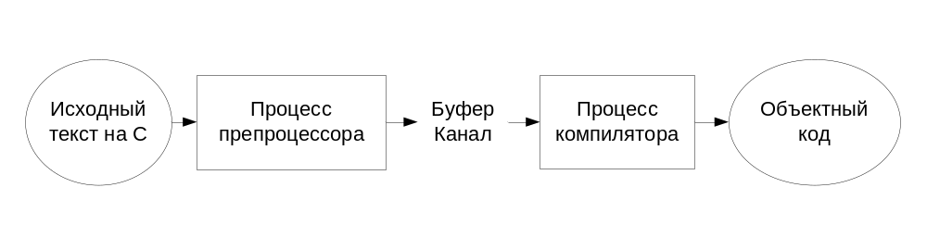
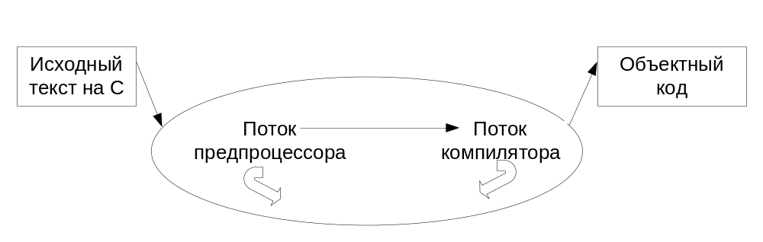
Concurrent Applications

Slide 24
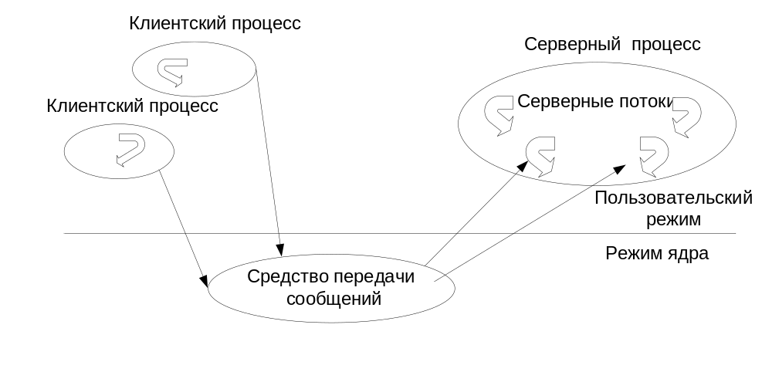
Многопоточный сервер

Slide 25
Processes & Threads
Why divide an application into multiple threads?
  Perceived user responsiveness, parallel/background execution
    Examples: Word background print – can continue to edit during print
  Take advantage of multiple processors
    On an MP system with n CPUs, n threads can literally run at the same time
    Question: given a single threaded application, will adding a 2nd processor make it run faster?
  Does add complexity
    Synchronization
    Scalability well is a different question…
      # of multiple runnable threads vs # CPUs
      Having too many runnable threads causes excess context switching

Slide 26
Достоинства и недостатки
Потоки – это легковесные процессы
Используют одно адресное пространство процесса
Все ресурсы процесса доступны всем его потокам
Серверные приложения
  Каждый запрос обрабатывается отдельным потоком
Потоки могут пересечься друг с другом, выполняя чтение или запись в память не в том порядке

Slide 27
Thread Block
ETHREAD
KTHREAD
KTHREAD
Dispatcher Header
Create and Exit Time
Total User Time
Process ID
Total Kernel Time
EPROCESS
Kernel Stack Information
Thread Start Address
System Service Table
Access Token
Thread Scheduling Information
Impersonation Information
Trap Frame
LPC Message Information
Thread Local Storage
Timer Information
Synchronization Information
Pending I/O Requests
List of Pending APCs
Timer Block and Wait Blocks
List of Objects Being Waiting On
TEB

Slide 28
Объект поток
Атрибуты тела
  Идентификатор потока
  Контекст потока
  Базовый приоритет потока
  Динамический приоритет потока
  Процессорное сродство потока
  …
  Код завершения потока

Slide 29
Объект поток
Сервисы
  Создать поток - CreateThread
  Создать поток в другом процессе - CreateRemoteThread
  Завершить поток - TerminateThread
  …

Slide 30
Windows Thread APIs
CreateThread
CreateRemoteThread
GetCurrentThreadId - returns global ID
GetCurrentThread - returns handle
SuspendThread/ResumeThread
ExitThread
TerminateThread - no DLL notification
GetExitCodeThread
GetThreadTimes
Windows 2000 adds:
  OpenThread
  new thread pooling APIs
Notes:
The following are the thread-related functions (the description of the mechanism behind system calls is in Unit OS2):
AttachThreadInput Attaches the input processing mechanism of one thread to that of another thread.
CreateRemoteThread Creates a thread that runs in the virtual address space of another process.
CreateThread Creates a thread to execute within the virtual address space of the calling process.
ExitThread Ends a thread.
GetCurrentThread Retrieves a pseudo handle for the current thread.
GetCurrentThreadId Retrieves the thread identifier of the calling thread.
GetExitCodeThread Retrieves the termination status of the specified thread.
GetThreadId Retrieves the thread identifier of the specified thread.
GetThreadIOPendingFlag Determines whether a specified thread has any I/O requests pending.
GetThreadPriority Retrieves the priority value for the specified thread.
GetThreadPriorityBoost Retrieves the priority boost control state of the specified thread.
GetThreadTimes Retrieves timing information for the specified thread.
OpenThread Opens an existing thread object.
ResumeThread Decrements a thread's suspend count.
SetThreadAffinityMask Sets a processor affinity mask for the specified thread.
SetThreadIdealProcessor Specifies a preferred processor for a thread.
SetThreadPriority Sets the priority value for the specified thread.
SetThreadPriorityBoost Disables the ability of the system to temporarily boost the priority of a thread.
Sleep Suspends the execution of the current thread for a specified interval.
SleepEx Suspends the current thread until the specified condition is met.
SuspendThread Suspends the specified thread.
SwitchToThread Causes the calling thread to yield execution to another thread that is ready to run on the current processor.
TerminateThread Terminates a thread.
ThreadProc An application-defined function that serves as the starting address for a thread.
TlsAlloc Allocates a thread local storage (TLS) index.
TlsFree Releases a TLS index.
TlsGetValue Retrieves the value in the calling thread's TLS slot for a specified TLS index.
TlsSetValue Stores a value in the calling thread's TLS slot for a specified TLS index.
WaitForInputIdle Waits until the specified process is waiting for user input with no input pending, or until the time-out interval has elapsed.

Slide 31
Windows scheduler
Priority-driven, preemptive scheduling system
Highest-priority runnable thread always runs
Thread runs for time amount of quantum
No single scheduler – event-based scheduling code spread across the kernel
Dispatcher routines triggered by the following events:
  Thread becomes ready for execution
  Thread leaves running state (quantum expires, wait state)
  Thread‘s priority changes (system call/NT activity)
  Processor affinity of a running thread changes

Slide 32
Windows Scheduling Principles
32 priority levels
Threads within same priority are scheduled following the Round-Robin policy
Non-Realtime Priorities are adjusted dynamically
  Priority elevation as response to certain I/O and dispatch events
  Quantum stretching to optimize responsiveness
Realtime priorities (i.e.; > 15) are assigned statically to threads

Slide 33
Scheduling
Multiple threads may be ready to run
“Who gets to use the CPU?”
From Windows API point of view:
  Processes are given a priority class upon creation
    Idle, Normal, High, Realtime
    Windows 2000 added “Above normal” and “Below normal”
  Threads have a relative priority within the class
    Idle, Lowest, Below_Normal, Normal, Above_Normal, Highest, and Time_Critical
From the kernel’s view:
  Threads have priorities
  0 through 31
  Threads are scheduled,
  not processes
  Process priority class is not used
  to make scheduling decisions
Windows Scheduling-related APIs:
  Get/SetPriorityClass
  Get/SetThreadPriority
  Get/SetProcessAffinityMask
  SetThreadAffinityMask
  SetThreadIdealProcessor
  Suspend/ResumeThread

Slide 34
CPU Scheduler
Selects from among the threads in memory that are ready to execute, and allocates the CPU to one of them
CPU scheduling decisions may take place when a thread:
  1. Switches from running to waiting state
  2. Switches from running to ready state
  3. Switches from waiting to ready
  4. Terminates
Scheduling under 1 and 4 is nonpreemptive
All other scheduling is preemptive

Slide 35
Dispatcher
Dispatcher module gives control of the CPU to the thread selected by the short-term scheduler; this involves:
  switching context
  switching to user mode
  jumping to the proper location in the user program to restart that program
Dispatch latency – time it takes for the dispatcher to stop one thread and start another running.
Windows scheduling is event-driven
  No central dispatcher module in the kernel

Slide 36
Scheduling Algorithms:
First-In, First-Out (FIFO)
Also known as First-Come, First-Served (FCFS)
Thread Burst Time
T₁ 20
T₂ 5
T₃ 4
Suppose that the threads arrive in the order: T₁ , T₂ , T₃
  The Gantt Chart for the schedule is:
Waiting time for T₁ = 0; T₂ = 20; T₃ = 25
Average waiting time: (0 + 20 + 25)/3 = 15
Convoy effect: short thread behind long threads experience long waiting time
T₁
T₂
T₃
0
20
25
29

Slide 37
FIFO Scheduling (Cont.)
Suppose that the threads arrive in the order
T₂ , T₃ , T₁ .
The Gantt chart for the schedule is:
Waiting time for T₁ = 9; T₂ = 0; T₃ = 5
Average waiting time: (9 + 0 + 5)/3 = 4.66
Much better than previous case
T₂
T₃
T₁
0
5
9
29

Slide 38
Планирование потоков
Вытесняющее планирование на основе уровней приоритета. Всегда выполняется поток с наибольшем приоритетом, готовый к выполнению. Учитывается привязка к процессорам
Квант определяет, сколько времени будет работать поток, пока ОС не прервет его
Поток может не полностью использовать свой квант. Если появляется поток с более высоким приоритетом готовый к выполнению, то текущий поток вытесняется, даже если не истек его квант

Slide 39
Планирование потоков
Код, отвечающий за планирование, реализован в ядре. Этим занимается диспетчером ядра (kernel’s dispatcher)
Диспетчеризация потоков инициализируется любым из следующих событий:
  поток готов к выполнению (он создан или вышел из состояния ожидания);
  поток вышел из состояния выполнения (истек его квант, он завершился или перешел в состояние ожидания);
  приоритет потока изменился;
  изменилась привязка к процессорам

Slide 40
Квант
Квант – это интервал процессорного времени, отведенный потоку для выполнения
Потокам выделяются разные кванты в зависимости от ОС. По умолчанию начальная величина кванта:
  Windows 2000 Professional - 6
  Windows 2000 Server - 36
Windows может динамически увеличивать величину кванта

Slide 41
Сценарии планирования
Самостоятельное переключение
  Поток может самостоятельно освободить процессор, перейдя в состояние ожидания на каком-либо объекте
Вытеснение
  Поток с более низким приоритетом вытесняется готовым к волнению потоком с более высоким приоритетом. Это возможно в двух случаях:
    поток с более высоким приоритетом “дождался” (произошло событие, которого он ждал);
    приоритет потока увеличился или уменьшился.
Завершение кванта
Завершение потока

Slide 42
Scheduling Scenarios
Preemption
Preemption is strictly event-driven
  does not wait for the next clock tick
  no guaranteed execution period before preemption
  threads in kernel mode may be preempted (unless they raise IRQL to >= 2)
A preempted thread goes back to the head of its ready queue
Running Ready
from Wait state
18
17
16
15
14
13

Slide 43
Scheduling Scenarios
Ready after Wait Resolution
If newly-ready thread is not of higher priority than the running thread…
…it is put at the tail of the ready queue for its current priority
Running Ready
18
17
16
15
14
13
from Wait state

Slide 44
Scheduling Scenarios
Voluntary Switch
When the running thread gives up the CPU…
…Schedule the thread at the head of the next non-empty “ready” queue
Running Ready
18
17
16
15
14
13
to Waiting state

Slide 45
Scheduling Scenarios
Quantum End (“time-slicing”)
When the running thread exhausts its CPU quantum, it goes to the end of its ready queue
  Applies to both real-time and dynamic priority threads, user and kernel mode
    Quantums can be disabled for a thread by a kernel function
  Default quantum on Professional is 2 clock ticks, 12 on Server
    standard clock tick is 10 msec; might be 15 msec on some MP Pentium systems
  if no other ready threads at that priority, same thread continues running (just gets new quantum)
18
17
16
15
14
13
Running Ready

Slide 46
Динамическое повышение приоритета
Динамическое повышение приоритета предназначено:
  для оптимизации общей пропускной способности и отзывчивости системы
  для устранения потенциально нечестных сценариев планирования
От этого выигрывают не все приложения
Windows может динамически повышать значение текущего приоритета потока в одном из следующих случаев:
  после завершения операции ввода/вывода
  по окончании ожидания на каком-либо объекте исполнительной системы
  при нехватке процессорного времени

Slide 47
Priority Adjustments
Dynamic priority adjustments (boost and decay) are applied to threads in “dynamic” classes
  Threads with base priorities 1-15 (technically, 1 through 14)
  Disable if desired with SetThreadPriorityBoost or SetProcessPriorityBoost
Five types:
  I/O completion
  Wait completion on events or semaphores
  When threads in the foreground process complete a wait
  When GUI threads wake up for windows input
  For CPU starvation avoidance
No automatic adjustments in “real-time” class (16 or above)
  “Real time” here really means “system won’t change the relative priorities of your real-time threads”
  Hence, scheduling is predictable with respect to other “real-time” threads (but not for absolute latency)

Slide 48
Kernel: Thread Priority Levels
31
16
16 “real-time” levels
15
1
15 variable levels
Used by zero page thread
0
i
Used by idle thread(s)

Slide 49
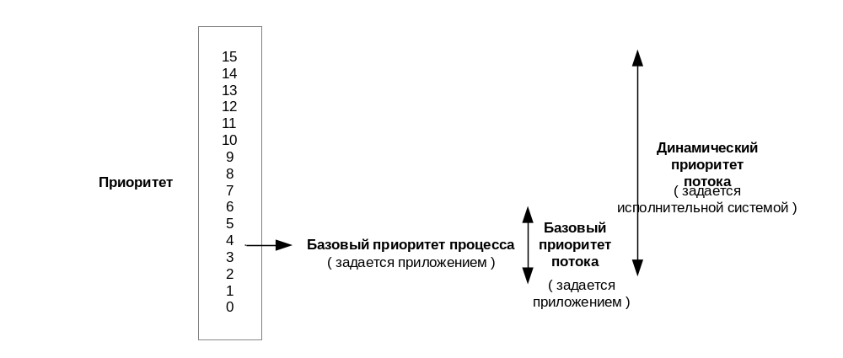
Соотношение приоритетов

Slide 50
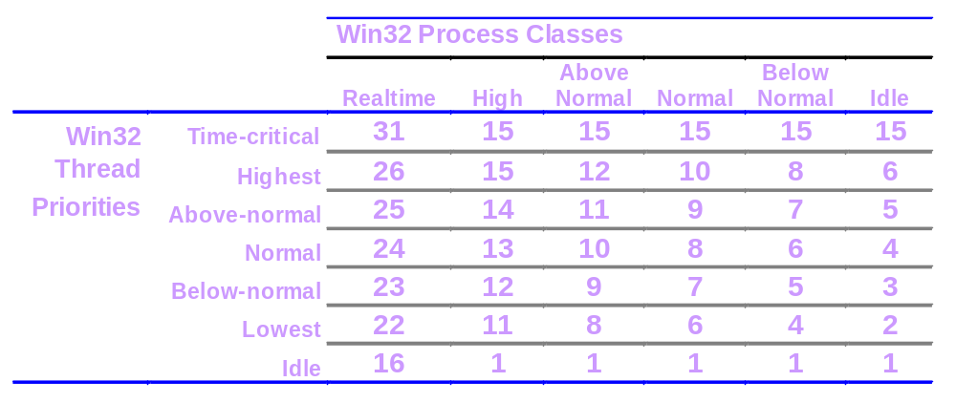
Windows vs. NT Kernel Priorities
  Table shows base priorities (“current” or “dynamic” thread priority may be higher if base is < 15)
  Many utilities (such as Process Viewer) show the “dynamic priority” of threads rather than the base (Performance Monitor can show both)
  Drivers can set to any value with KeSetPriorityThread

Slide 51
GrepMultiProcesses
Parent process
grep pattern argv[2]
argv[1], argv[2],…argv[n+1]
for(i=1;i<=N;i++)
{ StartUp.hStdOut=CreateFile(Temp[i]);
CreateProcess(grep pattern argv[i+1]);}
WaitForMultipleObjects;
for(i=1;i<=N;i++)
{ CreateProcess(cat Temp[i]);
WaitForSingleObject;}
ExitProcess;
Process1
grep pattern argv[3]
Process2
…
grep pattern argv[N+1]
ProcessN

Slide 52
GrepMultiThreads
Parent process
grep pattern argv[2]
argv[1], argv[2],…argv[n+1]
for(i=1;i<=N;i++)
{ _beginthreadex(ThGrep,&gArg[i]); }
ExitProcess;
Thread1
grep pattern argv[3]
Thread2
…
grep pattern argv[N+1]
ThreadN

