Slide 1





@RLadiesMelb
Create and publish your personal website with Blogdown
19th May 2021
Notes:
I would like to begin by acknowledging the traditional owners and custodians of the land on which we are gathered today, the Wurundjeri [wuh·ruhn·juh·ree] people of the Kulin Nation.
I would also like to pay my respects to their Elders, past and present, and Aboriginal Elders of other communities who may be here today.
CSL provides funding for events, they extended their support for drinks for some of our events
nous provides us space
(WEHI - occasional location for meetings and events)

Slide 2
Would you like to give a seminar, workshop, short talk at the R-Ladies Melbourne?

Slide 3
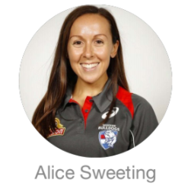
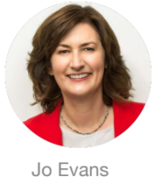
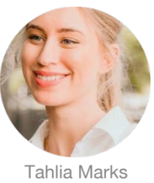
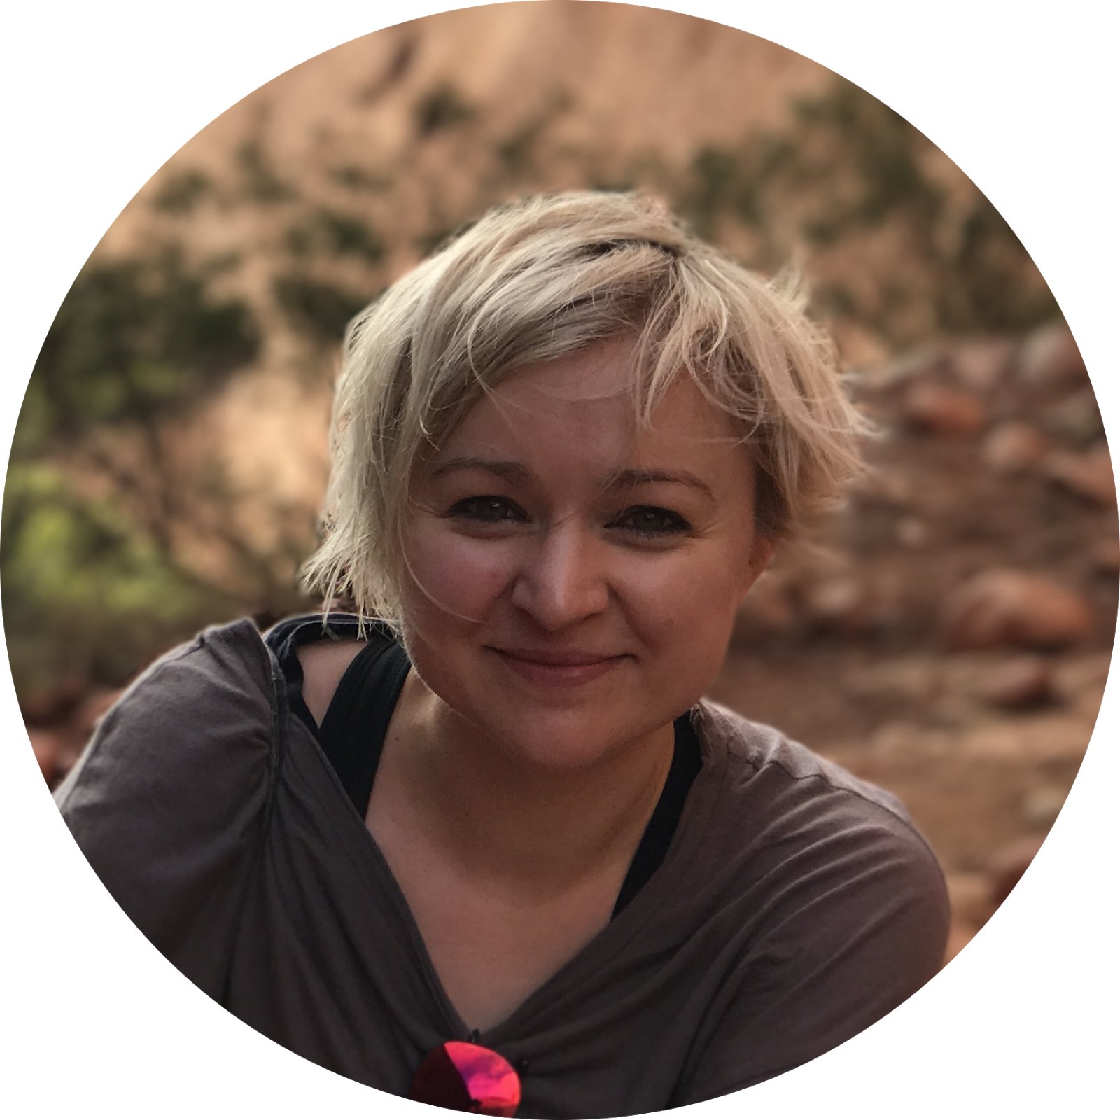
Get involved with R-Ladies Melbourne as Presenters
Notes:
Speakers from last year.
Jessica Kasza talked about her recent work in cluster trails, and work with Statistical Society of Australia (Women in Statistics).
Alice Sweeting discussed sports, data & R.
Jo Evans did a topic on public speaking and had fun exercise through zoom.
Tahlia Marks presents her work and insights around building Resume.
Also our committee members, Daidai and Anna are here today also presented in the past events.

Slide 4
Get involved with R-Ladies Melbourne as Presenters
Motivation
Getting exposure of expertise & projects
Networking, Opportunity & Collaboration
Public speaking
Support R-Ladies community

Slide 5
Get involved with R-Ladies Melbourne as
Committee Members
Motivation
Get experience organizing events
Public speaking and leadership practice and learn how a not-for-profit org runs
Bring your ideas to support and keep the R community awesome
Get to know people by being part of a diverse and inclusive committee with people from academia and industry
Exposure and networking (Hopefully we’ll be back in person soon!)
Notes:
CSL provides funding for events, they extended their support for the next Zendesk/nous provides us space and drinks for some of our events, WEHI - occasional location for meetings and events

Slide 6
Get involved with R-Ladies Melbourne as
Committee Members
Roles
Low commitment (a few hours a month for event setup and 1 hour monthly meeting)
GitHub repository maintainer - Happy to teach you if you’re new to GitHub!
Social media officer (live tweeting, promoting event)
More commitment (varies, but requires more continuous involvement)
After some exposure to the group you would be able to take roles like president, secretary, treasurer.

Slide 7
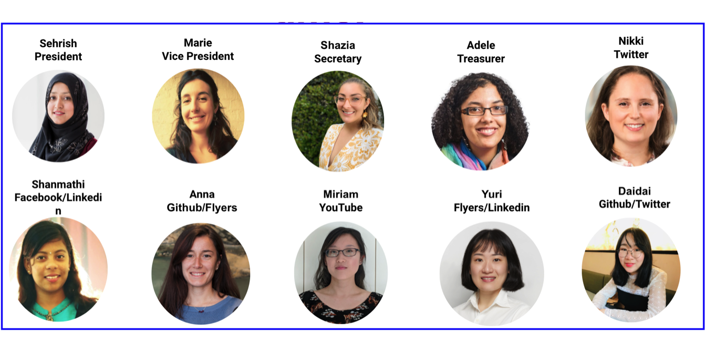
Get involved with R-Ladies Melbourne as
Committee Members

Slide 8





You can find us...
R-Ladies Melbourne
@RladiesMelb
@RladiesMelbourne

Slide 9
Join our community slack!
shorturl.at/bpyM4

Slide 10
AGM
8th June 2021
Rladies 2020 Highlights
https://skanwal.github.io/RLadiesMelbInc_2020/

Slide 11
Hello!
I am Danyang Dai
I am here because I would like to practice #blogdown with you!
@Daidaidai2014
Notes:
Danyang is a committee member and event organiser of R-Ladies Melbourne who graduated from Melbourne Uni with a Master's degree in Applied Econometrics.
She is a self-taught programmer and is passionate about programming in R. Danyang created her first personal website using Blogdown in 2018 before she know how to program in any language.
She is particularly passionate about using R to visualise and present data using R Markdown.
Danyang has taught R programming workshops at Monash Uni for the Data Visualisation and Analytics course.
She is now pursuing data analytic careers in Melbourne.

