Slide 1

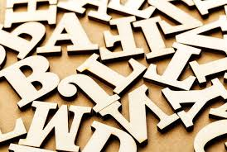
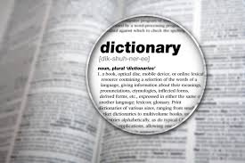


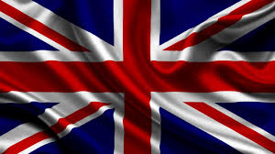

English
Borrowings

Slide 2


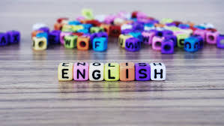
The research deals with general analysis of English language borrowings impact on contemporary Ukrainian language. It has been established, that Ukrainian language is actively absorbing lexical units from English language and the borrowing process is coming popular

Slide 3


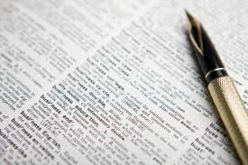
Ukrainian integration in European Union, globalization processes, commitment to West countries have caused close cultural, political, social and economic interaction of Ukraine with foreign, in particular with English-speaking, countries, that could not help reflecting on language level.

Slide 4
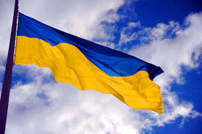
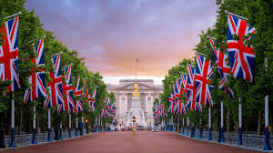

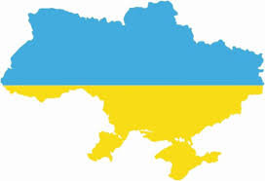
Goals and Objectives:
The aims of our research are:
to find out how deeply the English words entered the Ukrainian language
to attract the attention of teenagers to the universal significance of the English language
to stimulate interest in learning English
to promote the development of human culture

Slide 5
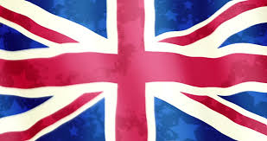
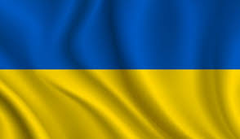
Hypotesis:
English is found everywhere: in the media, in science and technique
The percentage of its implementation in the
Ukrainian language is at least 20%. Let’s find out whether it’s right.
+
=
?

Slide 6
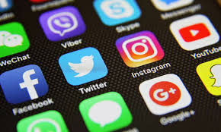


From the diagram we can see that English is used in all spheres of our life
With the help of the Internet, magazines, movies and the mass media, especially such channels as MTV, Animal Planet, CNN, and BBC…

Slide 7





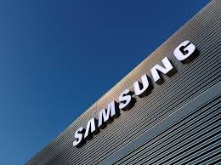



the number of English words is increasing

Slide 8



Mass Media is a source of a big number of foreign words. We can see and hear a lot of English words on TV

Slide 9
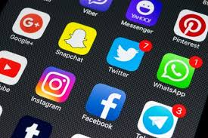
The biggest part of borrowings comes from:
the names of some channels
new kinds of programs invented in the USA and the UK
new types of films
sports programs
music programs

Slide 10
I watched the one’s day TV program of Novy Chanel and 1+1 and counted how many Ukrainian and foreign names of programs were there.

Slide 11


Every year there are more English words on TV. People watch TV every day and they do not notice how they add to their speech English words and phrases.

Slide 12



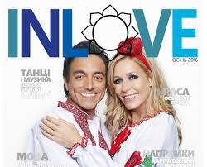
English borrowings in Ukrainian newspapers and magazines

Slide 13


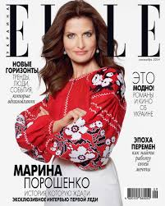
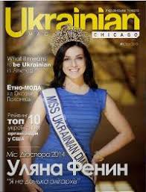

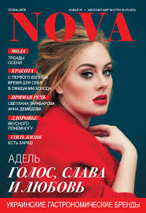
In this part of the work I :
analyzed all the magazines in Ukrainian Mass Media
identified and counted the number of English words
looked through some magazines and counted English borrowings among all of the words

Slide 14
English names in the titles of Ukranian magazines

Slide 15
The number of English borrowings in the press:
№ | The Name of Periodic Edition | All the Words | English Words | %
1 | Svit | 23567 | 364 | 1.5
2 | Svoboda | 24 358 | 183 | 0,75
3 | Korespondent | 17 815 | 134 | 0,75
 | Total: | 65740 | 681 | 3

Slide 16
We have asked the pupils of our school some questions on the topic English borrowings:
1.How often do you use English words in your speech?
2. Examples of English words in your speech
3. Where do you learn these words?

Slide 17
The Results
How often do you use English words?

Slide 18
The Results
Where do you learn the words?

Slide 19


Main spheres where considerable number of English borrowings are present have been determined. The experience of European countries regarding the process of foreign words entry regulation in various spheres of social life and the ways of original national languages retention has been analyzed

Slide 20
The range of issues raising in Ukrainian language due to the excessive use of anglicisms and americanisms has been discussed: on the one hand, language enrichment, the possibility to use borrowings to make it possible to cooperate in different spheres of society and state life and on the other hand – “the littering ” of Ukrainian language with alien words in spite of presence Ukrainian equivalents have been determined

Slide 21
It has been determined that due to time poverty to give Ukrainian names for new phenomena, processes and items Ukrainian language is bound to borrow new words from English language, which are strange for Ukrainian people and can cause loss of Ukrainian language uniqueness

