Slide 1








English
Borrowings

Slide 2
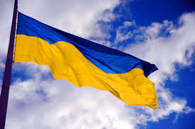



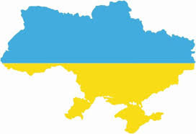
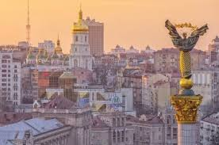

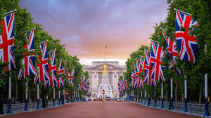
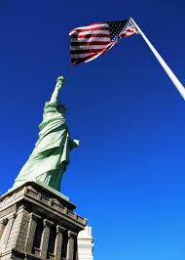

Goals and Objectives:
The aims of our research work are:
to find out how deeply the English words entered the Ukrainian language
to attract the attention of teenagers to the universal significance of the English language
to stimulate interest in learning English
to promote the development of human culture

Slide 3


Hypotesis:
English is found everywhere: in the media, in science and technique
The percentage of its implementation in the
Ukrainian language is at least 20%. Let’s find out whether it’s right.
+
=
?

Slide 4





From the diagram we can see that English is used in all spheres of our life
With the help of the Internet, magazines, movies and the mass media, especially such channels as MTV, Animal Planet, CNN, and BBC…

Slide 5





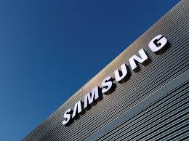



…the number of English words is increasing

Slide 6
Mass Media is a source of a big number of foreign words. We can see and hear a lot of English words on TV

Slide 7
The biggest part of borrowings comes from
the names of some channels
new kinds of programs invented in the USA and the UK
new types of films
sports programs
music programs

Slide 8
I watched the one’s day TV program of Novy Chanel and 1+1 and counted how many Ukranian and foreign names of programs were there.

Slide 9


Every year there are more English words on TV. People watch TV every day and they do not notice how they add to their speech English words and phrases.

Slide 10



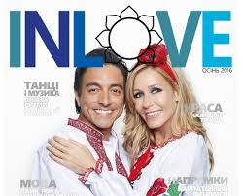
English borrowings in Russian newspapers and magazines

Slide 11


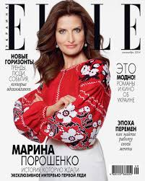
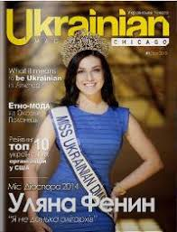


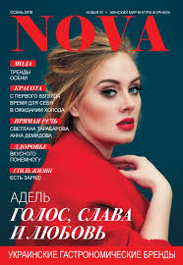
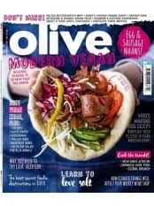
In this part of the work I should
analyzed all the magazines in Ukranian Mass Media
identified and counted the number of English words
looked through some magazines and counted English borrowings among all of the words

Slide 12
English names in the titles of Ukranian magazines

Slide 13
The number of English borrowings in the press
№№ | The Name of Periodic Edition | All the Words | English Words | %
1 | Svit | 23567 | 364 | 1.5
2 | Svoboda | 24 358 | 183 | 0,75
3 | Korespondent | 17 815 | 134 | 0,75
 | Total: | 65740 | 681 | 3

Slide 14
OutPut
Дороблюється

Slide 15
We have asked the pupils of our school some questions on the topic English borrowings:
1.How often do you use English words in your speech?
Often
Sometimes
Do not use
2. Examples of English words in your speech
3. Where do you learn these words?
TV
Magazines
Internet
Friends

Slide 16
The Results

Slide 18
Загальний Output

