Slide 1
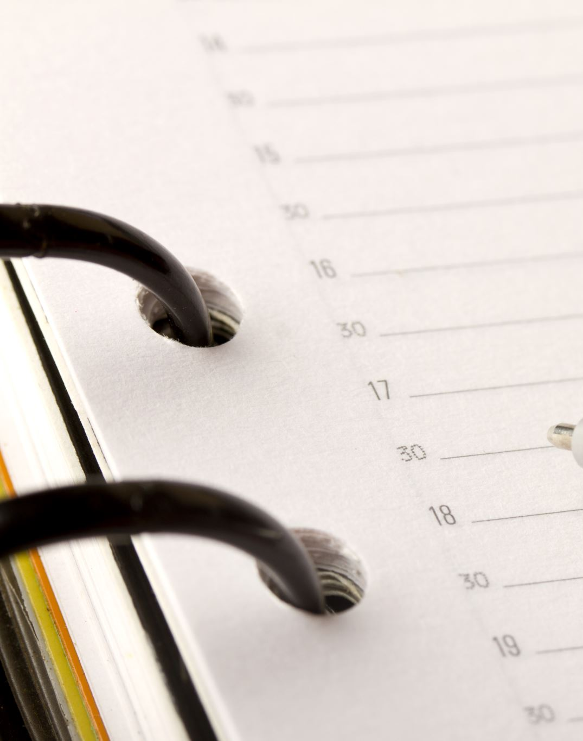
Task Scheduler
Developed and Maintained by
Danylo Piatyhorets
LinkedIn profile
GitHub profile

Slide 2
Intro
This website is crafted with user-friendliness in mind, aiming to simplify and optimize your task management. It provides a seamless experience, allowing you to effortlessly create, store, edit, complete, and delete tasks
Let’s have a look how TaskScheduler works
Detailed instructions how to install this application and run it on your machine can be found in `README.md` file, chapter “How to Use”

Slide 3
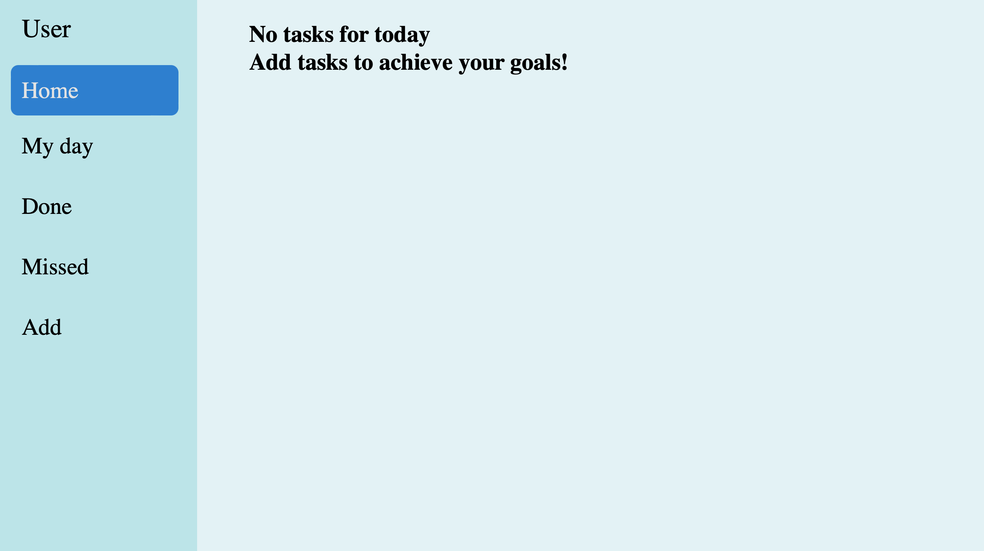
Now we are at the initial stage. There are different pages that enable you to keep your tasks organised
Let’s add our first task by clicking “Add”

Slide 4
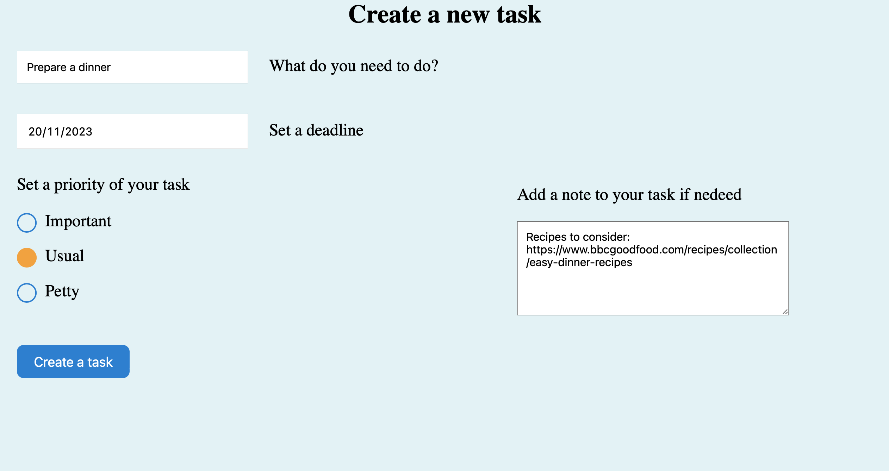
This page allows us not only to give a name to tasks but also to add:
- Deadline
- Priority
- Note (not required)
- State (hidden parameter, active by default, but you can mark it as “done” later)
Press the button!

Slide 5
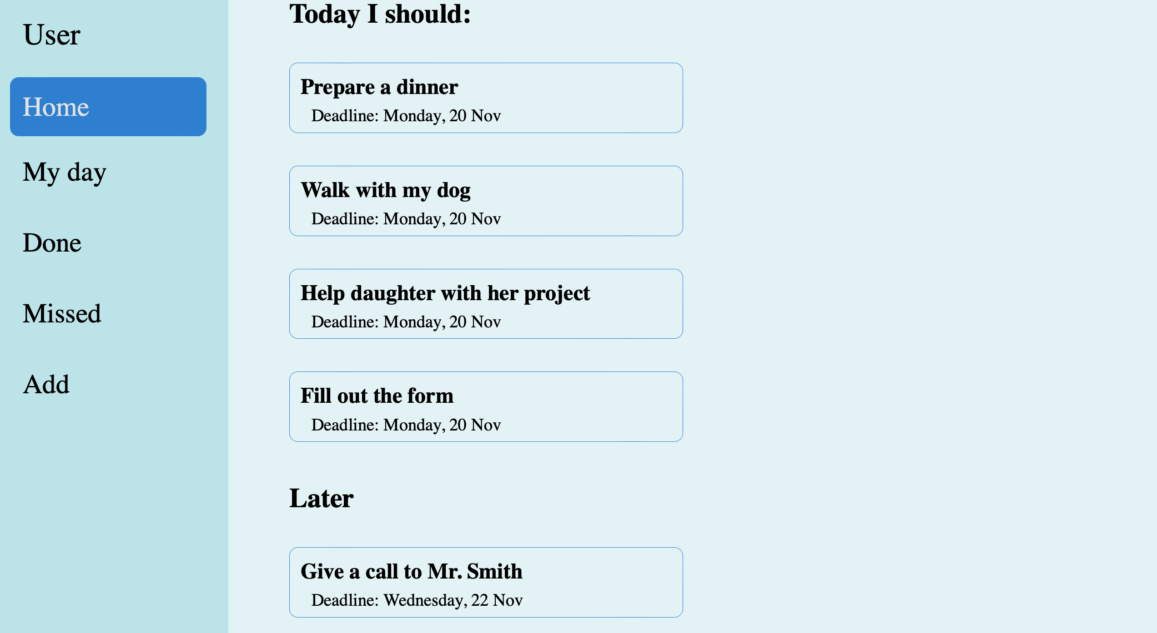
Now we’ve added our previous task “Prepare a dinner” and a few more the same way
The task we were creating on the previous slide
Tasks with today’s deadline are automatically placed in the “Today I should” section
To edit your task simply click on it and you’ll get a page shown on the next slide
Others are sorted by upcoming deadline and put into the “Later” section

Slide 6
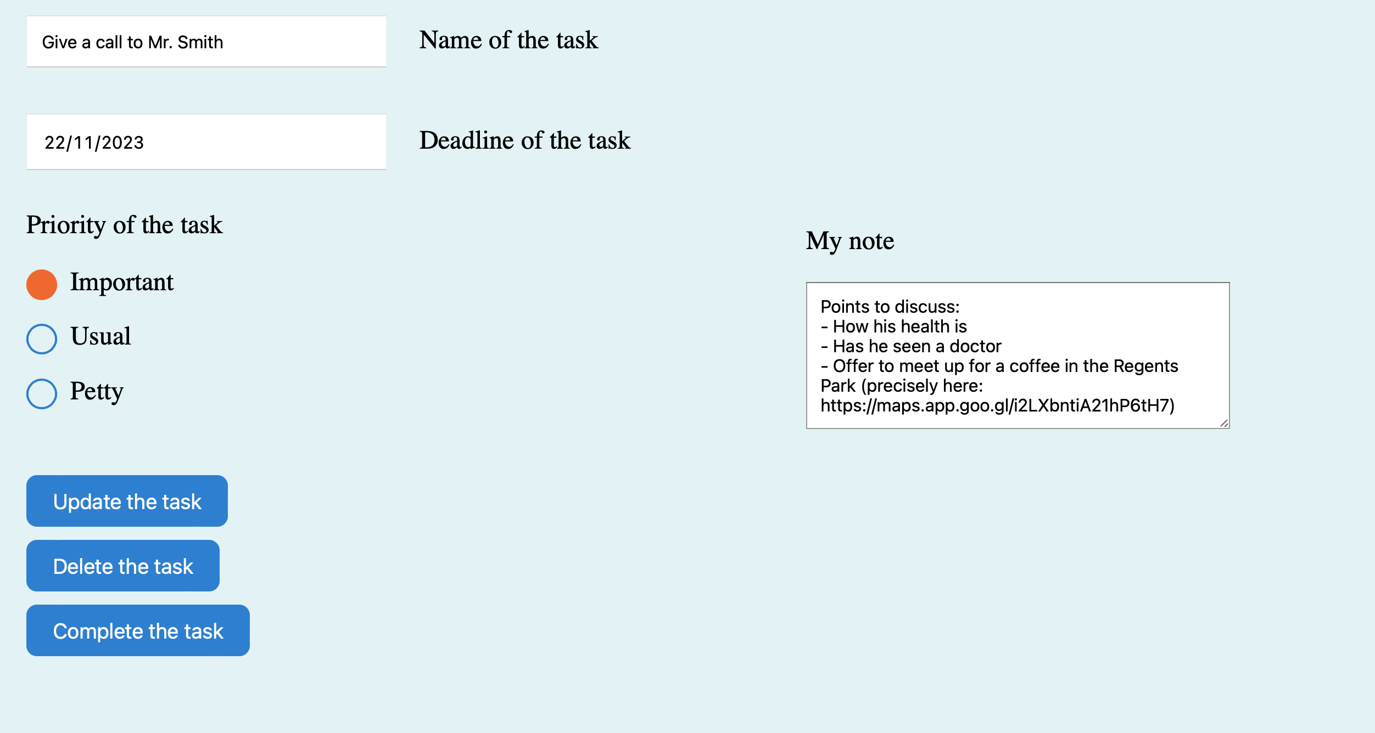
Now you can edit your task and then either update, or delete, or complete the task
If you press “Complete the task” it will be put to the “Done” section and deleted from all others
For more info see next slides

Slide 7
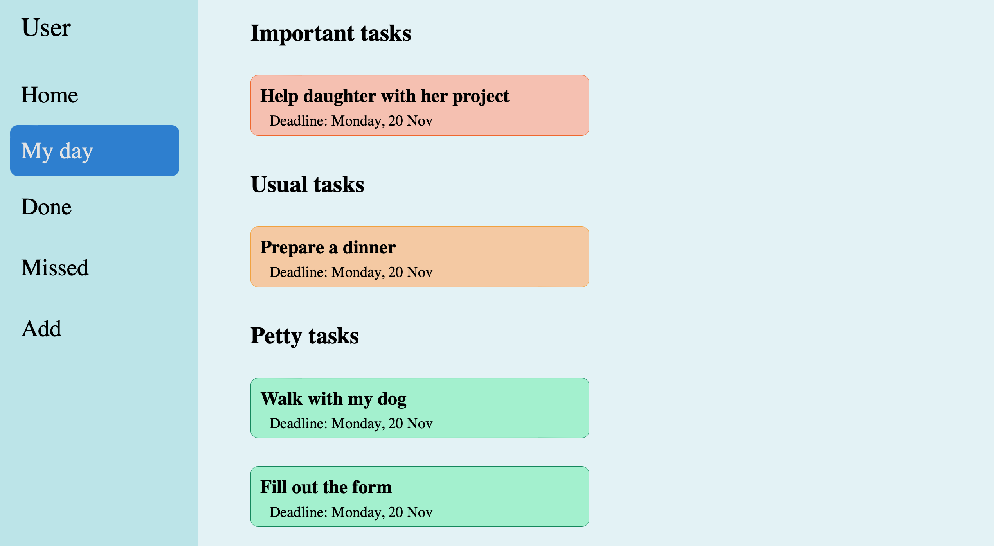
Sometimes we’ve got so many tasks that we would rather like to concentrate on important ones only for today
That's where the "My Day" section becomes incredibly useful!
For the next slide let’s imagine you’ve done this task…
All the tasks here have today’s deadline and sorted accordingly to their priorities (that were set during tasks’ creation)

Slide 8
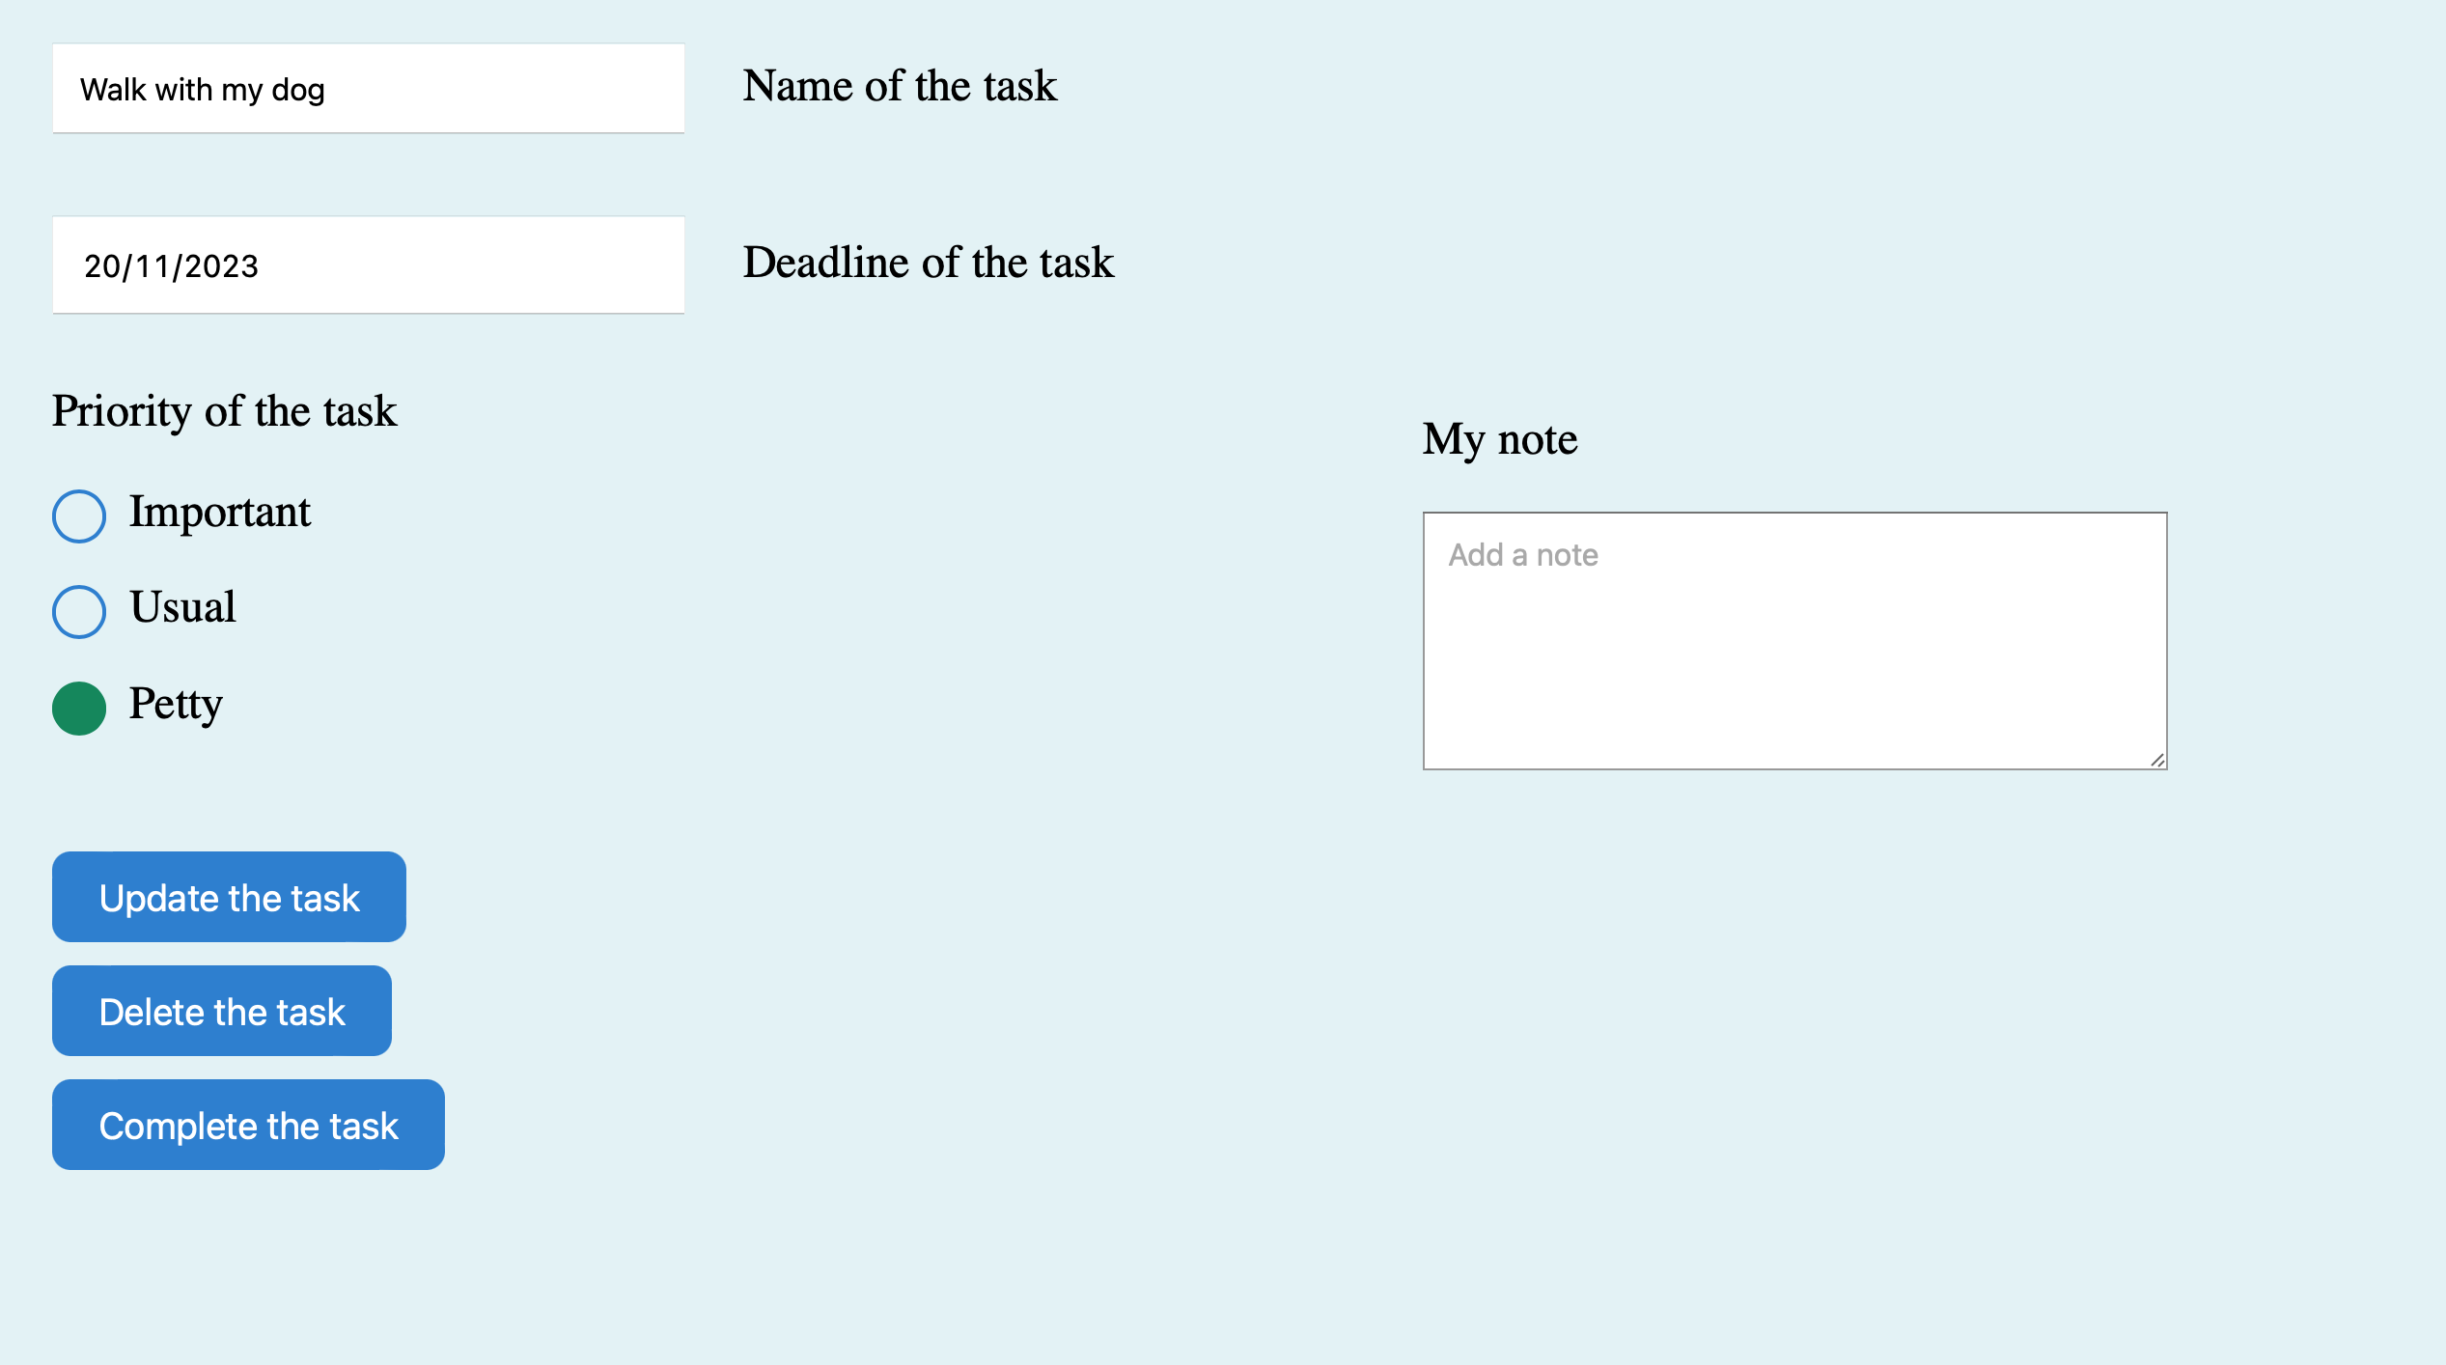
So you would like it to be removed from active tasks and placed to the “Done” section
Just press this button!

Slide 9
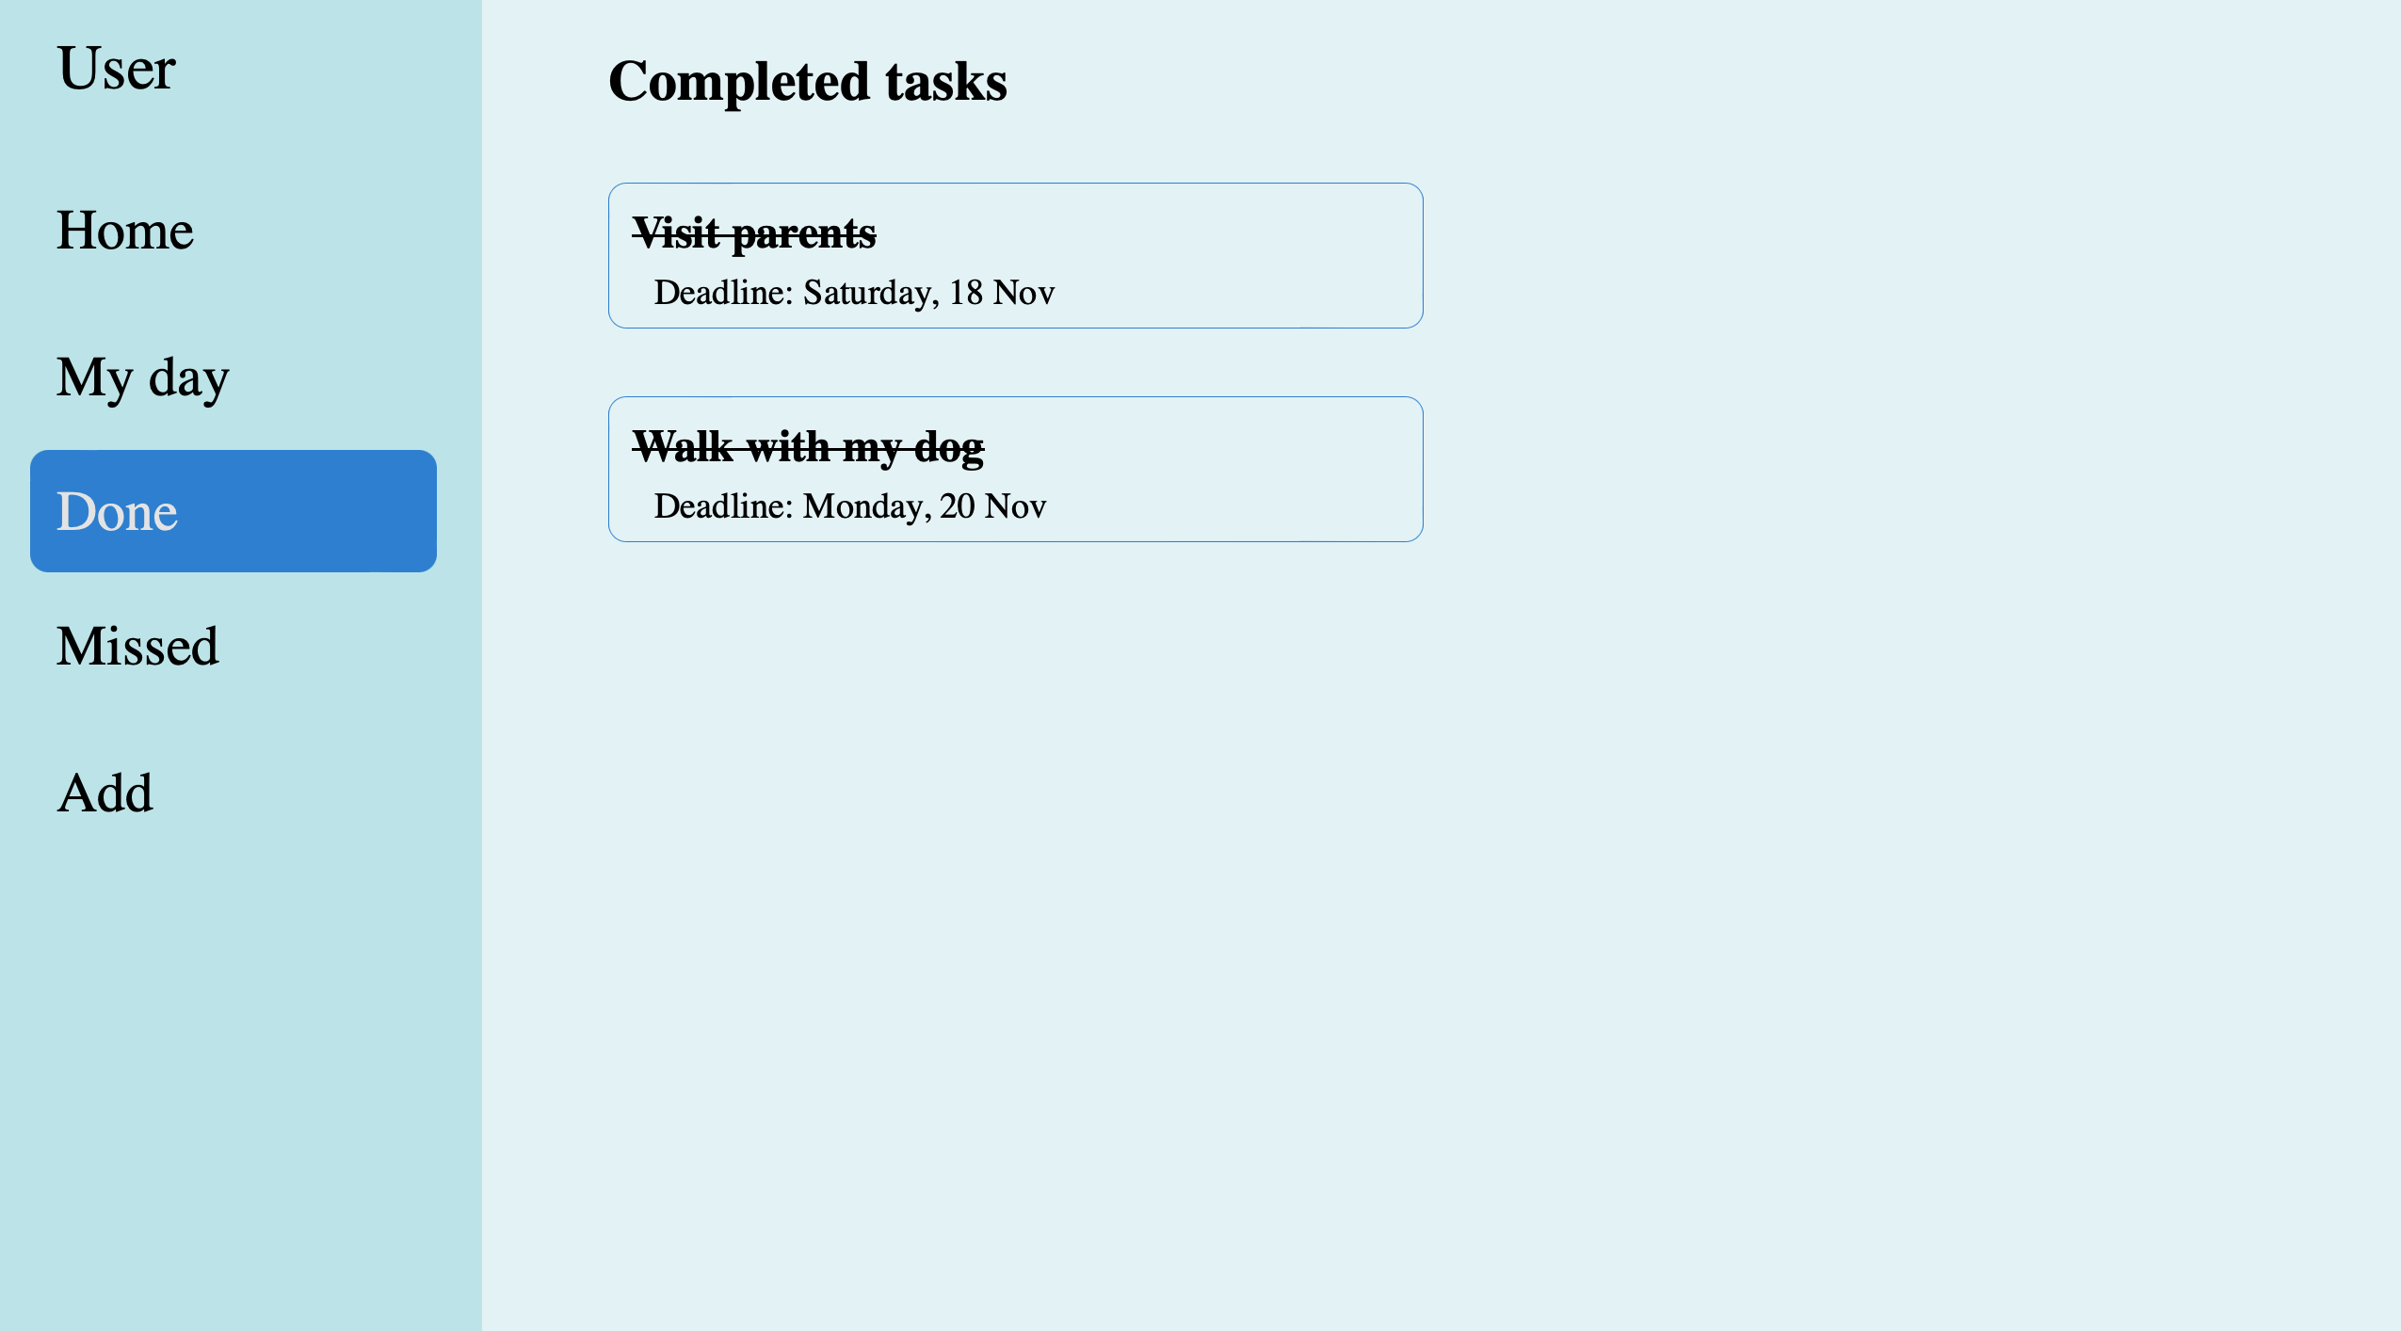
And this task will appear here, among all other done tasks

Slide 10
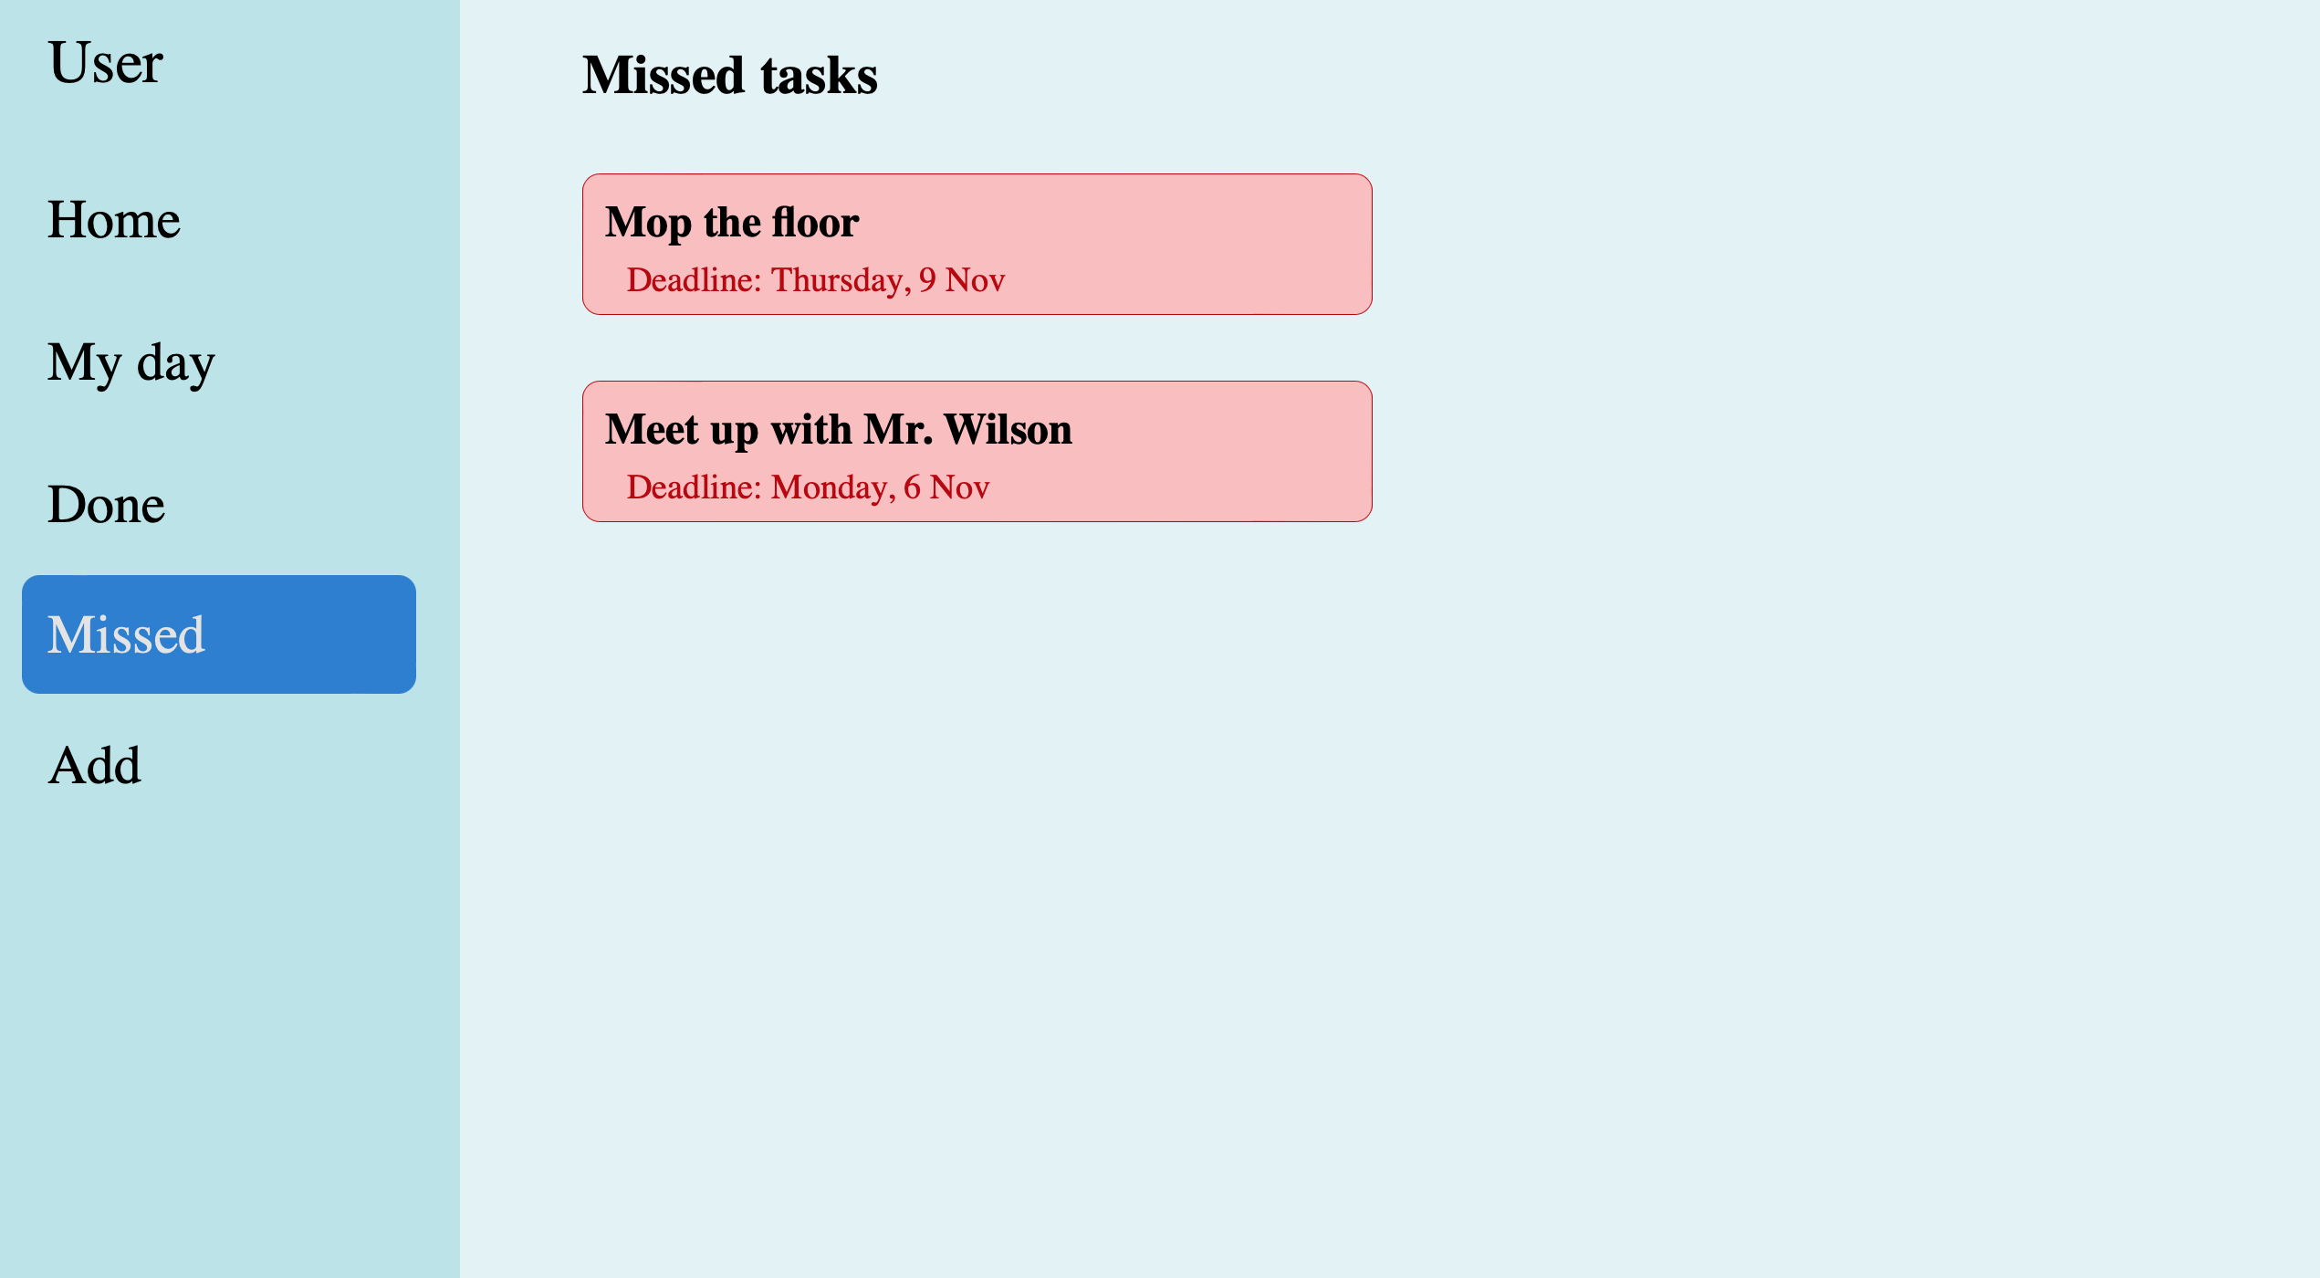
Sometimes we fail to complete all our tasks in time…
That’s where you can see your missed ones
But if Mr. Wilson doesn’t mind meeting up today, we shall edit the task and set the deadline for today

Slide 11
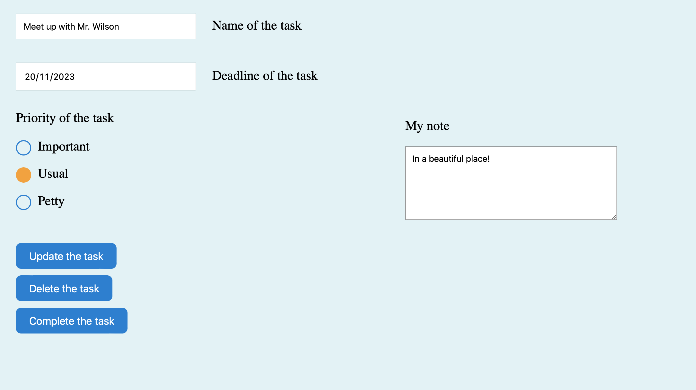
Let’s click on the task from the previous page and set a new deadline
After changing the deadline and clicking “Update the task” we will be able to see this task in the “My Day” page among other usual ones

Slide 12
Outro
That has been pretty much it for now
However, I have plans to introduce additional interesting features to enhance the project's substance and overall appeall (for more details refer to the `README.md` file, chapter “Further improvements”)
Thank you for checking out my project!

