Slide 1




if (fig == "A"): print "A"
if (fig == "A"): print "A"
Indoor Pool
Indoor Pool
50/75
50/75
Last Updated: 40 min.
Last Updated: 40 min.
Total Occupancy
174
Last Updated: 40 min.
Breakdown

Slide 2
if (fig == "A"): print "A"
90%
Indoor Pool
66%
Indoor Pool
50/75
50/75
Last Updated: 40 min.
Last Updated: 40 min.
CLOSED
Indoor Pool
Indoor Pool
50/75
0/0
Last Updated: 40 min.
Last Updated: 40 min.

Slide 3
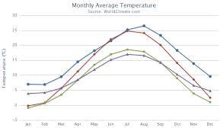
if (fig == "A"): print "A"
Events
Statistics
Indoor Pool
24 hrs
Weekday
Morning

