Slide 1





Table Extraction
Table Extraction & Few-shot Document Classification
Report date: 2025-03-28

Slide 2
Agenda
Research Status
Few-Shot Document Classification [ICDAR 2025]
Result
Table Information Extraction
Lookback
Introduction
Evaluation Metrics & Benchmark Datasets
Related Works
CascadeTSRDet - Table Structure Recognition
Run Samples by Pre-trained model

Slide 3
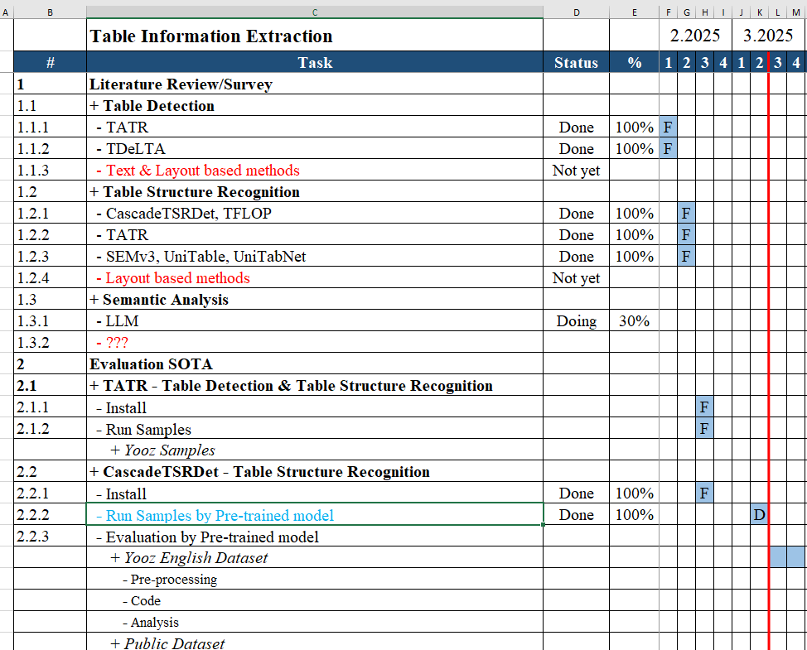
Status
Papers
Table Information Extraction
XYZ
SCL Loss
Revise manuscript - doing
CascadeTSRDet - Table Structure Recognition
Run Samples by Pre-trained model
[1] M. Khang et al., "TFLOP: Table Structure Recognition Framework with Layout Pointer Mechanism" , IJCAI 2024.
[2] B. Xiao et al., "CascadeTSRDet: Rethinking Detection Based Table Structure Recognition for Visually Rich Document Images" , Expert Systems With Applications 2025.

Slide 4
Table Information Extraction

Slide 5
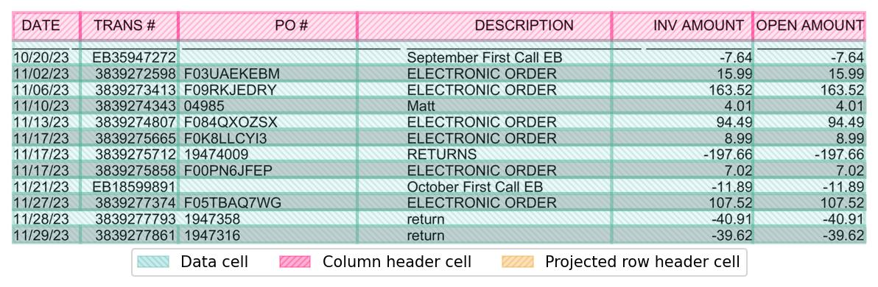
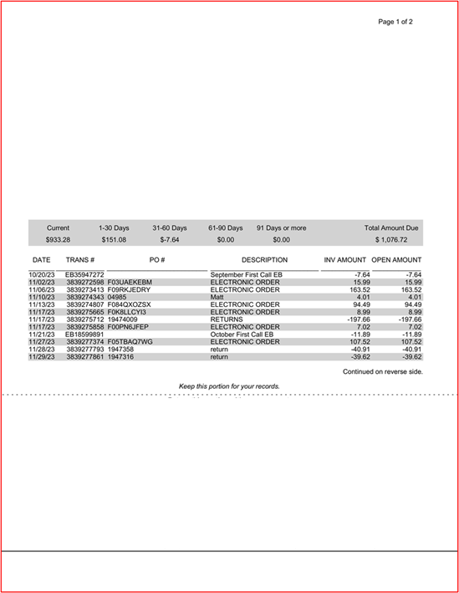
Introduction
Step 2 - Table Structure Recognition
Step 1 - Detection
JSON
Step 3 – Semantic Analysis
[ {
"DATE": "10/20/23",
"TRANS": "EB35947272",
"PO": "-",
"DESCRIPTION": "September First Call EB",
"INV_AMOUNT": -7.64,
"OPEN_AMOUNT": -7.64
},
{...}, {...}, {...}, {...}, {...}, {...} ]
returns header fields and line items as structured data.

Slide 7
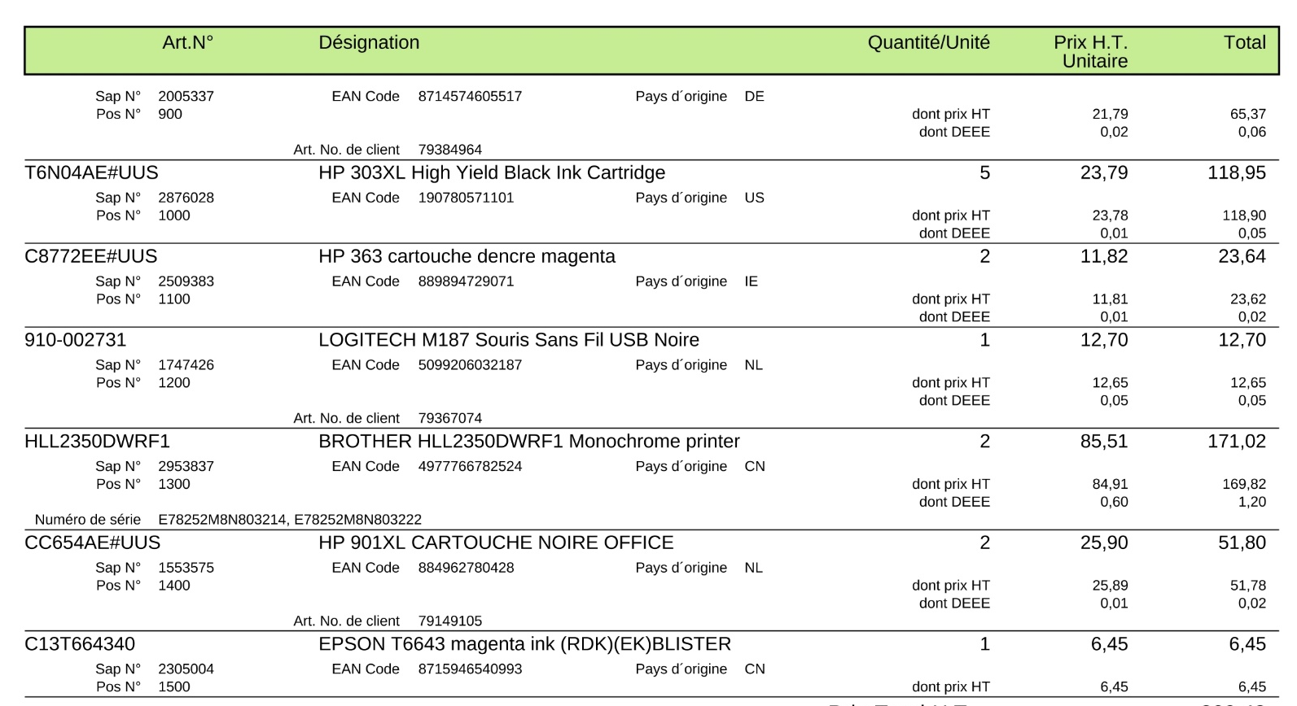

Semantic Analysis: By LLM
Column Header
Column Value
Désignation
HP 303XL High Yield Black Ink Cartridge
EAN Code 190780571101 Pays d'origine US
Extract only the product name from the text in a table, without any additional information.
LLM
JSON
[{
...
"product_name": "HP 303XL High Yield Black Ink Cartridge",
...
},
{...}, {...}, {...}, {...}, {...}, {...}]

Slide 8
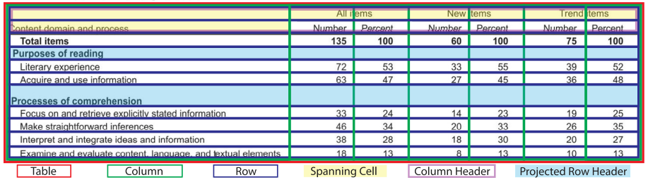
Task Definition [1]
[1] B. Xiao et al., "CascadeTSRDet: Rethinking Detection Based Table Structure Recognition for Visually Rich Document Images" , Expert Systems With Applications 2025.

Slide 9
Evaluation Metrics & Benchmark Datasets

Slide 10
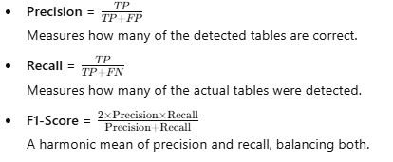

Evaluation Metrics:Table Detection
Precision, Recall, and F1-Score
Intersection over Union (IoU)
Mean Average Precision (mAP)
The average precision over multiple IoU thresholds (e.g., 0.5, 0.75).
[1] B. Smock et al., "GriTS: Grid table similarity metric for table structure recognition", ICDAR 2023.

Slide 11
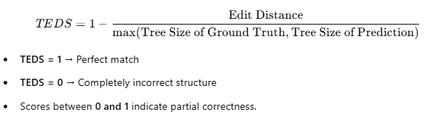
Evaluation Metrics: Table Structure Recognition
TEDS: Tree-Edit-Distance-based Similarity [1]
Convert Tables to Tree Representation
Compute Tree Edit Distance
Calculate Similarity Score
Advantages of TEDS
Structure-aware – Evaluates row/column hierarchy instead of treating tables as simple grids.
Handles merged cells – Accounts for complex structures like rowspan and colspan.
Text-sensitive – Checks if text is assigned to the correct cell.
Robust metric – Works well for both simple and complex tables.
[1] X. Zhong et al., "Image-Based Table Recognition: Data, Model, and Evaluation", ECCV 2020.

Slide 12
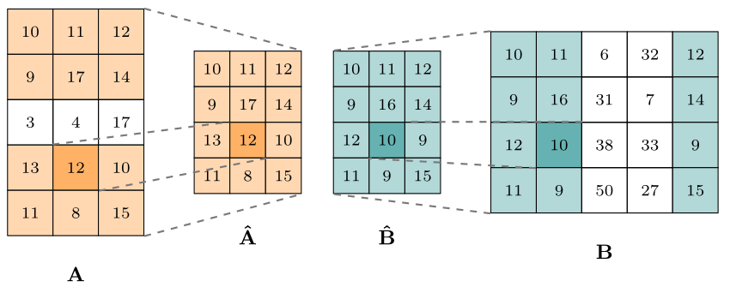

Evaluation Metrics: Table Structure Recognition
GriTS: Grid table similarity [1]
Represent Tables as Grids
Compute Cell-Level IoU (Intersection over Union)
Match Cells and Compute Similarity Score
Final GriTS Score Calculation
Key Features of GriTS
Grid-based approach – Evaluates tables as structured 2D grids, aligning well with how tables are processed.
Handles merged cells – Accounts for rowspan and colspan, making it robust for complex tables.
IoU-based matching – Provides a soft similarity score instead of strict binary correctness.
Fine-grained evaluation – Measures both structure and text correctness at the cell level.
[1] B. Smock et al., "GriTS: Grid table similarity metric for table structure recognition", ICDAR 2023.

Slide 13
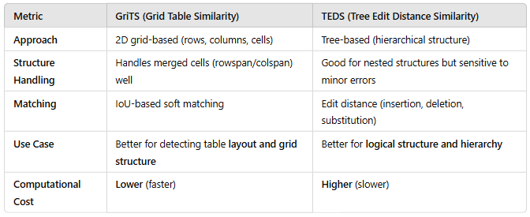
Evaluation Metrics: Table Structure Recognition
Comparison: GriTS vs. TEDS
[1] B. Smock et al., "GriTS: Grid table similarity metric for table structure recognition", ICDAR 2023.

Slide 14
Benchmark Datasets
Table Detection and Table Structure Recognition

Slide 15
Benchmark Datasets
# | Dataset | Domain | #Images | #Tables | Detection | Recognition
1 | PubTables-1M | Scientific articles | 460k | 1M | Yes | Yes
2 | FinTabNet | Financial reports | 48k | 113k | Yes | Yes
3 | ICDAR-2013 | Small expert-labeled dataset |  | 256 | Yes | Yes
4 | PubTabNet | HTML annotations of tables extracted from scientific articles. | 520k |  | ? | Yes
5 | PubLayNet | Public domain | 335k |  | Yes | No

Slide 16
Related Works
Table Detection and Table Structure Recognition

Slide 17
Related Works
Method | Table Structure Recognition |  |  |  |  | Table Detection |  |  |  | Information
 | TEDS-struc.(%) |  |  | GriTSCon |  | mAP
 | FinTabNet | PubTables1M | PubTabNet | PubTables1M | ICDAR-2013 | FinTabNet | PubTables1M | ICDAR-2013
TFLOP [1] | 99.56 |  | 98.38 |  |  |  |  |  |  | V + L + T
CascadeTSRDet [2] | 99.08 | 99.19 | 96.99 |  |  |  |  |  |  | V
SEMv3 [3] |  |  | 97.5 |  |  |  |  |  |  | V
TDeLTA [4] |  |  |  |  |  | 76.08 | 98.02 |  |  | V + L + T
UniTable [5] | 98.89 |  | 97.89 |  |  |  |  |  |  | V
UniTabNet [6] |  |  | 97.5 |  |  |  |  |  |  | V+L+T
TATR [7,8] |  |  |  | 98.5 | 98.11 |  | 97 | 88 |  | V
On a large public dataset, the accuracy of both TD and TSR is very high.
However, on the ICDAR-2013 dataset, Table Detection performs poorly.
Recently, there has been a trend of using Visual, Layout, and Text for TSR.
[1] M. Khang et al., "TFLOP: Table Structure Recognition Framework with Layout Pointer Mechanism" , IJCAI 2024.
[2] B. Xiao et al., "CascadeTSRDet: Rethinking Detection Based Table Structure Recognition for Visually Rich Document Images" , Expert Systems With Applications 2025.
[3] C. Qin et al., "SEMv3: A Fast and Robust Approach to Table Separation Line Detection", JCAI-24.
[4] Y. Fan et al., "TDeLTA: A Light-weight and Robust Table Detection Method based on Learning", AAAI 2024.
[5] S. Peng et al., "UniTable: Towards a Unified Framework for Table Recognition via Self-Supervised Pretraining", Table Representation Learning Workshop at NeurIPS 2024.
[6] Z. Zhang et al., "UniTabNet: Bridging Vision and Language Models for Enhanced Table Structure Recognition", EMNLP 2024.
[7] B. Smock et al., "PubTables-1M: Towards Comprehensive Table Extraction From Unstructured Documents ", CVPR 2022. -> TATR (Microsoft)
[8] B. Smock et al., "Aligning benchmark datasets for table structure recognition", ICDAR 2023. -> TATR (Microsoft)

Slide 18
Next Task

Slide 19
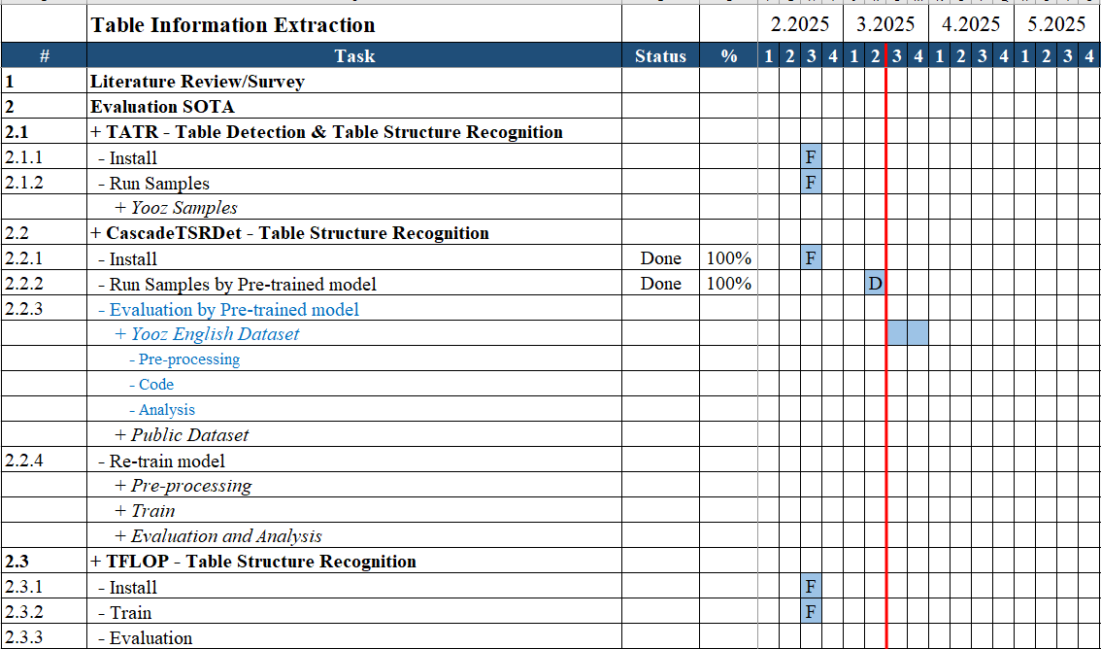
Next Task
Evaluate on Our dataset
CascadeTSRDet [2]
[1] M. Khang et al., "TFLOP: Table Structure Recognition Framework with Layout Pointer Mechanism" , IJCAI 2024.
[2] B. Xiao et al., "CascadeTSRDet: Rethinking Detection Based Table Structure Recognition for Visually Rich Document Images" , Expert Systems With Applications 2025.

Slide 20
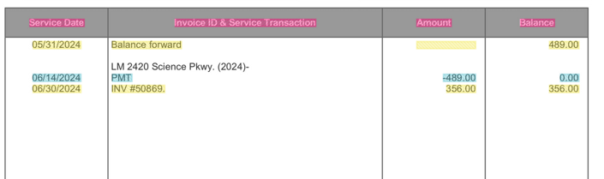
Our data
We did not label projected header
Need to do pre-processing
Maybe re-label some images
[1] B. Xiao et al., "CascadeTSRDet: Rethinking Detection Based Table Structure Recognition for Visually Rich Document Images" , Expert Systems With Applications 2025.

Slide 21

THANK YOU

