Slide 1
League of Legends Champion Stats
By: Jared Giampietro
Jim Nguyen

Slide 2
Description
Our project is showing League of Legends champion statistics to the user
The user will log into the website, if the user does not have an account, they must register for one.
Then the user will pick among x champion
Once x champion is selected, the user will be redirected to that champion page with all their stats
The admin will log into the website using their admin account
With the admin account, it grants them permission to insert new data, modify existing data or delete existing data.

Slide 3

UML Case Diagram
Notes:
Input data and modify data, UML diagram has equivalence of ERD diagram
Needs 6 entities, 6 relationships, 2 of which have to be many to many
For all use cases, need text explaining them
This can be seen in the slide before
Could make admin role to change data
User logs in, checks if admin or not
Admin has all permissions
User only has permission to view data
Think we have added that into our new UML Diagram
Reference Image: https://www.google.com/search?q=uml+case+diagram&sxsrf=AOaemvJZUiEL3Q09WUxzRWMyk7ejtyAyPA:1634263682871&source=lnms&tbm=isch&sa=X&ved=2ahUKEwiMlqXSqsvzAhXlHDQIHdMcCS4Q_AUoAXoECAIQAw&biw=1920&bih=941&dpr=1#imgrc=QqxPxhZnjk6UQM

Slide 4
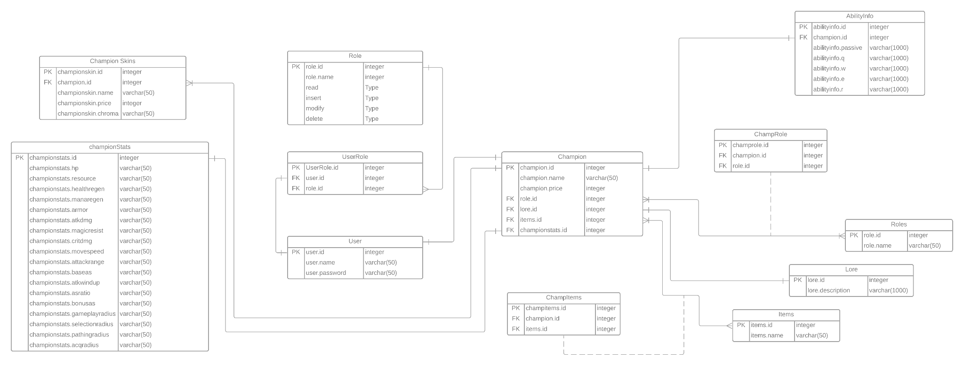
E/R Diagram & Schema
Notes:
Talk about what table represents and how its being used/linked
Let user pick what item champion has
That lets them modify champion data
We just allowing the admin user to modify any champion data instead of just what item a champion has

Slide 5
Thank you!
Any Questions?

Slide 6
Works Cited
https://www.google.com/search?q=uml+case+diagram&sxsrf=AOaemvJZUiEL3Q09WUxzRWMyk7ejtyAyPA:1634263682871&source=lnms&tbm=isch&sa=X&ved=2ahUKEwiMlqXSqsvzAhXlHDQIHdMcCS4Q_AUoAXoECAIQAw&biw=1920&bih=941&dpr=1#imgrc=QqxPxhZnjk6UQM
https://www.youtube.com/watch?v=zid-MVo7M-E
https://www.youtube.com/watch?v=QpdhBUYk7Kk
https://www.youtube.com/watch?v=-CuY5ADwn24

