Slide 2
+
Photon Scattering Rate
Applied Laser Frequency
+
Resonant Frequency

Slide 3
+
+

Slide 4
+
Stay still

Slide 5
+
Moving Right

Slide 6
+
Moving Left

Slide 7
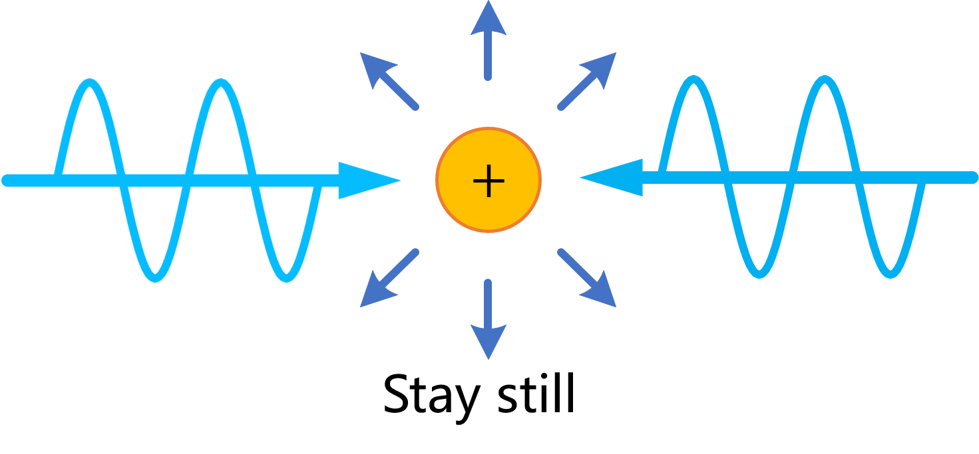
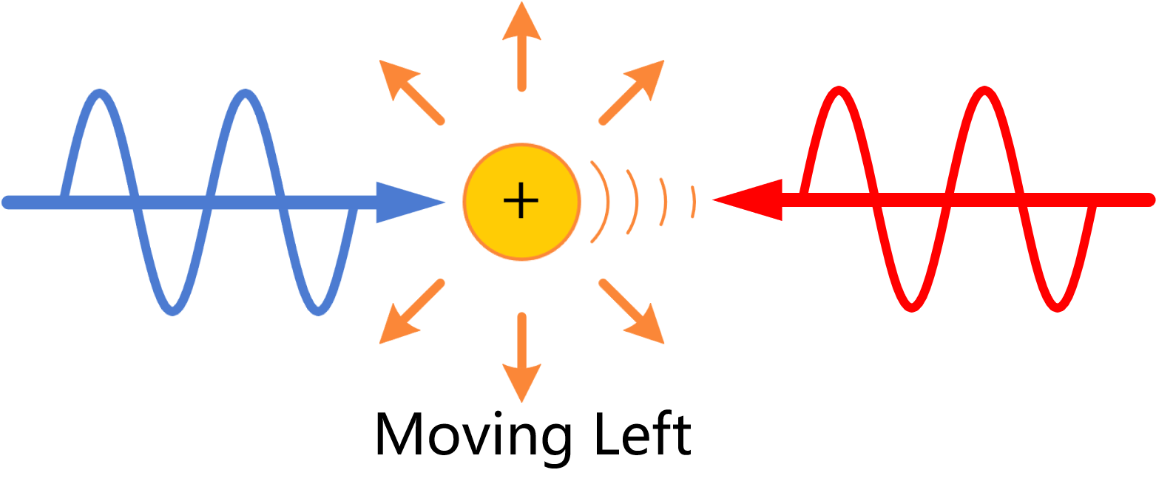
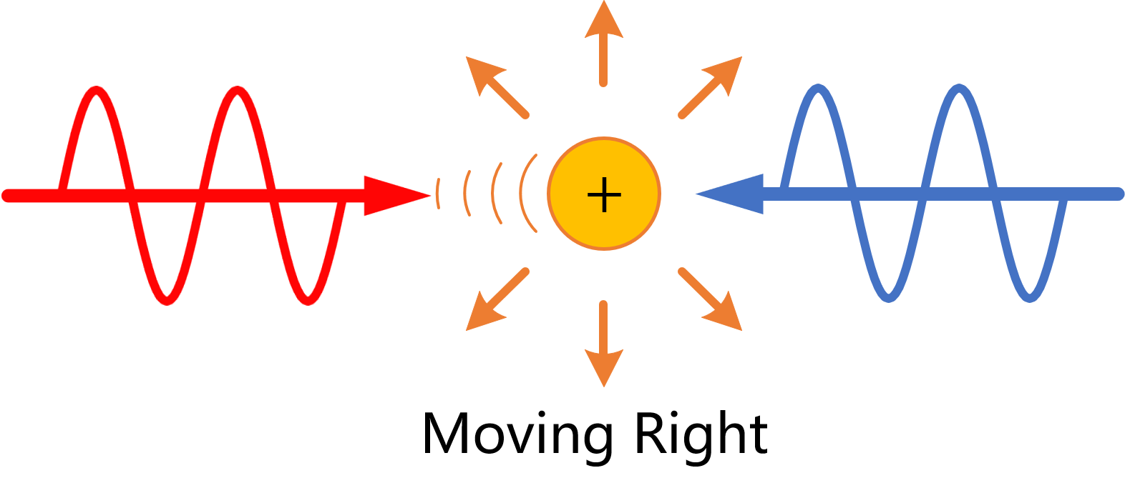

Slide 8
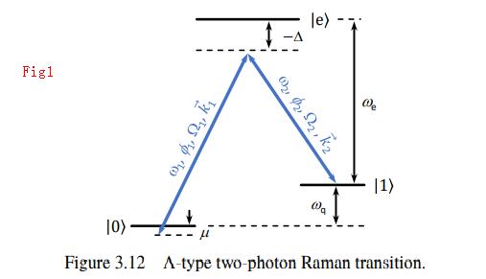



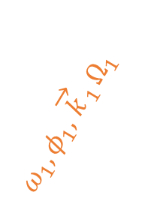
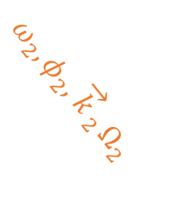




$$\left|e\right\rangle$$
$$−Δ≫Ω_{1}, Ω_{2}$$
$$ω_{e}$$
$$ω_{2},φ_{2},{\overset{→}{k}}_{2}Ω_{2}$$
$$ω_{1},φ_{1},{\overset{→}{k}}_{1}Ω_{1}$$
$$\left|1\right\rangle$$
$$ω_{q}$$
$$\left|0\right\rangle$$
$$μ$$

Slide 9
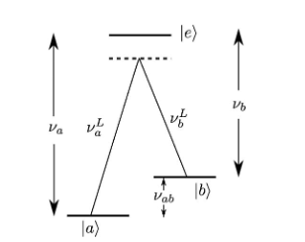






$$\left|e\right\rangle$$
$$ν_{a}$$
$$ν_{b}^{L}$$
$$ν_{a}^{L}$$
$$\left|b\right\rangle$$
$$ν_{ab}$$
$$\left|a\right\rangle$$

Slide 10
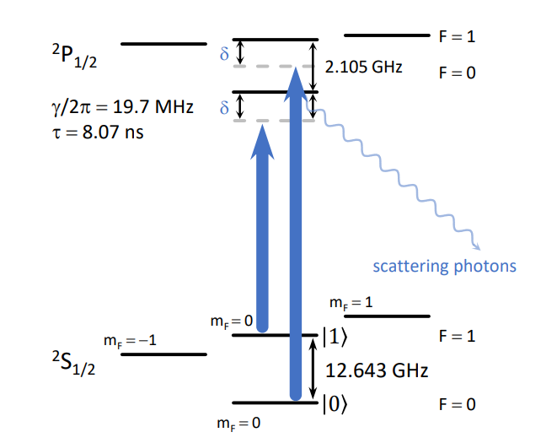














$${}_{}^{2}{P_{1/2}}$$
$$δ$$
$$F=1$$
$$2.105GHz$$
$$δ$$
$$F=0$$
Scattering Photons
$$m_{F}=1$$
$$m_{F}=0$$
$$m_{F}=−1$$
$$|1⟩$$
$$F=1$$
$${}_{}^{2}{S_{1/2}}$$
$$12.643GHz$$
$$|0⟩$$
$$F=0$$
$$m_{F}=0$$

Slide 11
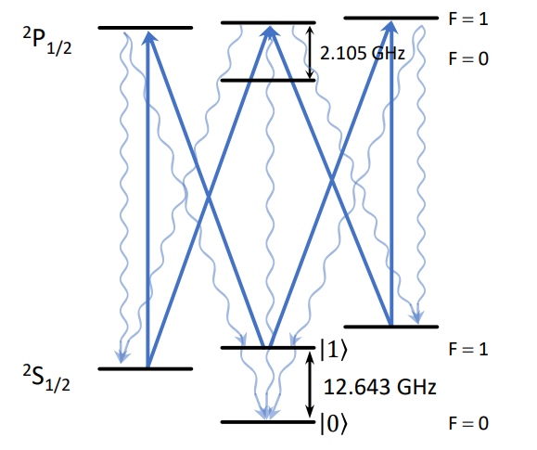
$${}_{}^{2}{P_{1/2}}$$
$$F=1$$
$$2.105GHz$$
$$F=0$$
$$m_{F}=1$$
$$m_{F}=0$$
$$m_{F}=−1$$
$$|1⟩$$
$$F=1$$
$${}_{}^{2}{S_{1/2}}$$
$$12.643GHz$$
$$|0⟩$$
$$F=0$$
$$m_{F}=0$$

Slide 12
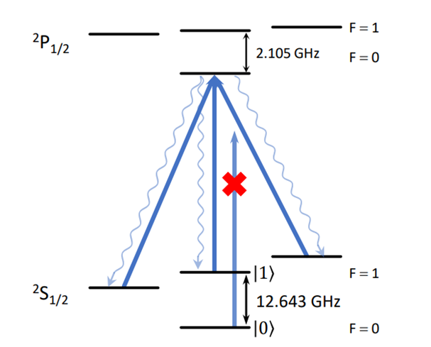
$${}_{}^{2}{P_{1/2}}$$
$$F=1$$
$$2.105GHz$$
$$F=0$$
$$m_{F}=1$$
$$m_{F}=0$$
$$m_{F}=−1$$
$$|1⟩$$
$$F=1$$
$${}_{}^{2}{S_{1/2}}$$
$$12.643GHz$$
$$|0⟩$$
$$F=0$$
$$m_{F}=0$$

Slide 13



$${}_{}^{2}{P_{1/2}}$$
$$F=1$$
$$2.105GHz$$
$$F=0$$
$$m_{F}=1$$
$$m_{F}=0$$
$$m_{F}=−1$$
$$|1⟩$$
$$F=1$$
$${}_{}^{2}{S_{1/2}}$$
$$12.643GHz$$
$$|0⟩$$
$$F=0$$
$$m_{F}=0$$

Slide 14
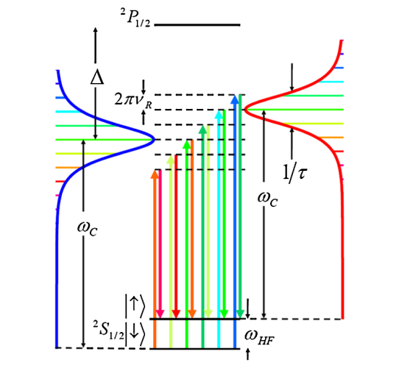










$${}_{}^{2}{P_{1/2}}$$
$$Δ$$
$$ω_{R}$$
$$1/τ$$
$$ω_{0}$$
$$ω_{0}$$
$$|1⟩$$
$$ω_{q}$$
$${}_{}^{2}{S_{1/2}}$$
$$|0⟩$$

Slide 15
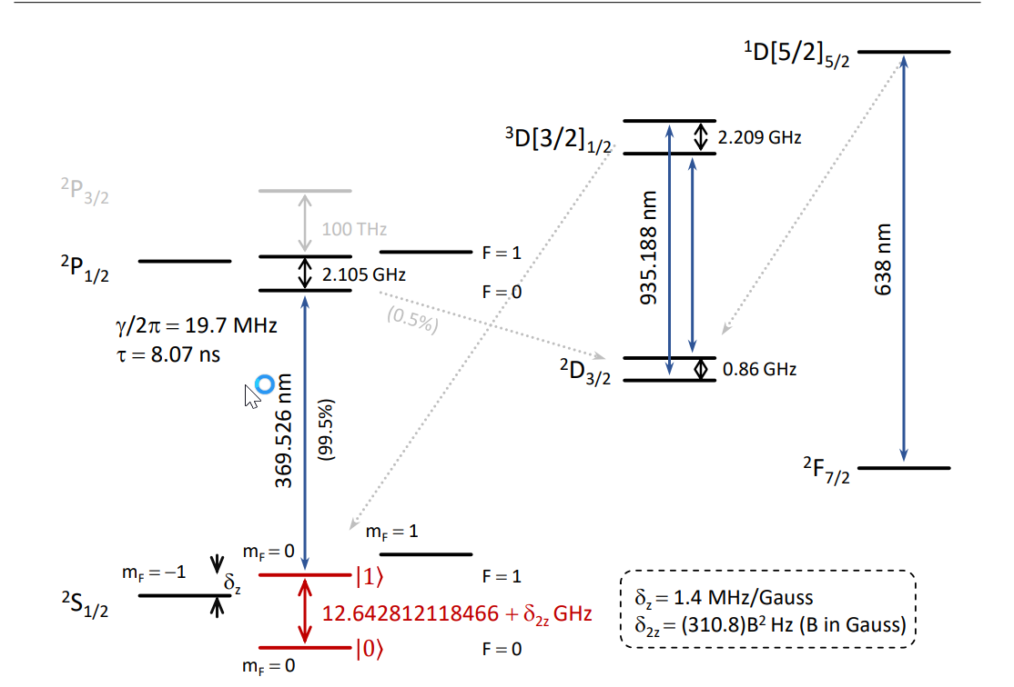




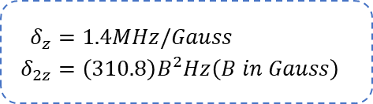


















$${}_{}^{1}{{D[5/2]}_{5/2}}$$
$${}_{}^{2}{P_{3/2}}$$
$$638 nm$$
$$100THz$$
$${}_{}^{3}{{D[3/2]}_{1/2}}$$
$$2.209GHz$$
$${}_{}^{2}{P_{1/2}}$$
$$F=1$$
$$2.105GHz$$
$$935.188 nm$$
$$F=0$$
$${}_{}^{2}{F_{7/2}}$$
$${}_{}^{2}{D_{3/2}}$$
$$0.86GHz$$
$$γ/2π=19.7MHz$$
$$τ=8.07ns$$
$$369.526 nm$$
$$m_{F}=1$$
$$m_{F}=0$$
$$m_{F}=−1$$
$$δ_{z}$$
$$|1⟩$$
$$F=1$$
$$\begin{aligned}δ_{z}&=1.4MHz/Gauss \\ δ_{2z}&=\left(310.8\right)B^{2}Hz\left(B in Gauss\right)\#\end{aligned}$$
$${}_{}^{2}{S_{1/2}}$$
$$12.643+δ_{2z} GHz$$
$$|0⟩$$
$$F=0$$
$$m_{F}=0$$

Slide 16
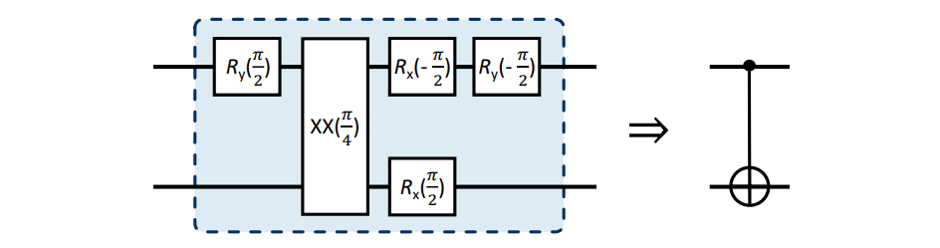





$$R_{y}\left(\frac{π}{2}\right)$$
$$XX\left(\frac{π}{4}\right)$$
$$R_{x}\left(−\frac{π}{2}\right)$$
$$R_{y}\left(−\frac{π}{2}\right)$$
$$R_{y}\left(\frac{π}{2}\right)$$

Slide 18
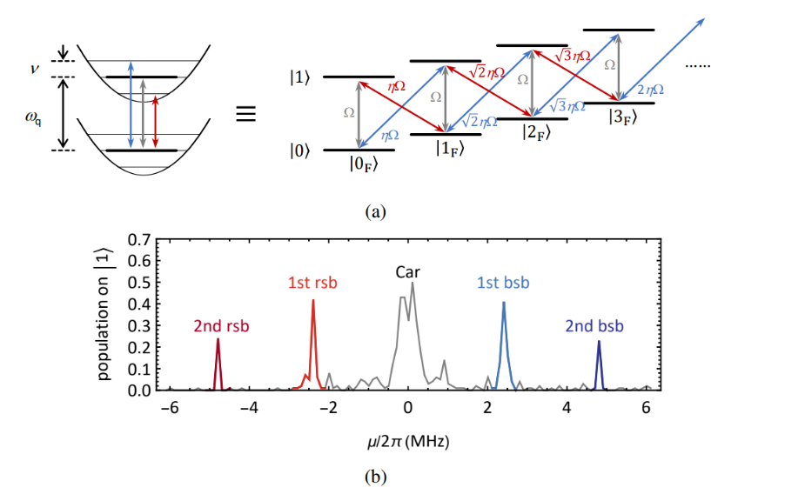





























$$ηΩ$$
…
$$|1⟩$$
$$ηΩ$$
$$Ω$$
$$ηΩ$$
$$Ω$$
$$Ω$$
$$ηΩ$$
$$ηΩ$$
$$|2_{F}⟩$$
$$|0⟩$$
$$ηΩ$$
$$|1_{F}⟩$$
$$|0_{F}⟩$$
$$ν$$
$$ηΩ$$
$$ηΩ$$
…
$$ν$$
$$|1⟩$$
$$Ω$$
$$ηΩ$$
$$Ω$$
$$Ω$$
$$ηΩ$$
$$ηΩ$$
$$|2_{F}⟩$$
$$ηΩ$$
$$|1_{F}⟩$$
$$|0⟩$$
$$|0_{F}⟩$$

