Slide 1
Mastering Data Structures and Algorithms: A Practical Approach
Priority Queues, Hashing
By Dr. Juan C. Gomez
Fall 2018

Slide 2
Overview
Hashing
  Hash Function
  Rehashing
  Universal Hashing
  Extendible Hashing
  Examples

Slide 3
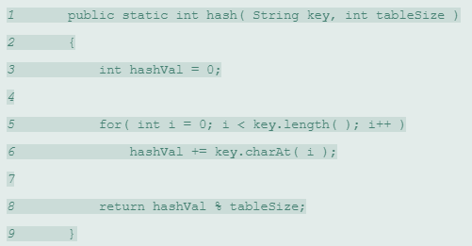
Hashing: Hash Function

Slide 4
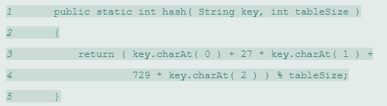
Hashing: Hash Function

Slide 5
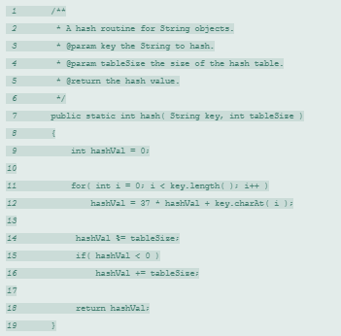
Hashing: Hash Function

Slide 6
Hashing: Rehashing
When:
  load factor is too large. N/TableSize
  insertion fails to find spot for new entry.
How:
  Double size and reinsert N entries as they will map to different spaces.
Cost:
  Amortized: only needed when there are O(N) entries and takes O(N) so add constant time only.

Slide 7
Hashing: Examples
Find whether an array is subset of another array
Union and Intersection of two Linked Lists
Given an array A[] and a number x, check for pair in A[] with sum as x
Find four elements a, b, c and d in an array such that a+b = c+d
Count distinct elements in every window of size k

