Slide 1
Mastering Data Structures and Algorithms: A Practical Approach
Sorting and Searching
By Dr. Juan C. Gomez
Fall 2018

Slide 2
Overview
Common Sorting Algorithms
  Bubble Sort
  Selection Sort
  Insertion Sort
  Shell Sort
  Merge Sort
  Quick Sort
  Heap Sort
  Linear Sort
    Bucket Sort
    Radix Sort

Slide 3
Overview
External Sorting
Searching Algorithms
  Binary Search
Sample Problems

Slide 4
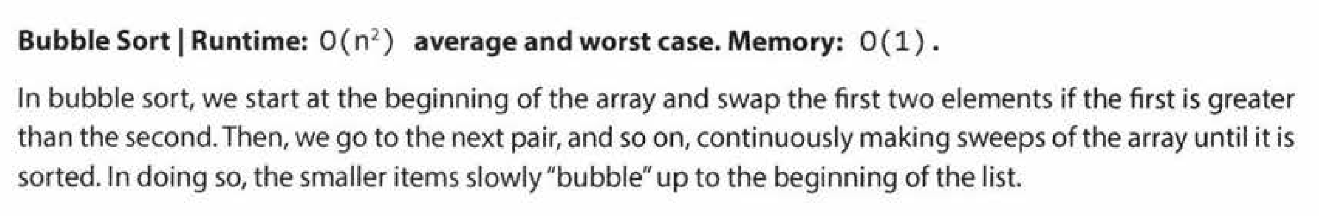
Bubble Sort

Slide 5
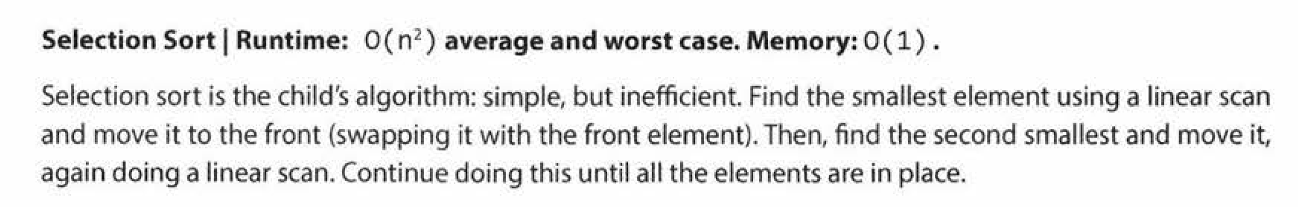
Selection Sort

Slide 6
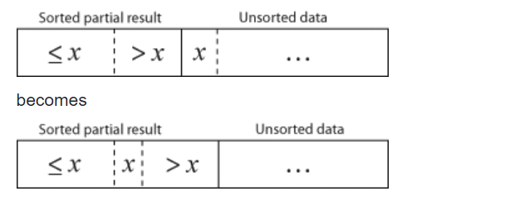
Insertion Sort

Slide 7
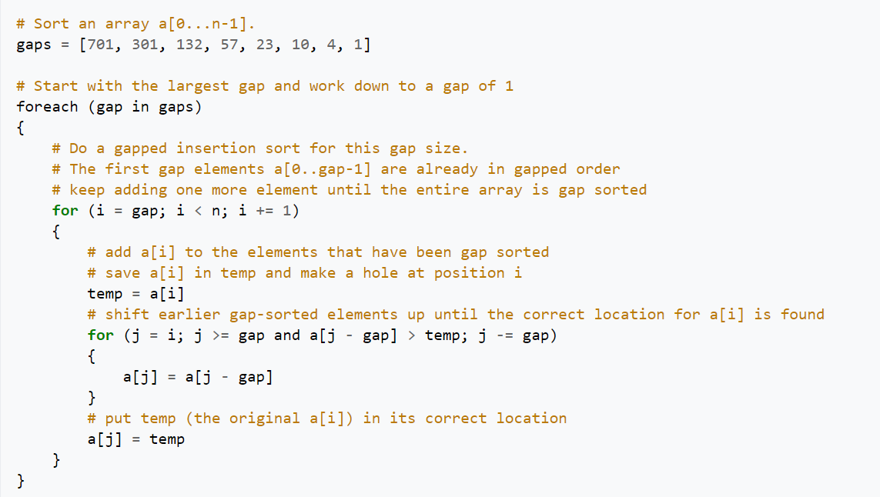
Shell Sort

Slide 8
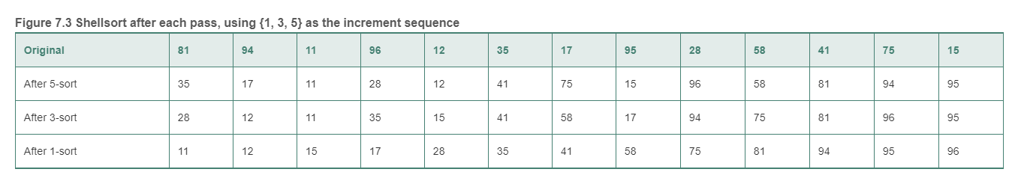
Shell Sort

Slide 9
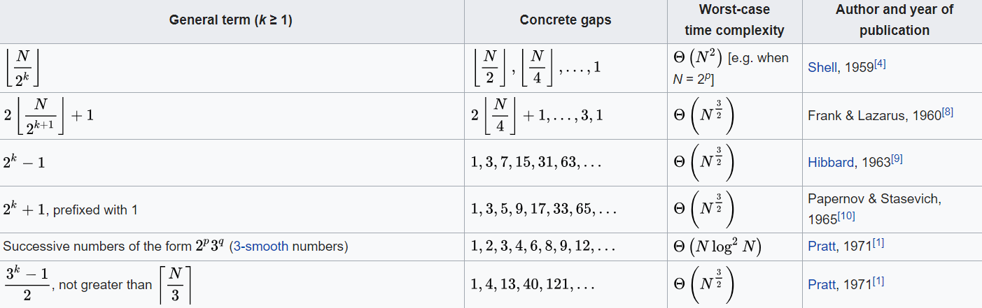
Shell Sort

Slide 10
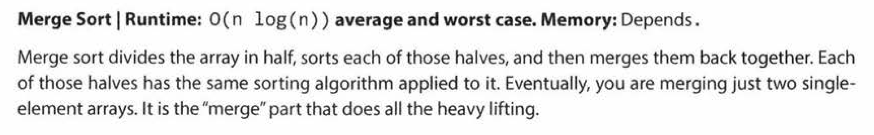
Merge Sort

Slide 11
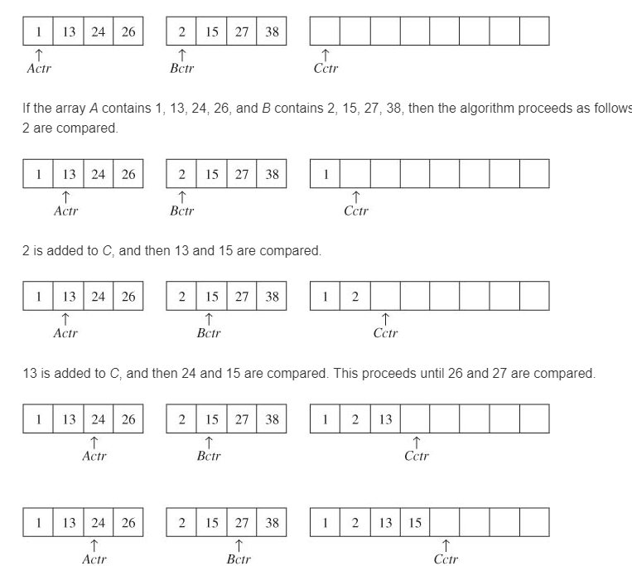
Merge Sort

Slide 12
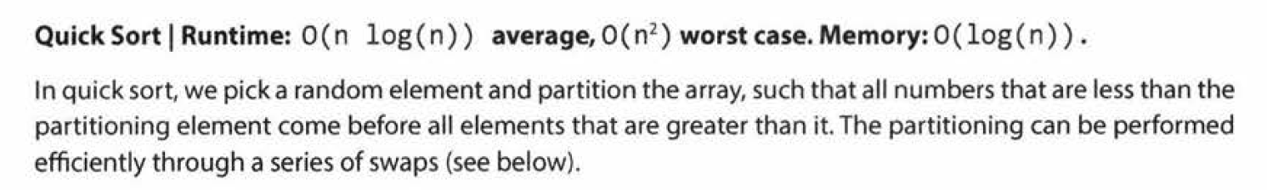
Quick Sort

Slide 13
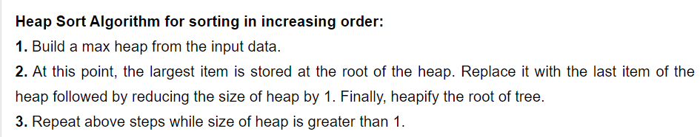
Heap Sort

Slide 14
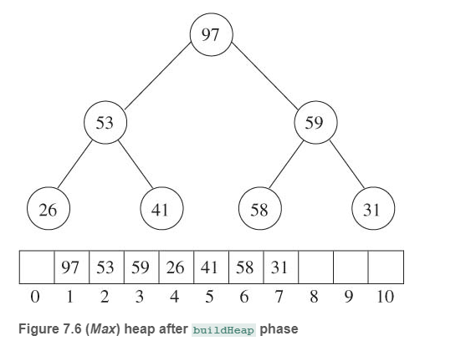
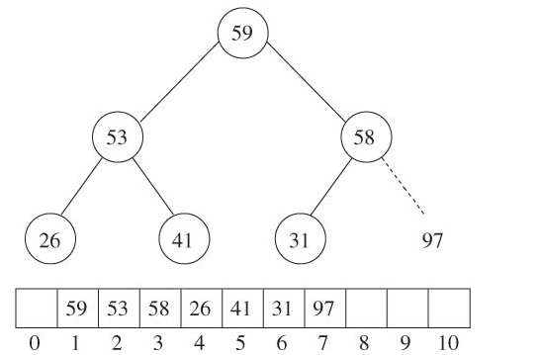
Heap Sort

Slide 15
Bucket Sort

Slide 16
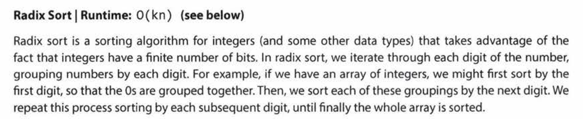
Radix Sort

Slide 17
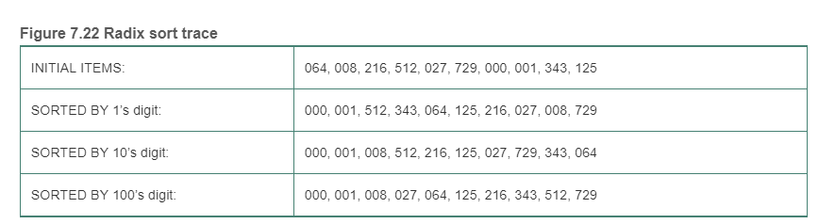
Radix Sort

Slide 18
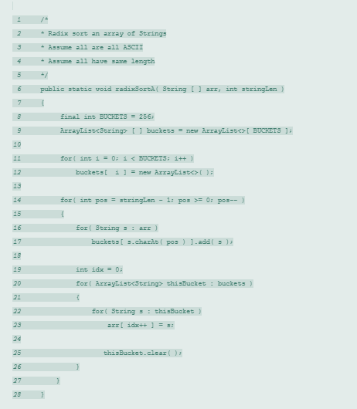
Radix Sort

Slide 19
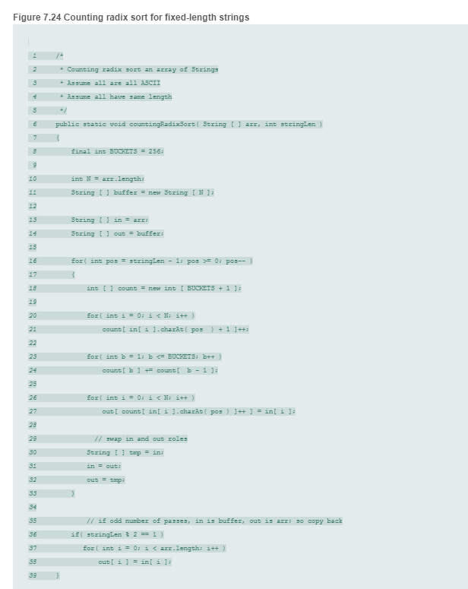
Radix Sort

Slide 20
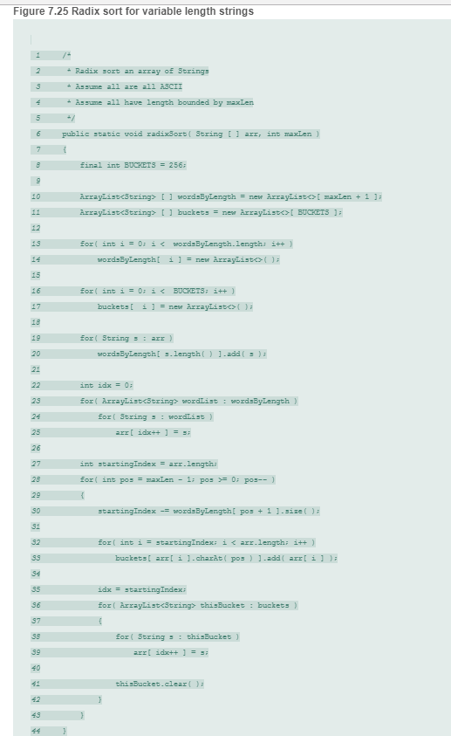
Radix Sort

Slide 21
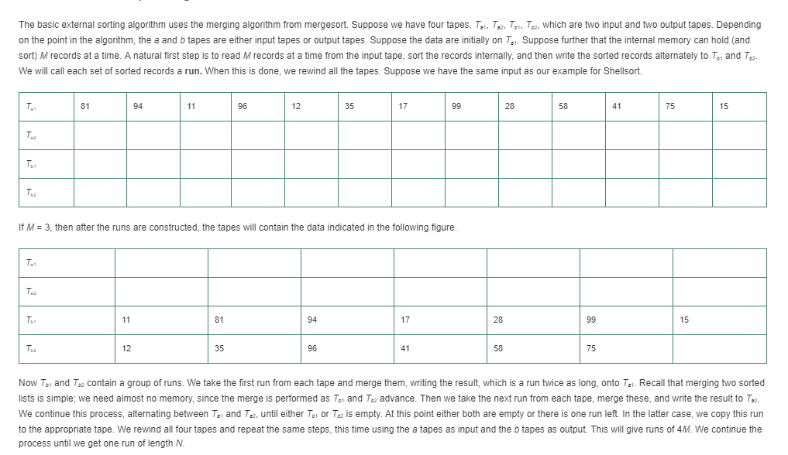
External Sort

Slide 22
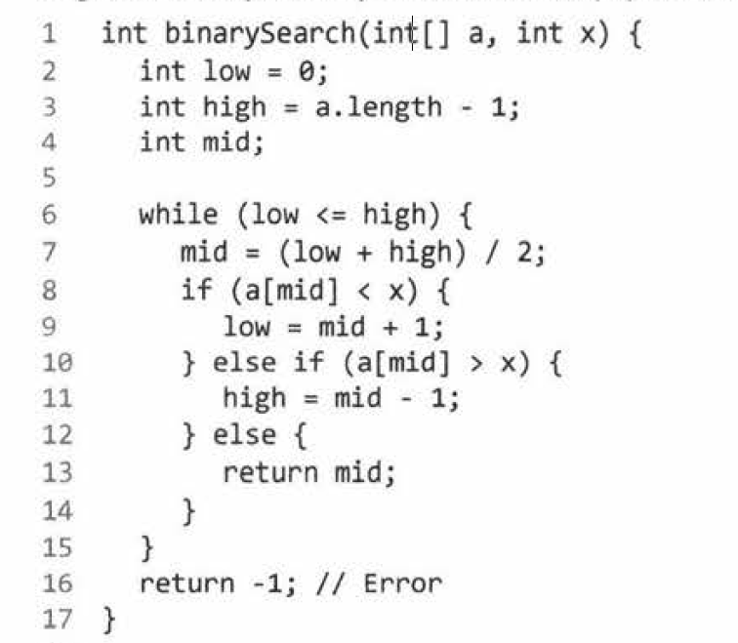
Binary Search: Iterative

Slide 23
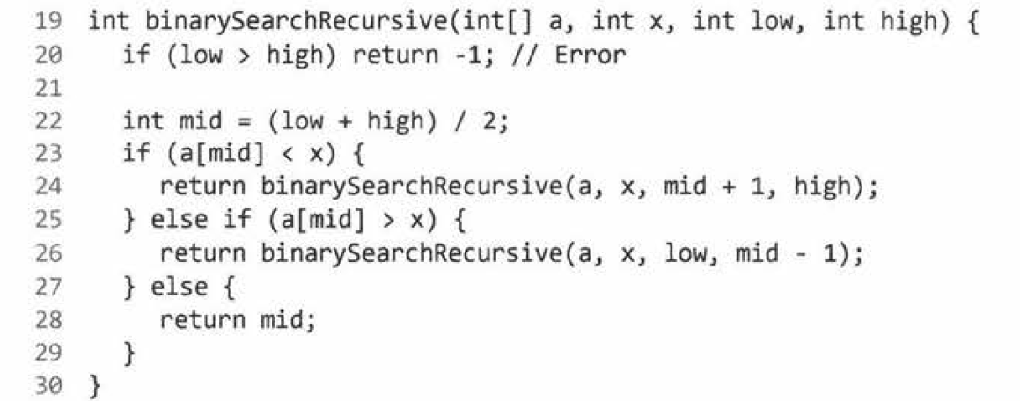
Binary Search: Recursive

