Slide 1
Mastering Data Structures and Algorithms: A Practical Approach
Trees and Graphs
By Dr. Juan C. Gomez
Fall 2018

Slide 2
Overview
Trees vs Graphs
Terminology
Types of Trees:
  Generic Tree vs Binary tree
  Binary Tree vs Binary Search tree
  Balanced vs Unbalanced tree
  Complete Binary Tree
  Full Binary Tree
  Perfect binary tree
Tree Traversals
  In-order
  Pre-order
  Post-order

Slide 3
Overview
Tries (Prefix trees)
Trees is Java
Trees in C++
Well-known Tree Data Structures:
  AVL Trees: O(log(N))
  Splay Trees: Amortized O(log(N))
  B-Trees

Slide 4
Overview
Graphs
  Concept
  Adjacency lists
  Adjacency Matrix
  Directed vs Undirected graphs
  Graphs with weights
  Graph traversals
    Depth-First Search
    Breadth-First Search
    Bidirectional Search

Slide 5
Overview
Well known graph algorithms:
  Topological Sort
  Dijkstra’s Shortest Path Algorithm

Slide 6
Trees: Trees vs Graphs
Trees are a Subset of Graphs
  Acyclic Graphs
Tree Terminology:
  Root node
  Leaf Node
  Inner Node
  Tree height
  Node depth

Slide 7
Trees: Trees vs Graphs
Tree Terminology:
  Parent node
  Child Node
  Leaf Node
  Path
  Ancestor
  Descendant

Slide 8
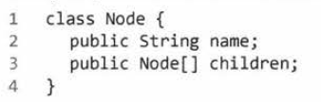

Trees: Implementation
Generic Implementation

Slide 9
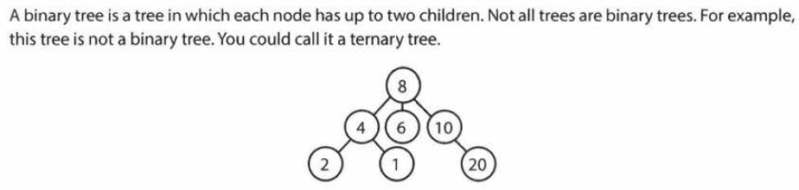
Trees: Generic vs Binary Trees

Slide 10
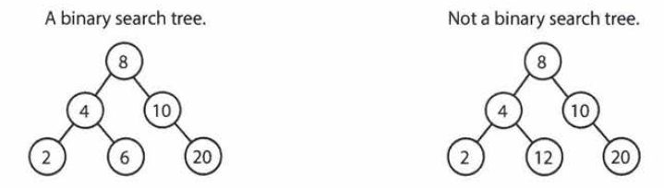
Trees: Binary vs Binary Search Trees

Slide 11
Trees: Balanced vs Unbalanced Trees
Balanced Trees:
  Not perfectly balanced, but balanced enough to ensure O(log(N))
  Usually differences are in the last level
  Well known balanced trees:
    AVL
    Red-Black

Slide 12
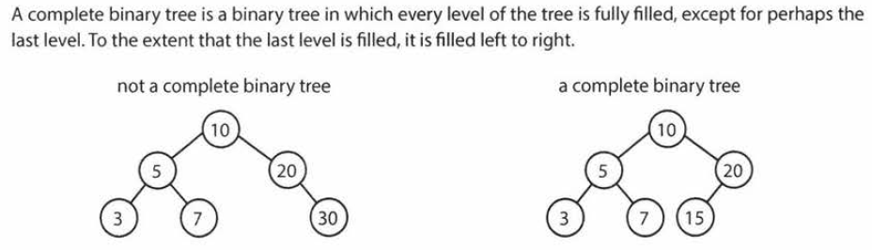
Trees: Complete Binary Tree

Slide 13
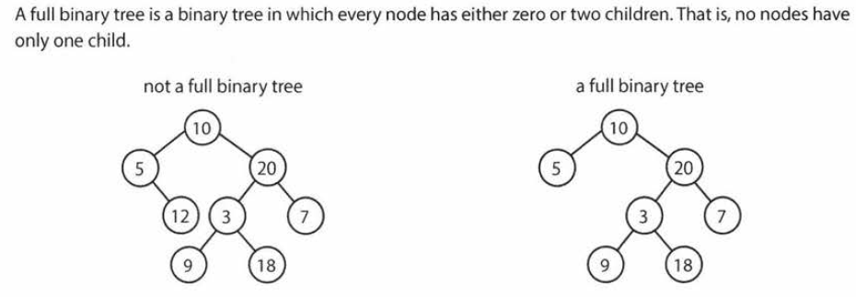
Trees: Full Binary Tree

Slide 14
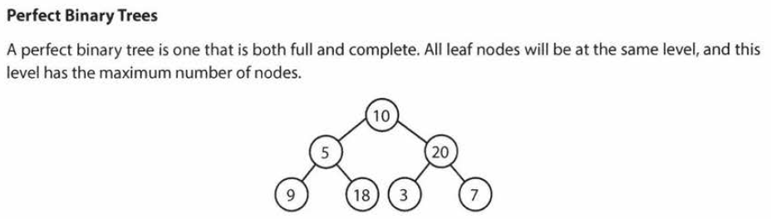
Trees: Perfect Binary Tree

Slide 15
Trees: Tree Traversals
Depth-first Search:
  In-order
  Pre-order
  Post-Order
Breadth-first Search:
  Level-Order

Slide 16
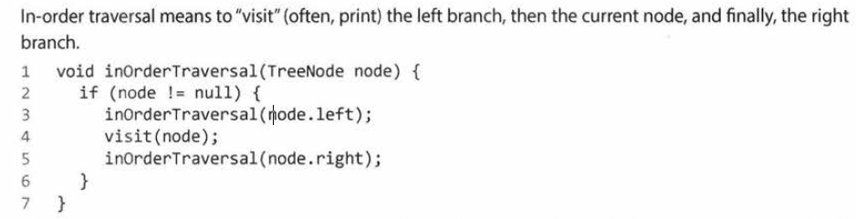
Trees: In-Order Traversal

Slide 17
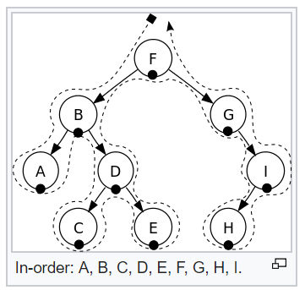
Trees: In-Order Traversal

Slide 18
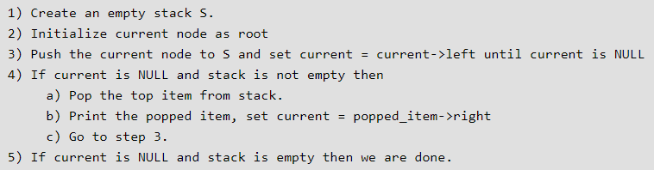
Trees: In-Order Traversal

Slide 19
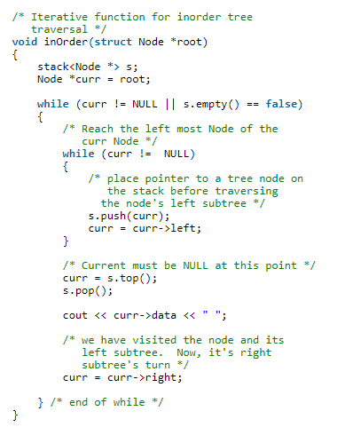
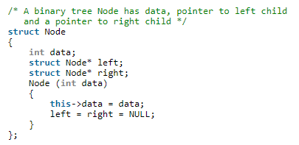
Trees: In-Order Traversal

Slide 20
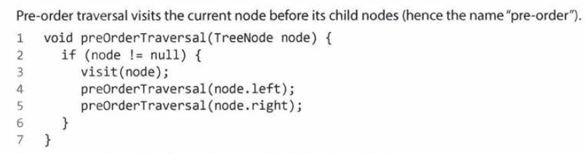
Trees: Pre-order Traversal

Slide 21
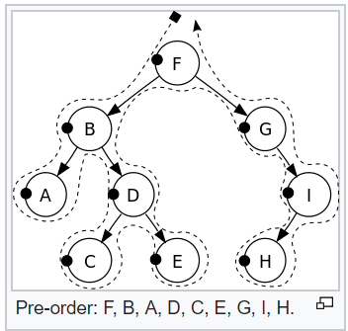
Trees: Pre-order Traversal

Slide 22
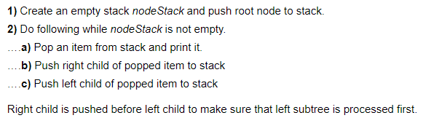
Trees: Pre-order Traversal

Slide 23
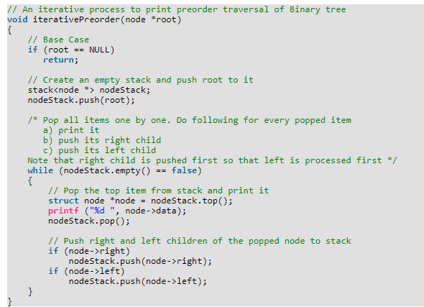
Trees: Pre-order Traversal

Slide 24
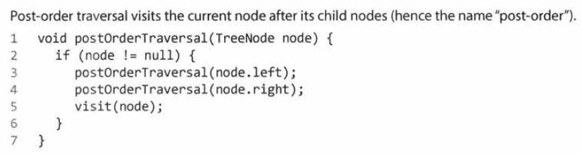
Trees: Post-order Traversal

Slide 25
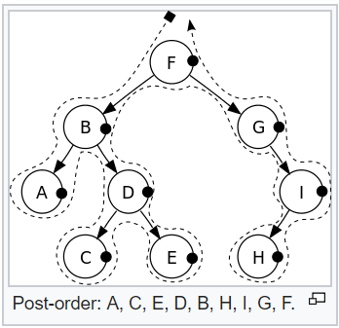
Trees: Post-order Traversal

Slide 26
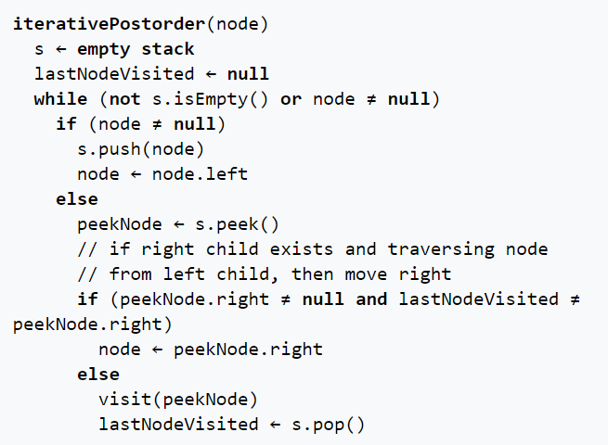
Trees: Post-order Traversal

Slide 27
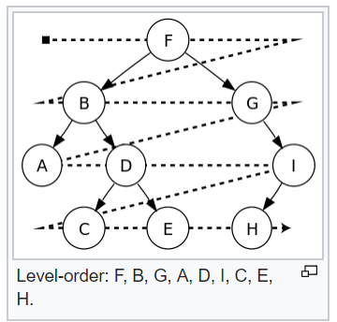
Trees: Level-Order
Breadth-First Search

Slide 28
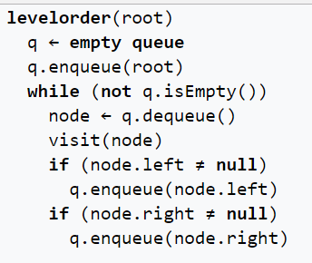
Trees: Level-Order

Slide 29
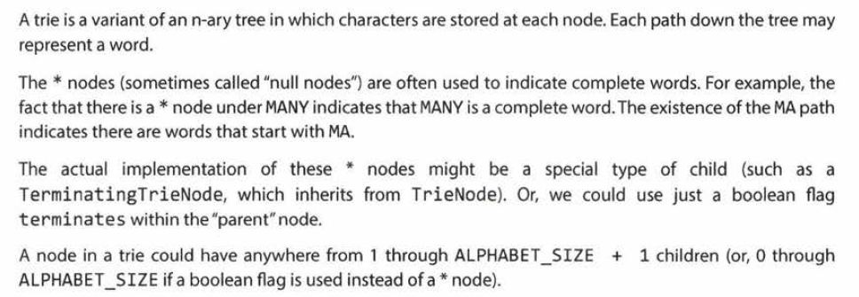
Trees: Tries (Prefix trees)

Slide 30
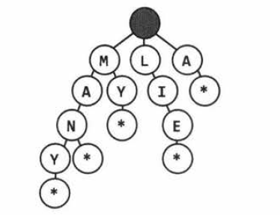
Trees: Tries (Prefix trees)

Slide 31
Trees: Tries (Prefix trees)
Applications:
  Networking prefix routing
  Word auto-completion
  Checking valid word:
    O(k), where K is the number of characters in the string.

Slide 32
Trees: Tries (Prefix trees)
Implementation:
  Node:
    Value: char
    Pointer to children nodes indexed by char
      Hash char -> Node
      Array of all chars -> Node

Slide 33
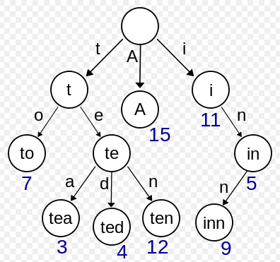
Trees: Tries (Prefix trees)

Slide 34
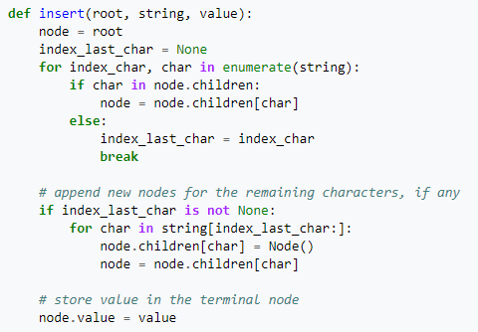
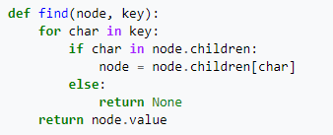
Trees: Tries (Prefix trees)

Slide 35
Trees: Java Interface
TreeSet, TreeMap: O(log(n)) basic operations
  Add()
  Remove()
  Contains()

Slide 36
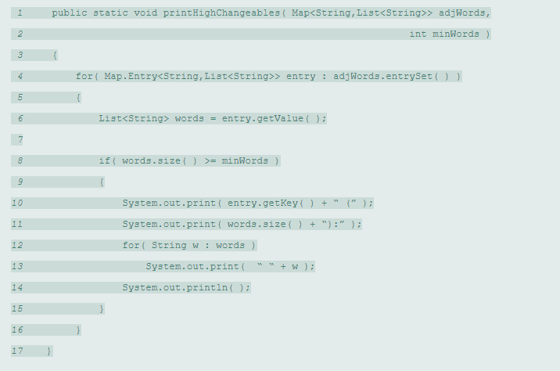
Trees: Java Interface

Slide 37
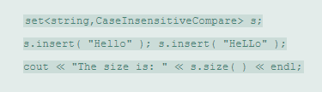
Trees: C++ Interface
Set, map: O(log(n)) basic operations
  insert()
  find()
  Contains()

