Slide 1
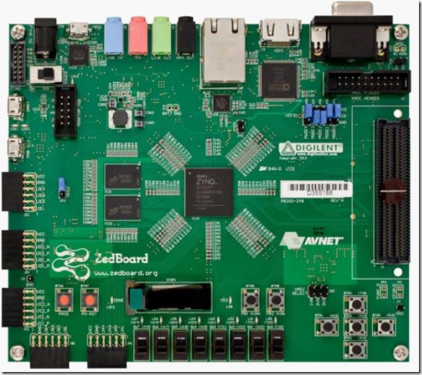
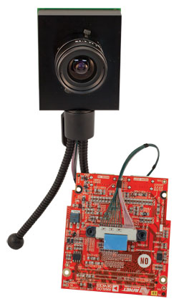
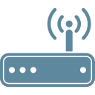



FMC
FMC
ZedBoard #1
Imageon
Imageon
ZedBoard #2
RJ45
RJ45
Router
WiFi
RJ45
Server
Aldebaran Nao's

