Slide 1
LFD Final Project
Marloes Kuijper
Daphne Groot
Hennie Veldthuis

Slide 2
Intro
To what extent can we automatically detect the gender and age range of a Twitter user based on a single tweet?

Slide 3
Background
[NOG TOEVOEGEN]

Slide 4
Data
English, Spanish, Italian and Dutch tweets
Age (18-24, 25-34, 35-49, 50-XX)
Gender (male/female)

Slide 5
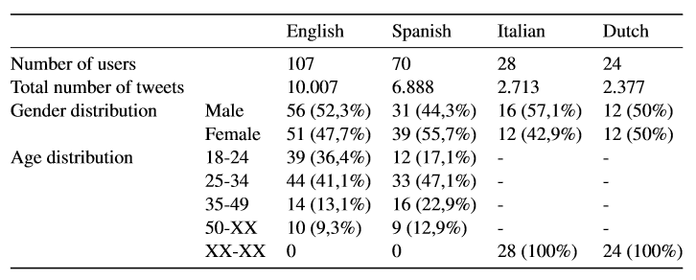
Data

Slide 6
Method
Baseline: most common gender or age
2 SVM models (age and gender)
word n-gram range of 1-2
character n-gram range of 3-5
linearSVC

Slide 7
Method
No improvement with:
POStagging
tekst length
emoticons
stereotypical linguistic features
binary = False
lowercase = True
strip_accents
min_df
norm
sublinear_tf
max_features
penalty
multi_class
TweetTokenizer
Lemmatizing & Stemming
Max_features = 400000
Stopwords
k-Fold cross validation (k=5)

Slide 8
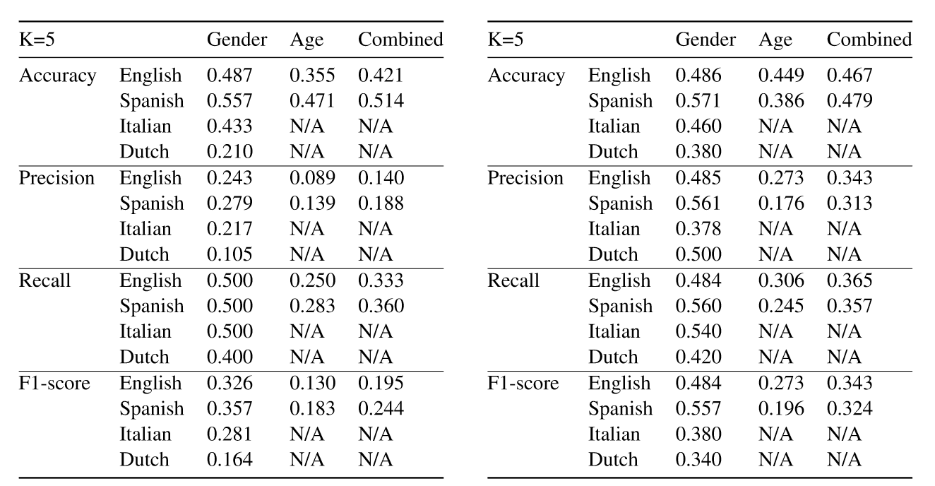
Results
Results baseline Results cross validation training set

Slide 9
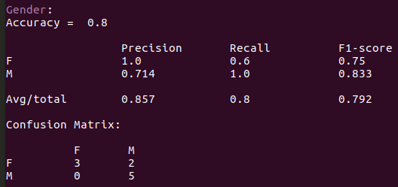
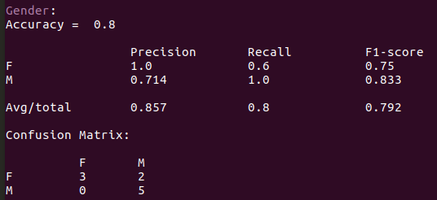
Dutch
Italian

Slide 10
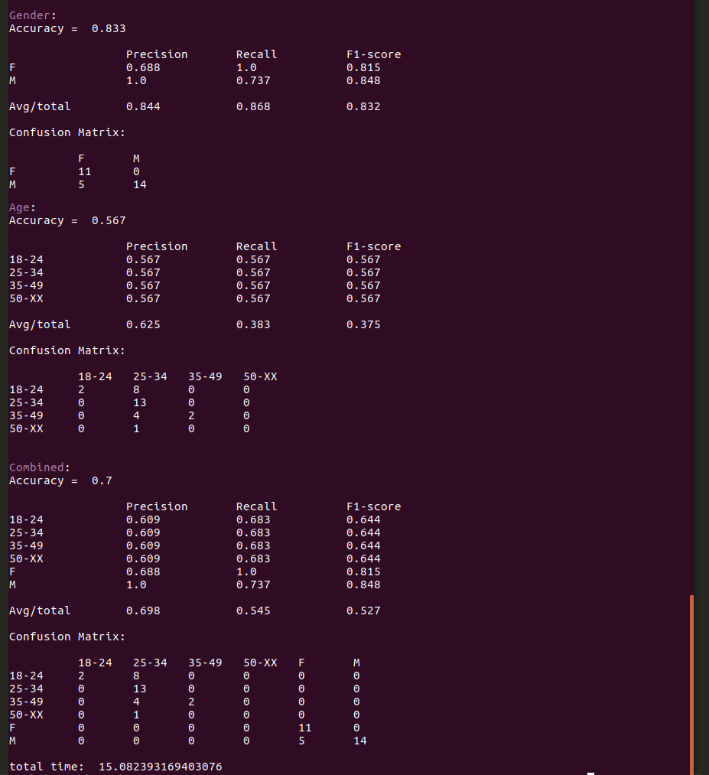
Spanish

Slide 11
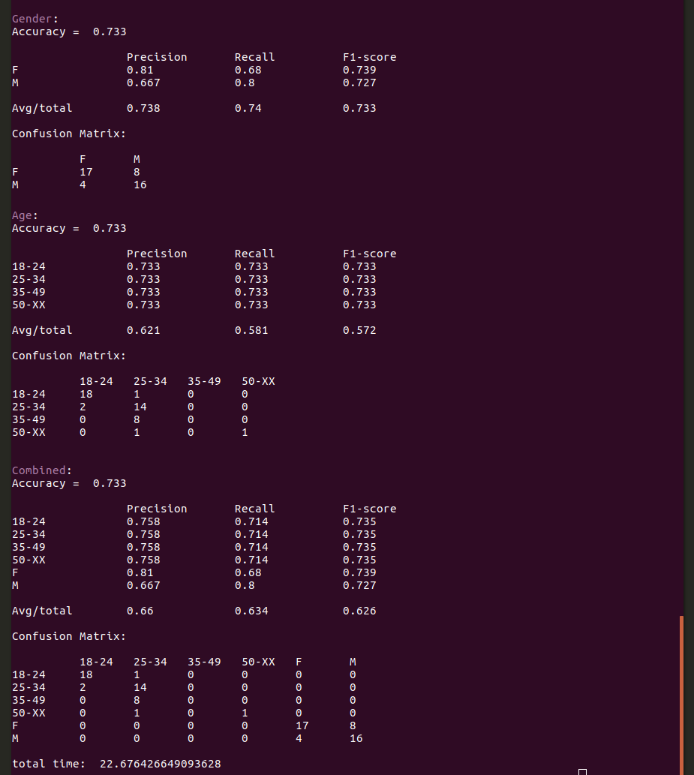
English

Slide 12
Conclusion
[NOG TOEVOEGEN]
Future work: Optimization per language Advanced neural networks Testing on different genres

Slide 13
Questions?

