Slide 1
LFD Final Project
Marloes Kuijper
Daphne Groot
Hennie Veldthuis

Slide 2
Intro
To what extent can we automatically detect the gender and age range of a Twitter user based on a single tweet?

Slide 3
Background
[NOG TOEVOEGEN]

Slide 4
Data
English, Spanish, Italian and Dutch tweets
Age (18-24, 25-34, 35-49, 50-XX)
Gender (male/female)

Slide 5
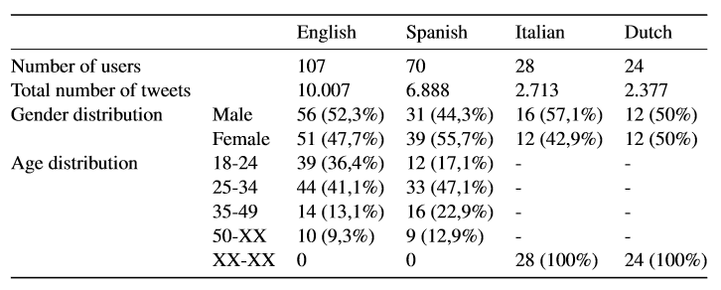
Data

Slide 6
Method
Baseline: most common gender or age
2 SVM models (age and gender)
word n-gram range of 1-2
character n-gram range of 3-5
linear kernel

Slide 7
Method
TweetTokenizer
Lemmatizing & Stemming
Max_features = 400000
Stopwords
k-Fold cross validation (k=5)

Slide 8
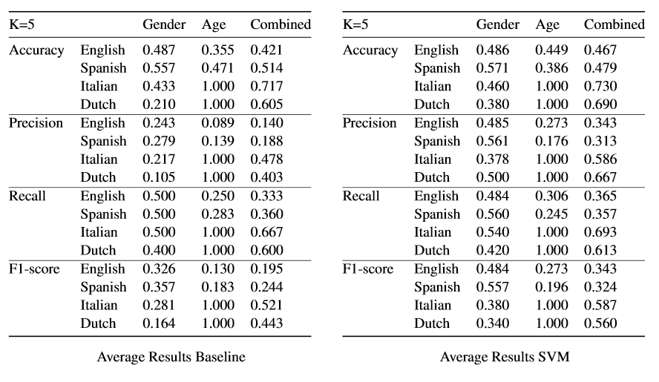
Results

Slide 9
Conclusion
[NOG TOEVOEGEN]

Slide 10
Questions?

