Slide 1
LFD Final Project
Marloes Kuijper
Daphne Groot
Hennie Veldthuis

Slide 2
Intro
To what extent can we automatically detect the gender and age range of a Twitter user based on a single tweet?

Slide 3
Background
PAN Shared Task Author Profiling 2017 (Rangel et al., 2017)
Gender and language variety
SVMs with char ngrams tf-idf word ngrams
Nguyen et al. (2011)
Author age prediction
Stylistic and content features

Slide 4
Data
English, Spanish, Italian and Dutch tweets
Age (18-24, 25-34, 35-49, 50-XX)
Gender (male/female)

Slide 5
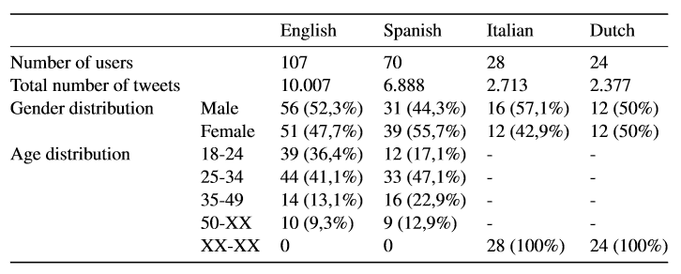
Data

Slide 6
Method
Baseline: most common gender or age
2 SVM models (age and gender)
word n-gram range of 1-2
character n-gram range of 3-5
linearSVC

Slide 7
Method
No improvement with:
POStagging
tekst length
emoticons
stereotypical linguistic features
binary = False
lowercase = True
strip_accents
min_df
norm
sublinear_tf
max_features
penalty
multi_class
Preprocessing
TweetTokenizer
Lemmatizing & Stemming
Max_features = 400000
Stopwords
k-Fold cross validation (k=5)

Slide 8
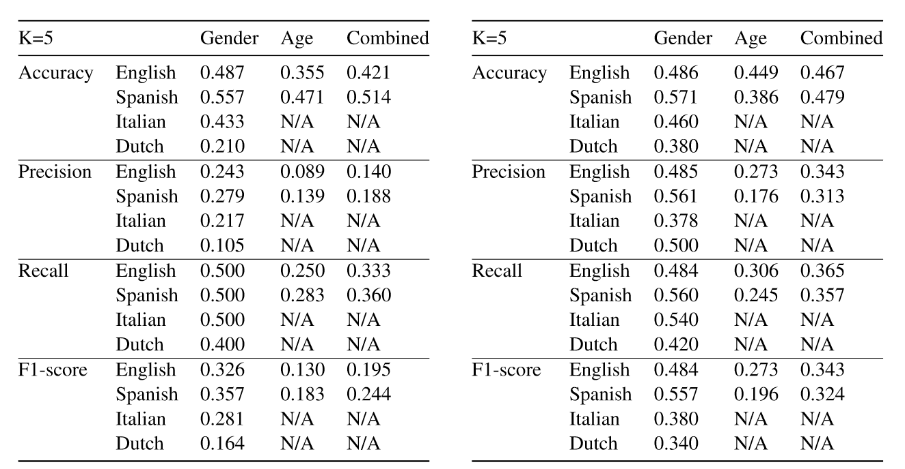
Results
Results baseline Results cross validation training set

Slide 9
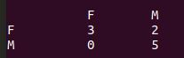
Dutch
Gender | Baseline | Development-set | Test-set
Accuracy | 0.210 | 0.380 | 0.800
Precision | 0.105 | 0.500 | 0.857
Recall | 0.400 | 0.420 | 0.800
F1-score | 0.164 | 0.340 | 0.792

Slide 10
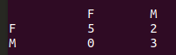
Italian
Gender | Baseline | Development-set | Test-set
Accuracy | 0.433 | 0.460 | 0.800
Precision | 0.217 | 0.378 | 0.800
Recall | 0.500 | 0.540 | 0.857
F1-score | 0.281 | 0.38 | 0.792

Slide 11
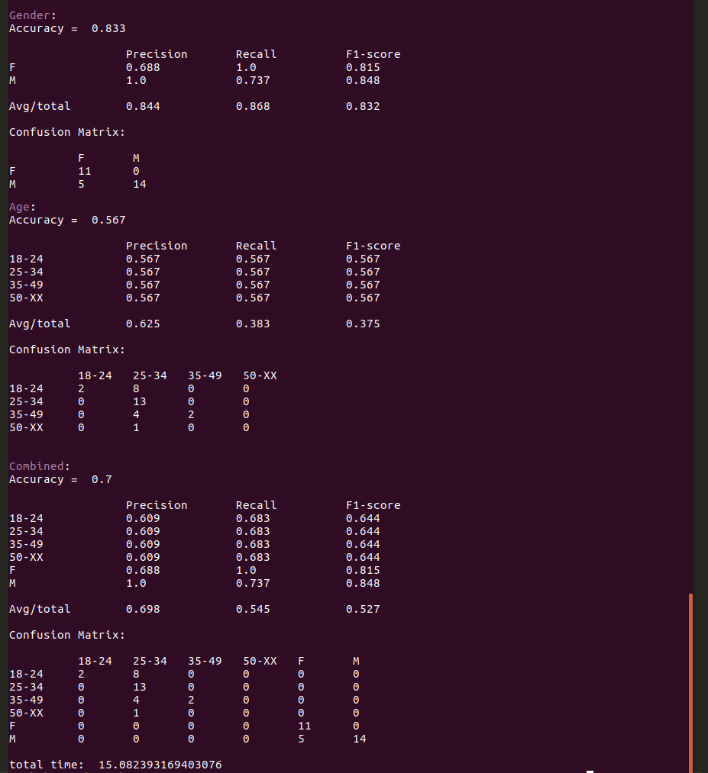
Spanish
Gender | Baseline | Development-set | Test-set
Accuracy | 0.557 | 0.571 | 0.833
Precision | 0.279 | 0.561 | 0.844
Recall | 0.500 | 0.560 | 0.868
F1-score | 0.357 | 0.557 | 0.832

Slide 12
Spanish
Age | Baseline | Development-set | Test-set
Accuracy | 0.471 | 0.386 | 0.567
Precision | 0.139 | 0.176 | 0.625
Recall | 0.283 | 0.245 | 0.383
F1-score | 0.183 | 0.196 | 0.375

Slide 13
Spanish
Combined | Baseline | Development-set | Test-set
Accuracy | 0.421 | 0.479 | 0.700
Precision | 0.140 | 0.313 | 0.698
Recall | 0.333 | 0.357 | 0.545
F1-score | 0.195 | 0.324 | 0.527

Slide 14
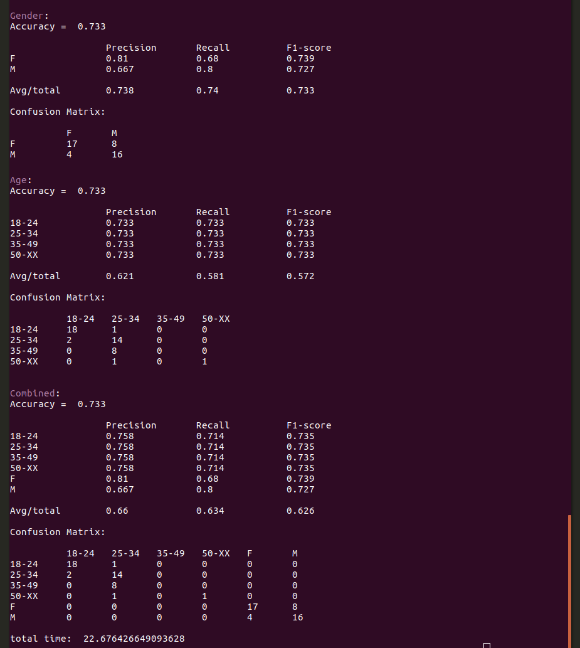
English
Gender | Baseline | Development-set | Test-set
Accuracy | 0.487 | 0.486 | 0.733
Precision | 0.243 | 0.485 | 0.738
Recall | 0.500 | 0.484 | 0.740
F1-score | 0.326 | 0.484 | 0.733

Slide 15
English
Age | Baseline | Development-set | Test-set
Accuracy | 0.355 | 0.449 | 0.733
Precision | 0.089 | 0.273 | 0.621
Recall | 0.250 | 0.306 | 0.581
F1-score | 0.130 | 0.273 | 0.572

Slide 16
English
Combined | Baseline | Development-set | Test-set
Accuracy | 0.421 | 0.467 | 0.733
Precision | 0.140 | 0.343 | 0.660
Recall | 0.333 | 0.365 | 0.634
F1-score | 0.195 | 0.343 | 0.626

Slide 17
Conclusion
F1-scores outperform baseline system
Scores on test data higher than on development set
Due to K-fold CV with few samples per fold
Suggests that for age and gender prediction, corpus size is important
Future work:
Optimization per language
Advanced neural networks
Testing on different genres

Slide 18
Questions?

