Slide 1

Contoso Banking Chatbot
Zhi Yi (Daphne) See
zsee930@aucklanduni.ac.nz
Notes:
Please enter project details and your details here.

Slide 2
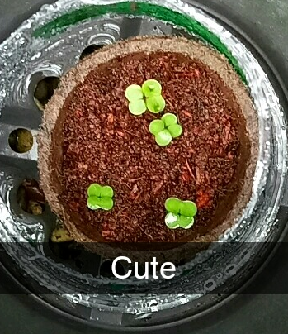
About myself :D
Computer Science and Commerce
Hobbies?
I love coding.
Notes:
This section is NOT assessed. We just want to get to know you ☺.

Slide 3
The Contoso banking Chatbot : UX
Brainstorm
Information that is hard to find on site (what exactly you should do when you lose your credit card)
Updating personal info ( change of phone no, address, etc)
Where are the ATMs?
Easy to use
Notes:
This section is NOT assessed. We just want to get to know you ☺.

Slide 4

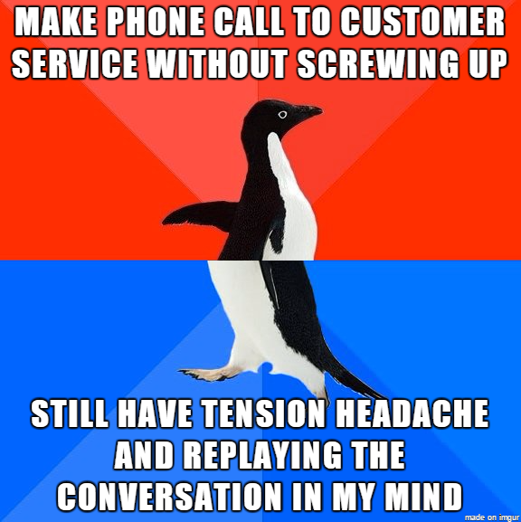
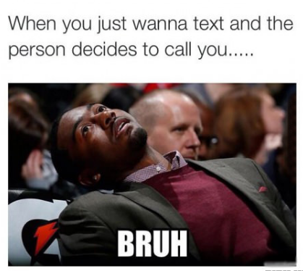
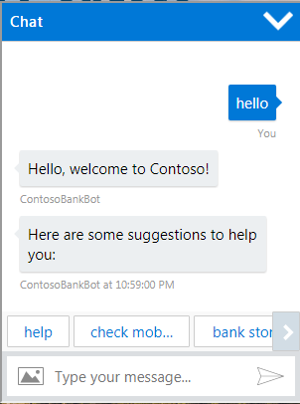
User Experience
Create a bot that helps customers with their inquiries
A new alternative for people who prefers not to call.
Notes:
User Experience

Slide 5
Databases
used Azure’s Easy tables
Contains customer’s basic information so we can identify them, and help them better
Username(unique to the user), name, mobile, email
Address them by their name, so the bot is less robot like
Notes:
Talk about your database, what schema you used and what data you used

Slide 6
API
LUIS – help understand what the user wants
API – To look for banks in their desired location
QnA – to answer their questions about the bank.
Notes:
Advanced features…

Slide 7
Azure Setup
Easy tables
Web App http://websitecontosobank1220.azurewebsites.net/
Bot framework
Notes:
Explain your Azure features here

Slide 8
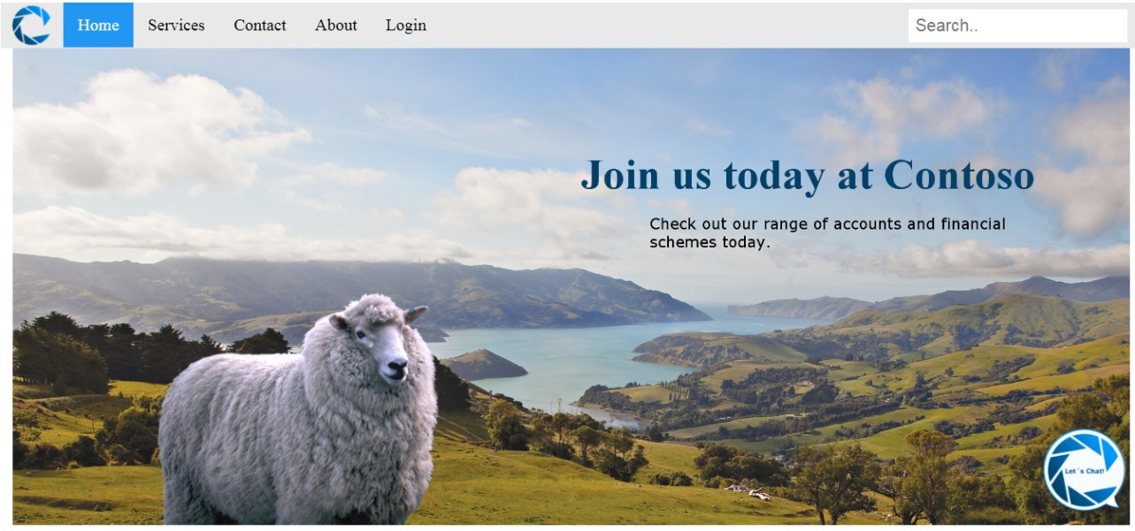


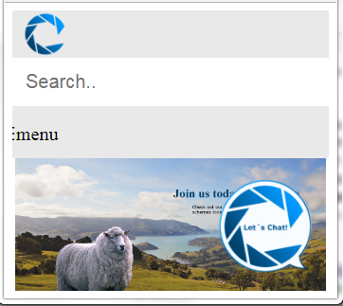
Advanced Features
Distinguishable logo
Tested to give room for input errors
Smaller screens? No problem!
Notes:
Advanced features…

Slide 9
Advanced Considerations
Colour scheme
Tested to give room for input errors
Notes:
Advanced considerations…

Slide 10
Final Comments
Notes:
Any final things you want to tell us

