Slide 1
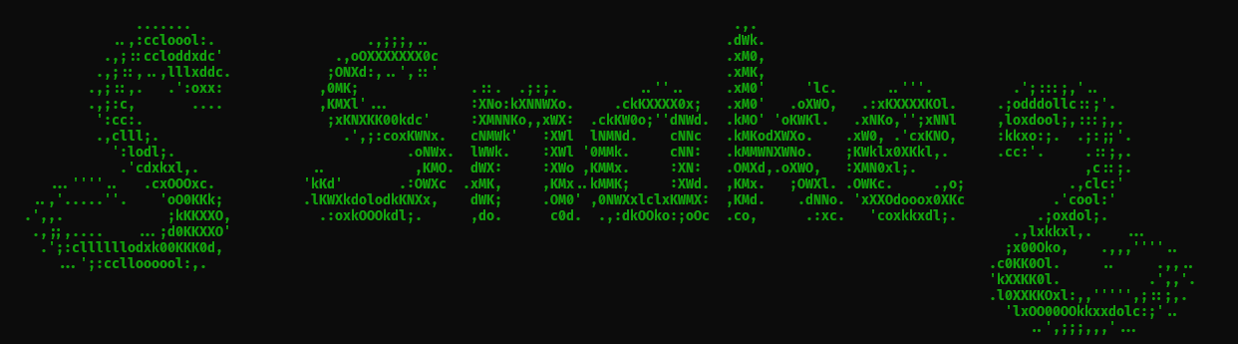
//Nathan Johnson
//Tiaron Starrine

Slide 2
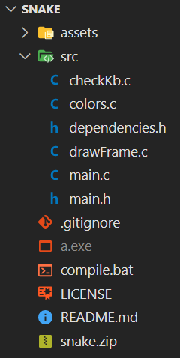
Header files
// main.h
#define ROWS 20
#define COLS 20
#define SPEED 150
void colorRed();
void colorGreen();
void colorDefault();
void drawFrame();
char checkKb();
// dependencies.h
#include <stdio.h>
#include <stdlib.h>
#include <time.h>
#include <windows.h>
#include <winuser.h>

Slide 3
Variables
// Initialize variables
unsigned char grid[ROWS][COLS];
int snake[ROWS*COLS][2];
char keyPress;
char key = 'd';
int score = 1;
int apple[2];
int alive = 1;
char c;
FILE* f;

Slide 4

File io
char c;
FILE* f;
- - - - - - - - - - - - - - - - - -
// Display title screen
system("cls");
printf("WELCOME TO\n");
colorGreen();
f = fopen("./assets/snek.txt", "r");
while ((c = fgetc(f)) != EOF)
printf ("%c", c);
colorDefault();
fclose(f);
printf("\nPress space to start...\n");
while (!(GetKeyState(0x20) < 0)) ;
https://www.ascii-art-generator.org/

Slide 5
If
// Check for death
for (int i = 1; i < ROWS*COLS; i++) {
if (snake[0][0] == snake[i][0] && snake[0][1] == snake[i][1])
alive = 0;
if (snake[0][0] >= COLS || snake[0][0] < 0)
alive = 0;
if (snake[0][1] >= ROWS || snake[0][1] < 0)
alive = 0;
}

Slide 6
Functions
char checkKb() {
if (GetKeyState(0x57) < 0) return 'w';
if (GetKeyState(0x41) < 0) return 'a';
if (GetKeyState(0x53) < 0) return 's';
if (GetKeyState(0x44) < 0) return 'd';
return '\0';
}
void colorRed() {
printf("\033[0;31m");
}
void colorGreen() {
printf("\033[1;32m");
}
void colorDefault() {
printf("\033[0m");
}

Slide 7
Error checking
if (keyPress != '\0') {
switch (keyPress) {
case 'w':
if (key!='s')
key = keyPress;
break;
case 'a':
if (key!='d')
key = keyPress;
break;
case 's':
if (key!='w')
key = keyPress;
break;
case 'd':
if (key!='a')
key = keyPress;
break;
}
}

Slide 8
Loops
// Move
for (int i = score-1; i >= 1; i--) {
snake[i][0] = snake[i-1][0];
snake[i][1] = snake[i-1][1];
}
while (apple[0] == snake[0][0] && apple[1] == snake[0][1]) {
apple[0] = rand()%ROWS;
apple[1] = rand()%COLS;
}

Slide 9
Arrays
unsigned char grid[ROWS][COLS];
 | 0 | 1 | 2 | 3 | 4 | 5 | 6
0 | \0 | \0 | \0 | \0 | \0 | \0 | \0
1 | █ | \0 | ▓ | ▓ | ▓ | ▓ | \0
2 | \0 | \0 | \0 | \0 | \0 | ▓ | \0
3 | \0 | \0 | \0 | \0 | ▓ | ▓ | \0
4 | \0 | \0 | \0 | \0 | \0 | \0 | \0
5 | \0 | \0 | \0 | \0 | \0 | \0 | \0
6 | \0 | \0 | \0 | \0 | \0 | \0 | \0
int snake[ROWS*COLS][2];
{1,2} | {1,3} | {1,4} | {1,5} | {2,5} | {3,5} | {3,4} | {-1, -1} | {-1, -1} | {-1, -1}
…

Slide 10
unsigned char grid[ROWS][COLS];
 | 0 | 1 | 2 | 3 | 4 | 5 | 6
0 | \0 | \0 | \0 | \0 | \0 | \0 | \0
1 | █ | ▓ | ▓ | ▓ | ▓ | ▓ | \0
2 | \0 | \0 | \0 | \0 | \0 | ▓ | \0
3 | \0 | \0 | \0 | \0 | \0 | ▓ | \0
4 | \0 | \0 | \0 | \0 | \0 | \0 | \0
5 | \0 | \0 | \0 | \0 | \0 | \0 | \0
 | 0 | 1 | 2 | 3 | 4 | 5 | 6
0 | \0 | \0 | \0 | \0 | \0 | \0 | \0
1 | █ | \0 | ▓ | ▓ | ▓ | ▓ | \0
2 | \0 | \0 | \0 | \0 | \0 | ▓ | \0
3 | \0 | \0 | \0 | \0 | ▓ | ▓ | \0
4 | \0 | \0 | \0 | \0 | \0 | \0 | \0
5 | \0 | \0 | \0 | \0 | \0 | \0 | \0
6 | \0 | \0 | \0 | \0 | \0 | \0 | \0
6 | \0 | \0 | \0 | \0 | \0 | \0 | \0
int snake[ROWS*COLS][2];
{1,2} | {1,3} | {1,4} | {1,5} | {2,5} | {3,5} | {3,4} | {-1, -1} | {-1, -1} | {-1, -1}
…
{1,1} | {1,2} | {1,3} | {1,4} | {1,5} | {2,5} | {3,5} | {-1, -1} | {-1, -1} | {-1, -1}
…

Slide 11
Sources
Keyboard Input:
https://docs.microsoft.com/en-us/windows/win32/inputdev/keyboard-input
Colored Text:
https://www.theurbanpenguin.com/4184-2/
Class PowerPoints
(for things we forgot how to do)

