Slide 1
The current research status of solving blockchain scalability
issue
Darllaine R. Lincopinis
Orven E. Llantos, PhD
Mindanao State University-Iligan Institute of Technology, Philippines
CENTERIS2023
Notes:
Good day everyone!
I am Darllaine R. Lincopinis from Mindanao State University - Iligan institute of technology. Country of the Philippines
I will be presenting my paper of the current research status of solving blockchain scalability issue

Slide 2
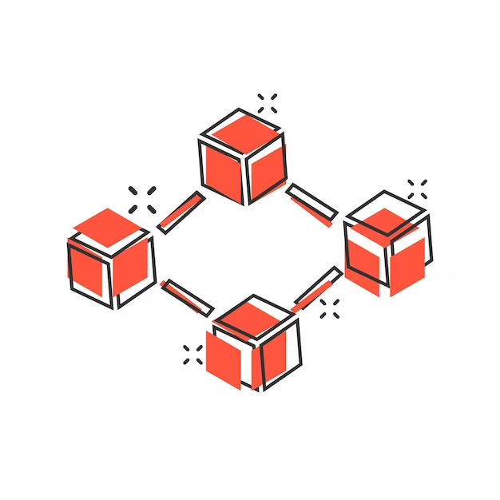
01
02
03
Contribution of Blockchain Technology to different industries
Factors that contribute to Scalability Issue in Blockchain
What is Blockchain Technology
04
05
Scalability Solutions
Role of Blockchain Parameters
06
07
Conclusion
Performance metric of ideal Scalability Solutions
Notes:
Title page 1

Slide 3
Contribution of Blockchain Technology to different industries
It does not hinge on a central entity.
It averts the possibility of intrusions by adopting cryptographic techniques
Immutable
Auditability
The Challenge of Transaction Validation of Blockchain:
The more nodes need to store and execute computational tasks, the longer the waiting time for transaction to be validated[1][2]. It is here where Blockchain puts up with Scalability issues.
CENTERIS2023
Notes:
Nowadays, aside from cryptocurrencies the industries such as voting, health, prediction, food, electricity distribution, and data storage. are integrating blockchain technology. This is because blockchain technology contributes the characteristics of decentralization, anonymity, persistence and auditablity.
-However, a certain challenge has came into the limelight, that is: blockchain puts up with Scalability issues.
The reason for this, is that because of its popularity Blockchain technology has captured the attention and interests of a number of users/industries.
The more users means more nodes to store and execute computational tasks, which leads for longer waiting times for transactions to be validated.
-Accordingly, the average waiting time for a single transaction to be validated has increased to 29 minutes (thats just too much time)

Slide 4
Factors that contribute to Scalability Issue in Blockchain
Mostly discussed:
Transaction processing speed (TPS)
Transaction Confirmation Latency
Other interdependent factors:
Storage
Block size
Nodes
CENTERIS2023
Notes:
There are several factors that were mostly discussed which contribute to the outcome of the Scalability issue in Blockchain. Factors such as: TPS and transaction confirmation latency
For instance, Ethereum and Bitcoin are two Blockchain
platforms that process 20 and 7 transactions per second (tps), corresponding to typical systems such as Pay Pal and VISA, which process 193 and 1667 transactions per second, respectively .
Other interdependent factors also exist, such as storage, block size, number of nodes, energy consumption, and cost.

Slide 5
Blockchain Technology
Blockchain is composed of:
Blocks - linked to similar blocks to form a chain where each block correlates with the previous block[3].
Hash function - used to create a hash value of each block[3].
Hash value - a digital fingerprint generated by the current block and the previous block’s hash in the chain[3].
Applications:
Voting
Health
Prediction
Food
Electricity distribution
Data storage.
CENTERIS2023
Notes:
Explanation:
START
Blockchain is a type of shared database that differs from a typical database in the way it stores information; blockchains store data in blocks that are linked together.
blocks is where certain types of information are stored, and there is an
assurance of the association and integrity of each block in the chain by a hash function used to create a hash value of each block, lastly properties of the hash value are linking each block, and when changes happen to the data
present in the block, it reflected in the hash of the block and all succeeding blocks.

Slide 6
Public Blockchain
Allows anyone to take part and join the network[4].
Permissionless
Therefore, more vulnerable to scalability issue than private and consortium Blockchain[5].
Upperhand:
It inaugurates trust in members since everybody makes the best decision to improve the network[1].
It is transparent and open.
Secure.
CENTERIS2023
Notes:
The partitions of the Blockchain are public, private, and consortium. However, this paper only focuses on the public blockchain since it is more vulnerable to scalability issue than private and consortium Blockchain.
A public blockchain network allows anyone to take part and join the network by allowing members to check the transaction and confirm it, and also, they can take part on the way toward getting a consensus. It is permissionless, which means no
restrictions for miners.
The upper hand..is that it inaugurates trust in members since everybody makes the best decision to improve the network, it is transparent and open; even though all information inside the transactions is open for every member to see, there is still legitimacy since the transaction and information are confirmed by anyone in the network. Lastly, public Blockchain is secure, mainly when every participant actively
participates in the decentralization, because the more nodes in the network, the harder it is to be attacked.

Slide 7
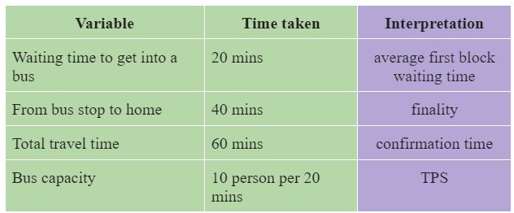
Role of Blockchain Parameters
Blocksize - the maximum limit of a block that can be filled up with transactions[1].
1MB fix size is an issue
Increasing the block size by removing digital signature is a problematic solution.
Transaction Processing Speed (measured by TPS) - TPS is the maximum number of transactions a blockchain can carry out in a second[4].
Finality, average first-block waiting time, and confirmation time must also be considered,
CENTERIS2023
Notes:
Blocksize:
When the notion of Blockchain came into the public eye by Nakamoto in 2008, its block size of data storage had a limit of 1 MB, which most researchers considers this as an issue. Because accordingly, if block size is increased this might solve the scalability issue of blockchain. However, another issue might rise when considering this solution. That is, in order to increase the blocksize you have to remove the signature data and THAT IS A PROBLEMATIC METHOD.
This interpretation says that processing up to a thousand TPS is excellent, but if it has a longer confirmation time, more is needed. Next, if network congestion occurs, TPS might not decrease, but confirmation time will degenerate because of the more extended average first block waiting time. Lastly, finality is a fixed waiting time for a block to be confirmed in the chain. The average first-block waiting time varies depending on the finality of a block. Thus, in order for the Blockchain platform to cope with tech giants such as VISA, MasterCard, and Paypal, some improvements are needed to scale up Blockchain technology.

Slide 8
Scalability Solutions
Layer 0 (propagation protocol)
focused on solving scalability through the dissemination of information in the blockchain network through propagation protocol [6][7][8] .
Layer 2 (on-chain)
requires changing the structure of the actual Blockchain [9].
Layer 3 (off-chain)
off-loading transactions from the main Blockchain to save space and reduce network congestion[14].
diminish the storage burden of blockchain nodes while ensuring the integrity of the off-chain data[14].
Notes:
Scaling Blockchain is a complex topic, and different approaches have been adopted to ameliorate blockchain
scalability. As mentioned, when the number of users for major blockchain platforms increases substantially, the scalability issues will intensify since it will produce transactions at a higher rate.
The identified blockchain solutions can be categorized into 3:

Slide 9
Layer 0 (propagation protocol)
BloXrou [7]:
Neutral transport layer running underneath cryptocurrencies.
Based on increasing the block size while decreasing the interval between blocks.
2. KadCast [8]:
Based on Kademlia Architecture.
a protocol for fast, efficient and secure block propagation for the bitcoin network.
fast propagation and secure transmission.
Notes:
The techniques proposed in this layer are focused on solving scalability through the dissemination of information in the blockchain network through propagation protocol
Read ppt..

Slide 10
Layer 2 (on-chain)
Redesigning the structure of blocks [9]
Increasing the block size and block compression process.
Bitcoin unlimited and Litecoin.
2. Directed Acyclic graph (DAG) [10]
Idea: transactions in blockchain are recorded in a linear type formation.
DAG-based blockchain considers a block as a vertex in the DAG attached to other previous vertices.
Conflux
Notes:
Explanation:
This process could reduce some unessential and redundant data of a block. When this technique is integrated, each block can accommodate more transactions, which unques tionably improves the overall throughput.
Conflux - The
ideal system that implements this technique is Conflux [11], a consensus protocol that represents
relationships between blocks as a DAG, which is a fast, scalable, and decentralized blockchain system
that optimistically processes concurrent blocks without discarding any as forks.

Slide 11
Layer 2 (on-chain)
3. Sharding techniques [11]
Database partitioning with the idea of improving performance and reducing the query response time.
Breaking up a vast database into a smaller and more manageable segments.
KSI cash, Ostraka, RapidChain, Elastico, OmniLedger, Monoxide.
4. SegWit [12]
a protocol upgrade that changes the way and structure of how data is stored in the block.
Removing digital signature
Notes:
SHARDING
This a form of data database partitioning with the idea of improving performance
and reducing the query response time. This technique involves breaking up a vast database into smaller and more manageable segments.
The ideal systems adopts this technique are:
SEGWIT:
This is done by removing the digital signature that verifies the ownership and availability of the sender’s data. Since digital signature takes up much space in a transaction, removing it would allow more transactions to be included in one block. In SegWit, the block size increases from 1MB to 4MB where the block is now divided into two parts: 1MB for the base transaction block size and 3 MB for
the extended block size.
However, Digital signatures are an essential feature of blockchain technology. They ensure the authenticity and integrity of transactions and data on the network.

Slide 12
Layer 3 (off-chain)
Side-chain techniques [13]
a separate blockchain linked to the main blockchain.
2. Payment channels [6]
Establishing temporary network between two parties to reduce the volume on main network and increase throughput of whole Blockchain
3. Cross-chain techniques [6]
Idea: enabling transactions and interactions between different blockchains without requiring every transaction to be recorded on each chain.
Polkadot
Notes:
The third layer of scalability solutions is executed by off-loading transactions from the main Blockchain
to save space and reduce network congestion. This approach can also be used to diminish the storage burden
of blockchain nodes while ensuring the integrity of the off-chain data
Side-chain techniques-is simply a separate blockchain linked to the main blockchain. This allows the assets in a specific blockchain to be moved between various sub-blockchain[7], while guaranteeing that the assets are secure and saved.
Payment channels - the idea of payment channels is to establish a temporary channel network between two parties who wants to make a transaction to reduce the volume on the main network and increase the transaction throughput of the whole Blockchain
Cross-chain techniques - are contemplated to be latent solutions to refine scalability in Blockchain. The idea isonce the interoperability of separated chains in these techniques is interconnected, this can result in enhancing scalability.
Those are the different technologies that I have identified in my paper, which are categorized into three. Now lets proceed to the performance metric of each scalability solutions.

Slide 13
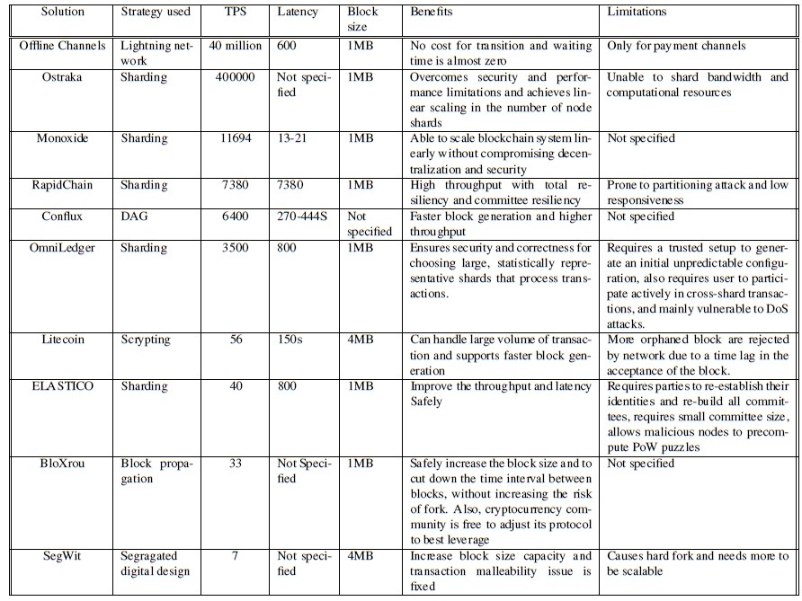
Performance metric of ideal Scalability Solutions
Notes:
The table depicts the elements that determine scalability, such as transaction per seconds (TPS), latency, and block size. The performance analysis in Table 1 is based solely on selected solutions.
discussed in the previous section that entirely contained their outcomes following the final integration. According to the Table, there are a number of proposed solutions that use the Sharding approach, and all but ELASTICO have a high throughput. The solutions that use the Sharding technique, on the other hand, are most vulnerable to attacks such as DoS attacks; thus, this constraint must be addressed before it can be used to solve blockchain scalability. Furthermore, when the block size of SegWit and Litecoin is compared to the rest of the mentioned options, it is discovered that raising the block size does not enhance throughput.
When compared to other alternatives, Conflux has the largest TPS for the DAG technique, with 20-30 tps and 500 tps, respectively. Other options, such as block propagation and SegWit, rank last in terms of performance because some specifics, like as latency and integration constraints, need to be resolved. Finally, the Lightning network technique for Offline channels is a cutting-edge option that may alleviate the scalability issue; nevertheless, this concept has only been tried on payment channels. Future effort will be required to integrate this solution into channels other than payment channels.
On the table shown, the factors that influence the scalability issue, such as transaction per seconds (TPS), latency and block size are illustrated. The performance analysis shown in Table 1 is only from selected solutions
discussed in the previous section that completely included their results after the final integration. From the Table, it is observed that there is a number of proposed solutions that use the Sharding strategy, and mostly they have a high throughput except for ELASTICO. However, the solutions that use the Sharding approach are
most prone to attacks such as DoS attacks; therefore, this limitation must be worked out for it to be ideal for solving blockchain scalability. In addition, comparing the block size of SegWit and Litecoin to the rest of the listed solutions, it is identified that increasing the block size does not improve the throughput. Conflux
has the highest TPS for the DAG approach compared to other solutions, such as Byteball [22] and IoTA, with 20-30 tps and 500 tps, respectively. Other solutions, such as block propagation and SegWit, come last in the performance metric since some details, such as the latency and limitations in the integration, need to be clarified. Lastly, the Lightning network strategy for Offline channels is the up-to-the-mark solution that might solve the scalability issue; however, this idea is only tested on payment channels only. Future work is needed to integrate this solution into other avenues besides payment channels.

Slide 14
Conclusion
Disadvantaging factors of Blockchain exists.
Roles of blockchain parameters must be considered for a better understanding of blockchain scalability issues.
More solutions for scalability issue must be developed.
Other state-of-the-art solutions must also be tested to other areas aside from payments and cryptocurrencies.
Notes:
In conclusion, disadvantaging factors of blockchain does exist, it is not a defined technology. Also, it is important to consider the roles of blockchain parameters for a better understanding of blockchain scalability issues, Next, based on the performance of metrics of each solutions there is a need for more solution in solving the scalability issue. Lastly, other state-of-the-art solutions must also be tested to other areas aside from payments and cryptocurrencies.
THANK YOU SO MUCH AND THATS IT FOR MY PAPER PRESENTATION ON the current research status of solving blockchain scalability issue.

Slide 15
Works Cited
[1]
[2]
[3]
[4]
[5]
[6]
[7]
[8]
G. Kaur, C. Gandhi, Scalability in blockchain: Challenges and solutions, in: Handbook of Research on Blockchain Technology, Elsevier, 2020, pp. 373–406.
D. Khan, L. T. Jung, M. A. Hashmani, Systematic literature review of challenges in blockchain scalability, Applied Sciences 11 (20) (2021) 9372.
S. Nakamoto, Bitcoin: A peer-to-peer electronic cash system, Decentralized business review (2008) 21260.
J. Praveen, The difference between public and private blockchain (2017).
D. Khan, L. T. Jung, M. A. Hashmani, Systematic literature review of challenges in blockchain scalability, Applied Sciences 11 (20) (2021) 9372.
A. Alrehaili, A. Namoun, A. Tufail, A comparative analysis of scalability issues within blockchain-based solutions in the internet
of things, International Journal of Advanced Computer Science and Applications 12 (9).
U. Klarman, S. Basu, A. Kuzmanovic, E. G. Sirer, bloxroute: A scalable trustless blockchain distribution network whitepaper,
IEEE Internet of Things Journal.
E. Rohrer, F. Tschorsch, Kadcast: A structured approach to broadcast in blockchain networks, in: Proceedings of the 1st ACM
Conference on Advances in Financial Technologies, 2019, pp. 199–213.
Notes:
End 1

Slide 16
Works Cited
[9]
[10]
[11]
[12]
[13]
[14]
R. Zhang, B. Preneel, On the necessity of a prescribed block validity consensus: Analyzing bitcoin unlimited mining protocol, in: Proceedings of the 13th International Conference on emerging Networking EXperiments and Technologies, 2017, pp. 108–119.
C. Li, P. Li, D. Zhou, W. Xu, F. Long, A. Yao, Scaling nakamoto consensus to thousands of transactions per second, arXiv preprint arXiv:1805.03870.
ultra-scalable blockchain platform for universal asset tokenization: design and implementation, IEEE Access 10 (2022) 77284–77322.
A. Manuskin, M. Mirkin, I. Eyal, Ostraka: Secure blockchain scaling by node sharding, in: 2020 IEEE European Symposium on Security and Privacy Workshops (EuroS&PW), IEEE, 2020, pp. 397–406.
C. Nartey, E. T. Tchao, J. D. Gadze, B. Yeboah-Akowuah, H. Nunoo-Mensah, D. Welte, A. Sikora, Blockchain-iot peer device storage optimization using an advanced time-variant multi-objective particle swarm optimization algorithm, EURASIP Journal on Wireless Communications and Networking 2022 (1) (2022) 1–27.
[14] S. Thakur, J. G. Breslin, Scalable and secure product serialization for multi-party perishable good supply chains using blockchain, Internet of Things 11 (2020) 100253.
Notes:
End 1

Slide 17
End Page
THANK YOU
Notes:
End 1

Slide 18
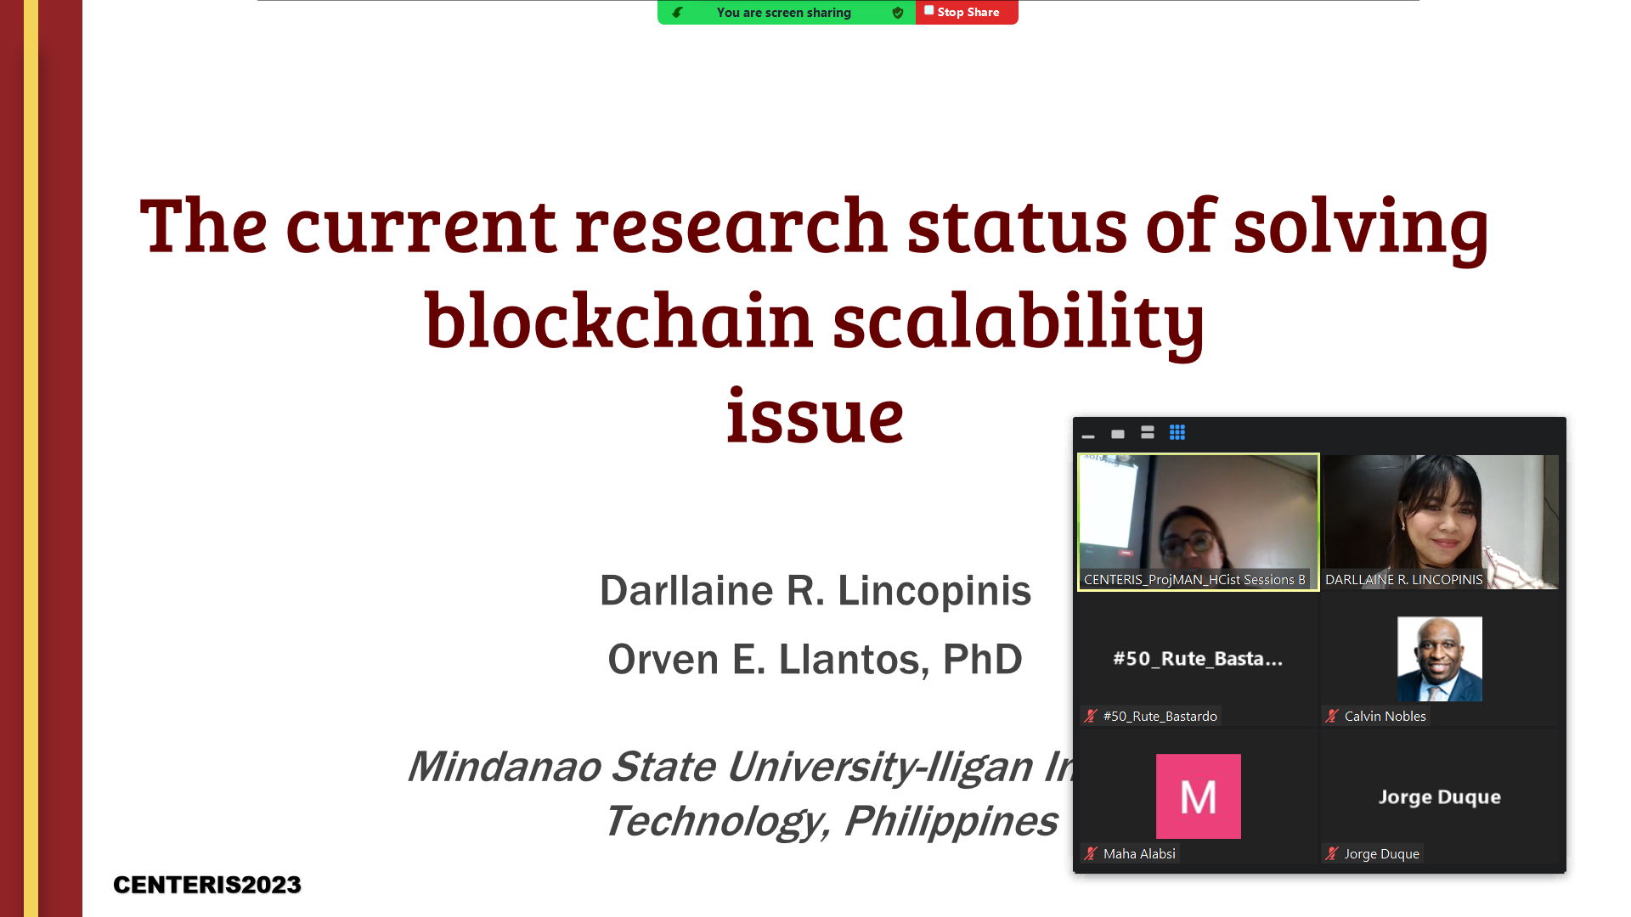

Slide 19
Accomplishments
Identified the materials used:
Ethereum
For scaling: state-channel
Development environment set up
Tools: Node.js , Hardhat
State channel Library (Connext)
Web3 for Ethereum interaction with .js and .ts project
Developed a basic smart contract (partial)
User registration
Material upload
Material access/retrieval
Material update and delete (this function also handles the collaborators approval to the update/delete request)
User comment, likes, number of reads, number of downloads
User log-in
Create react project
Browsing page
Selected material page
Confirm modal
Notes:
End 1

