Slide 1
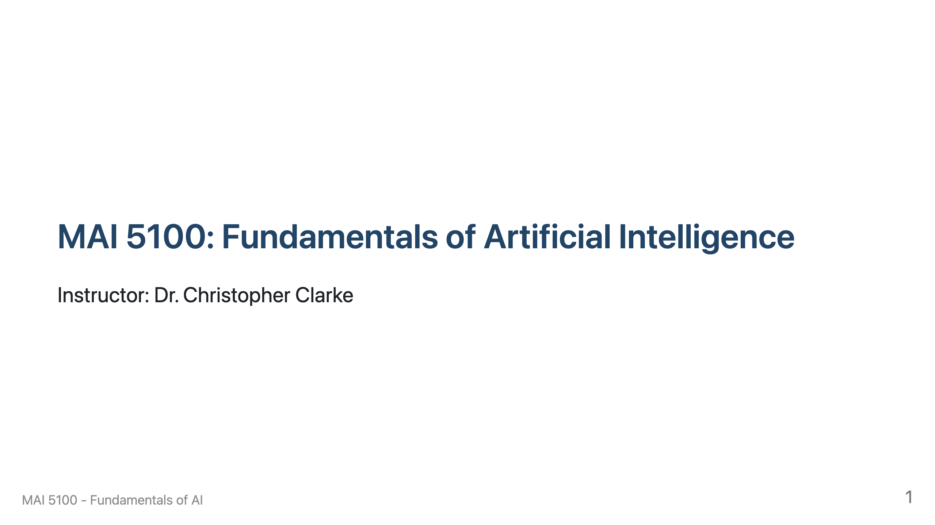

Slide 2
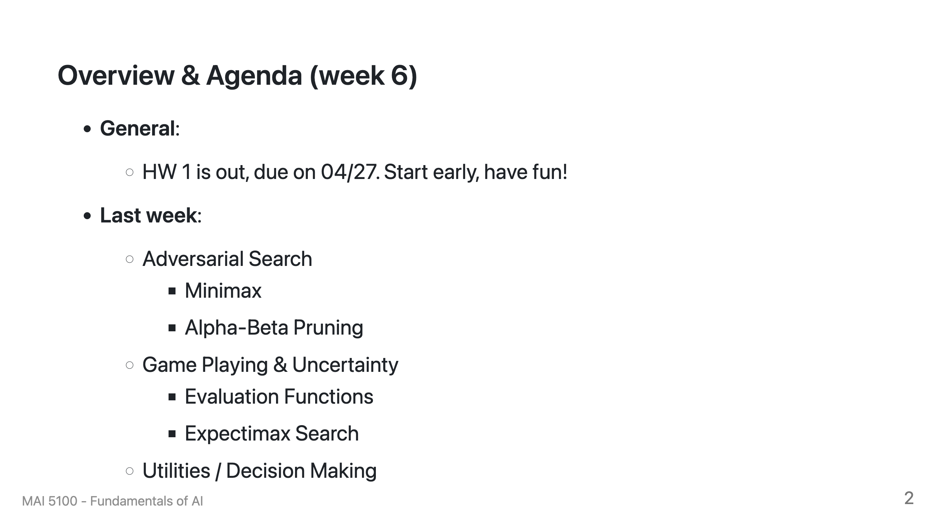

Slide 3
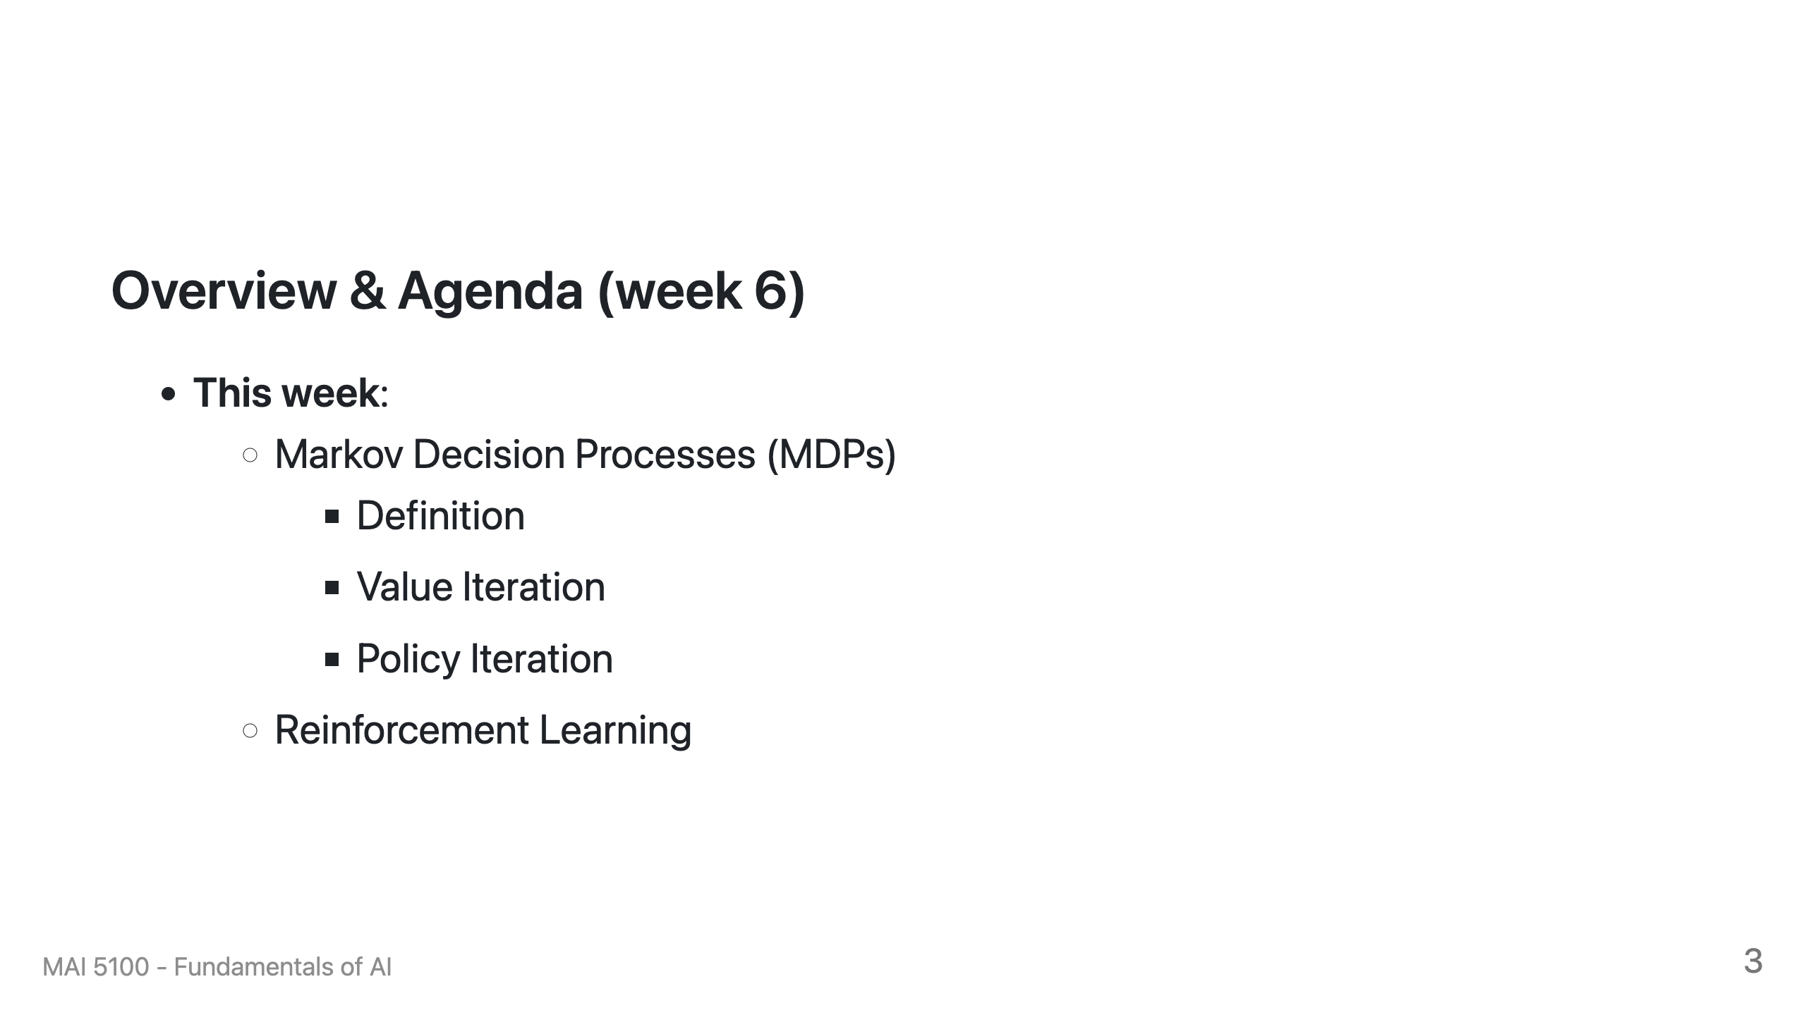

Slide 4
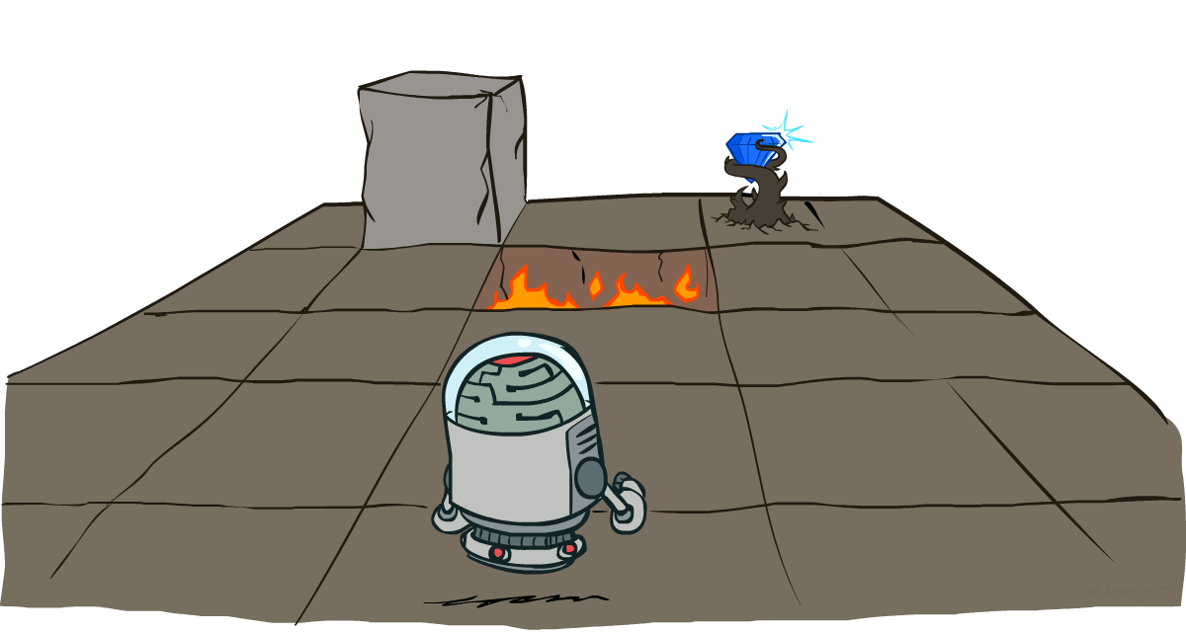
CS 188: Artificial Intelligence
Markov Decision Processes
Instructors: Dan Klein and Pieter Abbeel
University of California, Berkeley
[These slides were created by Dan Klein and Pieter Abbeel for CS188 Intro to AI at UC Berkeley. All CS188 materials are available at http://ai.berkeley.edu.]
Notes:
Please retain proper attribution, including the reference to ai.berkeley.edu. Thanks!

Slide 5
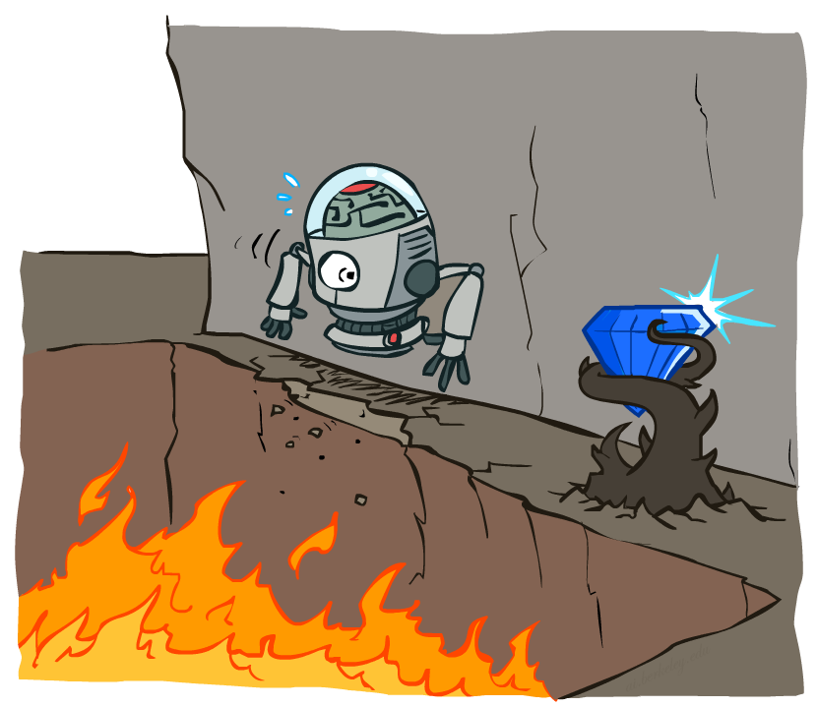
Non-Deterministic Search

Slide 6
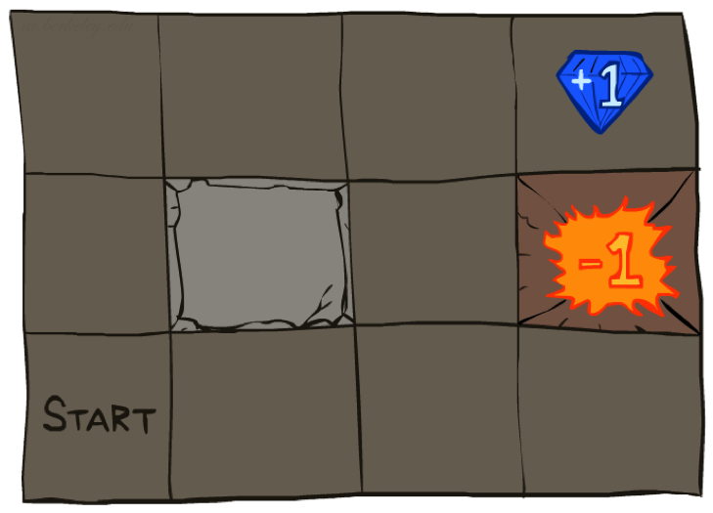




Example: Grid World
A maze-like problem
The agent lives in a grid
Walls block the agent’s path
Noisy movement: actions do not always go as planned
80% of the time, the action North takes the agent North (if there is no wall there)
10% of the time, North takes the agent West; 10% East
If there is a wall in the direction the agent would have been taken, the agent stays put
The agent receives rewards each time step
Small “living” reward each step (can be negative)
Big rewards come at the end (good or bad)
Goal: maximize sum of rewards
Notes:
[cut demo of moving around in grid world program]

Slide 7
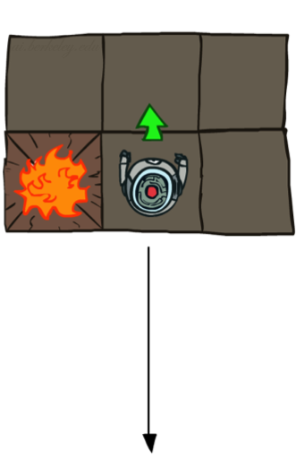
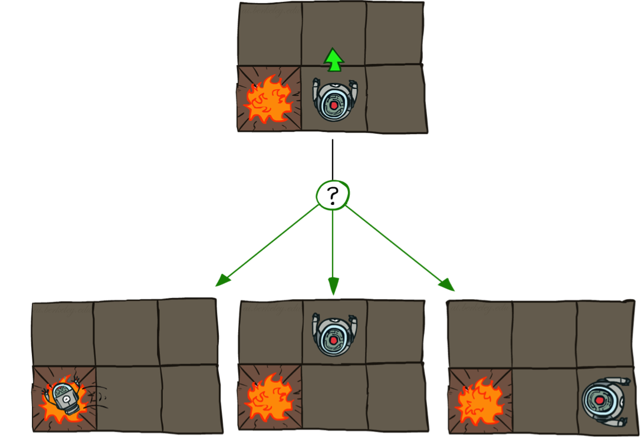
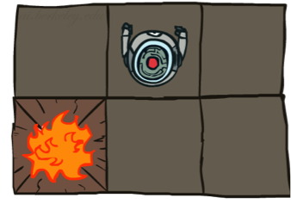
Grid World Actions
Deterministic Grid World
Stochastic Grid World

Slide 8
Markov Decision Processes
An MDP is defined by:
A set of states s ∈ S
A set of actions a ∈ A
A transition function T(s, a, s’)
Probability that a from s leads to s’, i.e., P(s’| s, a)
Also called the model or the dynamics
A reward function R(s, a, s’)
Sometimes just R(s) or R(s’)
A start state
Maybe a terminal state
MDPs are non-deterministic search problems
One way to solve them is with expectimax search
We’ll have a new tool soon
[Demo – gridworld manual intro (L8D1)]
Notes:
In search problems: did not talk about actions, but about successor functions --- now the information inside the successor function is unpacked into actions, transitions and reward
Write out S, A, example entry in T, entry in R
Reward function different from the book : R(s,a,s’)
In book simpler for equations, but not useful for the projects.
Need to modify expectimax a tiny little bit to account for rewards along the way, but that’s something you should be able to do, and so you can already solve MDP’s (not in most efficient way)

Slide 9

Video of Demo Gridworld Manual Intro

Slide 10
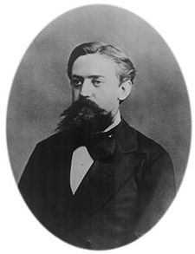

What is Markov about MDPs?
“Markov” generally means that given the present state, the future and the past are independent
For Markov decision processes, “Markov” means action outcomes depend only on the current state
This is just like search, where the successor function could only depend on the current state (not the history)
Andrey Markov (1856-1922)
Notes:
Like search: successor function only depended on current state
Can make this happen by stuffing more into the state;
Very similar to search problems: when solving a maze with food pellets, we stored which food pellets were eaten

Slide 11
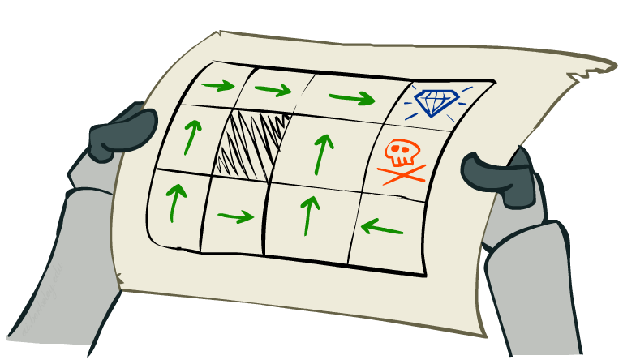
Policies
In deterministic single-agent search problems, we wanted an optimal plan, or sequence of actions, from start to a goal
For MDPs, we want an optimal policy π*: S → A
A policy π gives an action for each state
An optimal policy is one that maximizes expected utility if followed
An explicit policy defines a reflex agent
Expectimax didn’t compute entire policies
It computed the action for a single state only
Optimal policy when R(s, a, s’) = -0.03 for all non-terminals s
Notes:
Dan has a DEMO for this.

Slide 12
Optimal Policies
R(s) = -0.01
R(s) = -0.03
R(s) = -0.4
R(s) = -2.0
Notes:
R(s) = the “living reward”

Slide 13
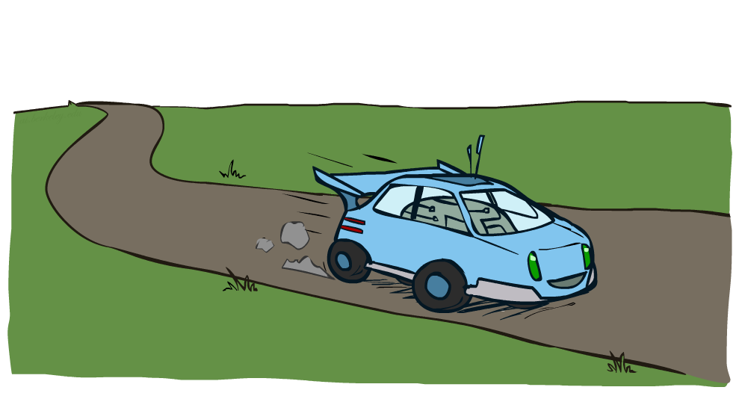
Example: Racing

Slide 14
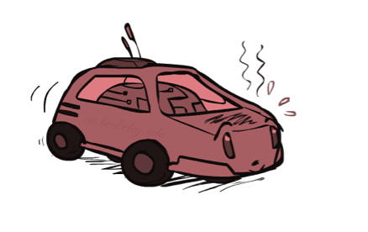
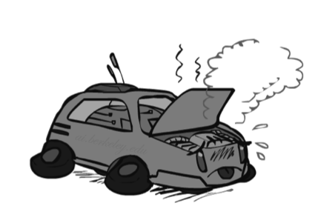
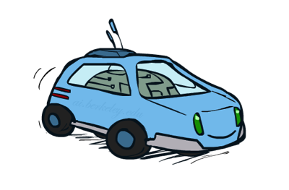
Example: Racing
A robot car wants to travel far, quickly
Three states: Cool, Warm, Overheated
Two actions: Slow, Fast
Going faster gets double reward
0.5
+1
1.0
Fast
Slow
-10
+1
0.5
Warm
Slow
Fast
0.5
+2
Cool
0.5
Overheated
+1
1.0
+2

Slide 15




Racing Search Tree

Slide 16
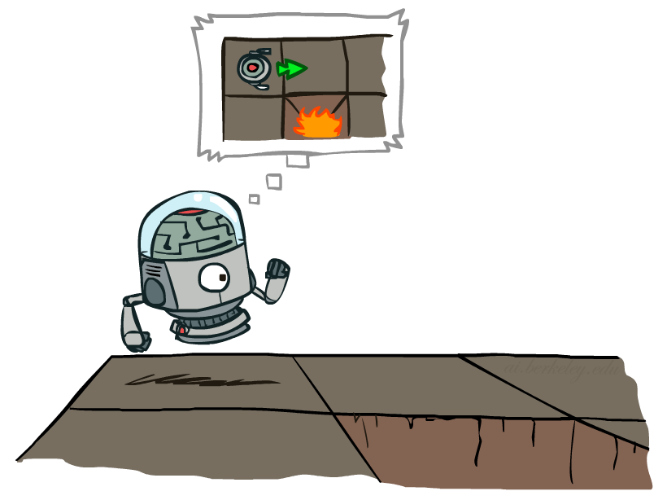

MDP Search Trees
Each MDP state projects an expectimax-like search tree
s
s is a state
a
(s, a) is a q-state
s, a
(s,a,s’) called a transition
T(s,a,s’) = P(s’|s,a)
R(s,a,s’)
s,a,s’
s’
Notes:
In MDP chance node represents uncertainty about what might happen based on (s,a) [as opposed to being a random adversary]
Q-state (s,a) is when you were in a state and took an action

Slide 17
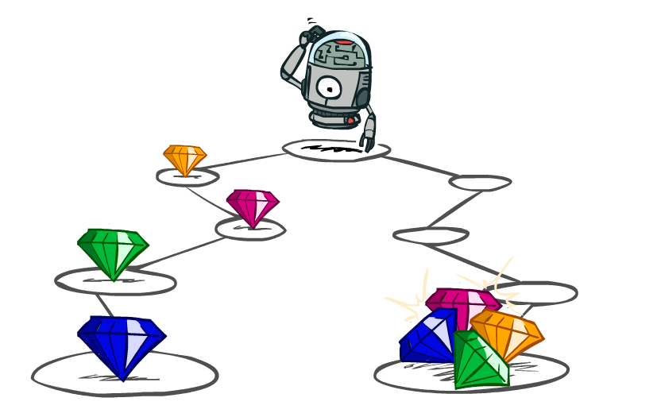
Utilities of Sequences

Slide 18
Utilities of Sequences
What preferences should an agent have over reward sequences?
More or less?
Now or later?
[1, 2, 2]
or
[2, 3, 4]
[0, 0, 1]
or
[1, 0, 0]

Slide 19
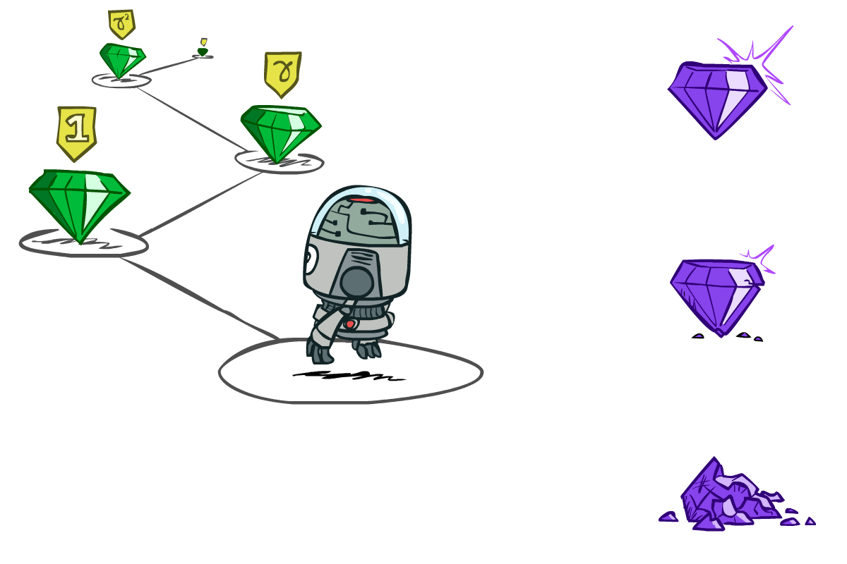

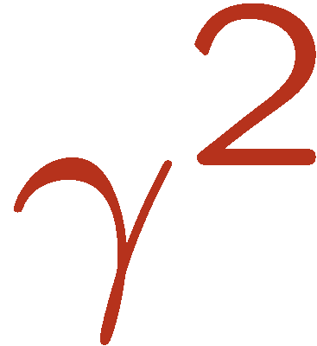
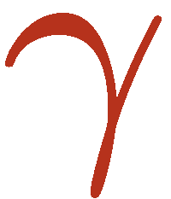
Discounting
It’s reasonable to maximize the sum of rewards
It’s also reasonable to prefer rewards now to rewards later
One solution: values of rewards decay exponentially
Worth Now
Worth Next Step
Worth In Two Steps

Slide 20

Discounting
How to discount?
Each time we descend a level, we multiply in the discount once
Why discount?
Sooner rewards probably do have higher utility than later rewards
Also helps our algorithms converge
Example: discount of 0.5
U([1,2,3]) = 1*1 + 0.5*2 + 0.25*3
U([1,2,3]) < U([3,2,1])
Notes:
Rewards in the future (deeper in the tree) matter less
Interesting: running expectimax, if having to truncate the search, then not losing much; e.g., less then \gamma^d / (1-\gamma)

Slide 21
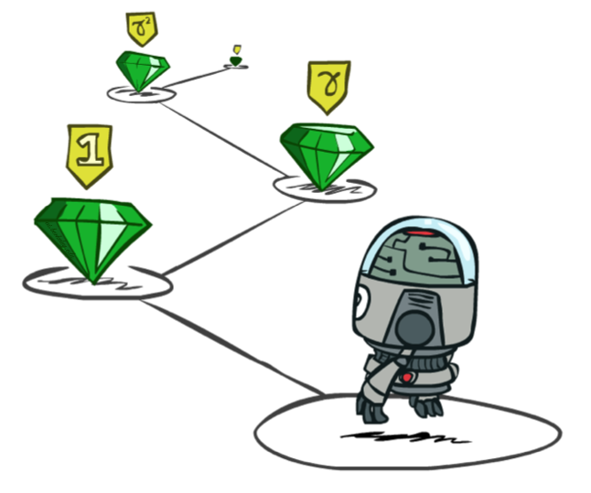
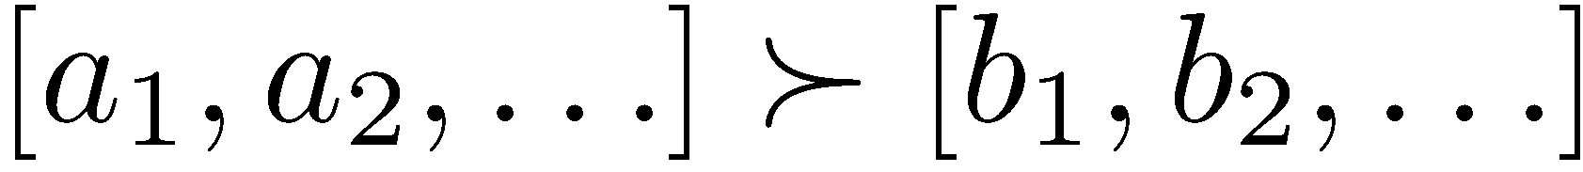
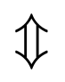
Stationary Preferences
Theorem: if we assume stationary preferences:
Then: there are only two ways to define utilities
Additive utility:
Discounted utility:

Slide 22


Quiz: Discounting
Given:
Actions: East, West, and Exit (only available in exit states a, e)
Transitions: deterministic
Quiz 1: For γ = 1, what is the optimal policy?
Quiz 2: For γ = 0.1, what is the optimal policy?
Quiz 3: For which γ are West and East equally good when in state d?
Notes:
- 1: <- , <-, <-
2: <-, <-, ->
γ≈0.3162

Slide 23
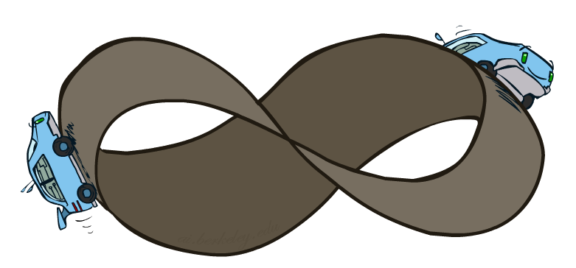
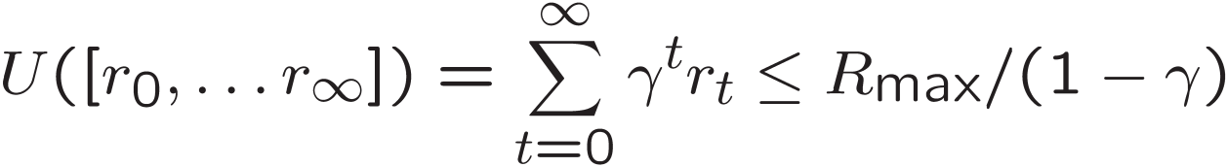
Infinite Utilities?!
Problem: What if the game lasts forever? Do we get infinite rewards?
Solutions:
Finite horizon: (similar to depth-limited search)
Terminate episodes after a fixed T steps (e.g. life)
Gives nonstationary policies (π depends on time left)
Discounting: use 0 < γ < 1
Smaller γ means smaller “horizon” – shorter term focus
Absorbing state: guarantee that for every policy, a terminal state will eventually be reached (like “overheated” for racing)

Slide 24
Recap: Defining MDPs
Markov decision processes:
Set of states S
Start state s₀
Set of actions A
Transitions P(s’|s,a) (or T(s,a,s’))
Rewards R(s,a,s’) (and discount γ)
MDP quantities so far:
Policy = Choice of action for each state
Utility = sum of (discounted) rewards
s
a
s, a
s,a,s’
s’

Slide 25
Solving MDPs

Slide 26
Optimal Quantities
The value (utility) of a state s:
V*(s) = expected utility starting in s and acting optimally
The value (utility) of a q-state (s,a):
Q*(s,a) = expected utility starting out having taken action a from state s and (thereafter) acting optimally
The optimal policy:
π*(s) = optimal action from state s
s
s is a state
a
(s, a) is a q-state
s, a
s,a,s’
(s,a,s’) is a transition
s’
[Demo – gridworld values (L8D4)]
Notes:
[Note: this demo doesn’t show anything in action, just pops up V and Q values.]

Slide 27
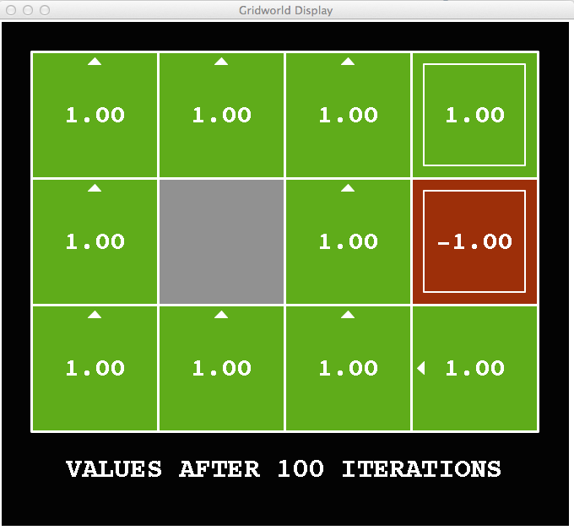
Snapshot of Demo – Gridworld V Values
Noise = 0
Discount = 1
Living reward = 0
Notes:
This demo doesn’t show anything in action, it just shows the V and Q values.

Slide 28
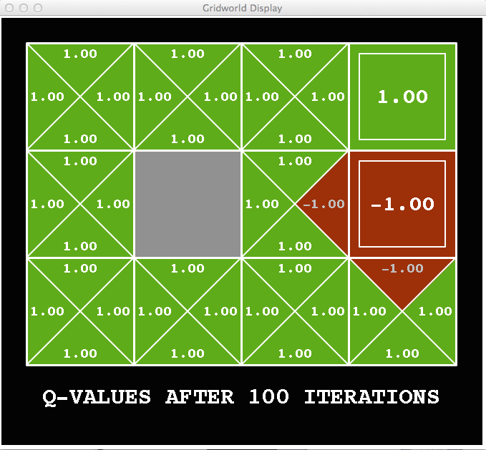
Snapshot of Demo – Gridworld Q Values
Noise = 0
Discount = 1
Living reward = 0
Notes:
This demo doesn’t show anything in action, it just shows the V and Q values.

Slide 29

Snapshot of Demo – Gridworld V Values
Noise = 0.2
Discount = 1
Living reward = 0
Notes:
This demo doesn’t show anything in action, it just shows the V and Q values.

Slide 30
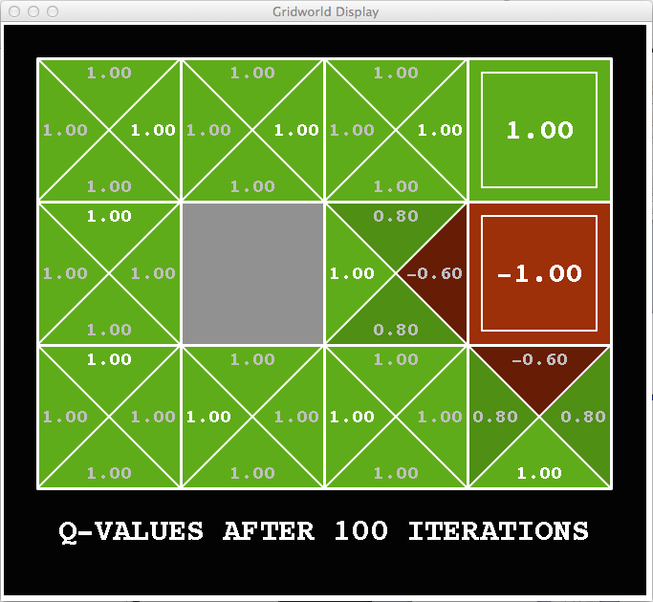
Snapshot of Demo – Gridworld Q Values
Noise = 0.2
Discount = 1
Living reward = 0
Notes:
This demo doesn’t show anything in action, it just shows the V and Q values.

Slide 31
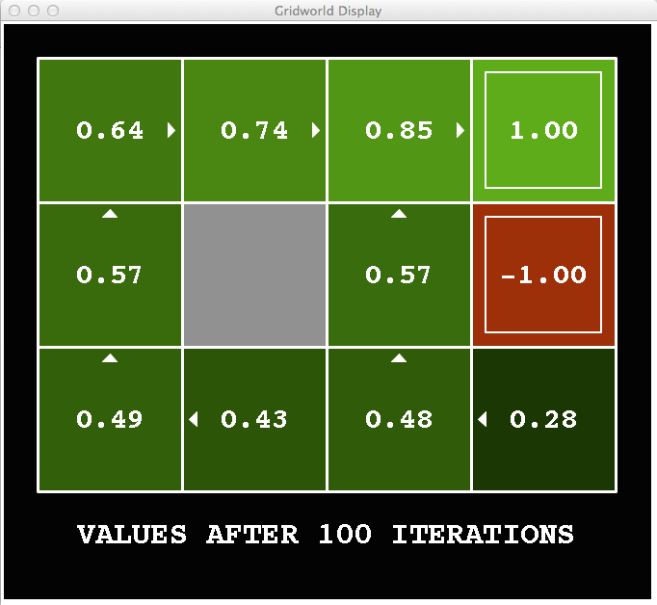
Snapshot of Demo – Gridworld V Values
Noise = 0.2
Discount = 0.9
Living reward = 0
Notes:
This demo doesn’t show anything in action, it just shows the V and Q values.

Slide 32
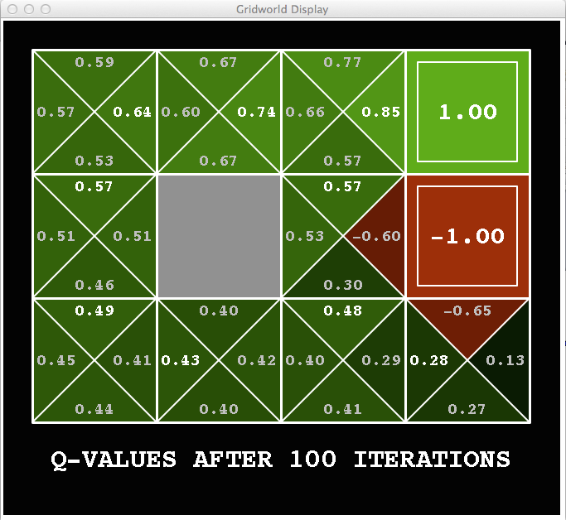
Snapshot of Demo – Gridworld Q Values
Noise = 0.2
Discount = 0.9
Living reward = 0
Notes:
This demo doesn’t show anything in action, it just shows the V and Q values.

Slide 33
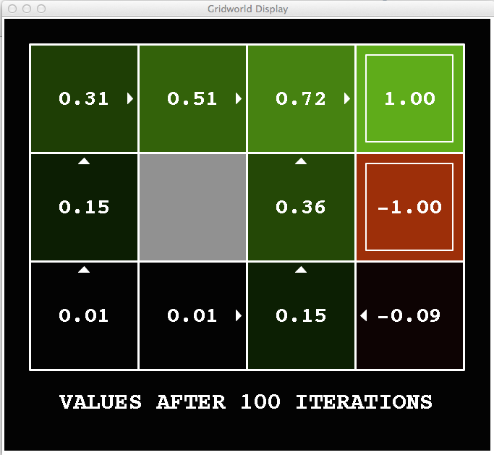
Snapshot of Demo – Gridworld V Values
Noise = 0.2
Discount = 0.9
Living reward = -0.1
Notes:
This demo doesn’t show anything in action, it just shows the V and Q values.

Slide 34
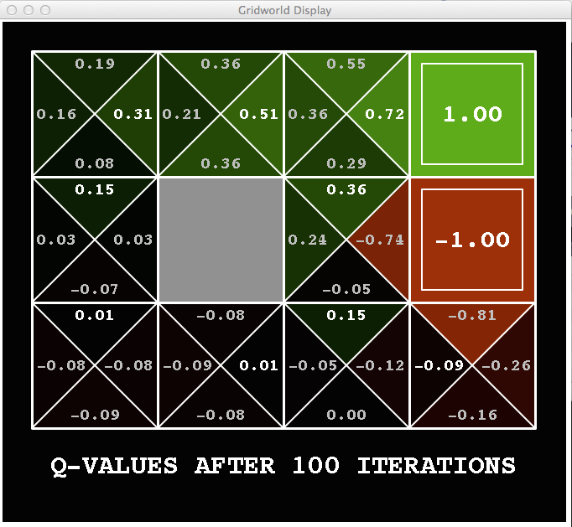
Snapshot of Demo – Gridworld Q Values
Noise = 0.2
Discount = 0.9
Living reward = -0.1
Notes:
This demo doesn’t show anything in action, it just shows the V and Q values.

Slide 35

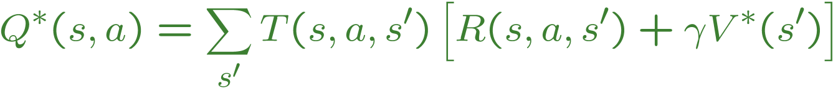
Values of States
Fundamental operation: compute the (expectimax) value of a state
Expected utility under optimal action
Average sum of (discounted) rewards
This is just what expectimax computed!
Recursive definition of value:
s
a
s, a
s,a,s’
s’

Slide 36
Racing Search Tree

Slide 37


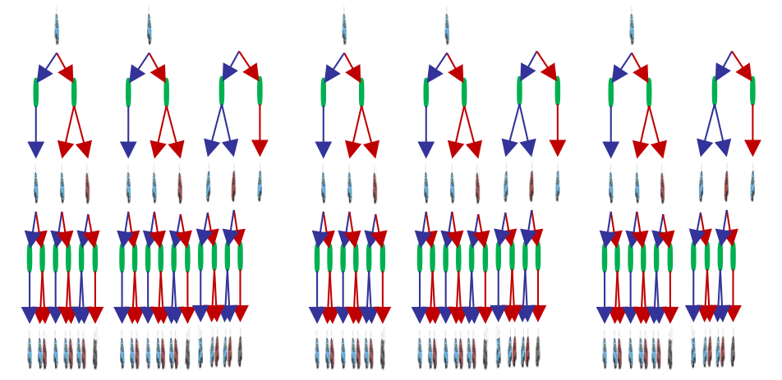

Racing Search Tree

Slide 38
Racing Search Tree
We’re doing way too much work with expectimax!
Problem: States are repeated
Idea: Only compute needed quantities once
Problem: Tree goes on forever
Idea: Do a depth-limited computation, but with increasing depths until change is small
Note: deep parts of the tree eventually don’t matter if γ < 1

Slide 39


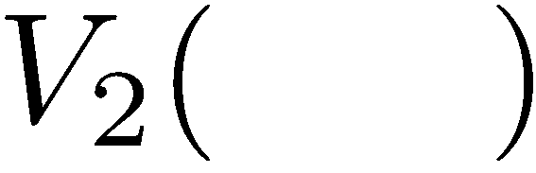


Time-Limited Values
Key idea: time-limited values
Define V_{k}(s) to be the optimal value of s if the game ends in k more time steps
Equivalently, it’s what a depth-k expectimax would give from s
[Demo – time-limited values (L8D6)]
Notes:
This demo generates the time-limited values for gridworld as snapshotted onto the next slides.

Slide 40
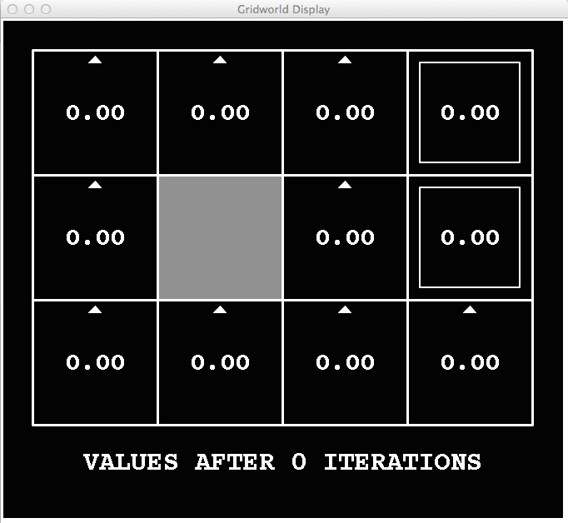
k=0
Noise = 0.2
Discount = 0.9
Living reward = 0
Notes:
Assuming zero living reward

Slide 41
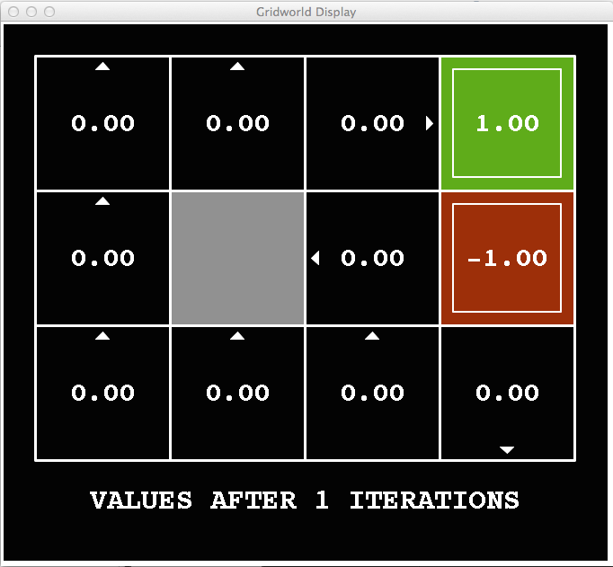
k=1
Noise = 0.2
Discount = 0.9
Living reward = 0
Notes:
Assuming zero living reward

Slide 42
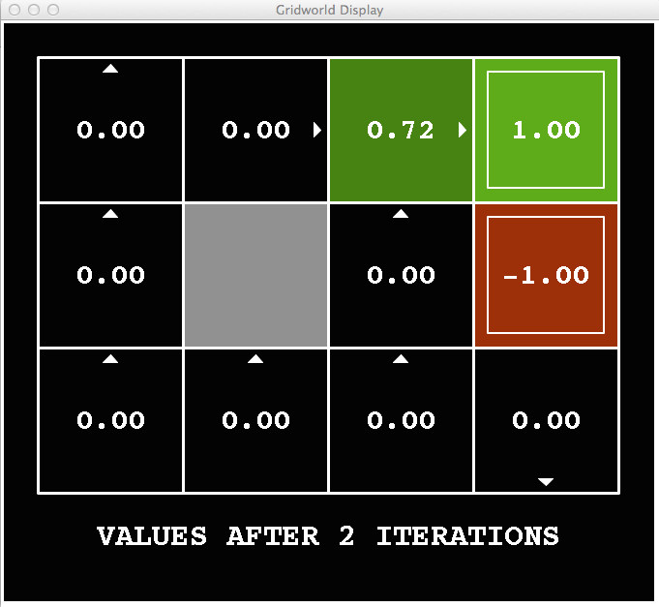
k=2
Noise = 0.2
Discount = 0.9
Living reward = 0
Notes:
Assuming zero living reward

Slide 43
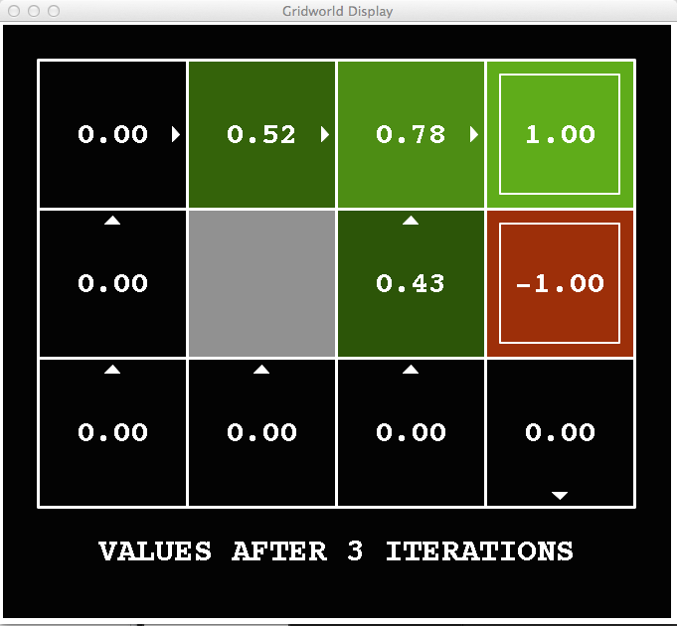
k=3
Noise = 0.2
Discount = 0.9
Living reward = 0
Notes:
Assuming zero living reward

Slide 44
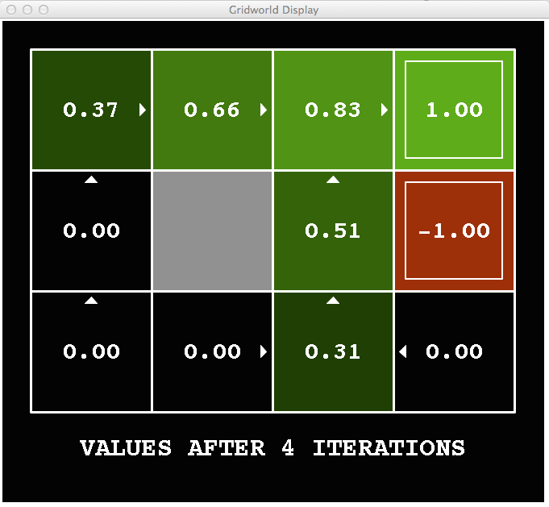
k=4
Noise = 0.2
Discount = 0.9
Living reward = 0
Notes:
Assuming zero living reward

Slide 45
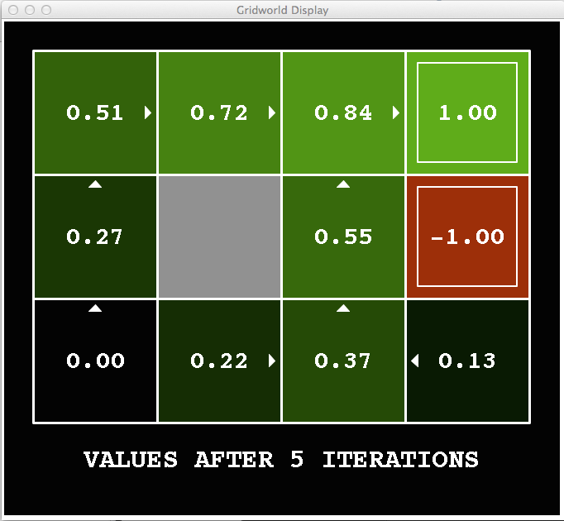
k=5
Noise = 0.2
Discount = 0.9
Living reward = 0
Notes:
Assuming zero living reward

Slide 46
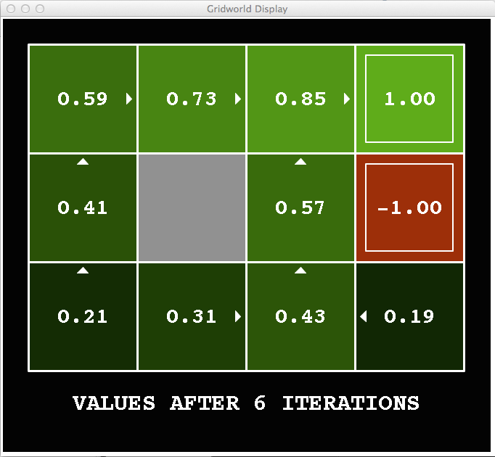
k=6
Noise = 0.2
Discount = 0.9
Living reward = 0
Notes:
Assuming zero living reward

Slide 47
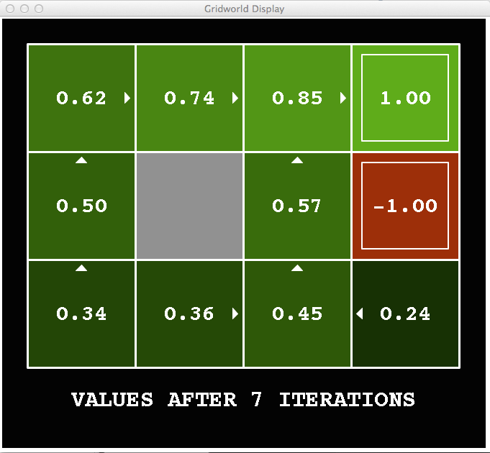
k=7
Noise = 0.2
Discount = 0.9
Living reward = 0
Notes:
Assuming zero living reward

Slide 48
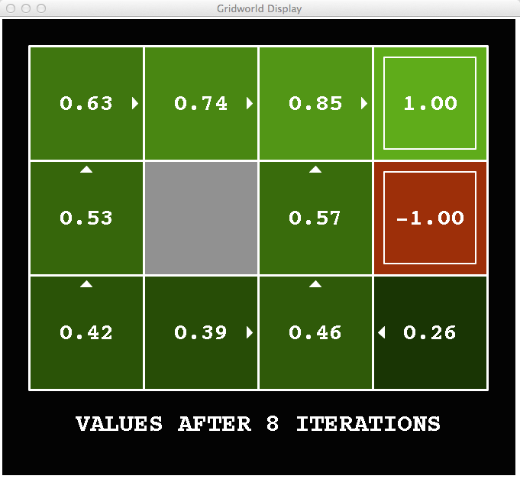
k=8
Noise = 0.2
Discount = 0.9
Living reward = 0
Notes:
Assuming zero living reward

Slide 49
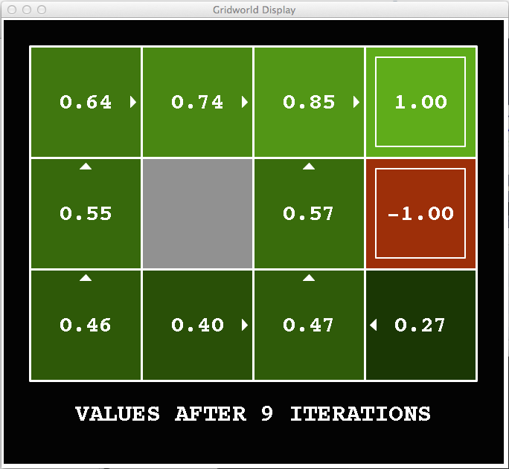
k=9
Noise = 0.2
Discount = 0.9
Living reward = 0
Notes:
Assuming zero living reward

Slide 50

k=10
Noise = 0.2
Discount = 0.9
Living reward = 0
Notes:
Assuming zero living reward

Slide 51

k=11
Noise = 0.2
Discount = 0.9
Living reward = 0
Notes:
Assuming zero living reward

Slide 52

k=12
Noise = 0.2
Discount = 0.9
Living reward = 0
Notes:
Assuming zero living reward

Slide 53

k=100
Noise = 0.2
Discount = 0.9
Living reward = 0
Notes:
Assuming zero living reward

Slide 54
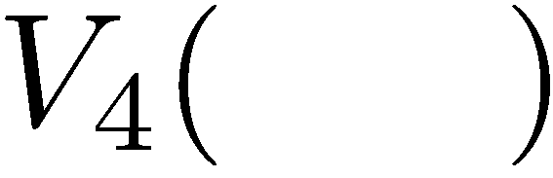

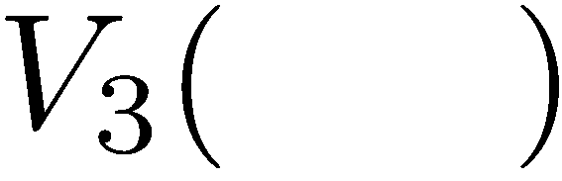
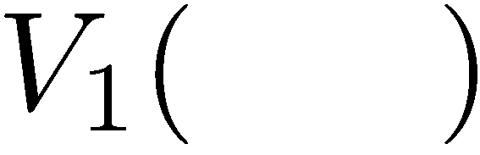
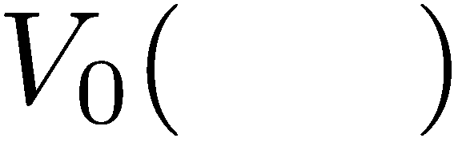
Computing Time-Limited Values
Notes:
V0 we know will be zero as there are no rewards

Slide 55
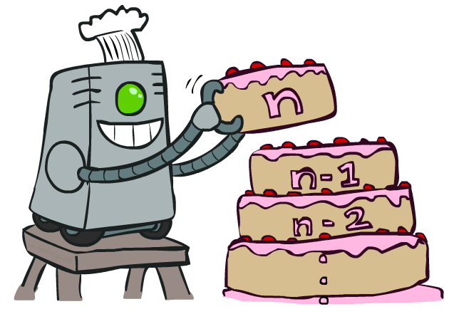
Value Iteration

Slide 56
Value Iteration
Start with V₀(s) = 0: no time steps left means an expected reward sum of zero
Given vector of V_{k}(s) values, do one ply of expectimax from each state:
Repeat until convergence
Complexity of each iteration: O(S²A)
Theorem: will converge to unique optimal values
Basic idea: approximations get refined towards optimal values
Policy may converge long before values do
V_{k+1}(s)
a
s, a
s,a,s’
V_{k}(s’)
Notes:
Discuss computational complexity: S * A * S times number of iterations
Note: updates not in place [if in place, it means something else and not even clear what it means]

Slide 57







Example: Value Iteration
3.5 2.5 0
2 1 0
Assume no discount!
0 0 0

Slide 58


Convergence*
How do we know the V_{k} vectors are going to converge?
Case 1: If the tree has maximum depth M, then V_{M} holds the actual untruncated values
Case 2: If the discount is less than 1
Sketch: For any state V_{k} and V_{k+1} can be viewed as depth k+1 expectimax results in nearly identical search trees
The difference is that on the bottom layer, V_{k+1} has actual rewards while V_{k} has zeros
That last layer is at best all R_{MAX}
It is at worst R_{MIN}
But everything is discounted by γ^{k} that far out
So V_{k} and V_{k+1} are at most γ^{k} max|R| different
So as k increases, the values converge

Slide 59
Example: Grid World
A maze-like problem
The agent lives in a grid
Walls block the agent’s path
Noisy movement: actions do not always go as planned
80% of the time, the action North takes the agent North (if there is no wall there)
10% of the time, North takes the agent West; 10% East
If there is a wall in the direction the agent would have been taken, the agent stays put
The agent receives rewards each time step
Small “living” reward each step (can be negative)
Big rewards come at the end (good or bad)
Goal: maximize sum of rewards
Notes:
[cut demo of moving around in grid world program]

Slide 60
Recap: MDPs
Markov decision processes:
States S
Actions A
Transitions P(s’|s,a) (or T(s,a,s’))
Rewards R(s,a,s’) (and discount γ)
Start state s₀
Quantities:
Policy = map of states to actions
Utility = sum of discounted rewards
Values = expected future utility from a state (max node)
Q-Values = expected future utility from a q-state (chance node)
s
a
s, a
s,a,s’
s’

Slide 61
Optimal Quantities
The value (utility) of a state s:
V*(s) = expected utility starting in s and acting optimally
The value (utility) of a q-state (s,a):
Q*(s,a) = expected utility starting out having taken action a from state s and (thereafter) acting optimally
The optimal policy:
π*(s) = optimal action from state s
s
s is a state
a
(s, a) is a q-state
s, a
s,a,s’
(s,a,s’) is a transition
s’
[Demo: gridworld values (L9D1)]
Notes:
Demo just shows V and Q values, snapshots on next slides.

Slide 62

Gridworld Values V*

Slide 63

Gridworld: Q*

Slide 64

The Bellman Equations
How to be optimal:
Step 1: Take correct first action
Step 2: Keep being optimal

Slide 65

The Bellman Equations
Definition of “optimal utility” via expectimax recurrence gives a simple one-step lookahead relationship amongst optimal utility values
These are the Bellman equations, and they characterize optimal values in a way we’ll use over and over
s
a
s, a
s,a,s’
s’
Notes:
Let’s start by equations that characterize these quantities through mutual recursions. [step through this by writing on slide, one step at a time]
Recursive characterization of V* in terms of V*; not necessarily helpful; but it is a characterization.
Note: this is a set of equations that needs to be satisfied; but it could have multiple solutions (it does not, but at this stage of our knowledge it could).

Slide 66
Value Iteration
Bellman equations characterize the optimal values:
Value iteration computes them:
Value iteration is just a fixed point solution method
… though the V_{k} vectors are also interpretable as time-limited values
V(s)
a
s, a
s,a,s’
V(s’)
Notes:
Discuss computational complexity: S * A * S times number of iterations
Note: updates not in place [if in place, it means something else and not even clear what it means]

Slide 67
Value Iteration
Start with V₀(s) = 0: no time steps left means an expected reward sum of zero
Given vector of V_{k}(s) values, do one ply of expectimax from each state:
Repeat until convergence
Complexity of each iteration: O(S²A)
Theorem: will converge to unique optimal values
Basic idea: approximations get refined towards optimal values
Policy may converge long before values do
V_{k+1}(s)
a
s, a
s,a,s’
V_{k}(s’)
Notes:
Discuss computational complexity: S * A * S times number of iterations
Note: updates not in place [if in place, it means something else and not even clear what it means]

Slide 68
Convergence*
How do we know the V_{k} vectors are going to converge?
Case 1: If the tree has maximum depth M, then V_{M} holds the actual untruncated values
Case 2: If the discount is less than 1
Sketch: For any state V_{k} and V_{k+1} can be viewed as depth k+1 expectimax results in nearly identical search trees
The difference is that on the bottom layer, V_{k+1} has actual rewards while V_{k} has zeros
That last layer is at best all R_{MAX}
It is at worst R_{MIN}
But everything is discounted by γ^{k} that far out
So V_{k} and V_{k+1} are at most γ^{k} max|R| different
So as k increases, the values converge

Slide 69

Policy Methods

Slide 70

Policy Evaluation

Slide 71
Fixed Policies
Do the optimal action
Do what π says to do
s
s
a
π(s)
s, a
s, π(s)
s,a,s’
s, π(s),s’
s’
s’
Expectimax trees max over all actions to compute the optimal values
If we fixed some policy π(s), then the tree would be simpler – only one action per state
… though the tree’s value would depend on which policy we fixed

Slide 72
Utilities for a Fixed Policy
Another basic operation: compute the utility of a state s under a fixed (generally non-optimal) policy
Define the utility of a state s, under a fixed policy π:
V^{π}(s) = expected total discounted rewards starting in s and following π
Recursive relation (one-step look-ahead / Bellman equation):
s
π(s)
s, π(s)
s, π(s),s’
s’

Slide 73


Example: Policy Evaluation
Always Go Right
Always Go Forward

Slide 74


Example: Policy Evaluation
Always Go Right
Always Go Forward

Slide 75

Policy Evaluation
s
How do we calculate the V’s for a fixed policy π?
Idea 1: Turn recursive Bellman equations into updates
(like value iteration)
Efficiency: O(S²) per iteration
Idea 2: Without the maxes, the Bellman equations are just a linear system
Solve with Matlab (or your favorite linear system solver)
π(s)
s, π(s)
s, π(s),s’
s’

Slide 76

Policy Extraction

Slide 77



Computing Actions from Values
Let’s imagine we have the optimal values V*(s)
How should we act?
It’s not obvious!
We need to do a mini-expectimax (one step)
This is called policy extraction, since it gets the policy implied by the values

Slide 78


Computing Actions from Q-Values
Let’s imagine we have the optimal q-values:
How should we act?
Completely trivial to decide!
Important lesson: actions are easier to select from q-values than values!

Slide 79

Policy Iteration

Slide 80
Problems with Value Iteration
Value iteration repeats the Bellman updates:
Problem 1: It’s slow – O(S²A) per iteration
Problem 2: The “max” at each state rarely changes
Problem 3: The policy often converges long before the values
s
a
s, a
s,a,s’
s’
[Demo: value iteration (L9D2)]
Notes:
Demo steps through value iteration; snapshots of values shown on next slides.

Slide 81
k=0
Noise = 0.2
Discount = 0.9
Living reward = 0
Notes:
Assuming zero living reward

Slide 82
k=1
Noise = 0.2
Discount = 0.9
Living reward = 0
Notes:
Assuming zero living reward

Slide 83
k=2
Noise = 0.2
Discount = 0.9
Living reward = 0
Notes:
Assuming zero living reward

Slide 84
k=3
Noise = 0.2
Discount = 0.9
Living reward = 0
Notes:
Assuming zero living reward

Slide 85
k=4
Noise = 0.2
Discount = 0.9
Living reward = 0
Notes:
Assuming zero living reward

Slide 86
k=5
Noise = 0.2
Discount = 0.9
Living reward = 0
Notes:
Assuming zero living reward

Slide 87
k=6
Noise = 0.2
Discount = 0.9
Living reward = 0
Notes:
Assuming zero living reward

Slide 88
k=7
Noise = 0.2
Discount = 0.9
Living reward = 0
Notes:
Assuming zero living reward

Slide 89
k=8
Noise = 0.2
Discount = 0.9
Living reward = 0
Notes:
Assuming zero living reward

Slide 90
k=9
Noise = 0.2
Discount = 0.9
Living reward = 0
Notes:
Assuming zero living reward

Slide 91
k=10
Noise = 0.2
Discount = 0.9
Living reward = 0
Notes:
Assuming zero living reward

Slide 92
k=11
Noise = 0.2
Discount = 0.9
Living reward = 0
Notes:
Assuming zero living reward

Slide 93
k=12
Noise = 0.2
Discount = 0.9
Living reward = 0
Notes:
Assuming zero living reward

Slide 94
k=100
Noise = 0.2
Discount = 0.9
Living reward = 0
Notes:
Assuming zero living reward

Slide 95
Policy Iteration
Alternative approach for optimal values:
Step 1: Policy evaluation: calculate utilities for some fixed policy (not optimal utilities!) until convergence
Step 2: Policy improvement: update policy using one-step look-ahead with resulting converged (but not optimal!) utilities as future values
Repeat steps until policy converges
This is policy iteration
It’s still optimal!
Can converge (much) faster under some conditions

Slide 96
Policy Iteration
Evaluation: For fixed current policy π, find values with policy evaluation:
Iterate until values converge:
Improvement: For fixed values, get a better policy using policy extraction
One-step look-ahead:

Slide 97
Comparison
Both value iteration and policy iteration compute the same thing (all optimal values)
In value iteration:
Every iteration updates both the values and (implicitly) the policy
We don’t track the policy, but taking the max over actions implicitly recomputes it
In policy iteration:
We do several passes that update utilities with fixed policy (each pass is fast because we consider only one action, not all of them)
After the policy is evaluated, a new policy is chosen (slow like a value iteration pass)
The new policy will be better (or we’re done)
Both are dynamic programs for solving MDPs

Slide 98
Summary: MDP Algorithms
So you want to….
Compute optimal values: use value iteration or policy iteration
Compute values for a particular policy: use policy evaluation
Turn your values into a policy: use policy extraction (one-step lookahead)
These all look the same!
They basically are – they are all variations of Bellman updates
They all use one-step lookahead expectimax fragments
They differ only in whether we plug in a fixed policy or max over actions

Slide 99



Double Bandits

Slide 100
Double-Bandit MDP
Actions: Blue, Red
States: Win, Lose
No discount
100 time steps
Both states have the same value
0.25 $0
0.75
$2
W
L
0.25
$0
$1
1.0
$1
1.0
0.75 $2

Slide 101
Offline Planning
Solving MDPs is offline planning
You determine all quantities through computation
You need to know the details of the MDP
You do not actually play the game!
No discount
100 time steps
Both states have the same value
0.25 $0
Value
0.75
$2
W
0.25
$0
Play Red
150
L
$1
1.0
$1
1.0
0.75 $2
Play Blue
100

Slide 102
Let’s Play!
$2
$2
$0
$2
$2
$2
$2
$0
$0
$0

Slide 103
Online Planning
Rules changed! Red’s win chance is different.
?? $0
??
$2
W
L
??
$0
$1
1.0
$1
1.0
?? $2

Slide 104
Let’s Play!
$0
$0
$0
$2
$0
$2
$0
$0
$0
$0

Slide 105
What Just Happened?
That wasn’t planning, it was learning!
Specifically, reinforcement learning
There was an MDP, but you couldn’t solve it with just computation
You needed to actually act to figure it out
Important ideas in reinforcement learning that came up
Exploration: you have to try unknown actions to get information
Exploitation: eventually, you have to use what you know
Regret: even if you learn intelligently, you make mistakes
Sampling: because of chance, you have to try things repeatedly
Difficulty: learning can be much harder than solving a known MDP

Slide 106
Next Time: Reinforcement Learning!

