Slide 1


SIMATS ENGINEERING
SAVEETHA INSTITUTE OF MEDICAL AND TECHNICAL SCIENCES
Regular Expressions for Real-World Text Processing
DSA0302 -Natural Language Processing
Guided by :
Presented by :
DR.T.DEVI
D.Bindu Priya [192425162]

Slide 2
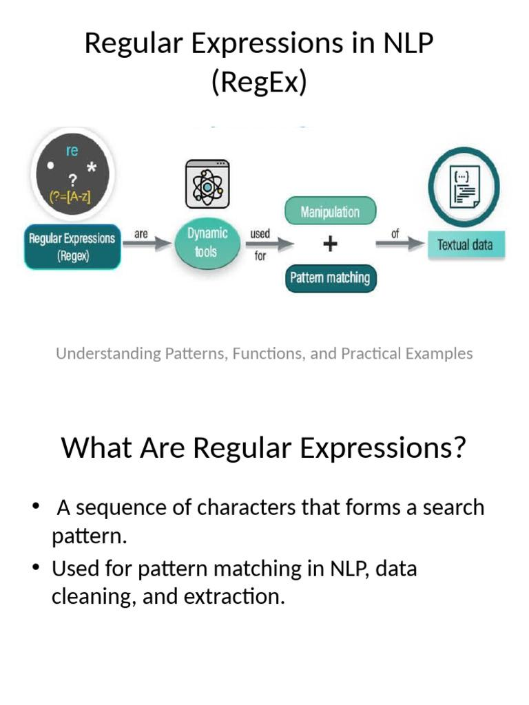
INTRODUCTION
What is a Regular Expression (Regex)?
A Regular Expression (Regex) is a sequence of characters used to search and match patterns in text.
It helps computers identify specific text formats quickly.
Regex is an important text preprocessing technique in Natural Language Processing (NLP).
It is widely used for extracting information from unstructured text.

Slide 3
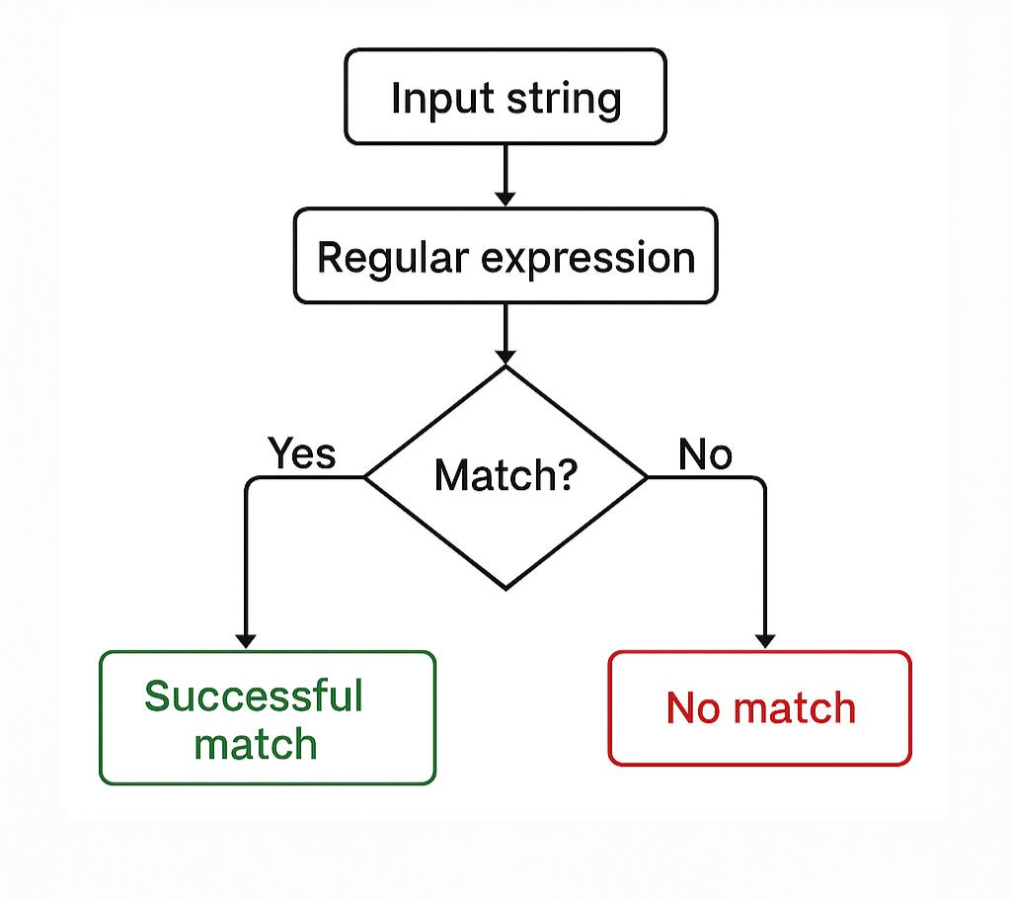
Example:
Input:
Email: abc@gmail.com
Phone: 9876543210
Output:
Email → abc@gmail.com
Phone → 9876543210

Slide 4
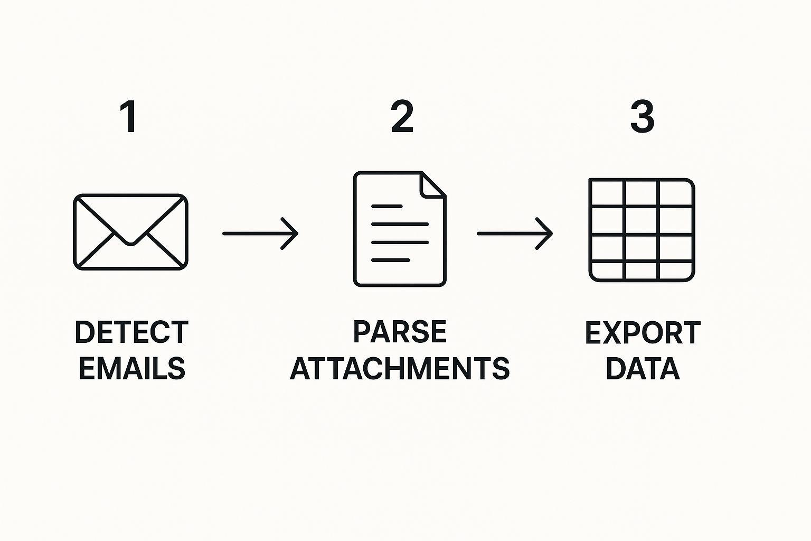
Applications
Real-World Applications of Regex
Email Extraction
Phone Number Detection
URL Detection
Date Extraction
Password Validation
Data Cleaning

Slide 5
Working Process
Regex Working Flow
Input Text
↓
Regex Pattern
↓
Pattern Matching
↓
Information Extraction
↓
Output

Slide 6
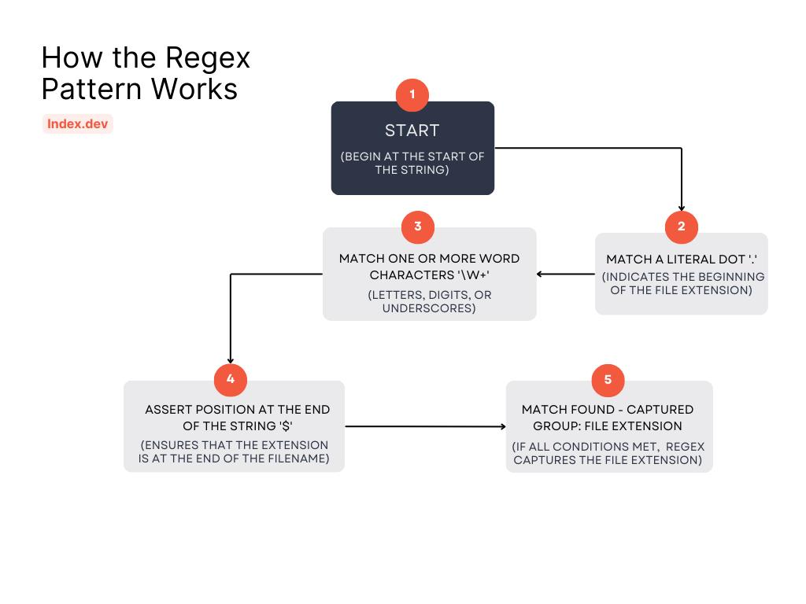
Advantages & Limitations
Advantages
Fast processing
Easy to learn
High accuracy for pattern matching
Saves time
Useful in NLP preprocessing
Limitations
Cannot understand sentence meaning
Complex patterns are difficult to create
Cannot detect context or emotions
Works only on predefined patterns

Slide 7
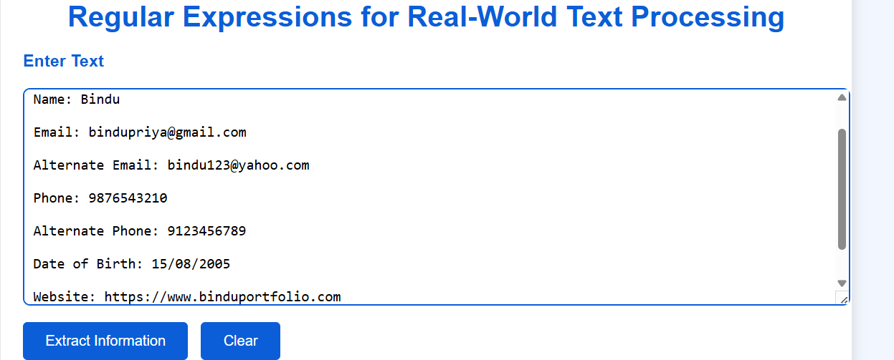
Input:

Slide 8
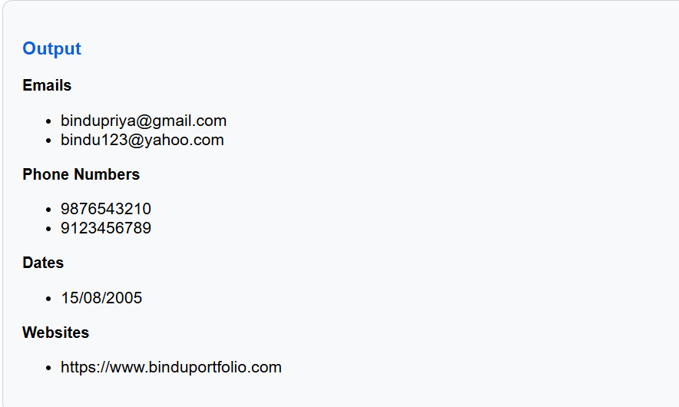
OUTPUT:

Slide 9
CONCLUSION
Regex is one of the simplest and most effective text-processing techniques in NLP.
It helps identify, validate, and extract important information from text.
It is widely used in search engines, data mining, and information retrieval.
Regex is an essential skill for every NLP developer.

Slide 10
THANK YOU

