Slide 1






TMTS Oracle
Company
Tesla
Square
Nerd Stuff
Collectibles
About us
Contact
2022

Slide 2
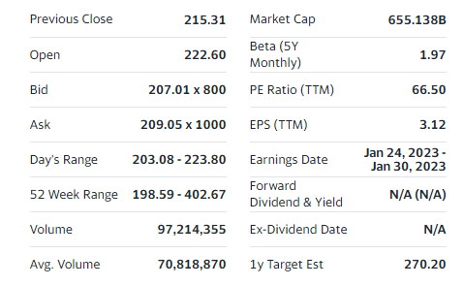
TMTS Oracle
Summary
Fundamentals
Liquidity&Solvency
Growth Metrics
Performance Metrics
Equity Structure
Price Forecast
Company
Tesla
Real-time stock Price chart (pull from some financial API source)
Square
Nerd Stuff
Collectibles
About us
Contact
Summary of main metrics, open/close prices, etc…
2022

Slide 3
TMTS Oracle
Summary
Fundamentals
Liquidity&Solvency
Growth Metrics
Performance Metrics
Equity Structure
Price Forecast
Company
Tesla
Quarter
Year
TTM
Dropdown (select bar chart)
Square
Bar Chart (Revenue, Gross profit, Income from operations, Net income attributable to common stockholders, Adjusted EBITDA, FcF): Total of 6 bar charts.
Nerd Stuff
Collectibles
About us
Contact
Dropdown (select scatter plot)
Line Chart (Gross profit margin, Operating income margin, Net income margin, Adjusted EBITDA margin): Total of 4 line charts.
2022

Slide 4
TMTS Oracle
Summary
Fundamentals
Liquidity&Solvency
Growth Metrics
Performance Metrics
Equity Structure
Price Forecast
Company
Tesla
Dropdown (select line chart)
Square
Line Chart (Current ratio, quick ratio, debt to equity ratio, debt to assets ratio, equity ratio): Total of 5 line charts.
Nerd Stuff
Collectibles
About us
Contact
Definition of what each liquidity/solvency ratio is. Basically how it is computed (what entries from assets and liabilities are considered in the calculation). Maybe add links to external resources (investopedia for example).
2022

Slide 5
TMTS Oracle
Summary
Fundamentals
Liquidity&Solvency
Growth Metrics
Performance Metrics
Equity Structure
Price Forecast
Company
Tesla
QoQ
YoY
5yr
Dropdown (select line chart)
Square
Line Chart (revenue growth, gross profit growth, operating margin growth, net income margin growth, adj ebitda growth, eps growth, 5yr operating profit CAGR, 5yr Fcf CAGR): Total of 5 line charts.
Nerd Stuff
Collectibles
About us
Contact
Definition of how each growth metric is computed (equation and quarters considered).
2022

Slide 6
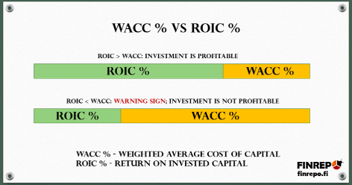
TMTS Oracle
Summary
Fundamentals
Liquidity&Solvency
Growth Metrics
Performance Metrics
Equity Structure
Price Forecast
Company
Tesla
TTM
Year
Dropdown (select bar chart)
Square
Line Chart (Invested Capital, Total Assets, ROE, ROA, operating ROIC, FcF ROIC): Total of 6 bar charts.
Nerd Stuff
Collectibles
About us
Contact
Definition of how each performance metric is computed (equation and quarters considered).
2022

Slide 7
TMTS Oracle
Summary
Fundamentals
Liquidity&Solvency
Growth Metrics
Performance Metrics
3Equity Structure
Price Forecast
Company
Tesla
Pie chart: institutional investors, insiders, retail investors
Line chart of outstanding shares.
Square
Nerd Stuff
Collectibles
About us
Contact
Table of main shareholders: name, number of shares, percentage, type of investor.
Tesla current credit rating is XXX
2022

Slide 8
TMTS Oracle
Summary
Fundamentals
Liquidity&Solvency
Growth Metrics
Performance Metrics
3Equity Structure
Price Forecast
Company
Tesla
Dropdown (select line chart)
Square
Line Chart (4 qtr rate of change of fcf ROIC, 4qtr rate of change of invested capital): Total of 2 line charts.
Nerd Stuff
Collectibles
About us
Contact
Dropdown (select line chart)
Bar Chart (Project FCF per quarte till 2030):.
TEXT: Mathematical model based on 4 qtr avg rate of change of fcf ROIC up to a máximum of 40% and Invested capital rate of change. Projected FCF based on quarter ROIC increase and Invested capital rate).
2022

