Slide 1

The Military Home

Slide 2
Research Goal
What is the economic upside for enlisted soldiers in today’s housing market?
Key Finding #1: The earliest rank to afford rent would be E4
Key Finding #2: The earliest affordable home purchase is E8

Slide 3

Housing and Rank
Assumptions
Max payment 28% -- BAH with dependents -- 4+ years in service
E1
$1125.60
E2
$1204.06
E3
$1338.96
E4
$1463.20
E5
$1564.42
E6
$1662.02
E7
$1837.67
E8
$2116.38
Minimum 8 years in service
E9:
$2483.12
Min 10 years in service
Notes:
Delete the math or keep it?

Slide 4
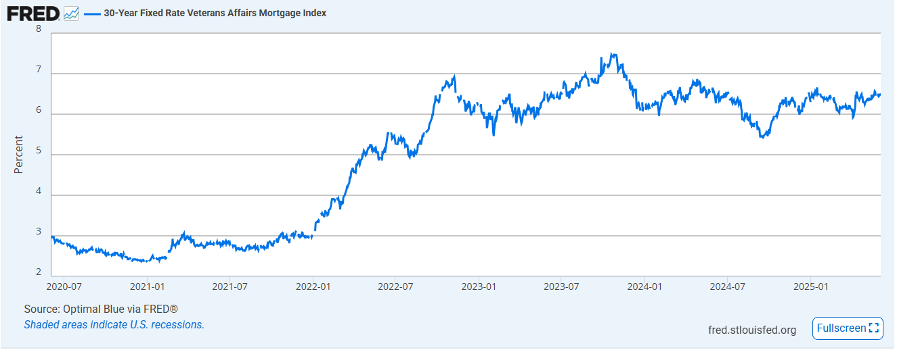
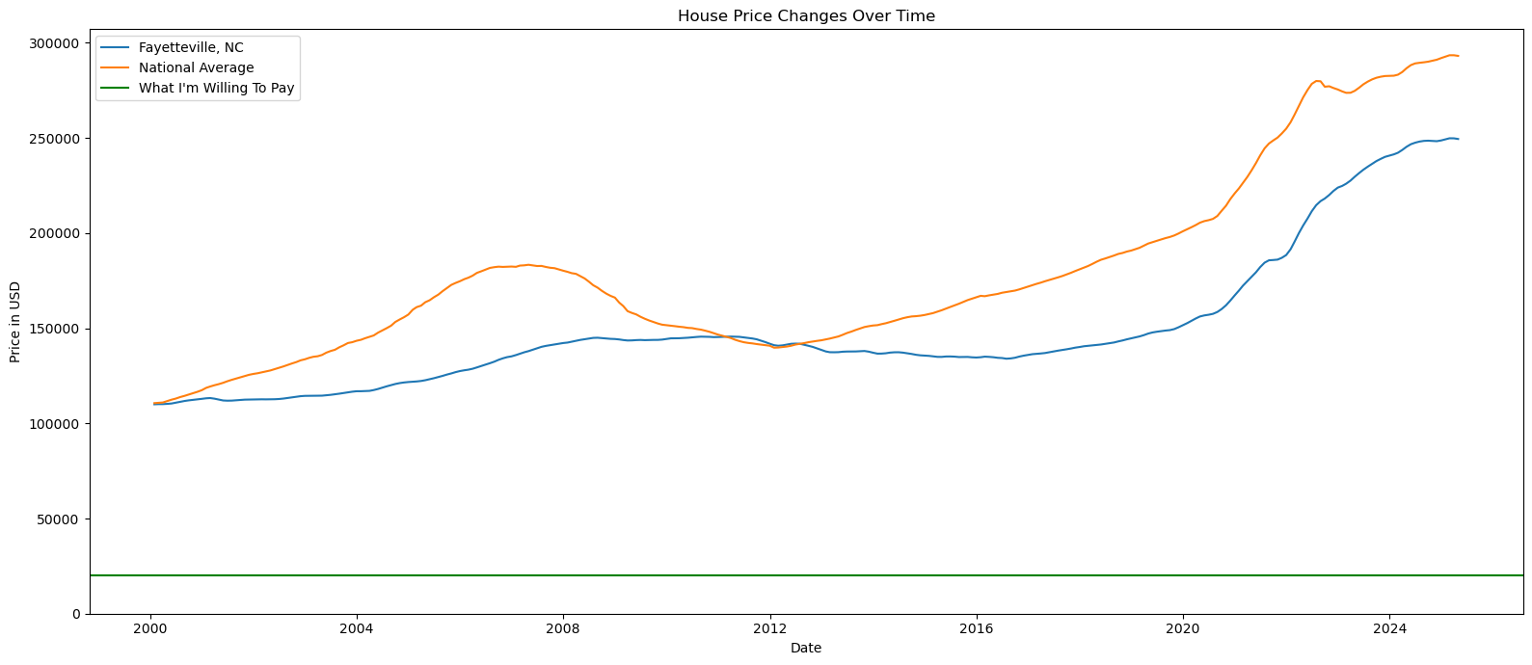
Market Trends
VA Home Loan Interest Rates
Fayetteville Home Prices
People losing their minds
FED Cuts
2008 Housing Crash
Federal Reserve Chair (Jerome Powell) Cuts FED rates
Covid Housing Boom
Covid Housing Boom
https://fred.stlouisfed.org/series/OBMMIVA30YF
The ebb and the flow of the market are at the whim of global influence, there is no such thing as timing the market or waiting for a crash though some may disagree

Slide 5
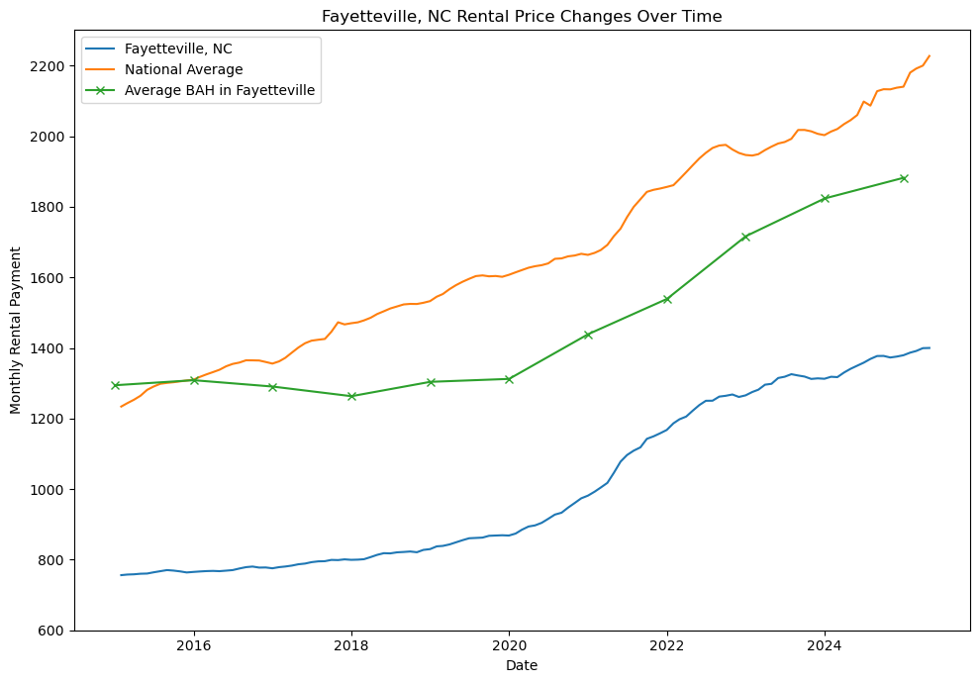
Rental Analysis
$1823/ mo
Averaging $8.38 / month increase since 2020
What are we looking at?
Military bases rent increases correlate with BAH increases
Not inflation adjusted, $1 in 2015 → $1.29 in 2024
Notes:
For a given ZIP code:
Find median rent for 1-bedroom (E-1 to E-4), 2-bedroom (E-5 to E-6), 3-bedroom (E-7 to E-9), etc.
Add average utility costs & insurance.
Resulting total = monthly BAH rate for that rank & dependency status.

Slide 6
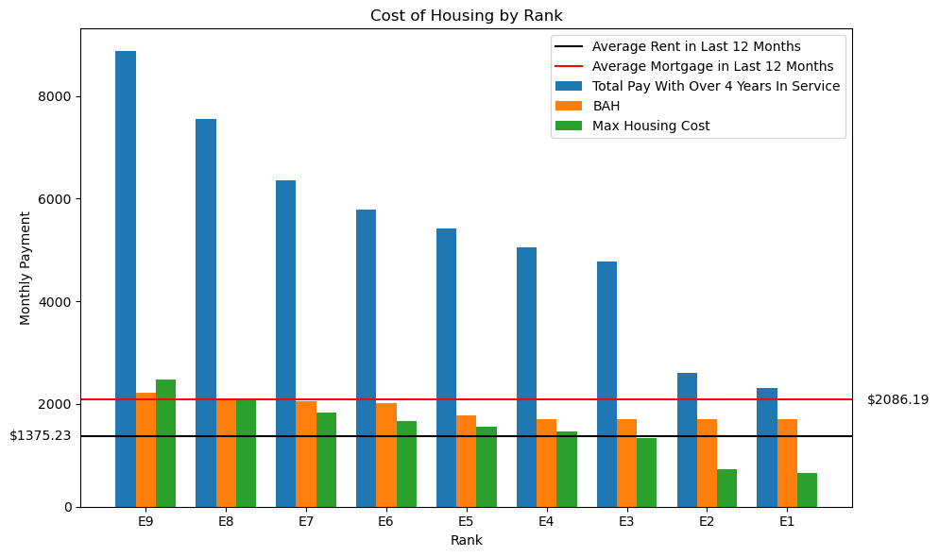
Take Away
Key Finding 2: Able to afford a home
Key Finding 1:
Able to afford renting
Gap between privatized housing and income
AVG Mortgage
AVG Rent
The total monthly payment includes the mortgage payment, homeowner’s insurance, property taxes, and maintenance costs worth 0.5% of the home’s value
Notes:
Data: Zillow Home value index, BAH and income, Zillow mortgage payment with less than 5% down
Living on post costs the exact amount of BAH, at no point does it make sense to live on post vs rent assuming you’re using your entire BAH for housing

Slide 7
Family of 4 cost of living
A comfortable living in Fayetteville for a family of four required $87,940 = $7,330 per month
Housing - $1,240
Child care - $1,350
Food - $920
Health care - $710
Transportation - $1,260
Misc. - $700
Taxes - $830
Savings - $320

Slide 8
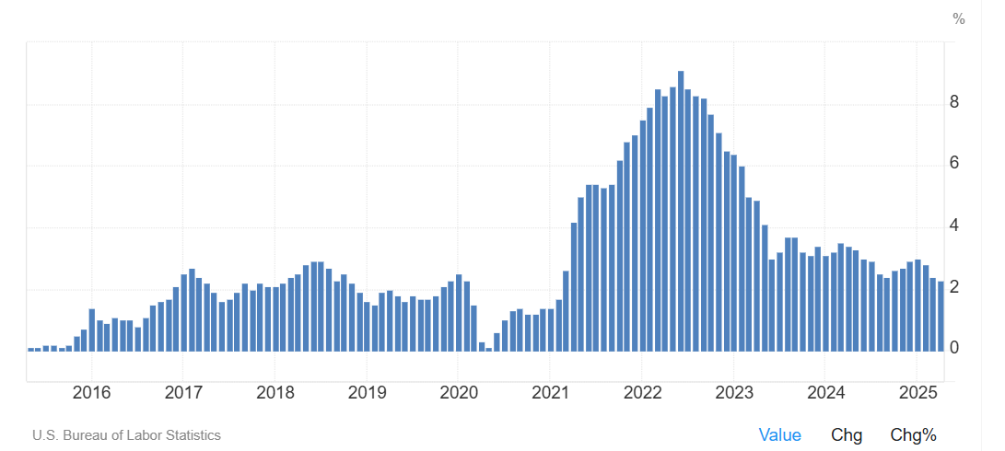
What The Fed?
People losing their minds at 9.2%
Causation of low interest rates but then lead to high inflation (COVID)
Jerome Powell tenure as Fed Chair (2018→)
✅ Controls the money flow:
-Print or destroy money-
✅ Helps people have jobs:
-Also increases unemployment when inflation is too high-
✅ Stops prices from going crazy:
-Withdraw and destroy currency-

Slide 9
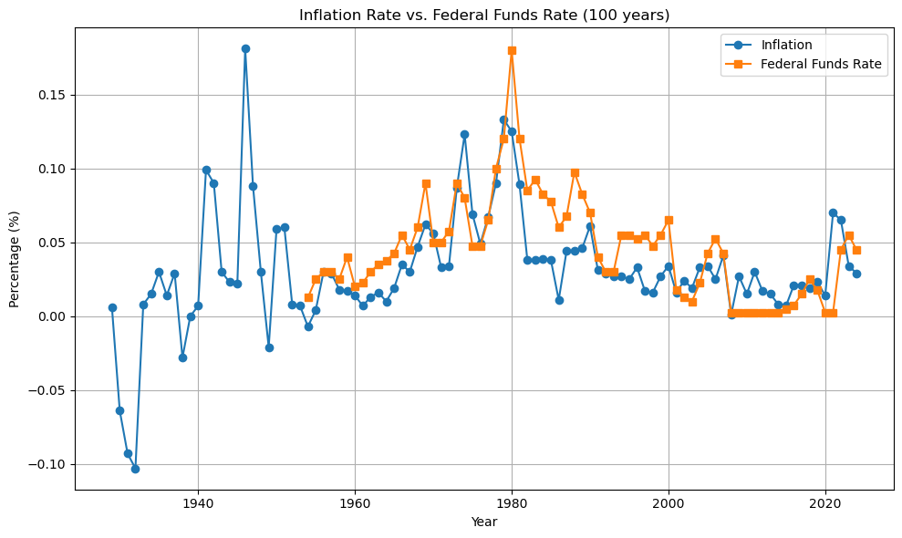
The Fed is at it again
Fed life = adjust the rate at which they lend to impact the whole economy
Banks borrow from the Fed at a rate that they change which changes the cost of lending from the bank
When unemployment increases, they decrease the cost to lend which creates more jobs and increases employment

Slide 10
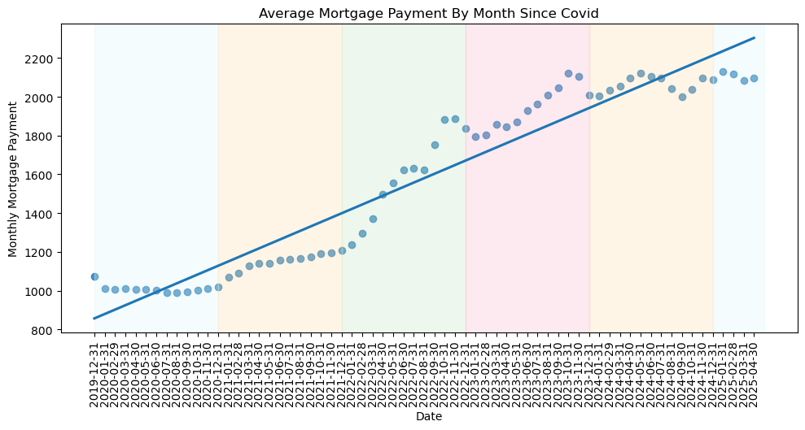
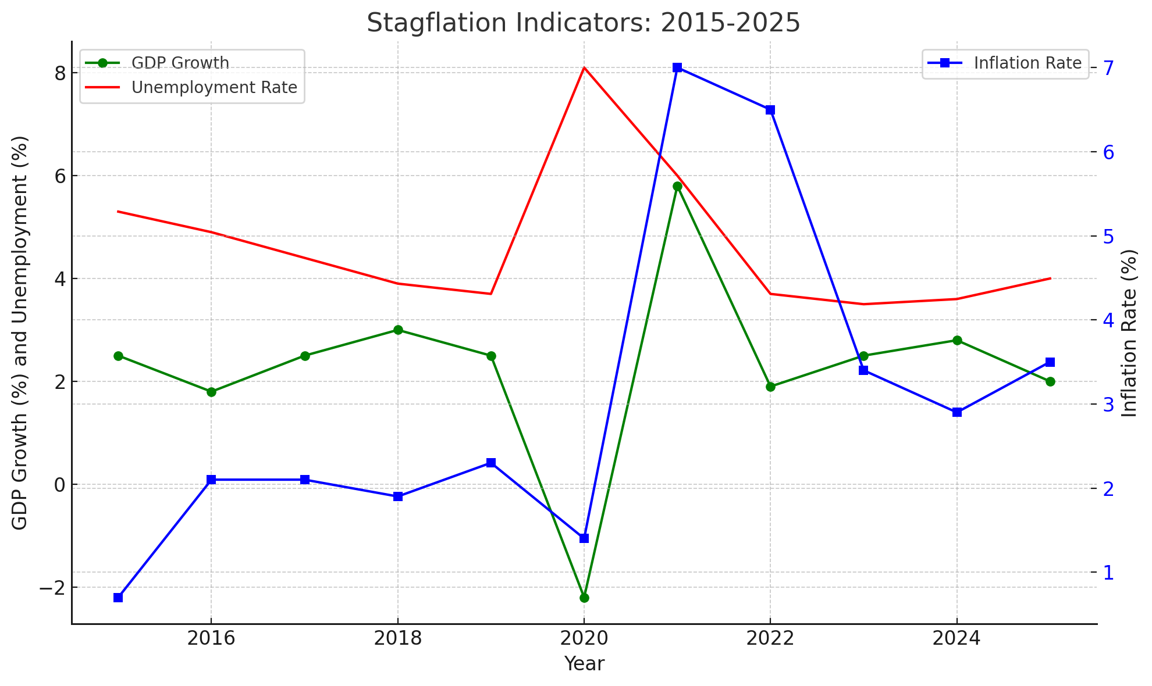
Stagflation
Where inflation is on the rise AND high unemployment
Current USA economic fear, only way out is to make it worse
Solution?
Stolen via AI

Slide 11
Why does this matter?
The American Dream
Affordability?
Investment or liability?
What’s best for you and your family?
Common Questions
Will interest rates return to 2%
What about the next big crash?
Is it better to get in now than miss out?
Notes:
American Dream – Historically this is the cornerstone of American idealism, the white picket fence, and now most people believe it is out of reach, the military offers a unique position to allow for home ownership
Affordibility – in 2025 home purchasing has become the most unaffordable since the inception of home loans
Investment- This is the largest single purchase most people will make in their life
Self reflect on what is best for you and your family, there is always on post housing at the cost of BAH

