Slide 1

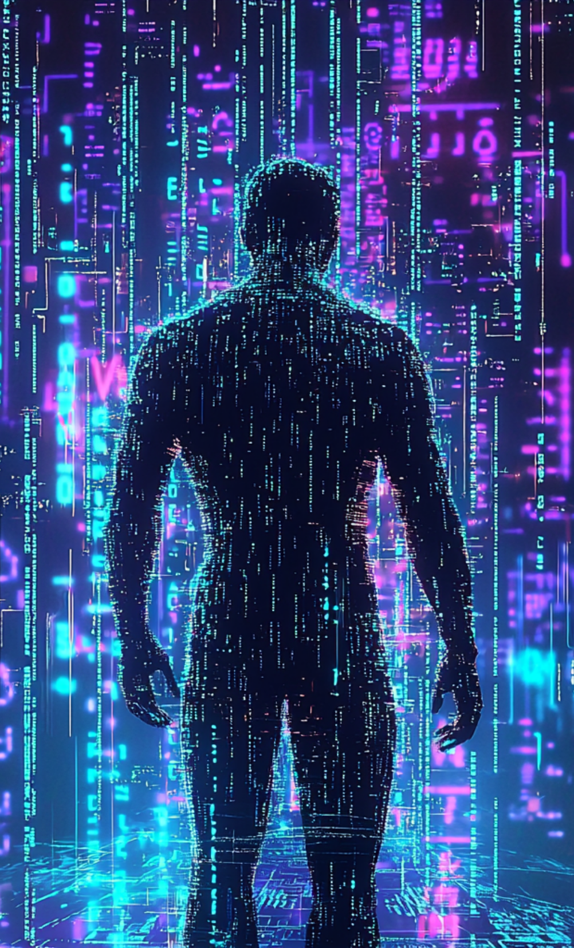

Roman Numeral Prediction Challenge
A CNN-Based AI Project with PyTorch and Flask

Slide 2
Team Members
Dara Shikoh Bodla (2023176)
Marwah Mohammad (2023304)

Slide 3



Objective
1
To build a machine learning system that accurately identifies handwritten Roman numerals (I to X) from uploaded images.
2
The model is trained using a supervised learning approach and deployed with a web interface for real-time predictions.

Slide 4
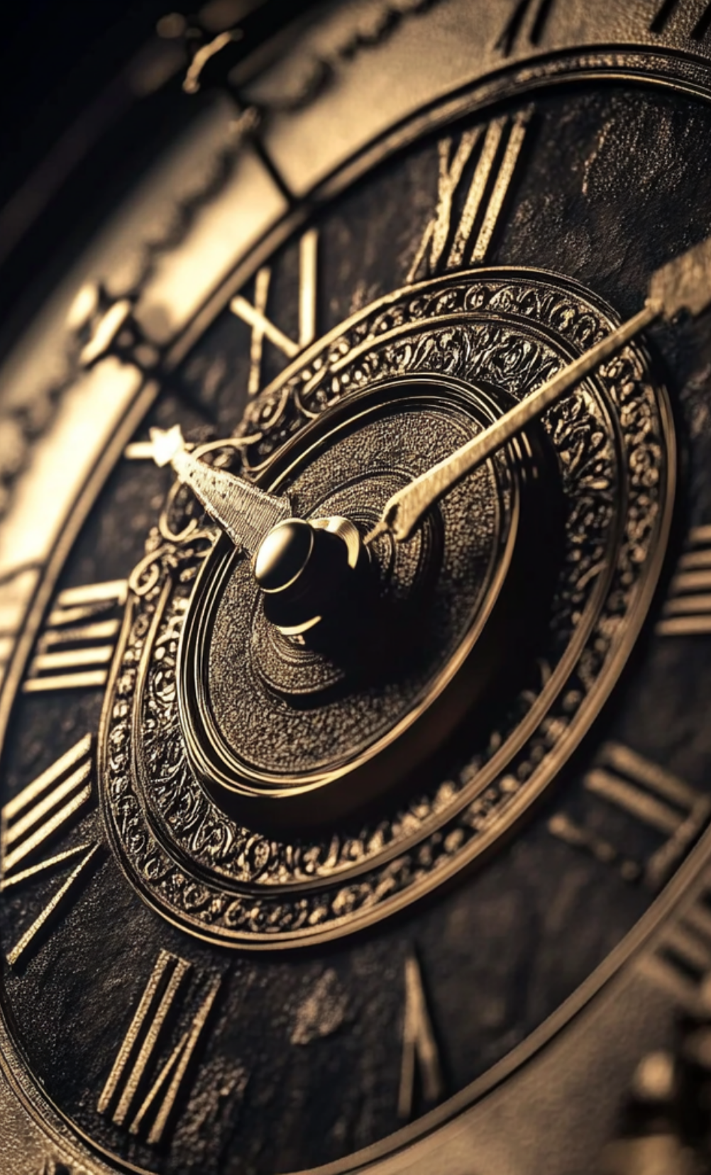
Roman Numeral Classes
["I", "II", "III", "IV", "V", "VI", "VII", "VIII", "IX", "X"]

Slide 5





Supervised Learning Approach
2
A Convolutional Neural Network (CNN) was trained using these labels to minimize classification error.
Used labeled training data where each image corresponds to one of 10 Roman numeral classes.
1
The model learns patterns and features from image pixels and uses these to predict class probabilities.
3

Slide 6
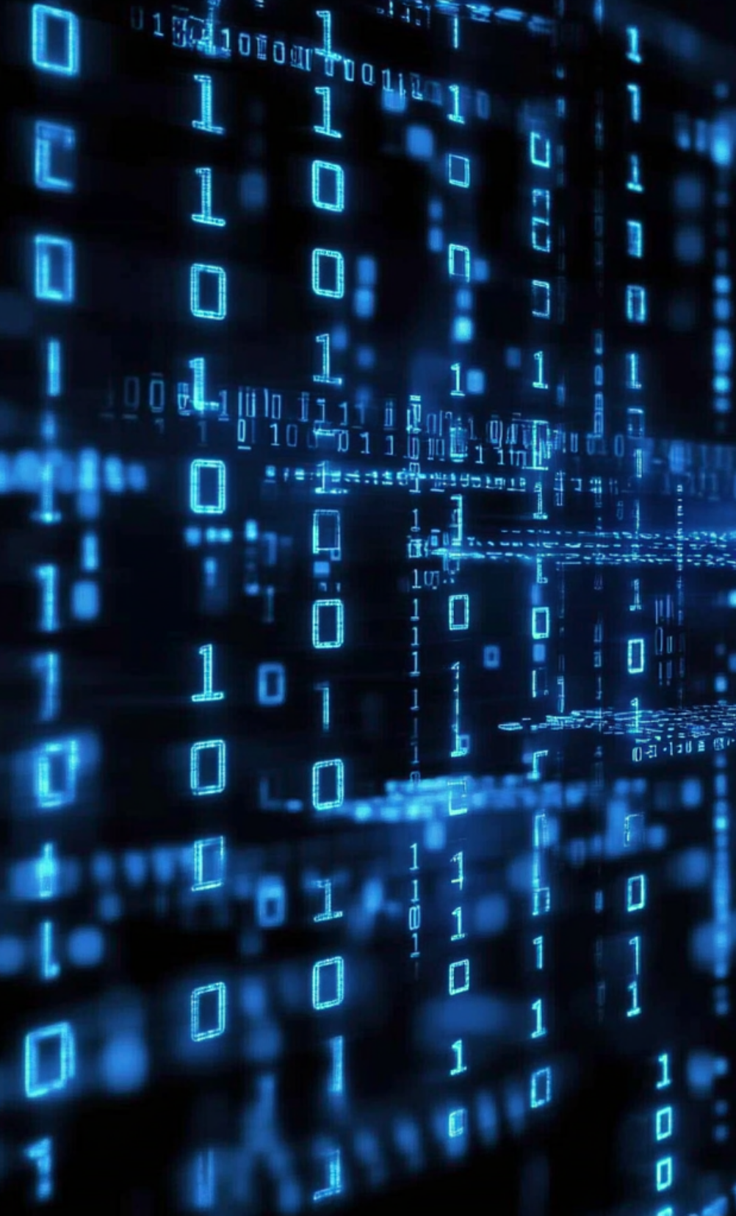


Dataset and Preprocessing
Dataset directory structure follows ImageFolder format from PyTorch.
Images were resized to 64×64, converted to tensors, and normalized to mean=0.5, std=0.5.

Slide 7
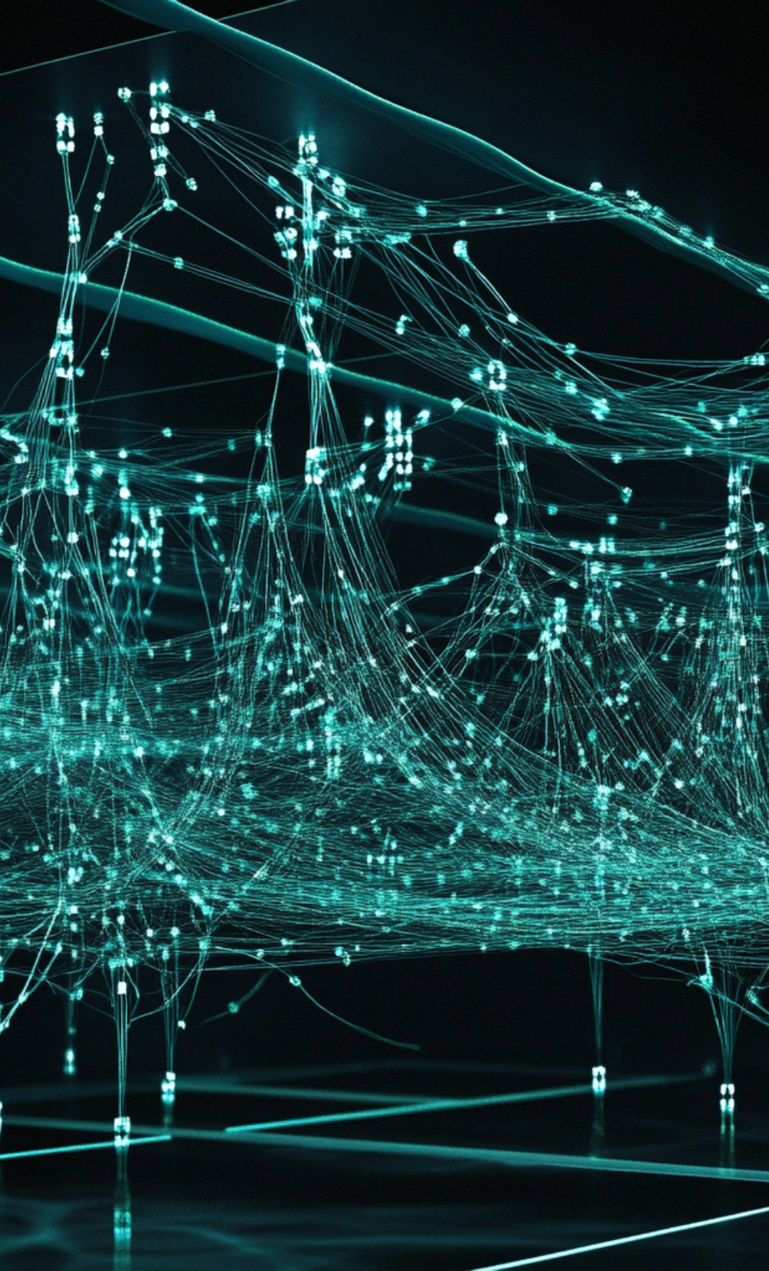
Model Architecture
A custom CNN model RomanCNN was built with:
•Convolutional Layers: Conv2D → ReLU → MaxPooling (×3 blocks with increasing depth: 32, 64, 128)
•Fully Connected Layers: Flatten → Linear(8192→256) → Dropout(0.3) → Linear(256→10)
•Activation: ReLU in all layers; Softmax applied at inference.

Slide 8
Training Details(1)
Parameter | Value
Optimizer | Adam
Loss Function | CrossEntropyLoss
Epochs | 10
Batch Size | 32
Train/Val Split | 80/20

Slide 9
Training Details(2)
Accuracy (Final Epoch) | \~92–95% (train set)
Model File | roman_model.pth

Slide 10

Flask Web Application
Upload interface built with Flask.
Users upload images and receive real-time predictions.
AJAX POST to /predict returns JSON prediction.

Slide 11

Results & Observations
High classification accuracy across Roman numerals.
Minor confusion observed among similar-looking classes (e.g., VII vs VIII).
Fast, reliable predictions with clean web interface.

Slide 12

Tools & Technologies
Python, PyTorch, TorchVision, PIL.
Flask, HTML/CSS, VS Code, Jupyter Notebook.
CPU and GPU training support.

Slide 13
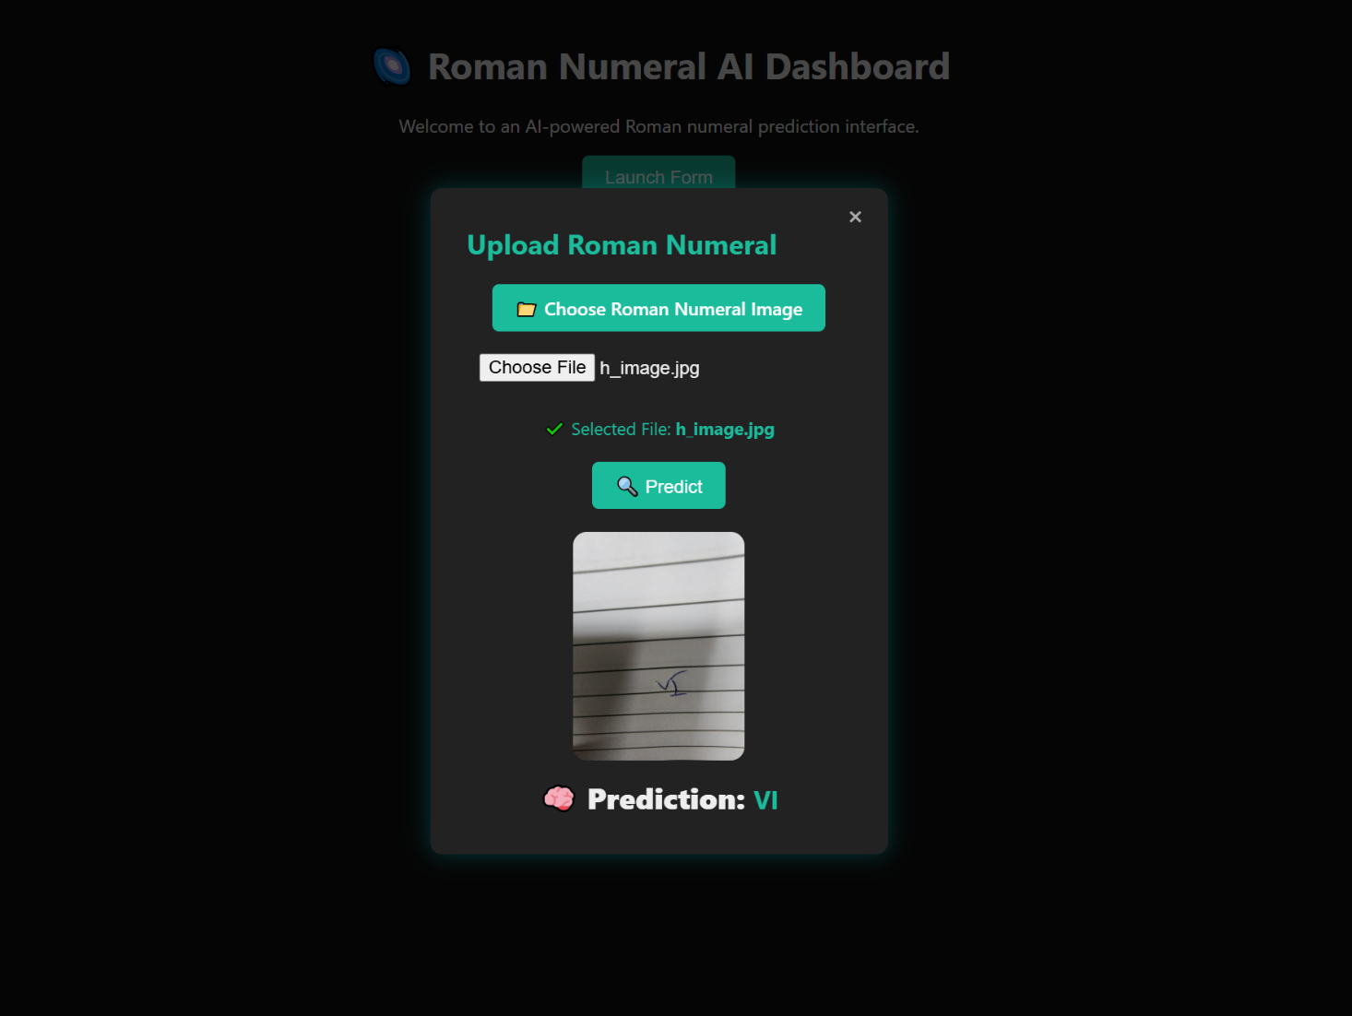
Dashboard Preview

