Slide 1
Authentication for Partner Center SDK

Slide 2
Module Overview
Azure Active Directory
Getting Setup to Manage your Azure AD Tenant
Azure AD Applications
Authentication with Azure AD
Application Types: User+App | App-Only
OAuth Flows

Slide 3
Azure Active Directory (AAD)

Slide 4
Azure Active Directory
Single source of truth for all user & application authentication (AuthN) + authorization (AuthZ) in Azure
Repository for users
Credentials
Profile details
Repository for applications
Credentials
Permissions

Slide 5
Azure AD Tenants
Partner tenant
Partner’s integration sandbox
Customer tenant
Partner roles within a customer tenant
Admin agent
Sales agent
Helpdesk agent
License assignment

Slide 6
Managing Azure AD Tenants
Initially Partner users cannot access the tenant administration interface
Web management interface for Azure AD tenants only available via existing Azure subscriptions
Step 1 – Get access to your partner’s Azure AD tenant

Slide 7
Getting Setup to Manage your Azure AD Tenant

Slide 8
Overview
Use the Azure Portal to manage Azure AD tenants
Use the Azure Management Portal (https://manage.windowsazure.com)
Not yet available in the new Azure Portal (https://portal.azure.com)
Valid Azure subscription required to login to the Azure Portals
Initially partners can’t access their Azure AD tenant

Slide 9
Accessing your CSP Azure AD Tenant
Need to associate the AAD tenant with an existing Azure subscription
Includes Integration Sandbox tenants
Association Process
Login to an Azure subscription with a global administrator account
Only MSA accounts supported, not Azure AD (work / school) accounts
Add existing Azure AD tenant
Logout of Azure subscription
Login with global administrator account within the Azure AD tenant
See MVA: Onboarding with CSP Partner Center SDK
https://mva.microsoft.com/en-US/training-courses/onboarding-with-the-csp-partner-center-sdk-15789?l=Y03umf64B_300115881
NOTE: Only need to do this once

Slide 10

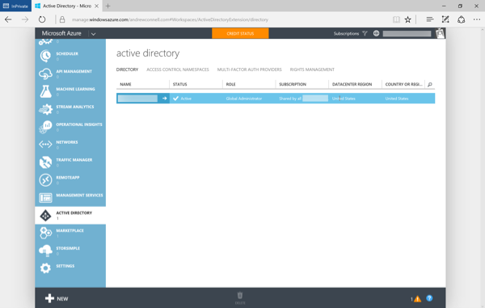

Slide 11

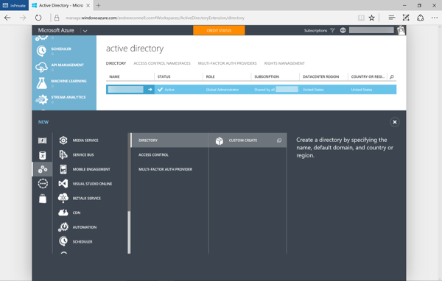

Slide 12

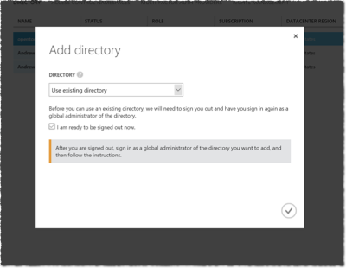

Slide 13

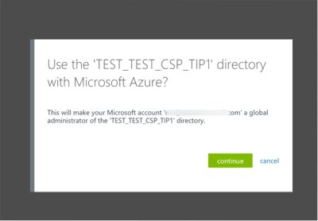

Slide 14
DEMO
Exploring Azure AD in Azure Management Portal

Slide 15
Azure AD Applications

Slide 16
Azure AD Applications
Any application that authenticates with Azure AD must be registered in the Azure AD tenant
Console apps, web apps, services, etc.
Applications in Azure AD are assigned credentials
Client ID: similar to a user’s login / username
Key / secret: similar to a user’s password
Created & managed using the Azure Portals
Also managed using Azure’s PowerShell module / Azure CLI x-platform tool
See: https://azure.microsoft.com/en-us/documentation/articles/active-directory-authentication-scenarios/

Slide 17
Azure AD Applications & Partner Center
Partner Center dashboard can onboard AAD apps
Two Options:
Create AAD Applications from Partner Center
Limited to web applications, native applications not supported
Register Existing AAD Applications
Supports web applications & native applications
Partner Center app registration / creation will
Register the app, as single-tenant, with Partner Center enabled with app-only & app+user scenarios
Add the Partner Center role & scope to the AAD application
Grants the app admin consent to partner’s tenant

Slide 18
Application Permissions
Delegated Permissions
User of the application consents application specific permission to act on the user’s behalf
User must have permissions the app is configured for delegated permission
Useful in User+App Authentication Scenarios (more later)
Application Permissions
Apps have permissions
Acts independent of user
Must be registered with Partner Center to work s

Slide 19
Single vs. Multi-Tenant Applications
Single Tenant Apps
Available to all users in your Azure AD directory
Not available to users outside your Azure AD directory
Typically internal apps for your organization’s users
Multi-Tenant Apps
Just like single tenant apps except…
Available to all users in any Azure AD directory
Typically built by ISVs or as a SaaS offering

Slide 20






Single Tenant Apps
Partner center
users
Office 365
Can login
and use
Azure subscriptions
Can access /
manage
resources
AAD apps
Wingtip
users
Can login
and use
Can login
and use
users
Can access /
manage
resources
resources
Can access /
manage
AAD apps
AAD apps
Contoso
Fabrikam

Slide 21
Multi-Tenant App
Partner center
users
Office 365
Can login
and use
Azure subscriptions
Can access /
manage
resources
AAD apps
Wingtip
users
Can login
and use
Can login
and use
users
Can access /
manage
resources
resources
Can access /
manage
AAD apps
AAD apps
Contoso
Fabrikam

Slide 22
DEMO
Creating Azure AD Applications

Slide 23
Authentication with Azure AD

Slide 24
Authentication with Azure AD
Partner Center SDK protected by Azure AD
All HTTP requests must include valid OAuth2 access token in the header
AUTHORIZATION: Bearer <base64 encoded JWT token>
Authentication process:
Authenticate as a user via Azure AD & obtain access token
Obtain access token from Partner Center API, providing user AAD access token for AuthN

Slide 25
Authenticating with Azure AD
// usually https://login.microsoftonline.com
var addAuthority = new UriBuilder(SettingsHelper.AadAuthority);
// credentials for user’s account within the partners Azure AD tenant
UserCredential userCredentials = new UserCredential(SettingsHelper.UserId, SettingsHelper.UserPassword);
AuthenticationContext authContext = new AuthenticationContext(addAuthority.Uri.AbsoluteUri);
// authenticate user with Azure AD with specific Azure AD App for API resource
var aadAuthenticationResult = await authContext.AcquireTokenAsync(SettingsHelper.PartnerCenterApiResourceId, SettingsHelper.ClientId, userCredentials);
var authToken = new AuthenticationToken(aadAuthenticationResult.AccessToken, aadAuthenticationResult.ExpiresOn);

Slide 26
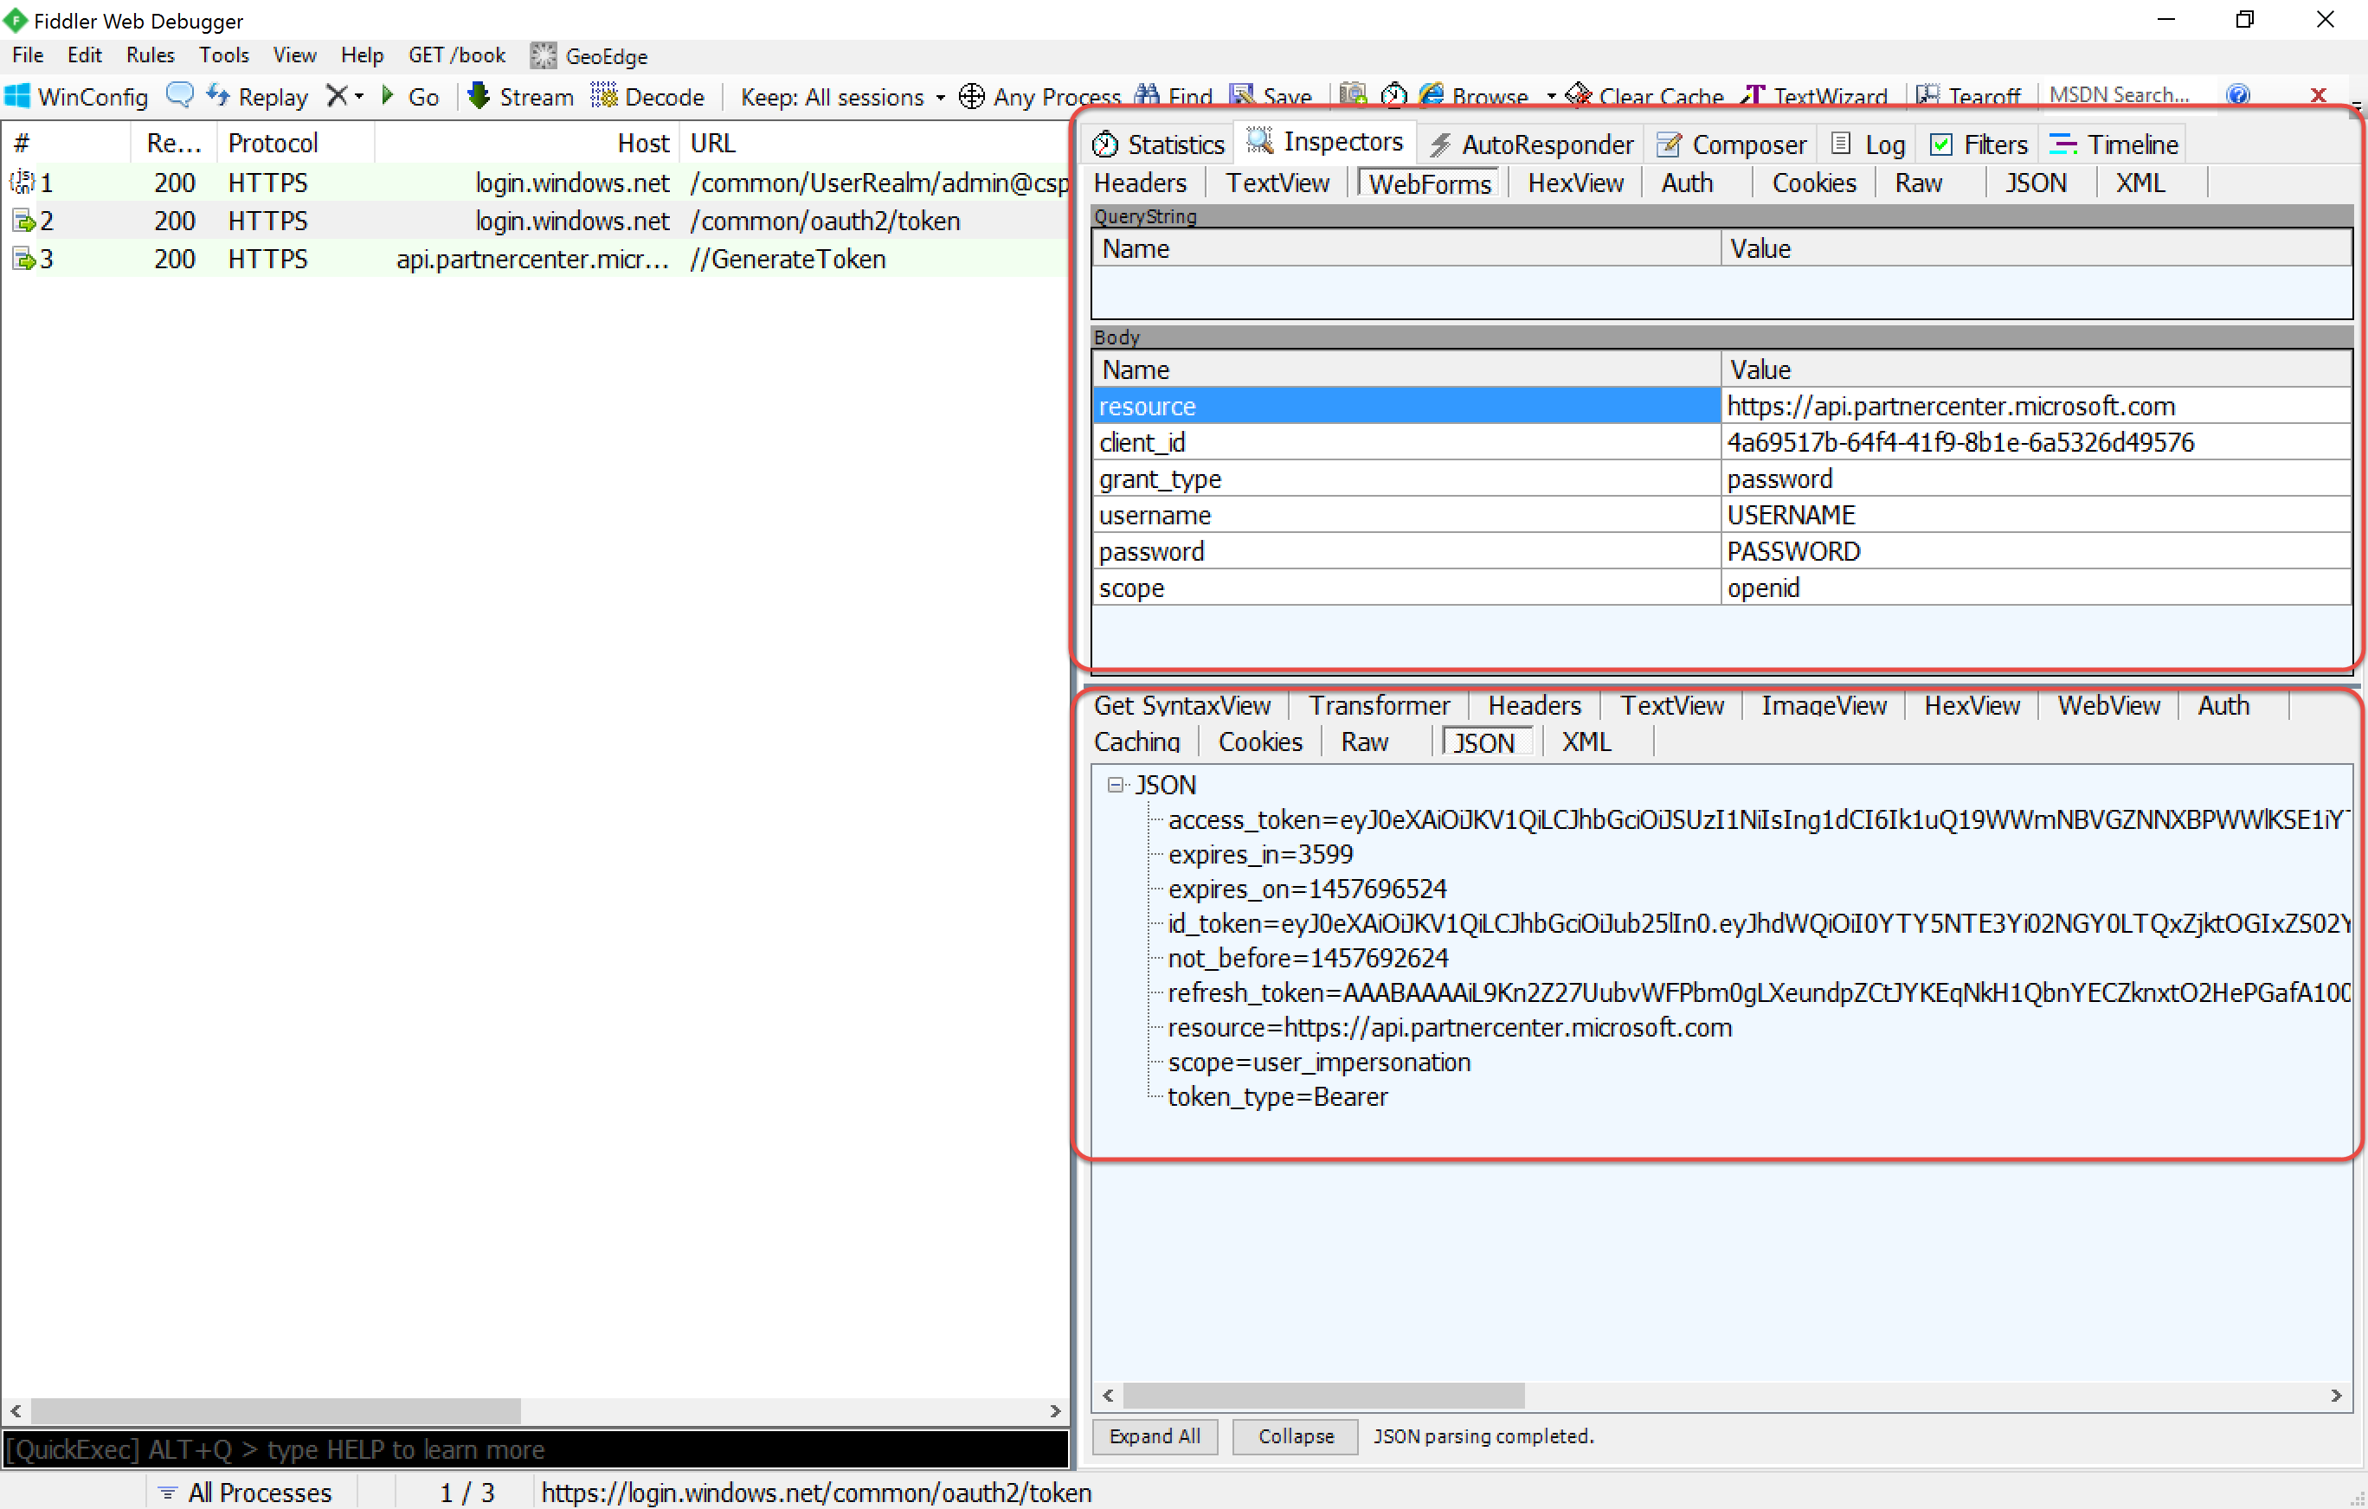
Authenticating with Azure AD

Slide 27
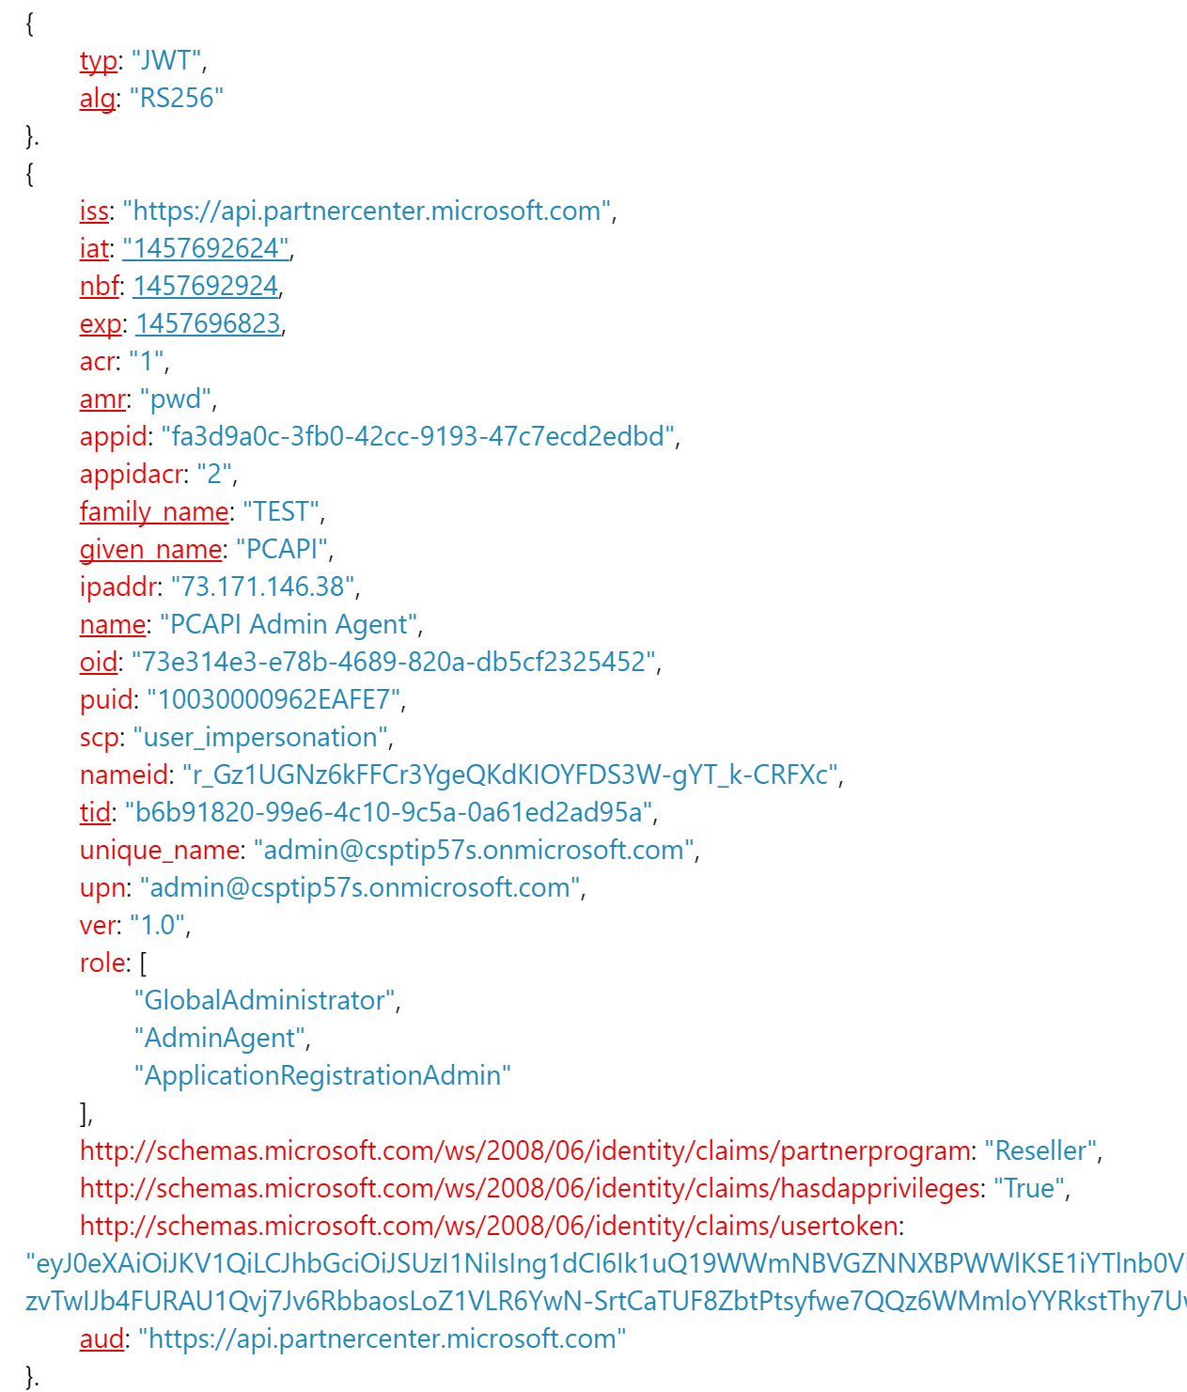
User Authenticated – Access Token

Slide 28
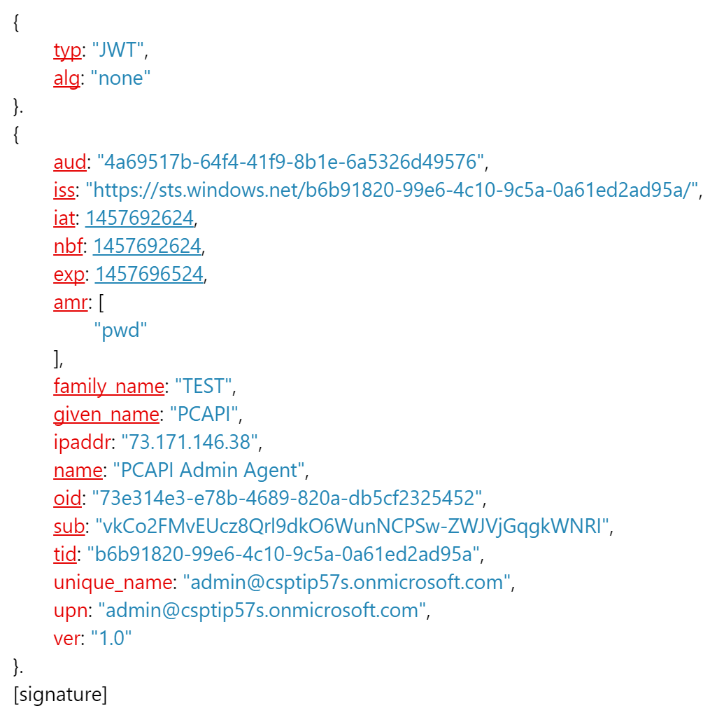
User Authenticated – OpenID ID Token

Slide 29
Application Types: User+App | App-Only

Slide 30
Application Type: User+App App
User authenticates with their partner Azure AD tenant credentials to use the application
Leverages delegated permissions
Required for some scenarios for auditing
Deleting user accounts from Azure AD
Actions need to be tracked to a specific individual
Scenario:
Management application used by partner employees

Slide 31
Application Type: App Only
Acts on behalf of & independent of user
No user involvement required
Must be registered with Partner Center to use SDK
Commonly needs access to the partner’s customer’s Azure AD tenants
Scenarios
Web app to onboard new customers
Create orders / resources for customers
Scheduled services / deamon jobs

Slide 32
App-Only Apps & Partner Center
App-Only Apps must be registered with Partner Center to access SDK
Create new customers
Place orders
Etc.
Initial app created & registered when a partner account is created
Typically just use this app – no need to create new one
If new app created, must be registered with Partner Center using the Partner Center website

Slide 33
Azure AD Apps & Accessing Customer Tenants
Apps do not have access to customer tenants
Blocks application from creating Azure resources within customer Azure subscriptions
App must be granted access to a partner’s customer’s tenants
One-time process
Applies to current & future customers (no need to re-apply when creating new customer)
Only possible via Azure AD Graph API
PowerShell script provided to “pre-consent” your application

Slide 34
OAuth Flows

Slide 35
Supported OAuth Flows with Partner Center SDK
Partner Center SDK requires all calls include a Partner Center created access token
Partner Center creates access tokens for authenticated & authorized users
Partner Center trusts Azure AD for establishing identity
Azure AD returns access tokens - include proof of identity
Azure AD supports multiple options for authenticating & obtaining access tokens
These options are referred to as OAuth Flows
Each OAuth Flow is applicable for specific scenarios

Slide 36
Resource Owner Password Credentials Flow

Slide 37
Resource Owner Password Credentials Flow
User provides app username & password
App authenticates as the user
Enables: user + app authentication
Scenarios: native applications with interactive session
Spec: https://tools.ietf.org/html/rfc6749-section-1.3.3

Slide 38
Resource Owner Password Credentials Flow
Azure AD
Authorization
Endpoint
https://login.microsoftonline.com/ [..]/oauth2/authorize
Token
Endpoint
https://login.microsoftonline.com/ [tenantid]/oauth2/token
Partner Center
Endpoint
https://api.partnercenter.microsoft.com
App
1. Request token (Client Id, Username, Password, resource=“https://partnerapi.store.microsoft.com”)
2. Returns AAD Access Token(JWT)
3. Request Partner Center token + AAD Access Token in Authorization Header (Client ID)
4. Returns Partner Center Access Token(JWT)
5. Issue query to Partner Center with Partner Center Access Token in Authorization Header

Slide 39
Client Credentials Flow

Slide 40
Client Credentials Flow
No user involvement required
App authenticates as the app; no user context
Enables: app-only authentication
Scenarios: services, daemons, apps with no user identity / interaction
Spec: https://tools.ietf.org/html/rfc6749-section-1.3.4

Slide 41
Client Credentials Flow
Azure AD
Authorization
Endpoint
https://login.microsoftonline.com/ [..]/oauth2/authorize
Token
Endpoint
https://login.microsoftonline.com/ [tenantid]/oauth2/token
Partner Center
Endpoint
https://api.partnercenter.microsoft.com
App
1. Request token (Client Id, Client Credential, resource=“https://partnerapi.store.microsoft.com”)
2. Returns AAD Access Token(JWT)
3. Request Partner Center token + AAD Access Token in Authorization Header (Client ID)
4. Returns Partner Center Access Token(JWT)
5. Issue query to Partner Center with Partner Center Access Token in Authorization Header

Slide 42
Authorization Code Flow

Slide 43
Authorization Code Flow
App does not store / receive user’s credentials
User authenticates with AAD independent of app
AAD returns code to user; code given to app
App uses code to obtain token on user’s behalf
Enables: user + app authentication
Scenarios: web apps with interactive sessions
Spec: https://tools.ietf.org/html/rfc6749-section-1.3.1

Slide 44
Authorization Code Flow
Azure AD
Authorization
Endpoint
https://login.microsoftonline.com/ [..]/oauth2/authorize
Token
Endpoint
https://login.microsoftonline.com/ [tenantid]/oauth2/token
Partner Center
Endpoint
https://api.partnercenter.microsoft.com
User
(Browser)
Web App
(Confidential Client)
1. Navigate to site
2. Redirects to sign-in and request for auth code (Client ID, Redirect URI)
3. Sign in
4. Returns Auth Code and ID Token to Redirect URI
Might require
user consent
5. Set session

Slide 45
Authorization Code Flow
Azure AD
Authorization
Endpoint
https://login.microsoftonline.com/ [..]/oauth2/authorize
Token
Endpoint
https://login.microsoftonline.com/ [tenantid]/oauth2/token
Partner Center
Endpoint
https://api.partnercenter.microsoft.com
User
(Browser)
Web App
(Confidential Client)
6. Redeem Auth Code (Auth Code, Client ID, Client Credential, Redirect URI, resource=“https://partnerapi.store.microsoft.com”)
7. Returns AAD Access Token(JWT), AAD Refresh Token (JWT)
8. Request Partner Center token + AAD Access Token in Authorization Header (Client ID)
7. Returns Partner Center Access Token(JWT)
9. Issue query to Partner Center with Partner Center Access Token in Authorization Header

Slide 46
Implicit Flow

Slide 47
Implicit Flow
User involvement required
App authenticates as the app; no user context
Slightly less secure (see cautions in spec)
Enables: user + app authentication
Scenarios: interactive apps, PowerShell
Spec: https://tools.ietf.org/html/rfc6749-section-1.3.2

Slide 48
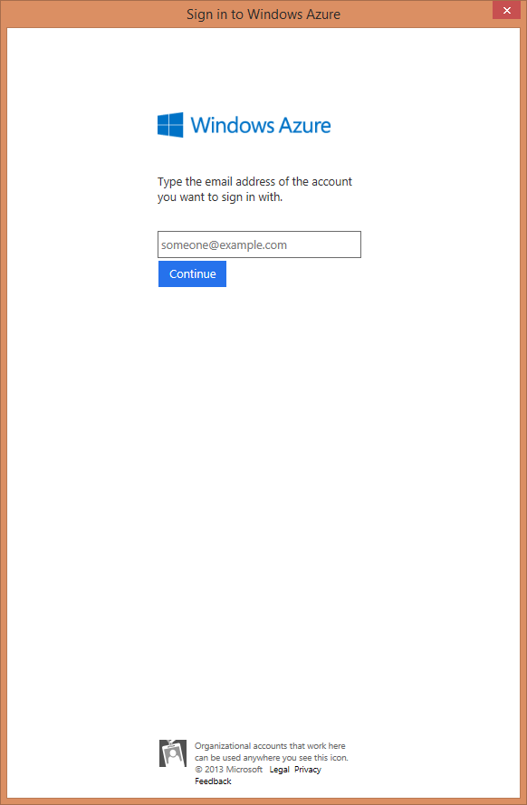
Implicit Flow
Azure AD
Authorization
Endpoint
https://login.microsoftonline.com/ [..]/oauth2/authorize
Token
Endpoint
https://login.microsoftonline.com/ [tenantid]/oauth2/token
Partner Center
Endpoint
https://api.partnercenter.microsoft.com
User + Native Application
1. Request token (Client Id, resource=“https://partnerapi.store.microsoft.com”)
2. Sign in
User sees web pop up
3. Returns Auth Code to Redirect URI

Slide 49
Implicit Flow
Azure AD
Authorization
Endpoint
https://login.microsoftonline.com/ [..]/oauth2/authorize
Token
Endpoint
https://login.microsoftonline.com/ [tenantid]/oauth2/token
Partner Center
Endpoint
https://api.partnercenter.microsoft.com
User + Native Application
4. Redeem Auth Code (Auth Code, Client ID, Redirect URI, resource=“https://partnerapi.store.microsoft.com”)
5. Returns Access Token(JWT), Refresh Token (JWT)
6. Request Partner Center token + AAD Access Token in Authorization Header (Client ID)
7. Returns Partner Center Access Token(JWT)
8. Issue query to Partner Center with Partner Center Access Token in Authorization Header

Slide 50
Comparing Different OAuth Flows
OAuth Flow | Supports App-Only | Supports User+App | Requires User Involvement
Resource Owner Password | - | yes | -
Client Credentials | yes | - | -
Auth Code | - | yes | yes
Implicit | - | yes | yes

Slide 51
Module Summary
Azure Active Directory
Getting Setup to Manage your Azure AD Tenant
Azure AD Applications
Authentication with Azure AD
Application Types: User+App | App-Only
OAuth Flows

