Slide 1
Understanding how Partner Center SDK works with CREST API

Slide 2
Module Overview
CREST API
Partner Center SDK
Partner Center SDK Authentication
Interop

Slide 3
CREST API

Slide 4
Commerce REST (CREST) API Overview
Original API for CSP partners
Used by partners to automate the process of
Creating & viewing customers
Acquiring offers available for customers
Placing orders for Office 365 subscriptions, offers and increasing seats (licenses)
Placing orders for Office 365 offer add-ons
Placing orders for Azure subscriptions & resources
Used in conjunction with Azure Graph Endpoint
Available & supported today
If you already have investments that leverage the CREST API, will continue to work as is
MSFT will continue to support CREST while partners are using it in production

Slide 5
Partner Center SDK

Slide 6
Partner Center SDK – REST API
New API endpoint for CSP customers
Functionality in sync with Partner Center website
Addresses common feedback & challenges with CREST API
Superset of capabilities in CREST API
Useful for non .NET integration projects
https://api.partnercenter.microsoft.com

Slide 7
Partner Center SDK – Managed API
Makes available key complex scenarios with OM to expedite integration & shorten development cycles
Managed API benefits
Strongly typed objects & collections
Simplifies authentication and obtaining OAuth2 access tokens
Abstraction to the REST API
Makes calls to Partner Center REST API
Available via NuGet
https://www.nuget.org/packages/Microsoft.Store.PartnerCenter

Slide 8
What’s New in the Partner Center SDK?
List customers
List available offers
Validate tenant domain name availability
Validate MPN ID & lookup partner name
Raise & manage support tickets
List invoice & invoice details
Get rated usage in one API call

Slide 9
When to use CREST API or Partner Center API?
CREST API available & supported today
If you already have investments that leverage the CREST API, they will continue to work as is
You don’t need to rewrite your existing CREST API based projects to use the Partner Center API
Can leverage Partner Center API in CREST API based projects to leverage new capabilities
Use Partner Center API for greenfield projects
Contains superset of functionality available in CREST API

Slide 10
Partner Center SDK Authentication

Slide 11
Partner Center API Authentication
Partner Center API protected by AAD
All HTTP requests must include valid OAuth2 access token in the header
AUTHORIZATION: Bearer <base64 encoded JWT token>
Authentication process:
Authenticate as a user via AAD & obtain access token
Obtain access token from Partner Center API, providing user AAD access token for AuthN

Slide 12
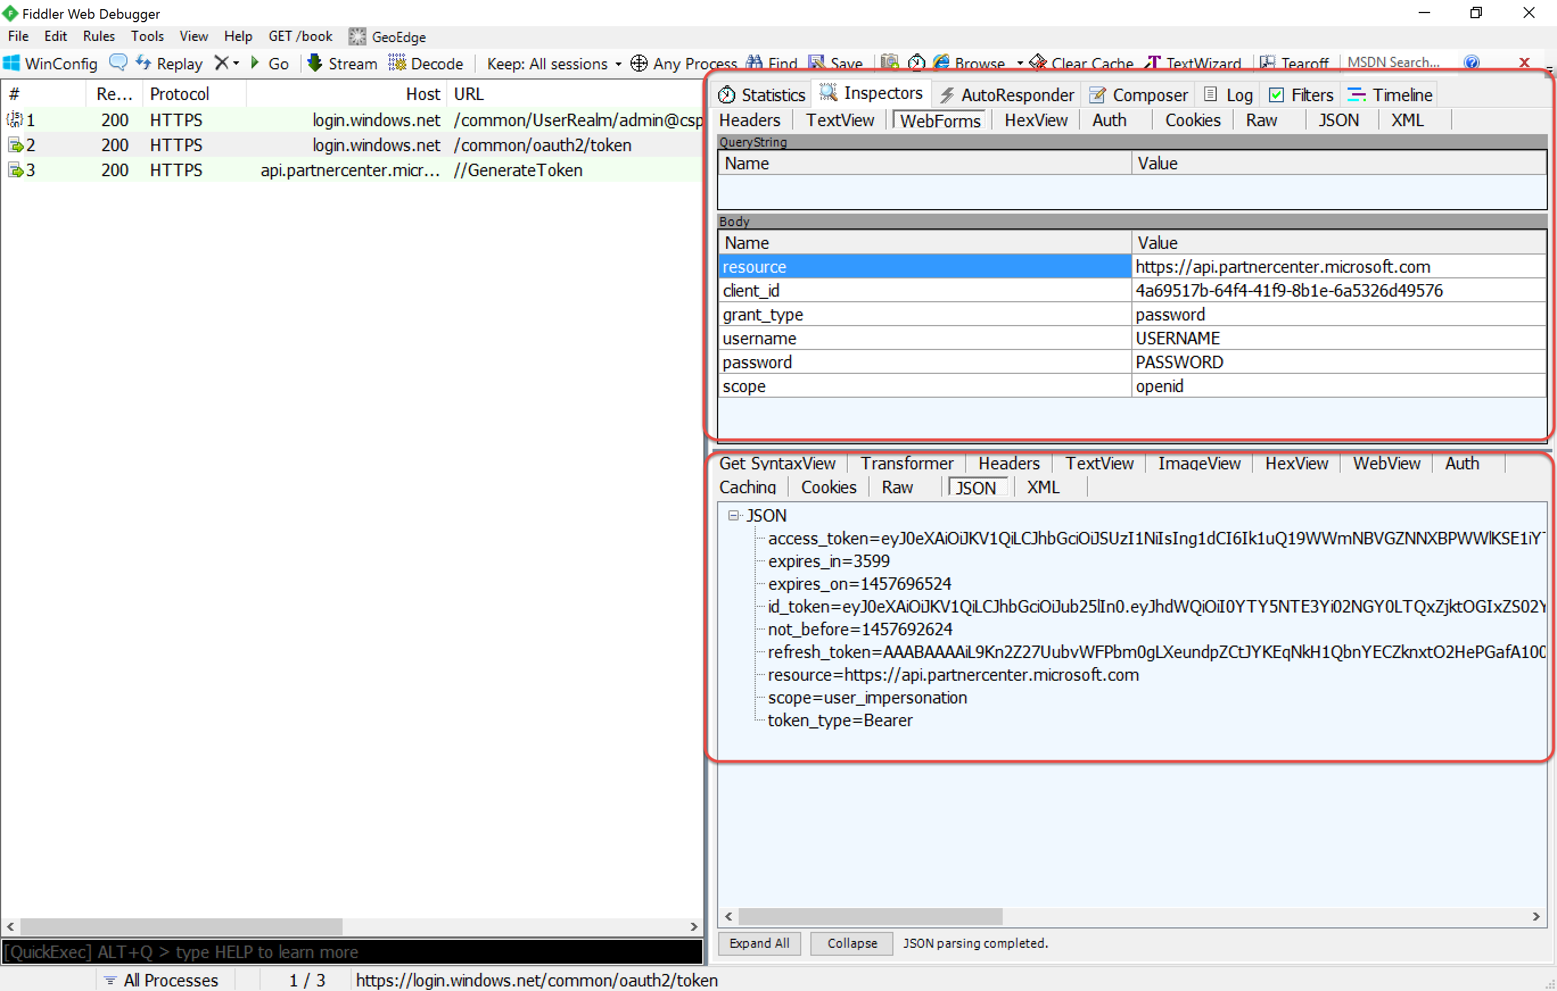
Authenticating with Azure AD

Slide 13
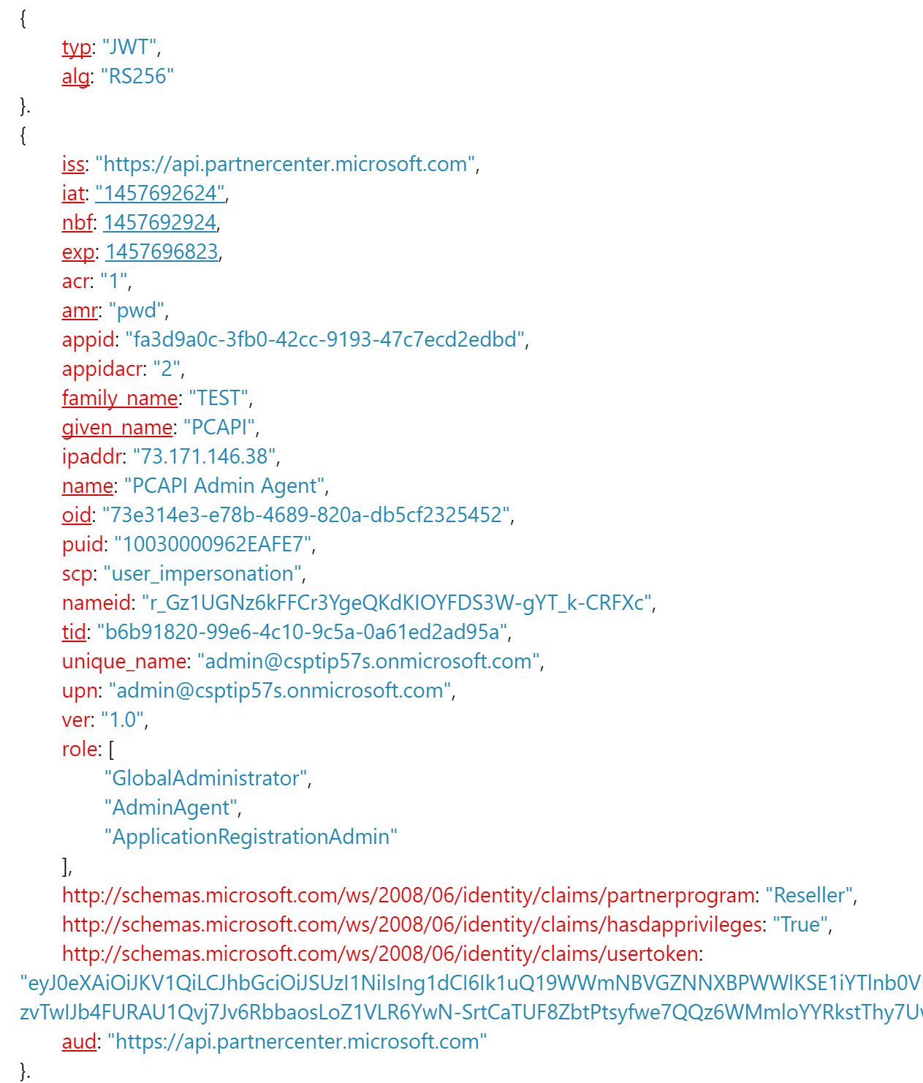
Partner Center - Access Token

Slide 14
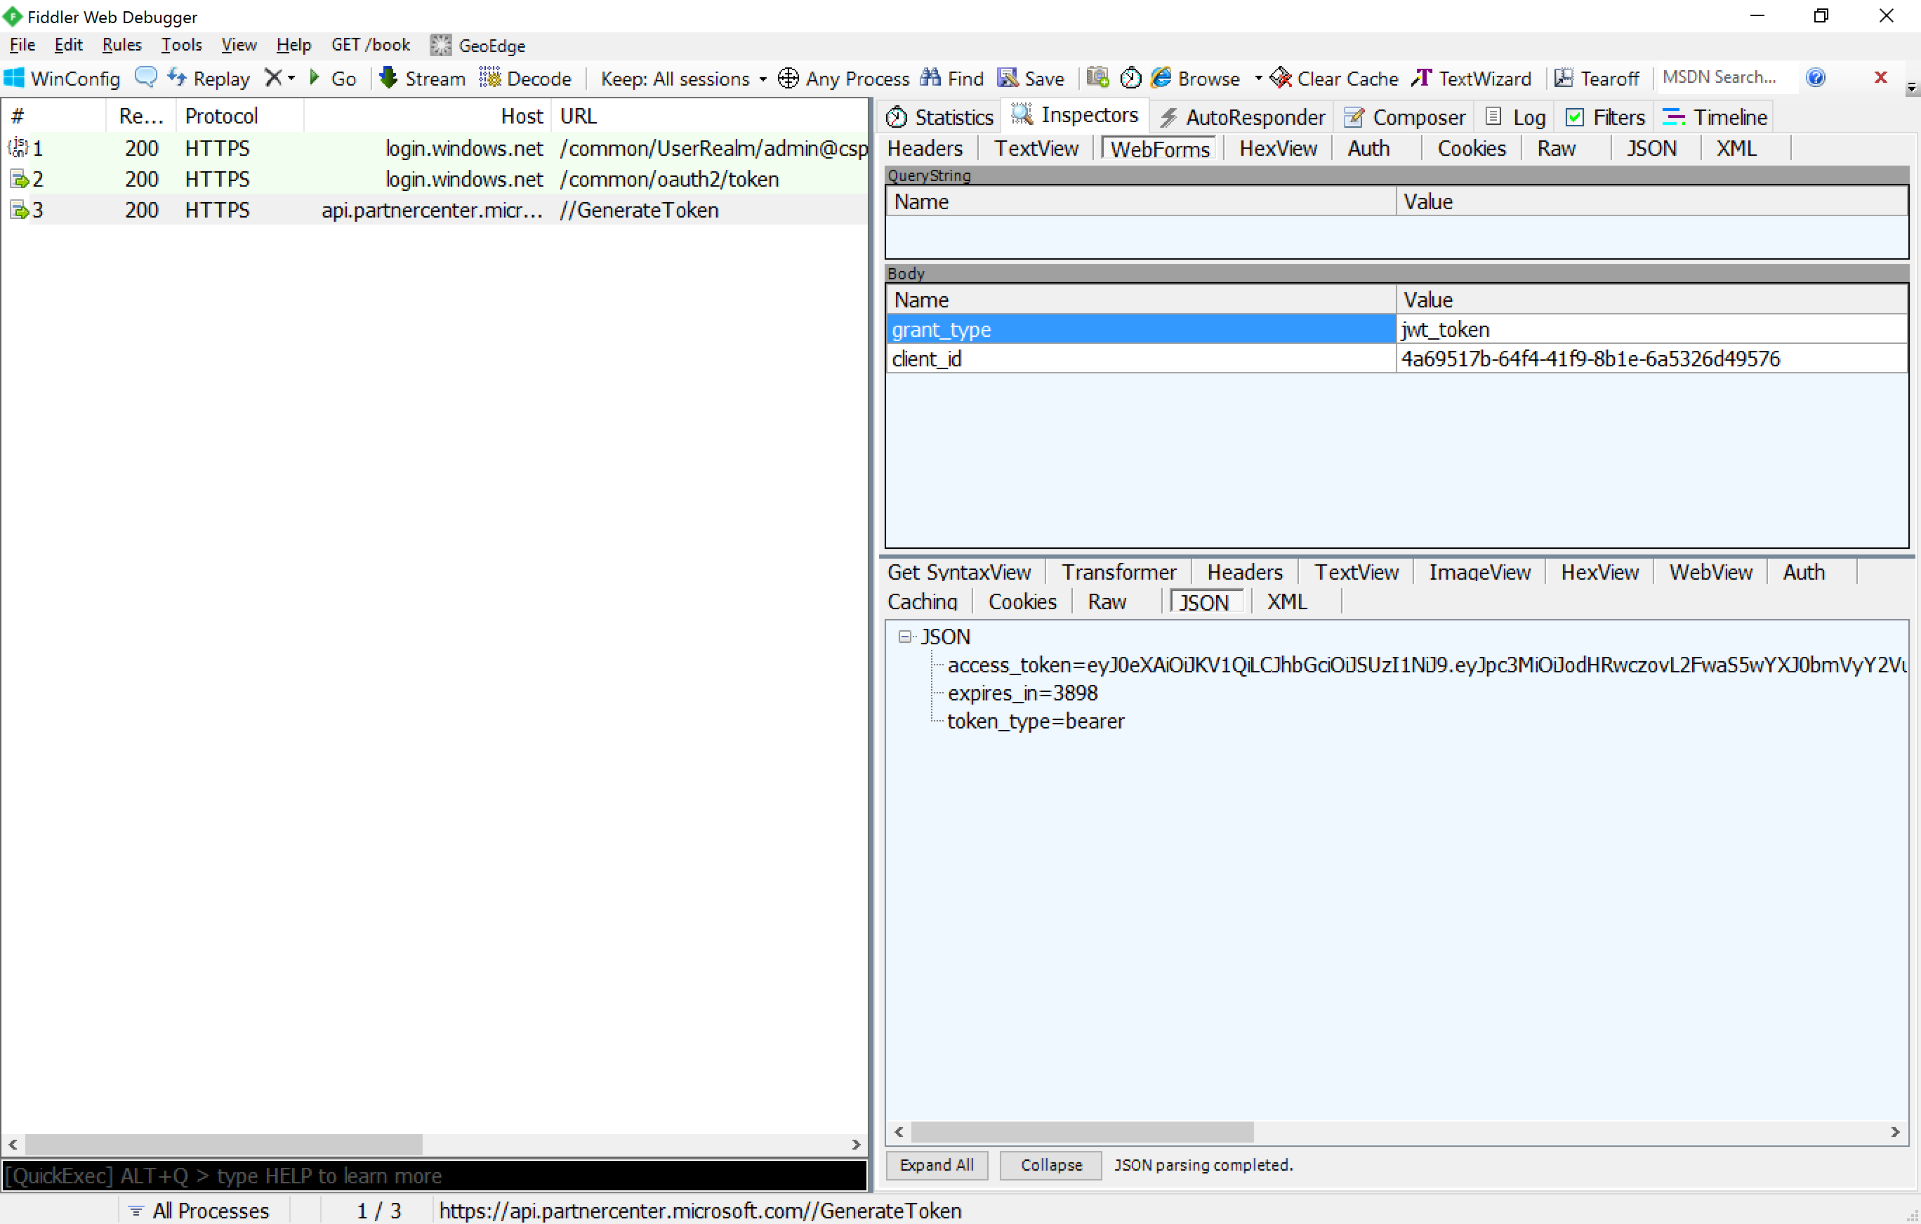
Obtain Access Token from Partner Center API

Slide 15
Two Options for Authentication
User + App
Ideal when users are involved
App configured with delegated permissions
Delegated permissions: app requires user with these permissions grant the app to act on the user’s behalf
Both user using the app & the app must have desired permissions
App Only
Ideal in headless (deamon / service) based applications
Requires extra step (“pre-consent”) to configure the AAD application access to the partner’s customer’s AAD tenants
Pre-consent set via Partner Center dashboard or via Azure AD Graph API

Slide 16
Obtaining Partner Center Credentials: User+App
var userCred = new UserCredential(username, pwd);
var authCtx = new AuthenticationContext(authority);
var resourceId = "https://api.partnercenter.microsoft.com";
// user authenticates with Azure AD
var userToken =
authCtx.AcquireTokenAsync(resourceId, aadAppId, userCred);
// app creates auth token from user login prompt
var pcToken = new AuthenticationToken(
userToken.AccessToken, userToken.ExpiresOn);
// PC-SDK exchanges AAD token with PC-API to get PC credentials
IPartnerCredentials pcCred = PartnerCredentials.Instance.GenerateByUserCredentials(aadAppId, pcToken);

Slide 17
Obtaining Partner Center Credentials: AppOnly
// notice no user detail used
IPartnerCredentials creds = PartnerCredentials.Instance.GenerateByApplicationCredentials(
appId, // Azure AD application ID
appSecret, // Azure AD application key / password
tenantId, // Azure AD tenant ID
authority, // Azure AD login authority
resourceId // Partner Center API resource ID
);

Slide 18
Interop: Leveraging Partner Center API in CREST API Applications

Slide 19
Leverage Partner Center SDK in Existing CREST Apps
Existing CREST API applications can use Partner Center SDK
No changes required to existing CREST API code
Add Partner Center SDK assemblies
Available in a publically available NuGet package
Must obtain an OAuth2 access token to call the Partner Center API

Slide 20
Obtaining Access Token for Partner Center SDK
Obtain Azure AD access token for authenticated user
Same process when using the CREST API
Create AAD application granted permission to Partner Center SDK & signin as the user
Call the /GenerateToken endpoint on the Partner Center SDK
HTTP POST
Include AUTHORIZATION HTTP header with AAD access token
Include grant type & AAD client ID
Returns OAuth2 access token for authorization to Partner Center SDK

Slide 21
DEMO
Updating CREST API Console App with Partner Center SDK

Slide 22
Module Summary
CREST API
Partner Center SDK
Partner Center SDK Authentication
Interop

