Slide 1
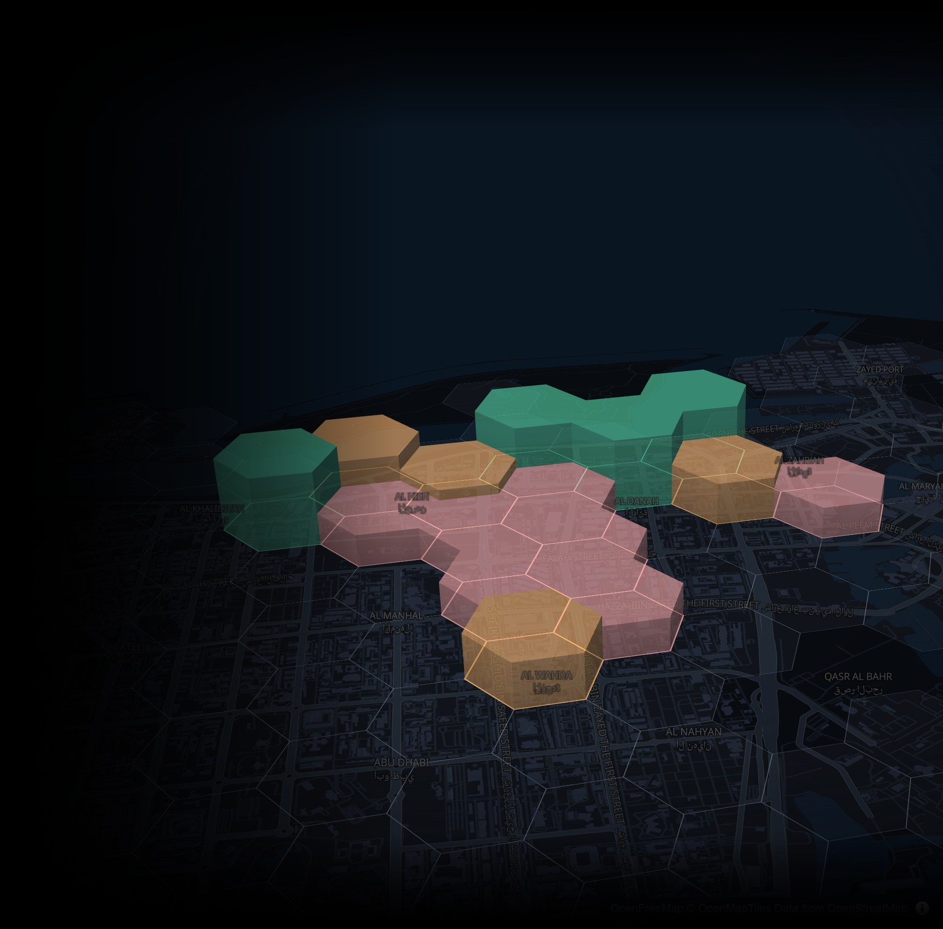

Stakeholder Update · October 2026
LocationReasoner
LLM reasoning for real-world site selection
Miho Koda
Dara Varam
Stefano Patiti
Notes:
LocationReasoner: where we started (a research benchmark), what we learned, and the decision-support platform we built from it.

Slide 2
The question
How can LLMs help people make strategic location decisions in cities: accurately, quickly, and in a way they can trust?
Notes:
Two halves to the story: (1) can LLMs reason about real locations at all, measured against ground truth; (2) how do we turn that into something a planner or business owner would actually use.

Slide 3
At a glance
We measured how well LLMs reason about real locations, then turned what worked into a working tool.
2
382
87%
20–65×
cities
benchmark queries
exact-match answers
faster than agents
Boston (SafeGraph) and Abu Dhabi (OpenStreetMap) on one shared pipeline
306 in Boston and 76 scored in Abu Dhabi, from easy to hard
Single-shot GPT-4o on Abu Dhabi; 100% on easy and medium
Single-shot code generation vs. ReAct / Reflexion, with higher F1
What we built
What we learned
What's next
An app that turns a plain-English request into a validated spec, exact zones, and ranked, explained results on a 3D city map.
Reasoning models and agents did not beat single-shot code generation. Explanations work better in the ranking layer.
Environmental layers, automatic relaxation for zero-match queries, regulatory rules, and an adaptive interface.
Notes:
Headline numbers. 382 = 306 Boston prompts (original benchmark) + 76 scored Abu Dhabi prompts. 87% = 66/76 exact set matches for GPT-4o single-shot. Speed-up = 1.6 s vs 32-35 s (GPT-4o) and 2.3 s vs 92-154 s (GPT-4o-mini).

Slide 4
How it works
LLMs where language matters; deterministic code where correctness matters.
LLM step
Deterministic step
Interface
1 ASK
2 UNDERSTAND
3 CHECK
4 SOLVE
5 RANK
6 SHOW
Plain-English request
Hard constraints plus an optional persona or priority
Spec generation
Request becomes a JSON constraint spec (AND / OR / NOT)
Validation
Every metric in the spec must exist in this city’s data
Rules engine
Exact zone set, computed deterministically (ground truth)
Constraint scoring
0–100% match, so near-misses still surface
3D map + zone card
Address (OSM), live weather (Open-Meteo), reasons
compare
“Urban designer who cares about greenery: zones within 800 m of a mall, ≥ 2 pharmacies”
Priority extraction
Persona becomes a ranking dimension, e.g. greenery
Unsupported request? Stop and say why. Never guess.
LLM solver
Code-gen, ReAct or Reflexion, checked against the rules engine
Context re-rank
0–100 per zone on the step-2 priority, with a reason
Two views
Consumer for decision-makers, ML for evaluation
City feature store
Boston
255 zones · 48 features · SafeGraph POIs, spending, population
Abu Dhabi
471 zones · 27 features · OpenStreetMap POIs
H3 hexagonal zones × features derived from points of interest
Notes:
End-to-end pipeline. The LLM is used for (a) understanding the request and (b) ranking/explaining. Correctness comes from the deterministic rules engine over a per-city feature table. The LLM solver (direct code generation, ReAct, or Reflexion) is what we benchmark: its zone set is compared with the rules engine's on every query (precision/recall/F1). Both cities use H3 resolution-8 hexagons.

Slide 5
01 · Benchmarking
Can LLMs actually reason about real locations?
Notes:
First: the research question, measured.

Slide 6
How we benchmark
Every query has one correct answer, computed by a deterministic rules engine. The LLM's zones are scored against it.
Easy
Medium
Hard
Boston 108 · Abu Dhabi 30
Boston 96 · Abu Dhabi 30
Boston 102 · Abu Dhabi 16
Single clause
2–3 clauses, AND / OR
3–6 clauses, AND / OR / NOT
“Find a zone with at least 5 restaurants.”
“Find zones with at least 1 tourist landmark and at least 2 parks.”
“Find zones with at least 2 pharmacies, within 800 m of a mall, with at least 1 parking location and no more than 5 coffee shops.”
cnt_restaurants ≥ 5
all_of:
cnt_tourist_landmarks ≥ 1
cnt_parks ≥ 2
all_of:
cnt_pharmacies ≥ 2
dist_to_malls_m ≤ 800
cnt_parking ≥ 1
cnt_coffee_shops ≤ 5
Scored on: exact match (predicted set = ground truth) · precision / recall / F1 (partial credit) · runtime (wall-clock per query)
Notes:
Boston numbers are the original LocationReasoner query bank (306 prompts across 51 query categories). Abu Dhabi has 80 prompts written for OSM data; 76 have scored results (16 of 20 hard). Each prompt is also stored as a JSON spec, which the rules engine evaluates to produce the ground truth.

Slide 7
A reasoning model did not beat its non-reasoning counterpart
Abu Dhabi, single-shot code generation. Consistent with the original Boston benchmark.
Exact-match answers by query difficulty
GPT-4o · non-reasoning
66 / 76
exact answers. All-or-nothing: no partial answers; all 10 misses are on hard queries.
o4-mini · reasoning
0.43
precision vs. 0.92 recall. It over-reasons and returns too many zones (14 partial answers).
76 Abu Dhabi queries. Precision and recall micro-averaged over predicted and true zones.
Notes:
From the Abu Dhabi runs (gpt-4o vs o4-mini, same prompts, single-shot). GPT-4o either gets a query exactly right or returns nothing useful. o4-mini produces more 'partial' answers - it tends to over-include zones (micro precision 0.43, recall 0.92). Matches the original LocationReasoner finding in Boston: reasoning models offered limited gains over non-reasoning predecessors.

Slide 8
Single-shot code generation was the most accurate, and 20–65× faster
Abu Dhabi, 30 medium-tier queries per model and strategy.
Mean F1 (higher is better)
Mean runtime per query, seconds (lower is better)
Trade-off: agents add step-by-step traces, but cost accuracy, time and tokens. We keep them for inspection in the ML view.
March 2026 runs. The o4-mini agentic run failed and is excluded.
Notes:
GPT-4o: direct F1 1.00 in 1.6 s; ReAct 0.67 in 34.6 s; Reflexion 0.88 in 31.8 s. GPT-4o-mini: direct 1.00 in 2.3 s; ReAct 0.44 in 92 s; Reflexion 0.49 in 154 s. Completion rates were 87-100%. Agent failures were mostly partial zone sets (low recall) - they stop early or filter on the wrong column before recovering.

Slide 9
Interpretability vs. cost: where we chose to sit
More visible reasoning costs time and, in our tests, accuracy.
Cheaper and faster
Our solver
Direct analysis
A function reads a structured spec. No visible reasoning.
Single-shot LLM
Writes the analysis code in one pass. Fastest and most accurate in our tests.
Single-shot reasoning LLM
Shows its reasoning, but tended to over-reason and over-include.
Agentic LLM
ReAct / Reflexion: thought → action → observation traces.
20–65× slower.
More interpretable
Our design choice
Keep the fast, accurate single-shot solver for the answer. Add interpretability where people actually look: per-zone scores, constraint checks and plain-English reasons in the ranking layer.
Notes:
This is the bridge between the research and the product. We don't need an agent's trace to be interpretable: we get explanations from a separate ranking/explanation step that runs after the fast, accurate solver, and we keep agent traces available in the ML view for technical users.

Slide 10
02 · The platform
From correct answers to useful decisions
Notes:
Second half: what we built on top of the benchmark.

Slide 11
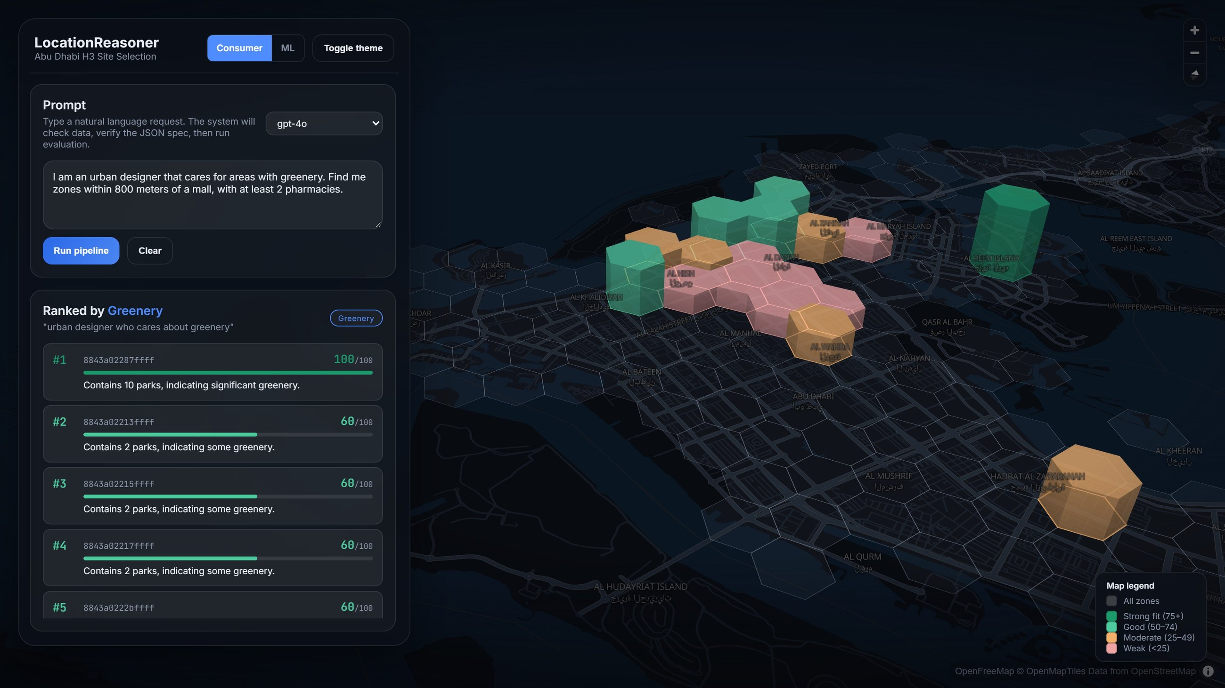
Ask in plain language, see ranked zones on a 3D city model
1
Type a request in plain English, with an optional persona.
2
Only zones that meet every hard constraint are kept: 21 of 471 here.
3
Column height and colour show fit to your priority, with a reason for each zone.
Notes:
Prompt: 'I am an urban designer that cares for areas with greenery. Find me zones within 800 meters of a mall, with at least 2 pharmacies.' 21 zones satisfy the hard constraints; they are then re-ranked by greenery. Map style matches the Dubai route demo: dark basemap, 50%-opacity 3D buildings, translucent result columns.

Slide 12
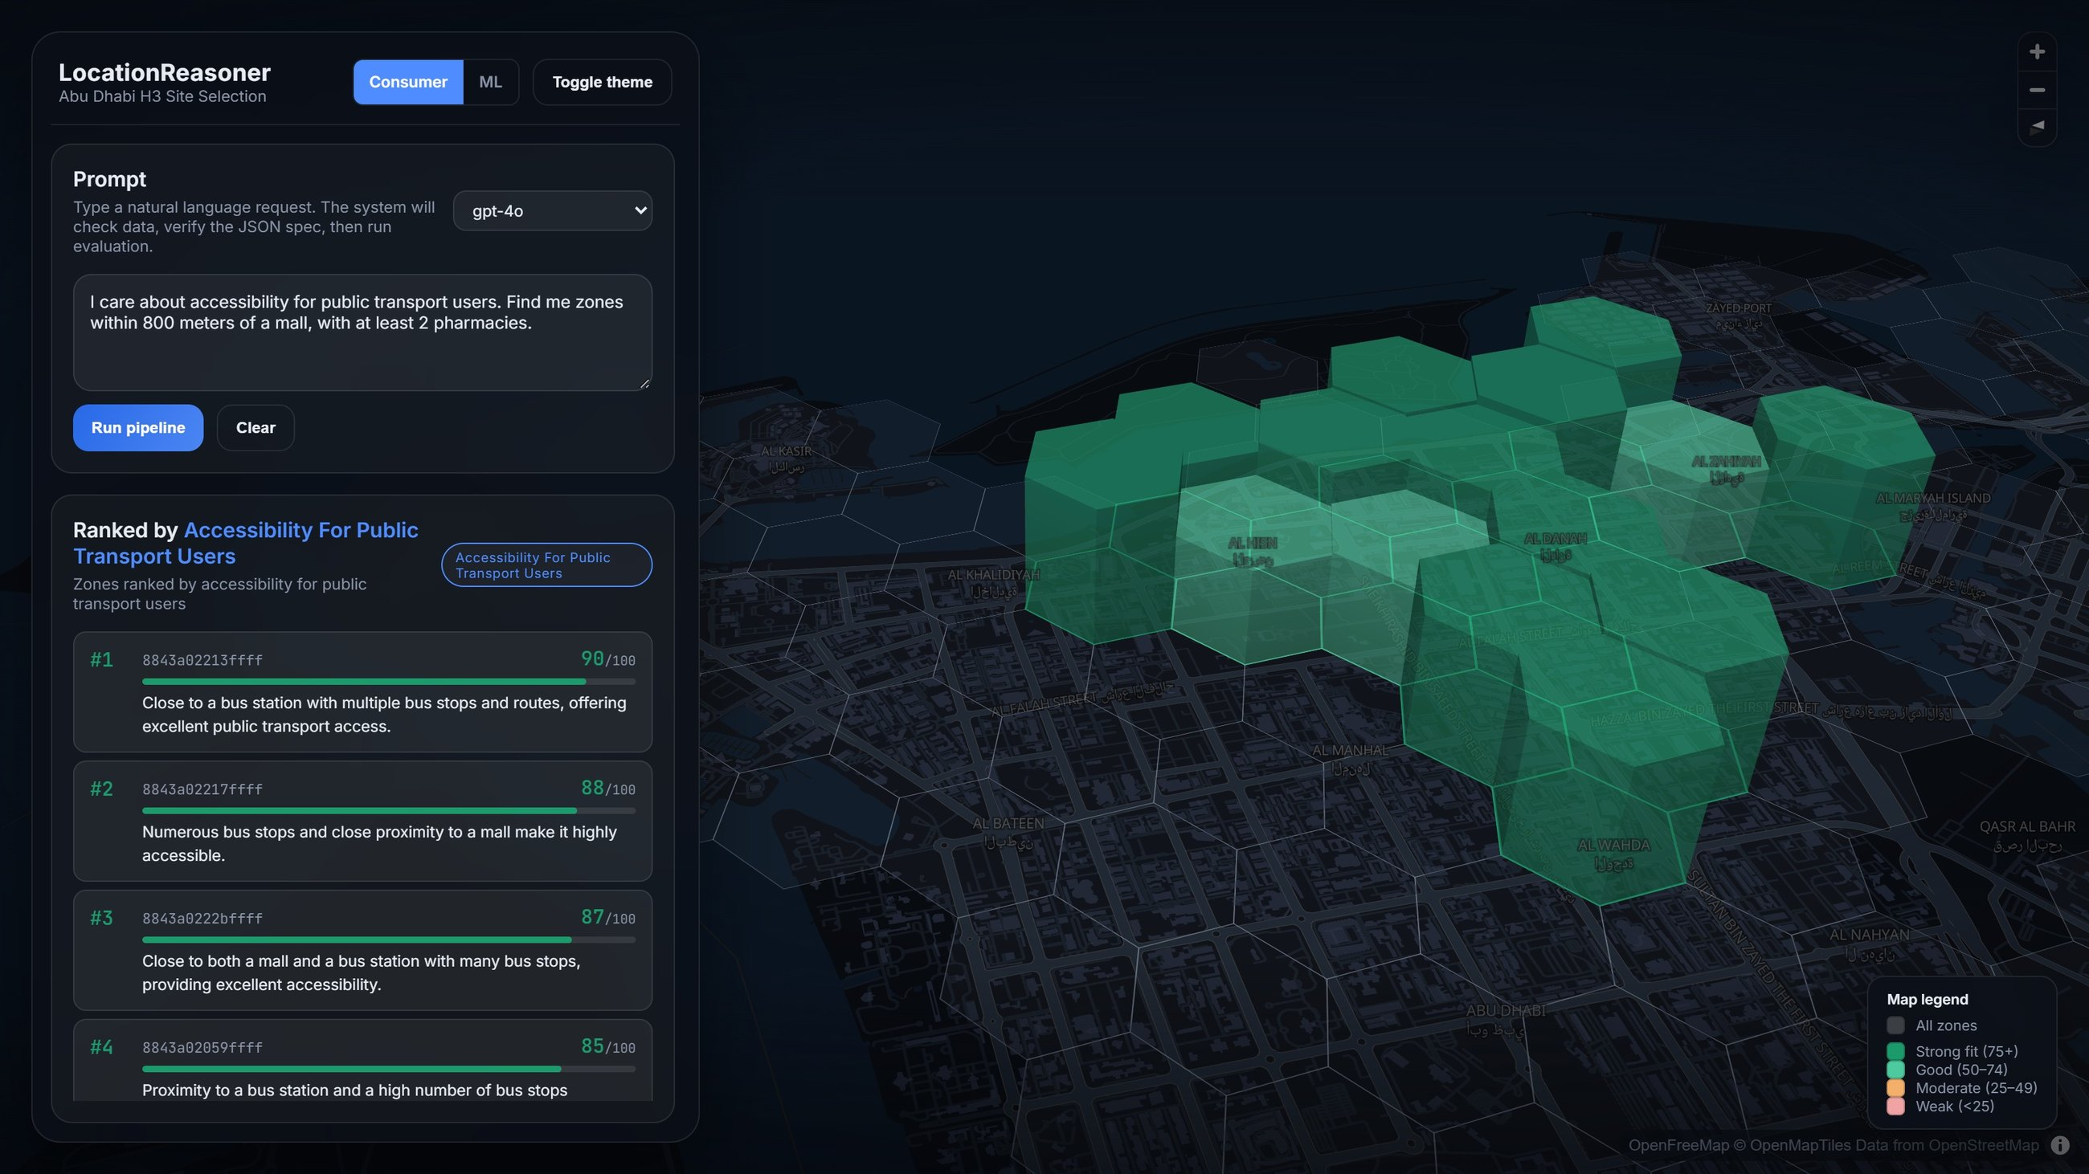
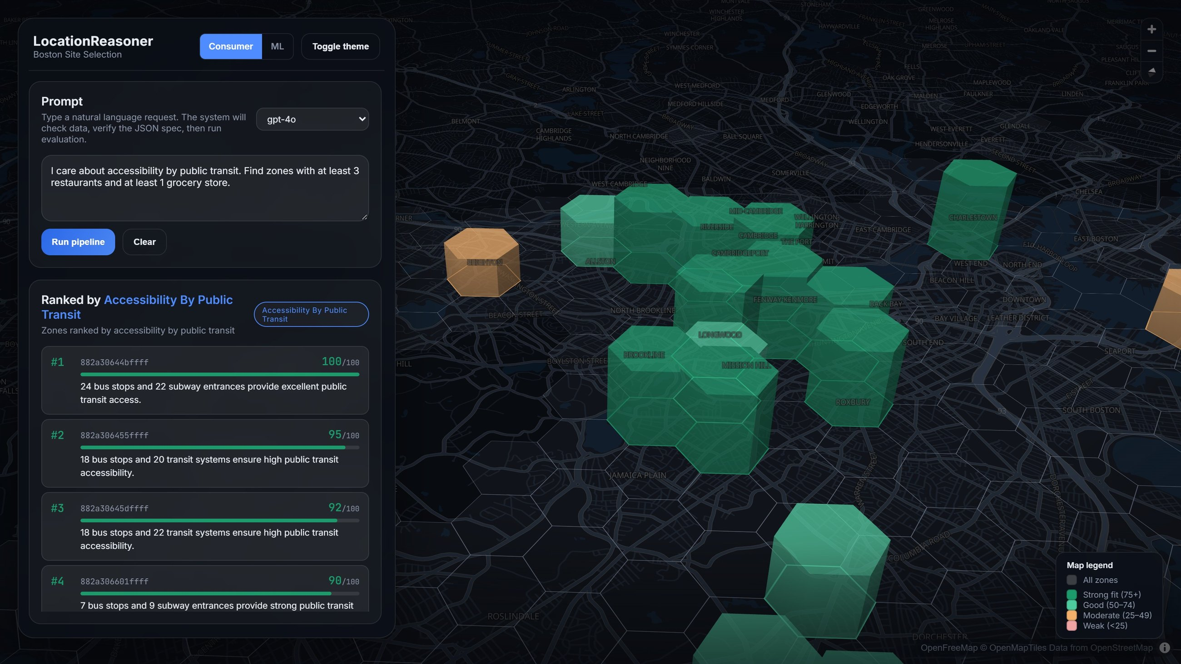
One system, two very different cities
Abu Dhabi
Boston
471 H3 zones · 27 features · OpenStreetMap points of interest
255 H3 zones · 48 features · SafeGraph POIs, spending, population
Open data only, so questions are about amenities and distances.
Richer data supports harder questions, such as spending patterns and demographics.
Boston also anchors the original LocationReasoner benchmark (306 queries).
Notes:
Left: Abu Dhabi, ranked by accessibility for public-transport users. Right: Boston, 'I care about accessibility by public transit. Find zones with at least 3 restaurants and at least 1 grocery store' (64 matching zones, top zones cite bus stops and subway entrances). Same code, different city config.

Slide 13
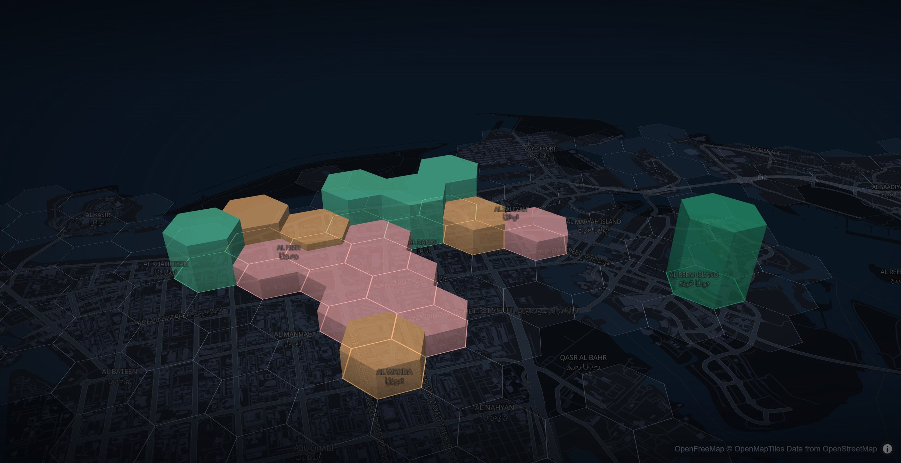
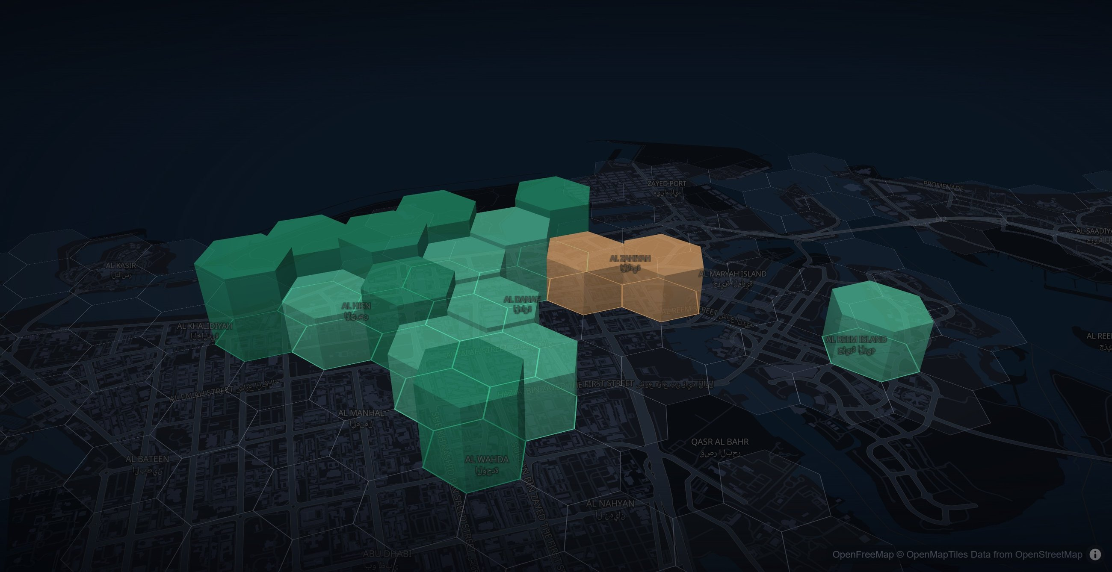
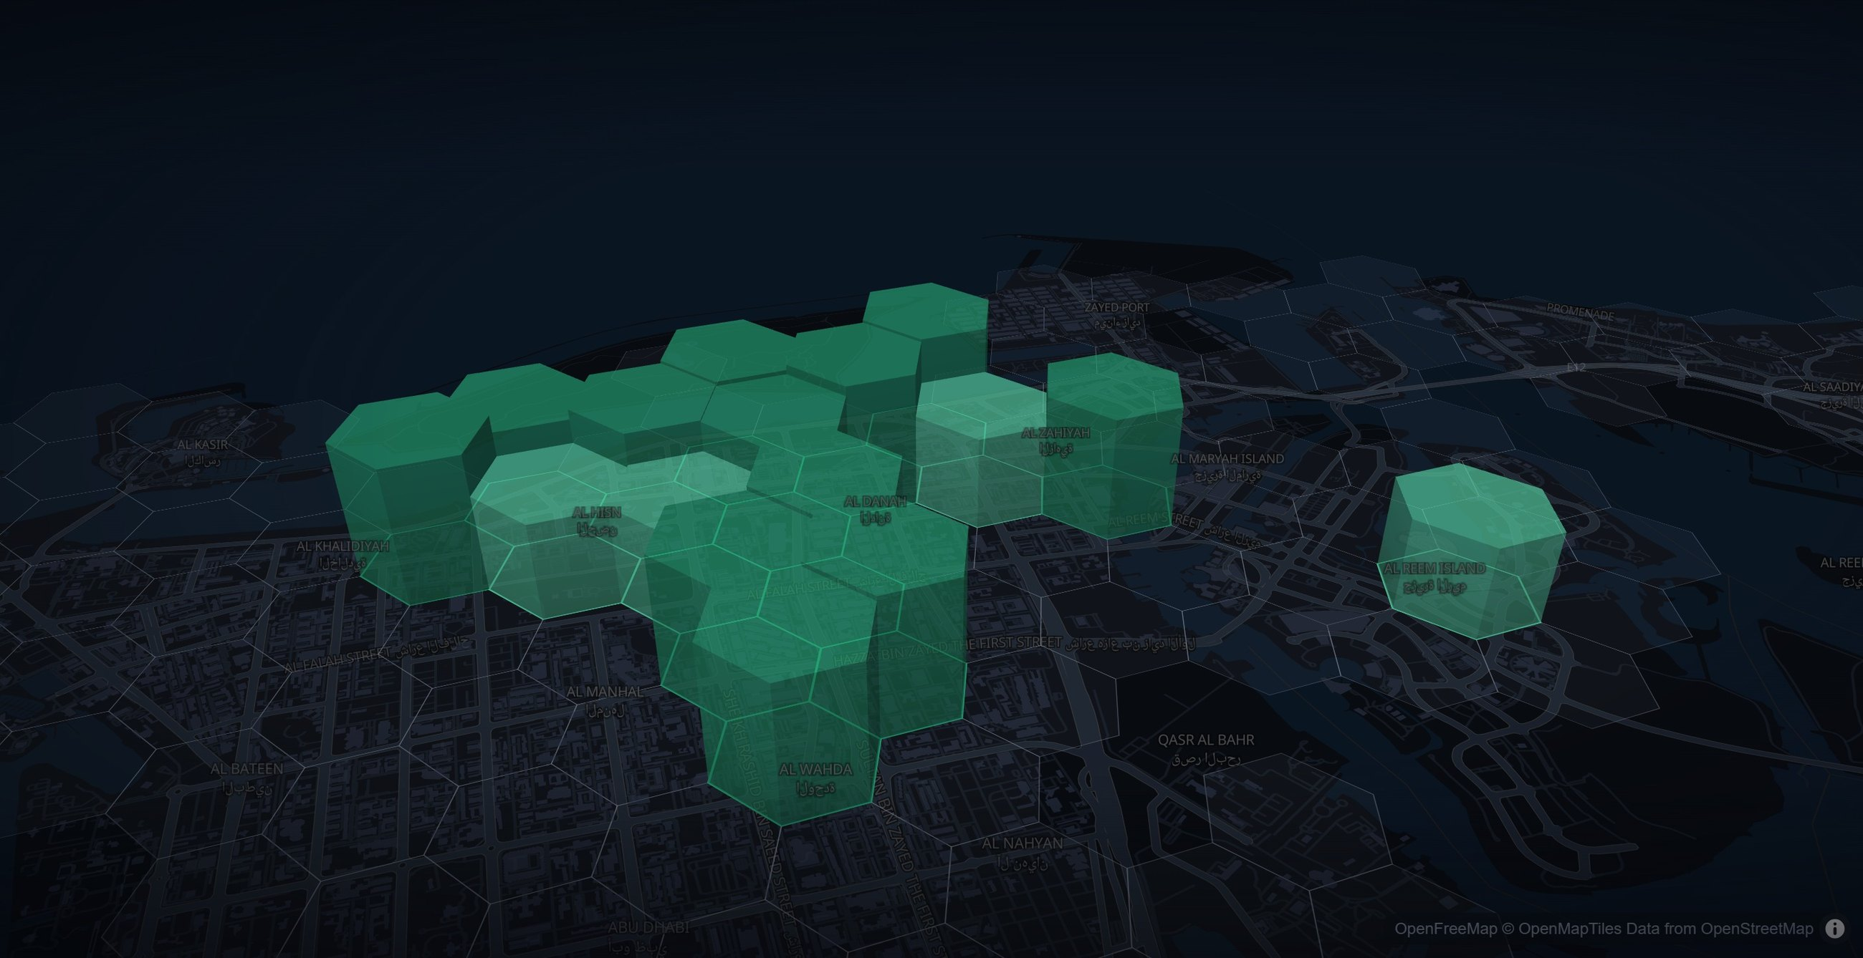
Same constraints, different priorities, different answers
“…zones within 800 m of a mall, with at least 2 pharmacies” returns the same 21 zones each time. Only the stated priority changes.
Greenery
Tourist landmarks
Public transport
“urban designer who cares about greenery”
“tourism business owner”
“accessibility for public transport users”
A
Contains 10 parks, indicating significant greenery.
100
D
Very close to tourist landmarks and has the highest number of landmarks in the zone.
90
B
Close to a bus station with multiple bus stops and routes.
90
B
Contains 2 parks, indicating some greenery.
60
E
Close proximity to tourist landmarks, with landmarks inside the zone.
88
F
Numerous bus stops and close proximity to a mall.
88
C
Contains 2 parks, indicating some greenery.
60
C
Excellent proximity to tourist landmarks and a high number of them in the zone.
85
E
Close to both a mall and a bus station with many bus stops.
87
Letters mark the same zone across columns. The #1 zone is different for every priority.
Notes:
Three real runs with identical hard constraints and an identical camera. The rules engine returns the same 21 zones; the context-ranking step scores them 0-100 on the stated priority using the zones' amenity data (parks, landmarks, bus stops) plus general knowledge, and writes a reason per zone. Zone B is #2 for greenery, #1 for public transport. Top-5 lists overlap by only 3-4 zones. Reasons are the model's own text, lightly shortened to fit.

Slide 14
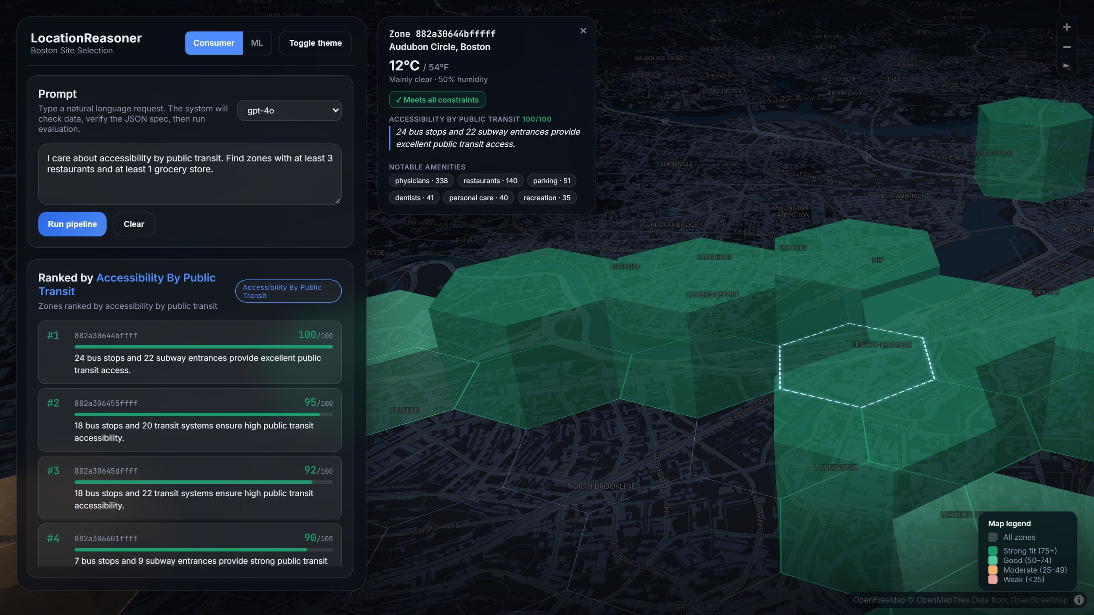
Click any zone: one card, five sources
Address
OpenStreetMap Nominatim (reverse geocoding)
Live weather
Open-Meteo, fetched on click
Constraint check
Rules engine: ✓ / ✗ for each clause
Why this score
LLM reasoning grounded in the zone’s data
Notable amenities
The zone’s feature table
Notes:
Works on every zone, matched or not. Address and weather come from free, keyless public APIs and fail gracefully. The reason text is the same LLM explanation shown in the ranking list.

Slide 15
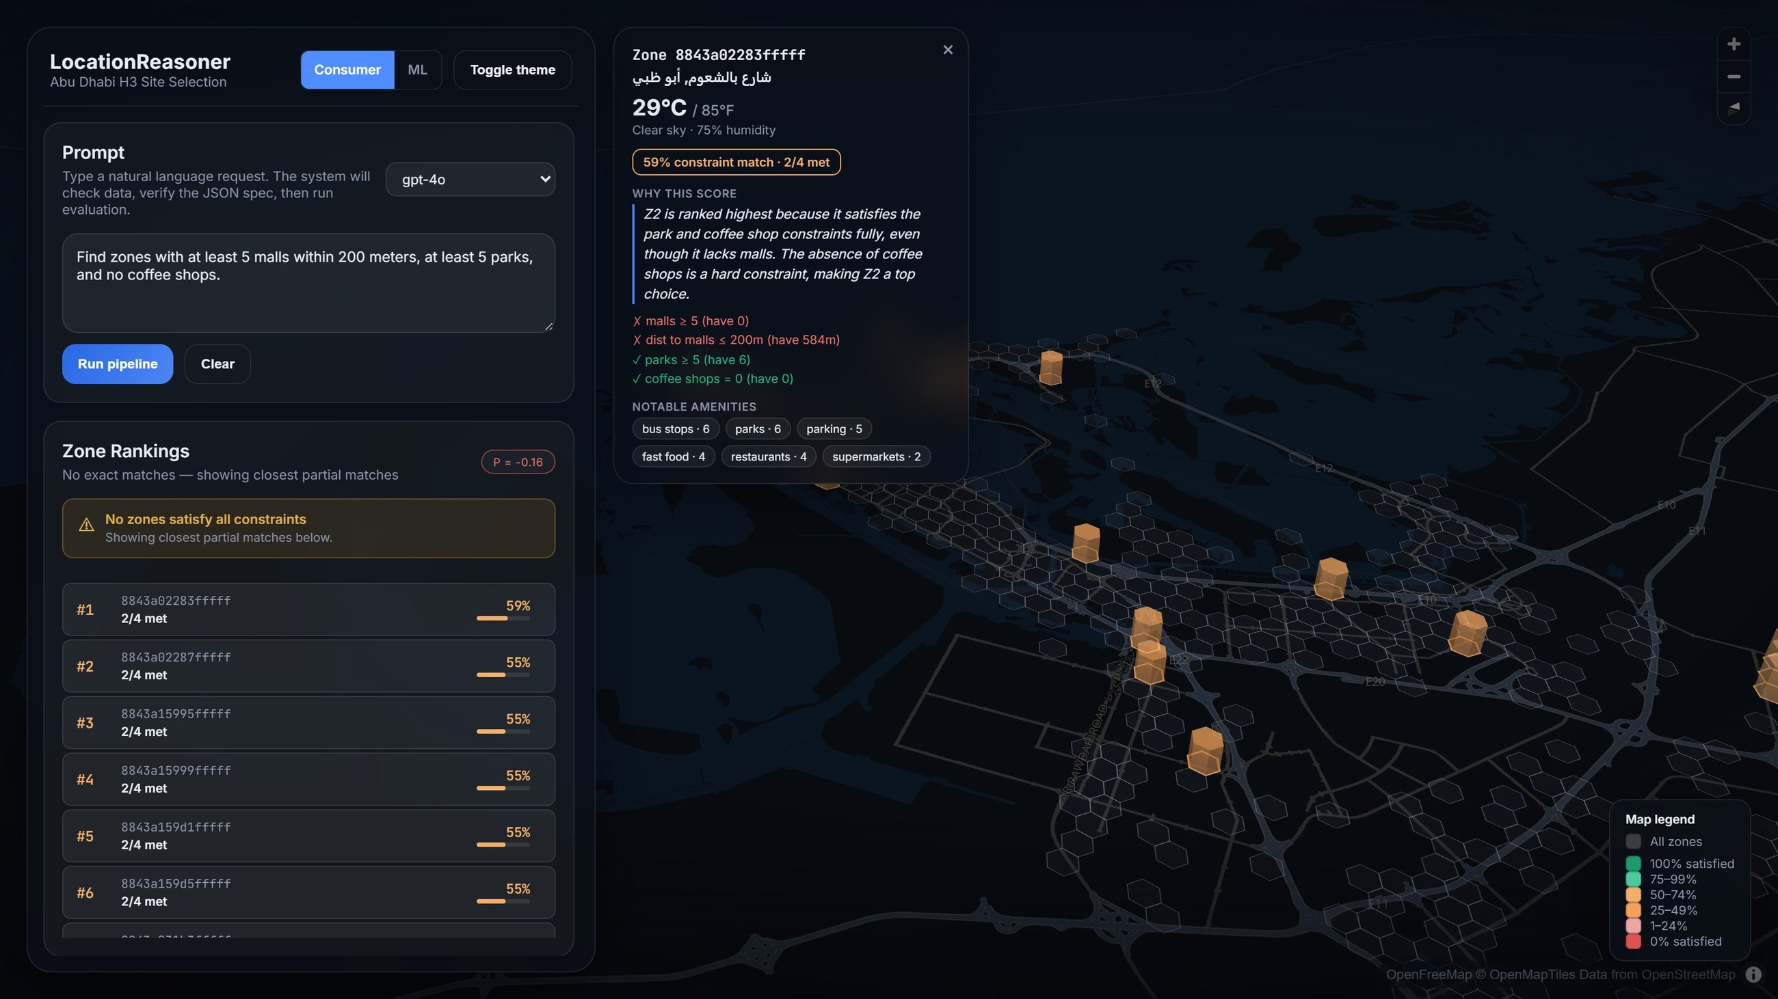
No exact match? Rank the near-misses and explain the trade-offs
How near-misses are scored
≥ x
actual ÷ x, capped at 100%
≤ x
x ÷ actual
AND
average of its parts
OR
best of its parts
NOT
1 − score
This query: no zone meets all 4 constraints. The best zone scores 59% (2 of 4 met).
An LLM explains each ranking in plain English. The ML view compares its order with the formula's (Spearman ρ).
Notes:
Prompt: 'Find zones with at least 5 malls within 200 meters, at least 5 parks, and no coffee shops.' Instead of an empty map, every zone gets a continuous score; the closest 30 are shown, coloured by score. Clicking one shows which clauses pass/fail and the LLM's trade-off explanation.

Slide 16
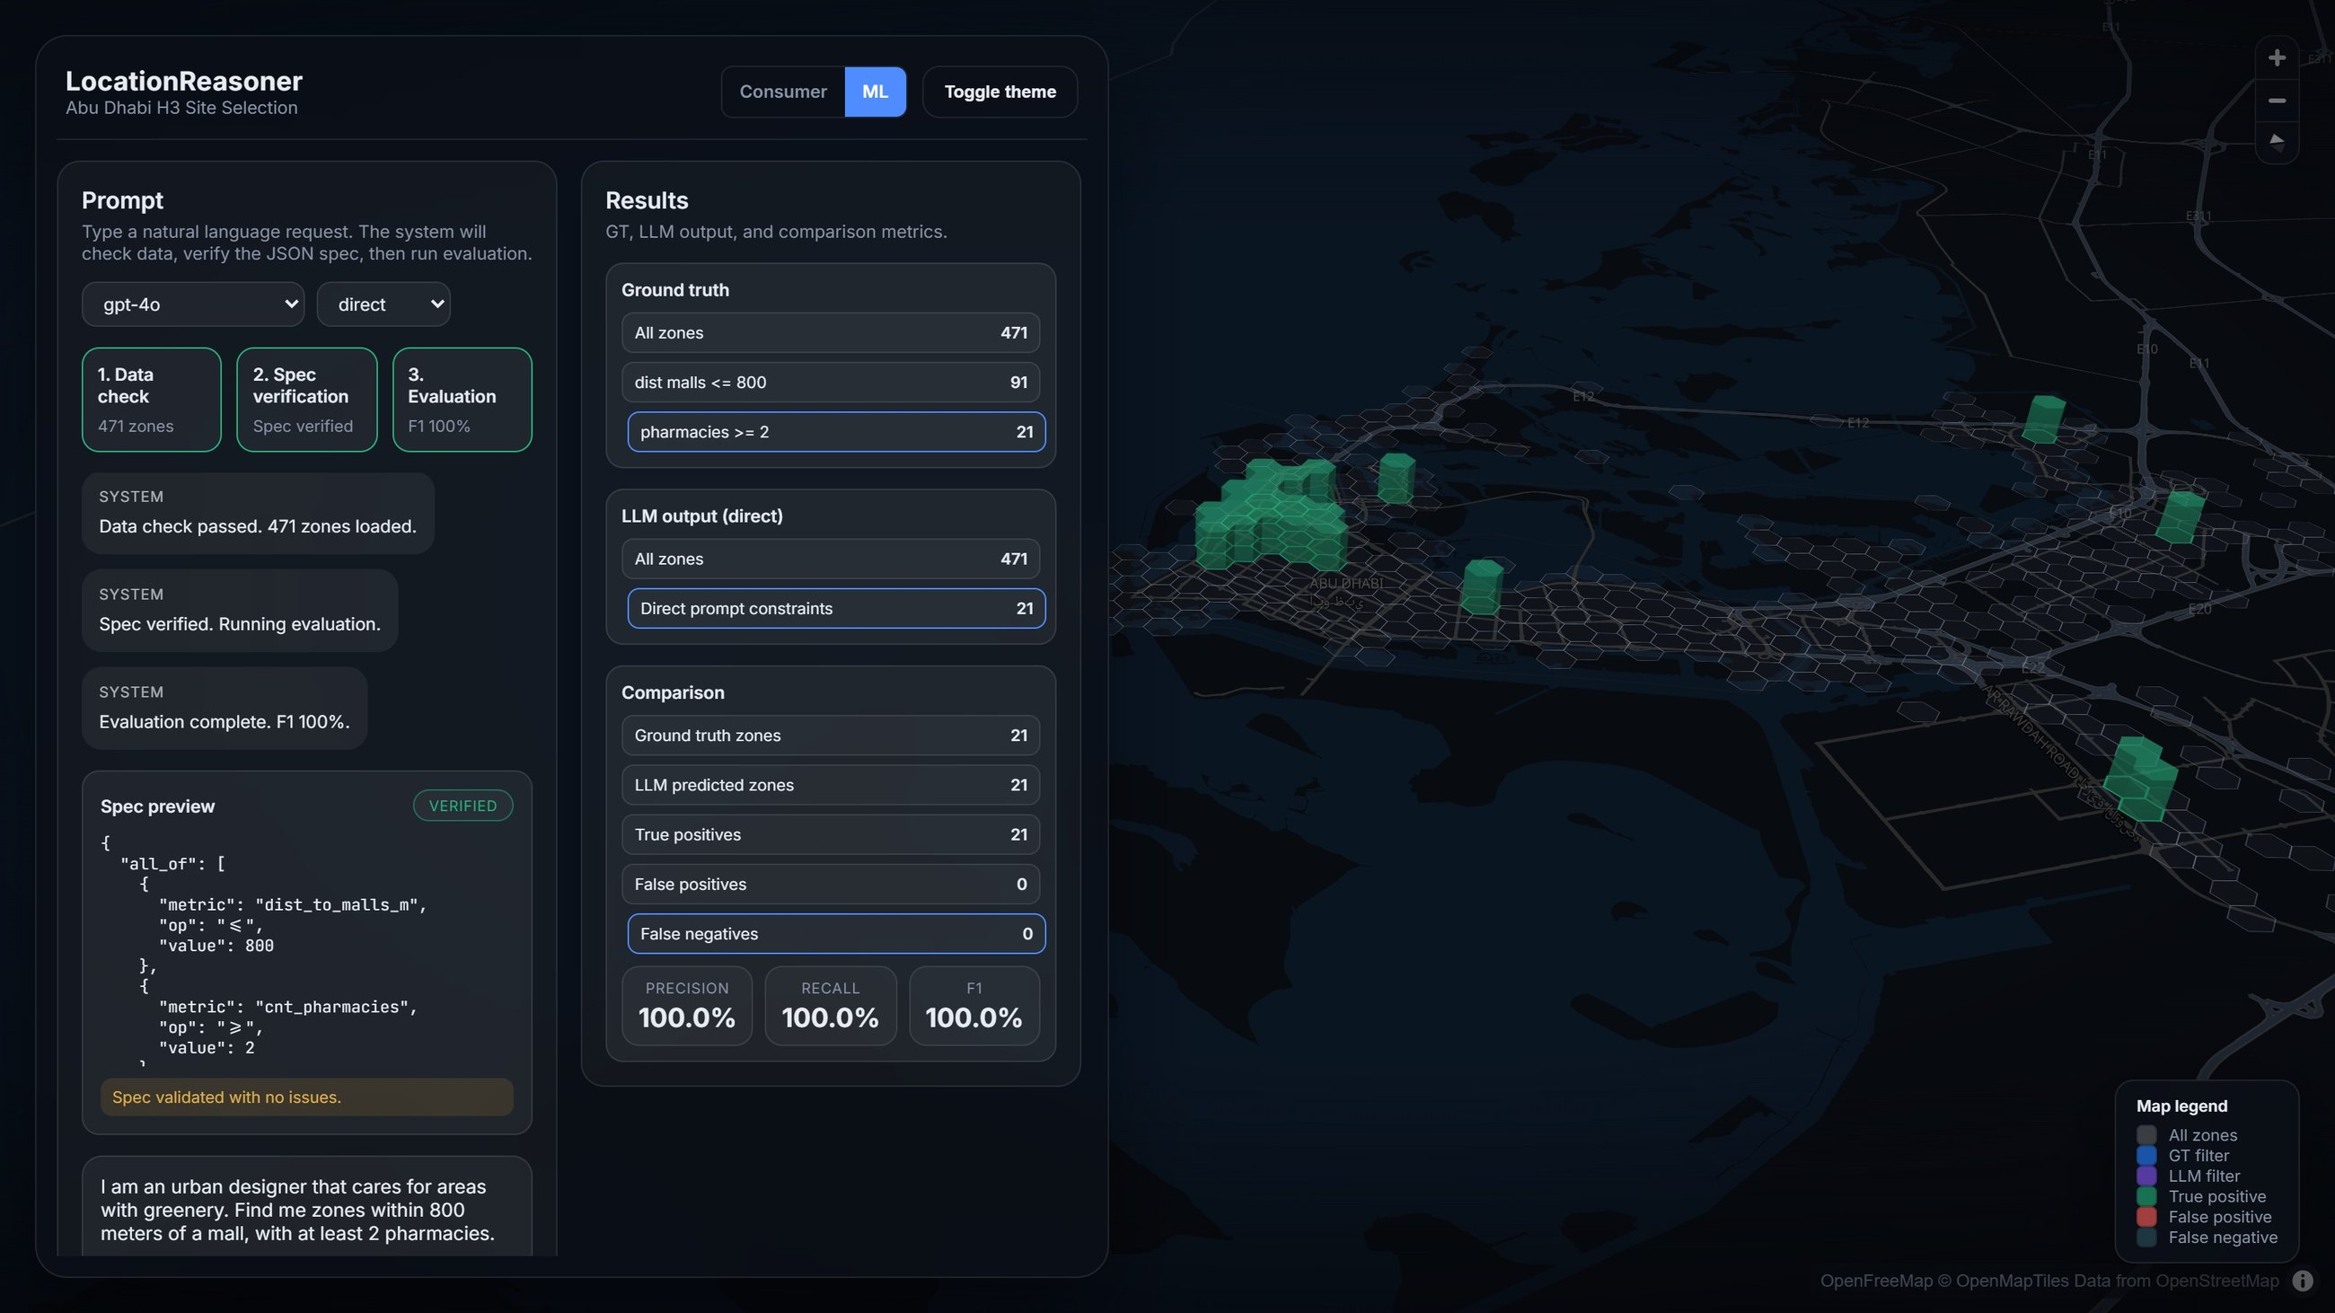
Every answer can be audited
Check before running
The spec is validated against the city’s data. Unknown metrics stop the run with a message instead of a guess.
Ground truth on every query
The LLM’s zones are compared with the rules engine: precision, recall and F1 (all 100% here).
Transparency on demand
Parsed spec, generated code and agent traces sit behind one toggle.
Notes:
The ML view is the same app with the internals switched on: data check, spec verification, step-by-step ground-truth filtering vs. the LLM's filtering, and P/R/F1. In 3D, true positives are green columns, false positives red, false negatives slate.

Slide 17
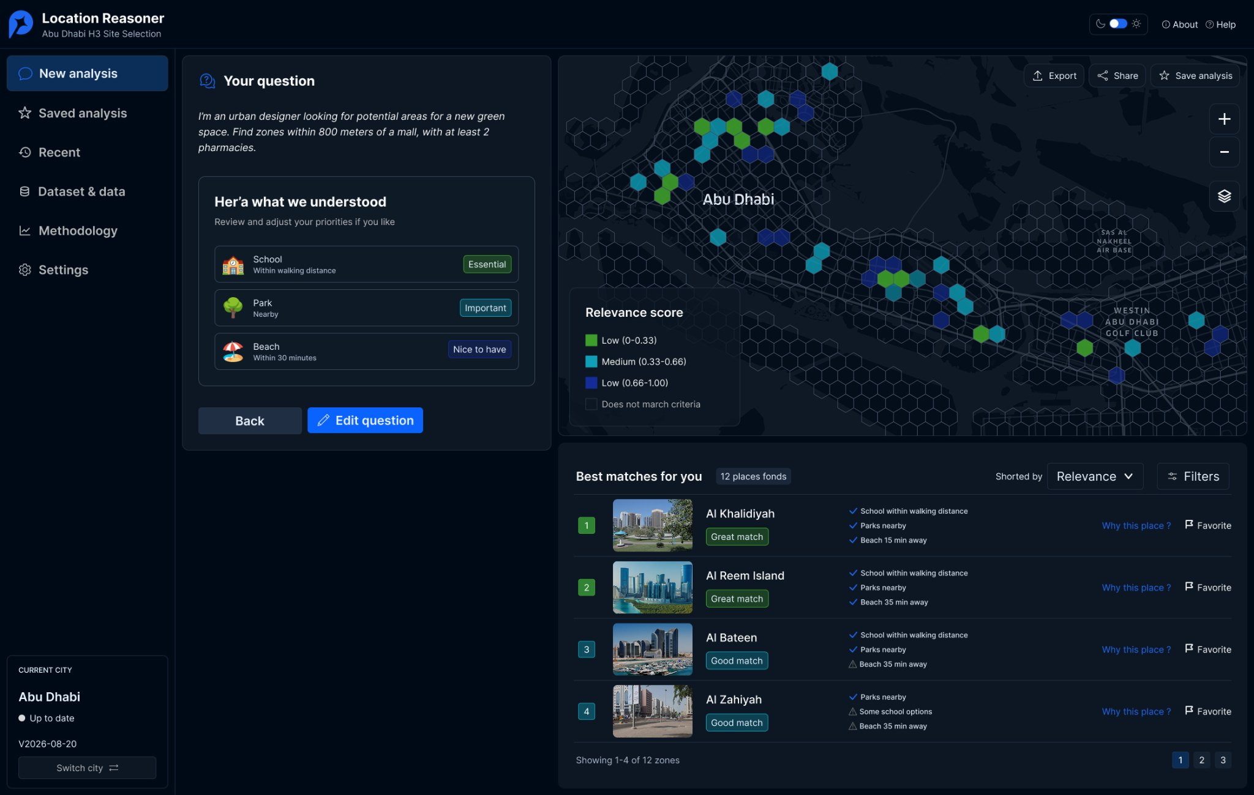
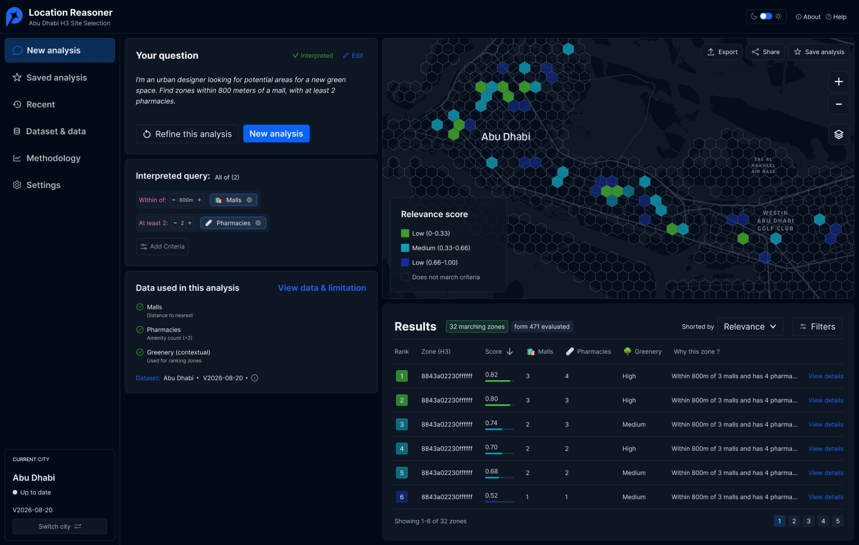
One reasoning system, different levels of detail
The same engine serves different people. What changes is how much of it they see.
Everyday Urban Explorer
Urban Professional
Technical Specialist
Guided, plain-language results
Editable criteria, data layers, export
Spec, code, traces and metrics
Live: Consumer view
Designed
Live: ML view
Progressive disclosure
Urban Explorer: needs in everyday words, recognisable places, simple reasons
Urban Professional: interpreted criteria, data used, ranked results
Notes:
Today the app ships the two ends of this spectrum as a single toggle (Consumer / ML). The middle - an analytical experience for planners - is designed (UX exploration by Stefano Patiti) and is the next build: editable criteria, visible datasets, environmental layers, saved analyses and export.

Slide 18
What's next
Built on what works today; focused on richer context and trust.
Shipped
Next
Exploring
Two-city benchmark: 382 queries, three difficulty tiers
Plain English to validated spec to exact zones, with safeguards
Near-miss scoring and persona-aware ranking with reasons
3D map, zone card with live context, Consumer / ML views
Deployment-ready web apps for both cities
Progressive relaxation: soften thresholds automatically (e.g. 200 m → 500 m) when nothing matches
Benchmark the ranking layer against the formula (Spearman ρ, NDCG)
Environmental layers: heat, greenery, air quality
Build the adaptive interface from the design study
Regulations as constraints, e.g. Abu Dhabi F&B zoning, buffers and parking ratios
More cities (Dubai) and user-supplied data
Saved analyses and exportable reports
Notes:
Next steps carried over from the June update (relaxation, ranking benchmark) plus the design study's environmental layers. The regulatory example comes from the Abu Dhabi F&B matrix: land-use rules, spatial buffers, parking generation and kitchen engineering requirements could become constraints in the same spec language.

Slide 19
Live demo
Abu Dhabi and Boston, running live
Notes:
Suggested prompts:
1) Abu Dhabi: 'I am an urban designer that cares for areas with greenery. Find me zones within 800 meters of a mall, with at least 2 pharmacies.' -> click the #1 zone.
2) Abu Dhabi: 'Find zones with at least 5 malls within 200 meters, at least 5 parks, and no coffee shops.' -> no exact match, click the top near-miss.
3) Toggle ML view to show ground truth vs LLM and P/R/F1.
4) Boston: 'I care about accessibility by public transit. Find zones with at least 3 restaurants and at least 1 grocery store.'

Slide 20
Contact
Miho Koda
mihok485@mit.edu
Stefano Patiti
spatiti@mit.edu
Dara Varam
varam@mit.edu
Instagram
@senseable City Lab
X
@SenseableCity
MIT Senseable City Lab
77 Massachusetts Avenue
Cambridge, MA
02139 USA
1-617-324-4474
1-617-258-8081
https://senseable.mit.edu/
Notes:
Questions.

