Slide 1
By: Ahmad Bilal & Dara Varam
## input layer [x]
Neural Networks
A Crash Course
STA 401 – Introduction to Data Mining

Slide 2

## Outline
What are Neural Networks?
Uses and Applications
Motivation
Activation Functions (Introduction to non-linearity)
Backpropagation (Training of Neural Networks)
Architectures
Evaluating Neural Networks: Regression and Classification

Slide 3
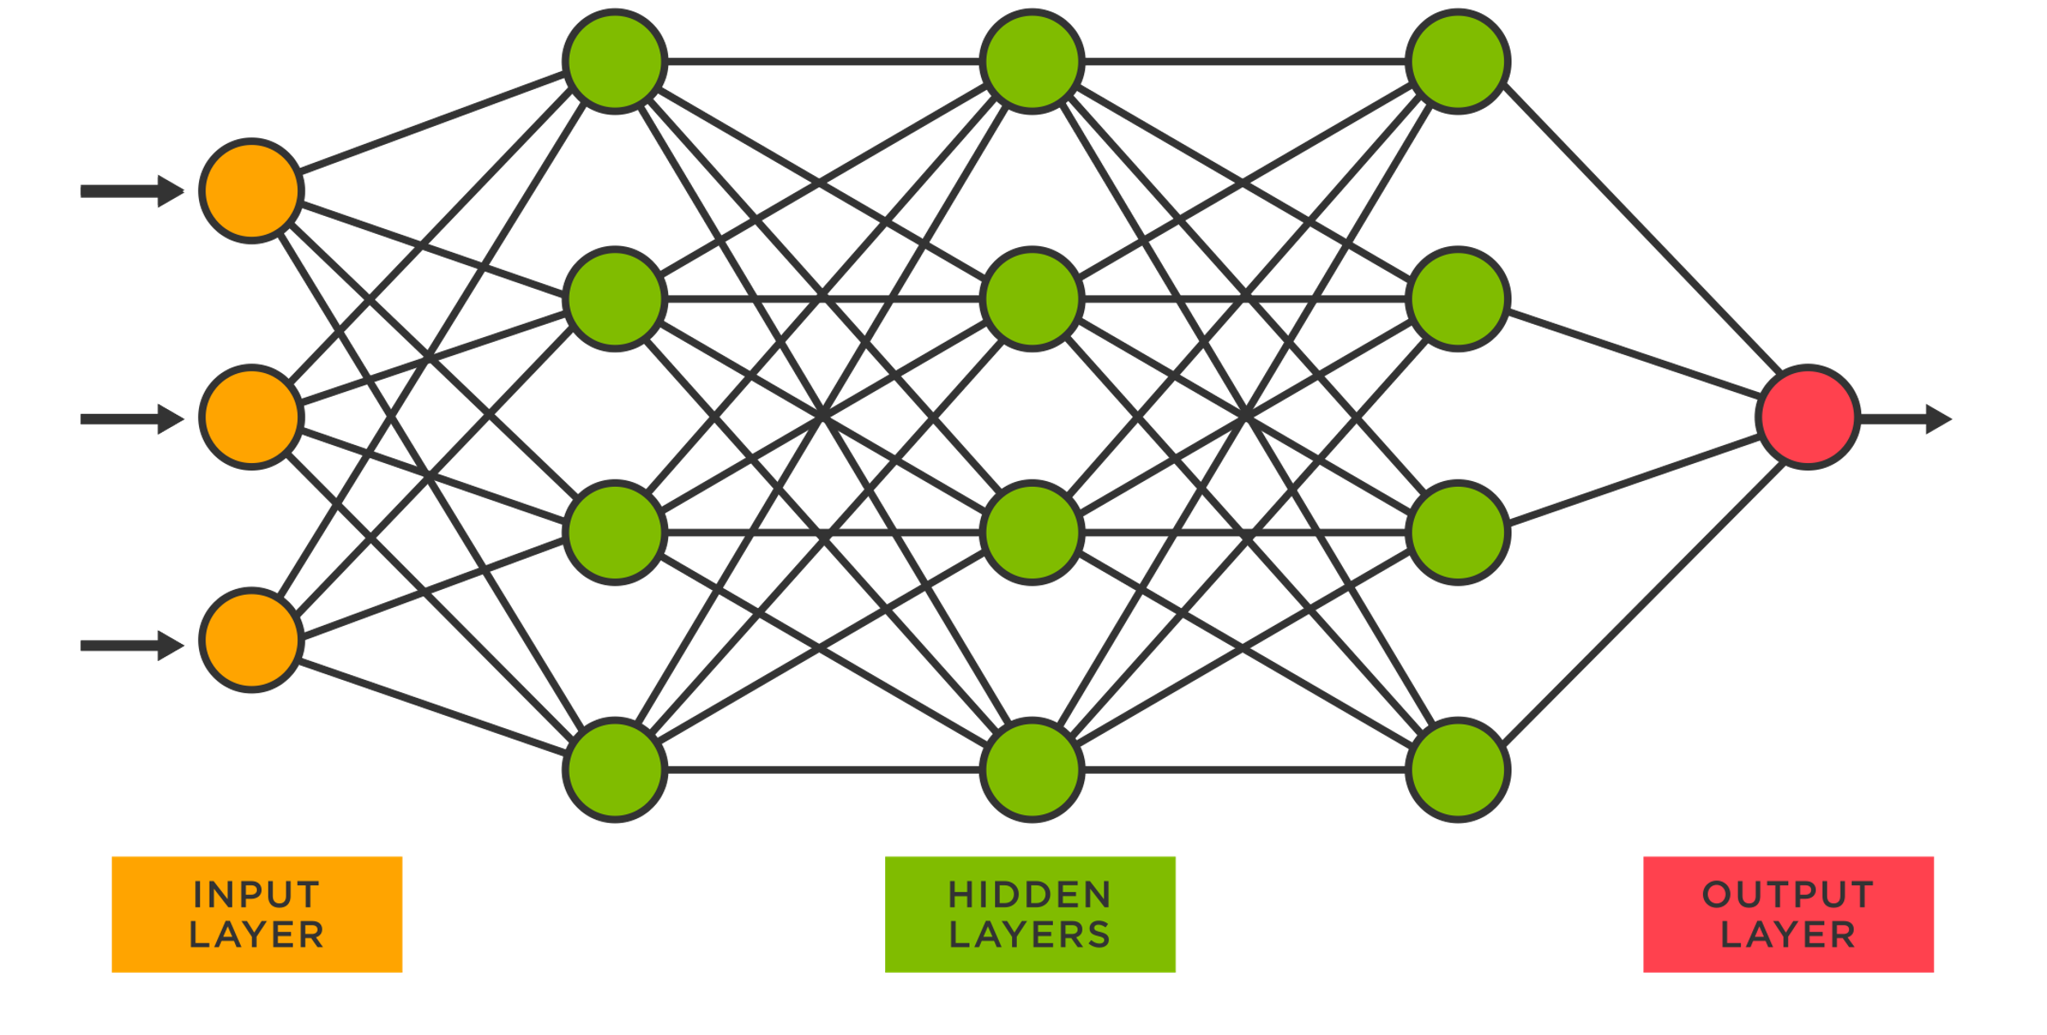
## What are Neural Networks?
Neural networks are a branch of artificial intelligence that focuses on solving problems based on a modeling of the human brain (neurons). The systems consist of the input, the hidden layers (unseen) that follow, and finally, an output.
def read_image():
## omitted
read_image(“NN.png”)

Slide 4
## Conventional Programming
Conventional Programming focuses on taking in a set of data and applying rules to said-data. The resulting output would be what the programmer wants (or expects) as the answer to the problem.
ex. def y(x):
y = x + 1
return y
Data
(x = 1)
Programming Magic
Answer
(y = 2)
Rules
(y = x + 1)

Slide 5
## Machine Learning & NNs
In neural networks, we are looking to get the rules rather than the answers. This means that we feed the program the inputs and the outputs and allow it to figure the rules out by itself.
The questions at hand are: 1. How do neural networks do this?
2. Why does this matter anyway?
Data
(x = 1)
Extra Programming Magic (Very Complex Stuff)
Rules
(???)
Answer
(y = 2)

Slide 6
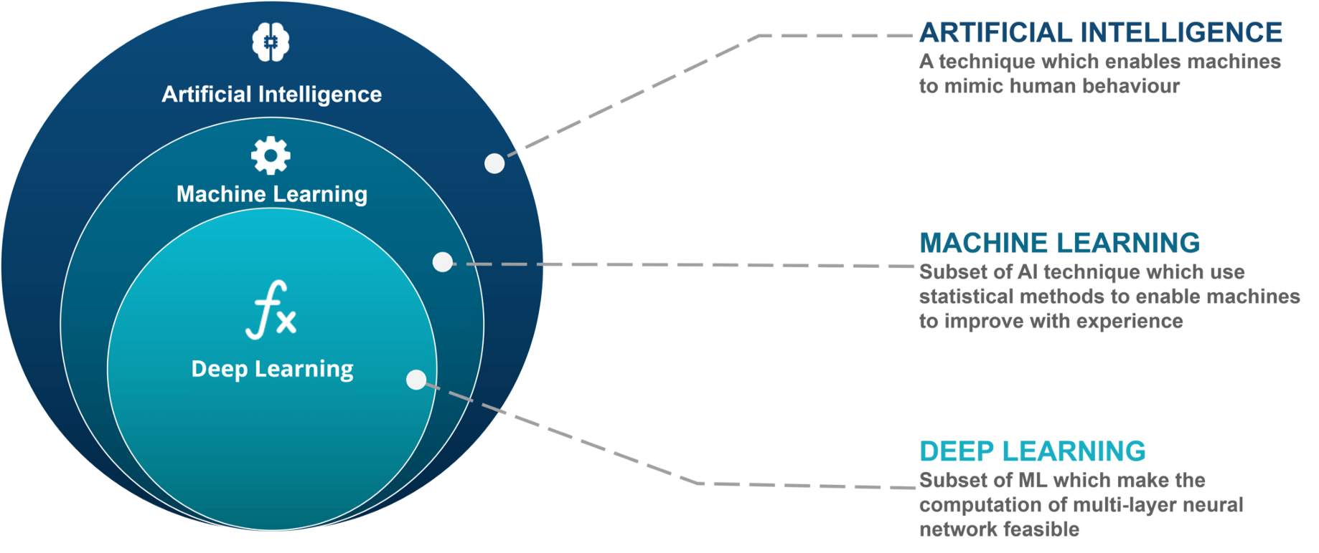
## “”” THE BIG PICTURE “””
read_image(“THEBIGPICTURE.png”)

Slide 7

## Applications of NNs
Understanding rules are sometimes very easy for humans – this is not always the case with machines (Hence the attempt to replicate the neurons in our brain)
Specific applications include:
Pattern Recognition
Regression problems (stock market, predicting height, etc…)
Speech Recognition (accents, dialects, sentiment analysis)
cpell shecking
Identifying Ahmad’s dyslexia

Slide 8

## How they work (Weights)
Consider the following example of adding two numbers to each other:
The way NNs work is through the weights associated to each link between neurons. By changing the weights around, we get the output that we desire – allowing us to figure out the rules of the problem.
Calculating the weights is essentially a linear algebra problem (can be done by hand) – but it is only simple if the system is small (and is also linear)
[x1]
w1
[x1] | [x2] | Output
1 | 0 | 1
1 | 1 | 2
y
$$\left[\begin{aligned}w1 \\ w2\end{aligned}\right]={\left[\begin{matrix}0 & 1 \\ 1 & 1\end{matrix}\right]}^{−1}\left[\begin{aligned}1 \\ 2\end{aligned}\right]$$
w2
[x2]
[0]*w1 + [1]*w2 = 1
[1]*w1 + [1]*w2 = 2

Slide 9
## Introduction to non-linearity
The problem is adding two numbers to each other is linear.
What if the problem was non-linear?
f is non-linear. It is known as the activation function. By introducing it, we can allow for our system to have non-linear outputs, and we also are no longer able to use linear algebra to solve it (introduction of the function f complicates things).
The following slide includes some examples of activation functions.
[x1]
w1
f
y = f([x1]*w1 + [x2]*w2)
w2
[x2]

Slide 10
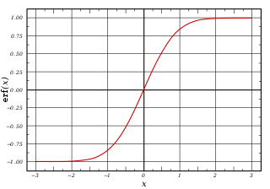
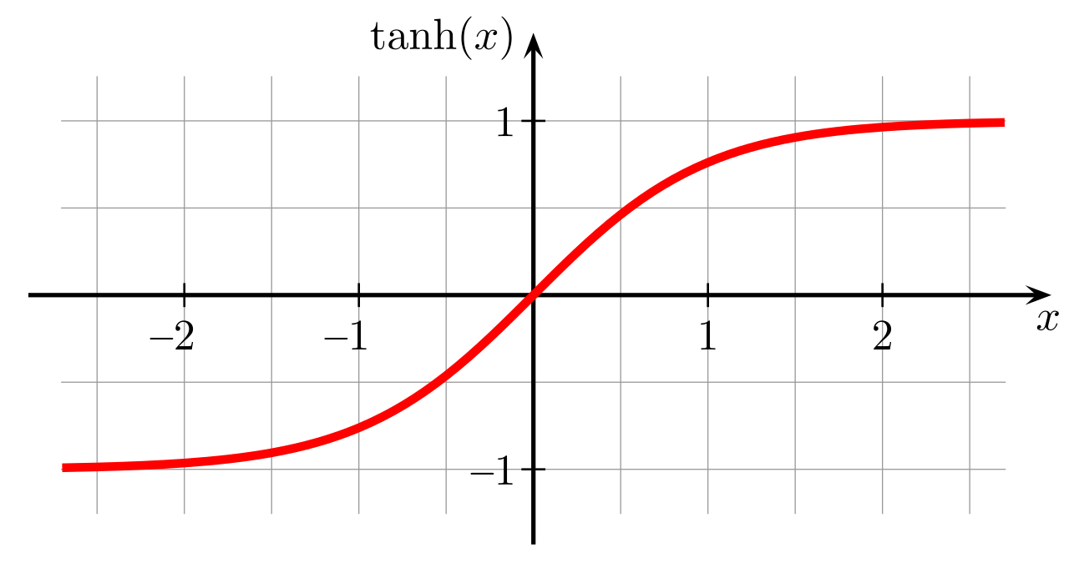
sigmoid
reLU = max(0, x)
tanh(x)
Other examples of activation functions include: softmax, leaky reLU, etc…
As mentioned, the goal of these activation functions is to introduce non-linearity to neural networks.
Recall the general form of y given two inputs to a neuron: y = f([x1]*w1 + [x2]*w2). As mentioned, our goal is finding the weights that give us the results expected. The function of the computer is to find the best weights. How do we proceed with this?

Slide 11







## Training Models to find Weights
The idea of training the model to minimize loss begins with randomizing weights and comparing errors (in accordance to the expected results). We then proceed to more advanced techniques – the use of backpropagation algorithms.
The weights are calculated based on the weights of the previous output ($z and a$). Since $w^{L}$ depends on ${\left(a\right)}^{L−1}$, we have backpropagation.
$${(z)}^{L−1}$$
$${(z)}^{L}$$
x
$$w^{L−1}$$
$$w^{L}$$
y
$${(a)}^{L−1}$$
$${(a)}^{L}$$

Slide 12

## Backpropagation
The loss is calculated by taking the difference between the layer ${\left(a\right)}^{L}$ and y. The loss can be calculated for each layer respective to the one that follows, denoted by $δ$.
The basic idea behind backpropagation: Change the weight in a way that makes it proportional to the impact it has on the loss.
Weights that have more impact on loss should be changed more. Mathematically:
$$∆w^{L}∝\frac{∂Loss}{∂w^{L}}→∆w^{L}=η\frac{∂Loss}{∂w^{L}}$$

Slide 13

## Backpropagation pt.2
$$∆w^{L}∝\frac{∂Loss}{∂w^{L}}→∆w^{L}=η\frac{∂Loss}{∂w^{L}}$$
$\frac{∂Loss}{∂w^{L}}$ is calculated based on its dependencies: rate of change of previous layers, activations, etc…
Note that ${\left(a\right)}^{L}=f({\left(z\right)}^{L})$, where f is the activation function. Thus we can explain backpropagation through the formula:
$$\frac{∂Loss}{∂w^{L}}=2\left(a^{L}−y\right)f^{′}\left(z^{L}\right)a^{L−1}$$
This is for one neuron.

Slide 14
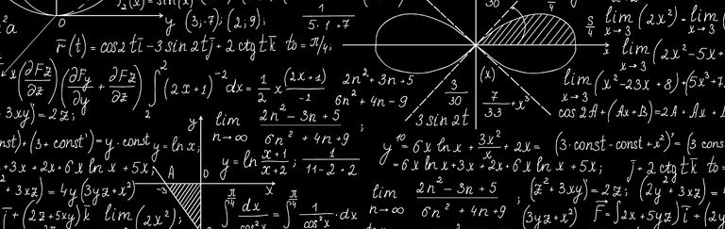
## Backpropagation pt.3
Issue: A typical modern neural network has countless layers, millions of neurons and even more weights.
Each weight depends on the one before it (retroactively) and calculating each one will take forever.
Solution: Don’t worry about it :D
read_image(“complicated_maths_stuff.png”)

Slide 15
## Architectures (Feed-forward)
Feed-forward NNs are the most common type of neural networks. Their features include:
Unidirectional (only goes forward, considers neurons in front), fully connected
Activation function is applied to all layers, and we also could have biases
Applications:
Regression problems, classification problems in general, etc… (Spoiler alert: one application is telling the difference between Batman and Superman)
input layer
output layer
hidden layers

Slide 16
## Architectures (Recurrent)
Recurrent NNs are similar in terms of the structure, the following differences:
The previous layer is stored in memory and we change weights based on both future and past layers;
The sequence at which we enter our data becomes important. This results in multiple input-output relationships.
Applications: Voice recognition software
input layer
output layer
hidden layers

Slide 17
## Architectures (Convolutional)
Convolutional Neural Networks focus on extracting features and classifying them. This is mostly used for classification problems and is an extension of the feed-forward architecture. In this, we look for data sequences to extract the features.
Application: Image classification (again, spoilers: Batman vs. Superman)
Class A
Class B
Class C
Class D

Slide 18
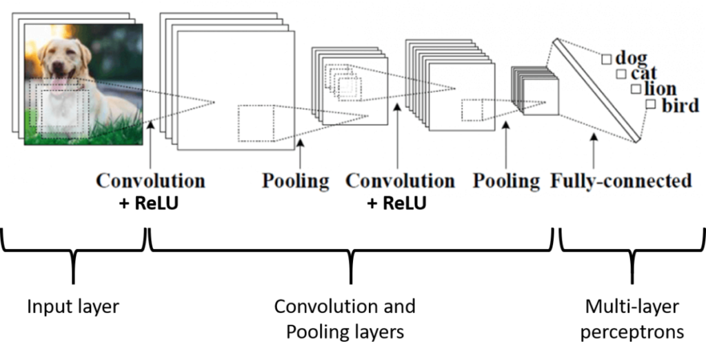
## Dog
read_image(“dog.png”)

Slide 19
## Evaluation of Neural Networks
The way we evaluate how “good” a neural network is depends on whether the problem at hand is a classification problem or a regression problem.

Slide 20
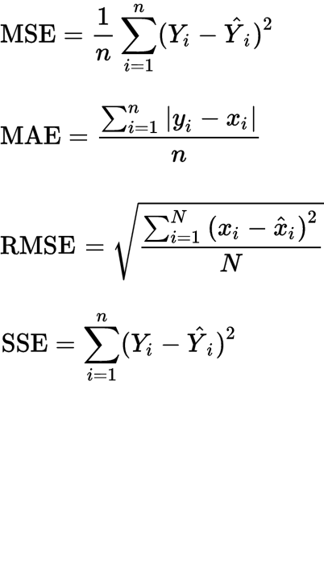
## Regression Problems
read_table(“regression measures”):
Mean
Mean Squared Error (MSE)
Mean
Mean Absolute Error (MAE)
Root
Root Mean Squared Error (RMSE)
Sum
Sum of Squared Error (SSE)

Slide 21
## Classification Problems
Confusion Matrices
Precision / Recall Curves
F1-Scores
ROC Curves
AUC

Slide 22

## Output
Recall not worrying about it.
Sponsored by:
Keras
TensorFlow
PyTorch
Using these frameworks / libraries takes care of many of the neural network mathematical issues that we may face. Stay tuned for the coding.

Slide 23
## output layer [y]
Thank you
for listening
## Expected output:
You now understand everything about neural networks
## Actual output:
You need a lot of clarification on how things work
STA 401 – Introduction to Data Mining

