Slide 1


Slide 2
Agenda
Problem Statement 03
Data Mining - 01 04
Data Mining - 02 05
Exploratory Data Analysis (EDA) 06
Data Visualization 07
Algorithms Used 08
Analysis of Results 09
Conclusion & Future Work 10

Slide 3
Problem Statement
The Dataset is the collection of the Basic Health and Biological
Signal Data .
The Goal is to Develop a machine learning model to determine the presence
or absence of Smoking through bio-signals

Slide 4
Data Mining – 01
Valuable Insights from Large Volume of Data .
Data Preprocessing :
Importing and loading Data Manipulation Libraries .
Identification of Variables
Target Variable : Smoking (binary) ,so Classification can be choosen.
Type of Data Set : Balanced Data Set .
Quantitative Measure of Data : 55692 Records , 26 Attributes .
Missing Values : No Missing Values in Data Set .
In case of Missing Values Imputation and Deletion Techniques can be used .
Simple Imputer : Categorical and Discrete Variables .
KNN Imputer : Continuous Variables .

Slide 5
Data Mining – 02
No Duplicated Records
In case of Duplicates Drop Duplicates and Reset the Index
Classes in Target Variable : 2
Deletion of Attribute: Id
Data Transformation :
gender, oral ,tartar attributes Transformed using map function
Training and Testing Data to Evaluate Model Performance .
Data Scaling implemented to bring all Features of Variables in Similar Scale .
Types of Scaling :
Min Max Scaling
Standard Scaling
Robust Scaling
Scaling Technique Used :
Min Max Scaler

Slide 6
Exploratory Data Analysis (EDA)
Our Target Variable is “Smoking” and we split the data based on Independent and Target Variable .
We split our Dataset using the method train_test_split .
The two Datasets [x ,y] are of with Target and Independent Variables divided into train and test Datasets .
In the given dataset,we have only one single target variable.
The Dataset is divided into Train and Test Datasets that are used to Discover algorithms and predict the values respectively .

Slide 7
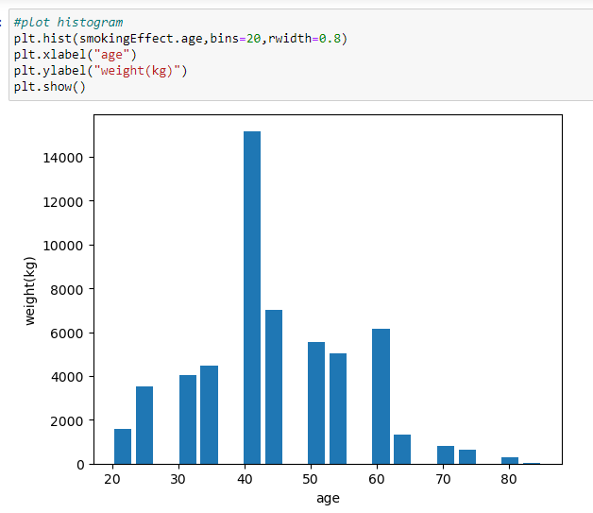
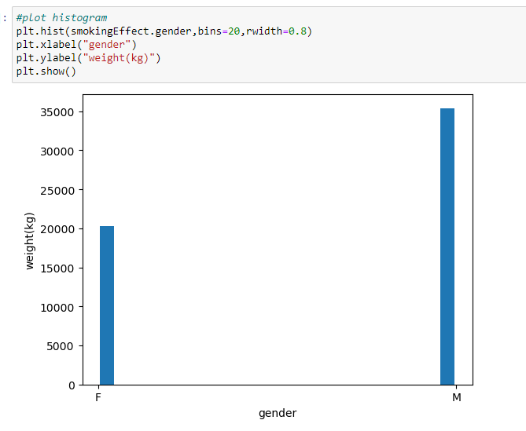
Data Visualization
Bar between age and weight(kg) and Bar plot between weight(kg) and gender

Slide 8
Algorithms Used
The Different Classification Algorithms Used
Logistic Regression
Decisio Tree
Random Forest
Extra Trees
K-Nearest Neighbour (KNN)
Support Vector Machine (SVM)
Gaussian Naïve Bayes (GNB)

Slide 9
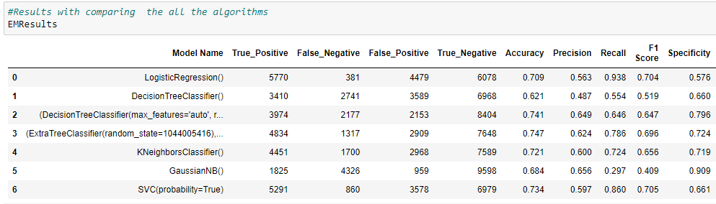
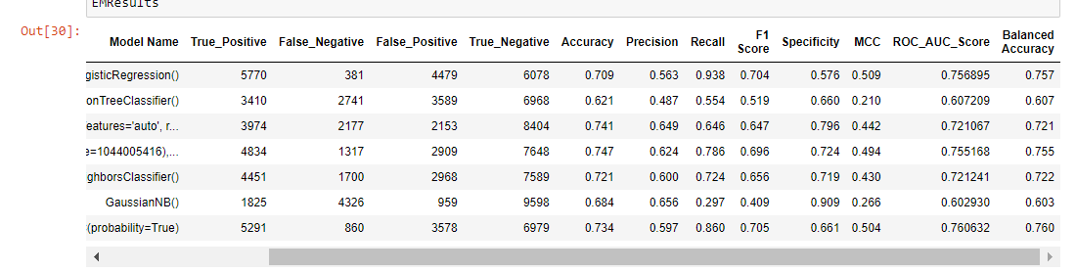
Analysis of Results

Slide 10
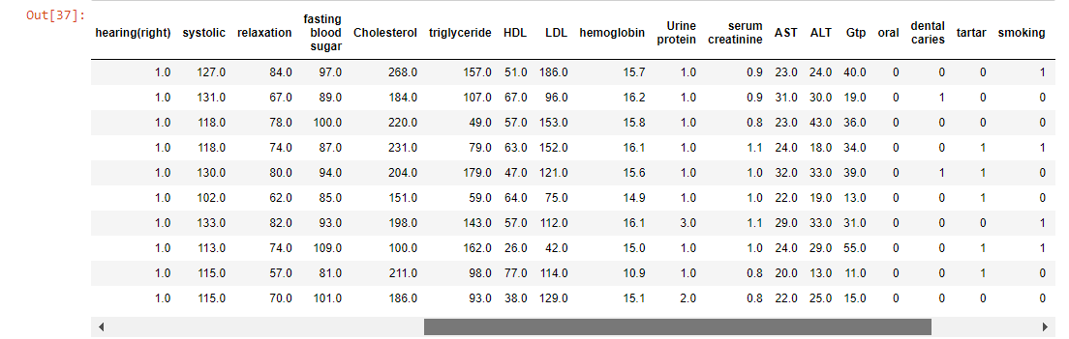
Conclusion and Future Work
We Predict the Algorithm using the validation dataset given .
From the above we got Accuracy 74% for Decision Tree Classifier.
So we take the Random Forest Algorithm to predict the result .

Slide 11
Thank You
Q & A
Student Name : TEKETI DARAHASINI
Roll Number: 21B91A54H3
SRKR Engineering College
Mobile: +91 9391429140
Email: 21B91A54H3@srkrec.ac.in
Bhimavaram - India

