Slide 1

EXCITE 2K19
TITLE :
SMART MEDICAL KIT
ACE ENGINEERING COLLEGE

Slide 2
PROBLEM :
To handle the problem of “absentia” faced by people these days, where the user need to be reminded of their medication timings. These timings should be according to requirements of the user.
SOLUTION :
We provide a device is to help the user locate their medical kit easily and warn the user about their particular medication timings.
1

Slide 3
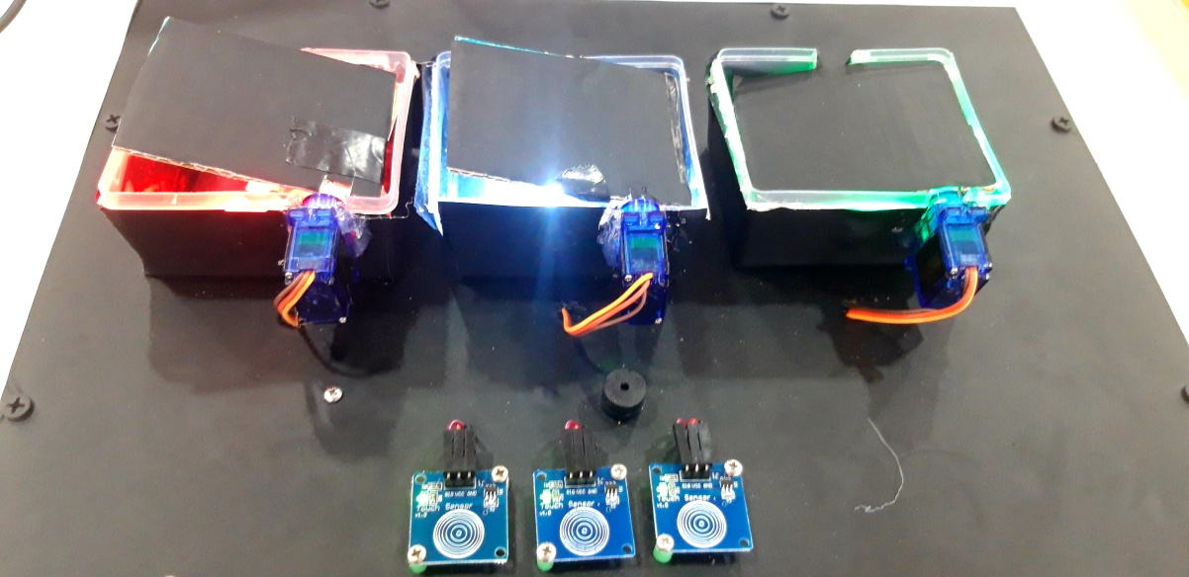
PRODUCT DESCRIPTION
It is an automatic and user friendly device. It alerts the user regarding the medication timings accordingly. It also warns the user about the capacity of the container.
2

Slide 4
MARKET
Hospital
Households
Old age homes
4

Slide 5
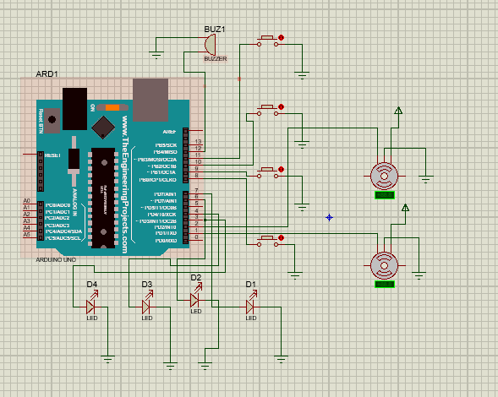
3

Slide 6
Revenue Model :
Buy the product at store
Online stores
Retail store
Marketing with hospitals
5

Slide 7
FINANCIALS :
Making charges include sensors which costs around Rs2000.
We assume our monthly revenue to be Rs 1,00,000
Cost=Rs 2000
Selling prize=Rs 2500
Profit=RS 500
6

Slide 8
Team :
Sno | Name of the team member | Qualifications | Role
1. | Lendale Rushali | Btech 3rd year | Team leader
2. | Ravuri divya | Btech 3rd year | Team member
3. | Sai sathyak | Btech 3rd year | Team member
7

Slide 9

8

Slide 10
The future belongs to those who believe in the beauty of their dreams.
THANK YOU

