Slide 1


Slide 2
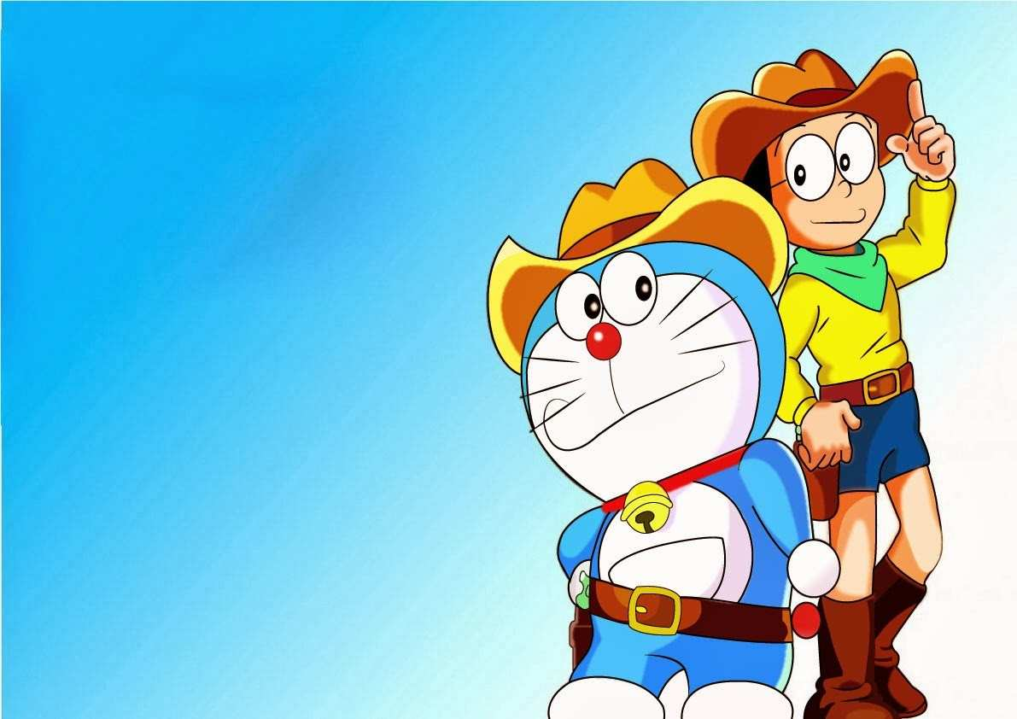
CONTENTS
About Doraemon
History of Doraemon
Doraemon real story
Main characters
DokoDemo Door

Slide 3
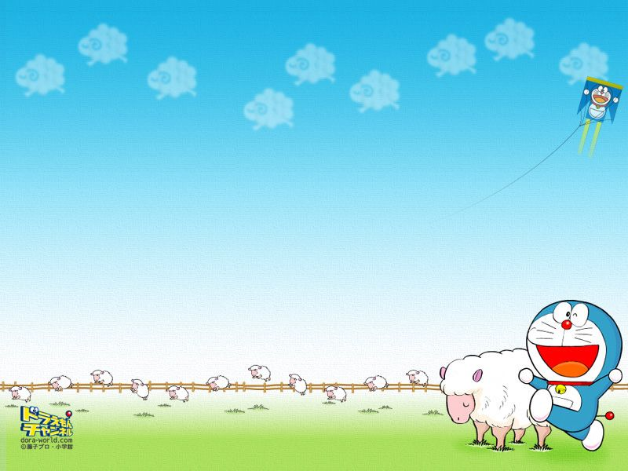
Doraemon is a fictional character in the Japanese manga and anime series. The story revolves around an earless robotic cat named Doraemon, who travels back in time from the 22nd century to aid a boy named Nobita Nobi. Doraemon is preferred by all sorts of people and it has occupied a specific place in our hearts.

Slide 4
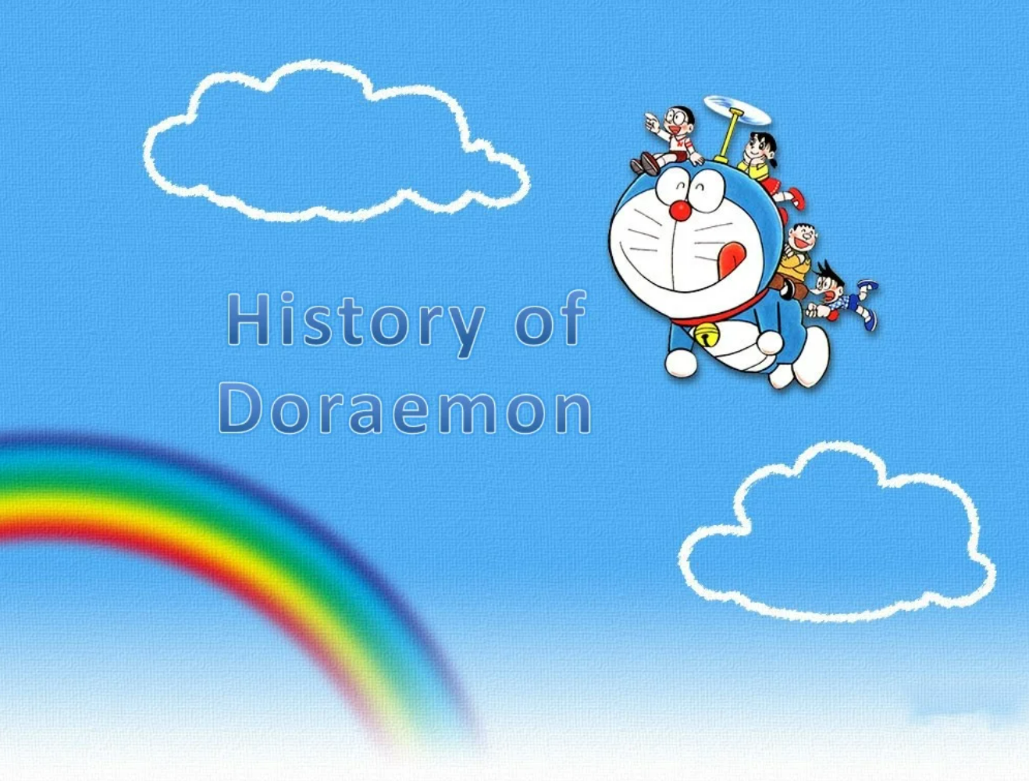

Slide 5

In December 1969,Doraemon comic titles published continuously in six children’s monthly magazine. Day. He came out of Nobita’s desk and since then he lived with Nobita, his misson is to prevent Nobita become a failure. In trouble every time Nobita, Doraemon will be helping with magic tools.The stoty focused on Nobita everyday life,the main character.Doraemon has a four-dimensional pocket which he filled with objects from the future. Nobita usually goes too far,ignoring the advice or command Doraemon, and as a result fell into a deeper problem.After begging, Doraemon will issue a tool that helps Nobita resolve the problem.

Slide 6









Slide 7
The real emotional story of the series Doraemon is that “Nobita” was suffering from Schizophrenia. It is a disorder in which a person has less ability to think, feel and behave clearly. Nobita was abused and bullied in his school by his classmates because he suffered from this mental condition. His friends left him fearing that one-day Nobita can provide harm to them and he became lonely. His medical condition forced him to imagine the character of Doraemon, who is a robotic cat and has come to help him in every possible way. Later on, making Doraemon Nobita’s best friend.When he was 16 years old, the his family finally took him to the doctors who dismissed the existence of Doraemon, prompting Nobita to take the extreme step. This left Nobita in a complete shock that he was lonely again. Finally, Nobita couldn’t bear the truth. He shot himself by his father’s gun and committed suicide at the age of 16.So, to pay tribute to Nobita’s soul Doraemon series was started.

Slide 8

Main characters
Nobita
Shizuka
Gian
Suneo
Dorami
Mini-Doras.

Slide 9


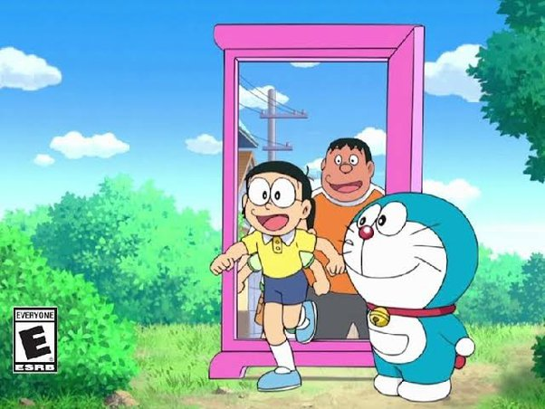

DOKODEMO DOOR
The Dokodemo Door, also known as The Anywhere Door, is a special door that has been used to move instantaneously between places. They can come in varying colours, but their most prominent colour is pink. Nobita, Doraemon, and their friends used them frequently, resulting in the gadget's iconic nature.

