Slide 1

PRESENTED BY:
D.AKHILA
17NQ1A0424

Slide 2
content
Introduction
Cybercrime crimes
Cybercrime acts
Types of Cyber crimes
Reasons for cybercrime and ways to prevent cyber crime
Cyber criminals Mode and manner of committing cybercrime
Classification Acts for security Prevention of cybercrime
Conclusion

Slide 3
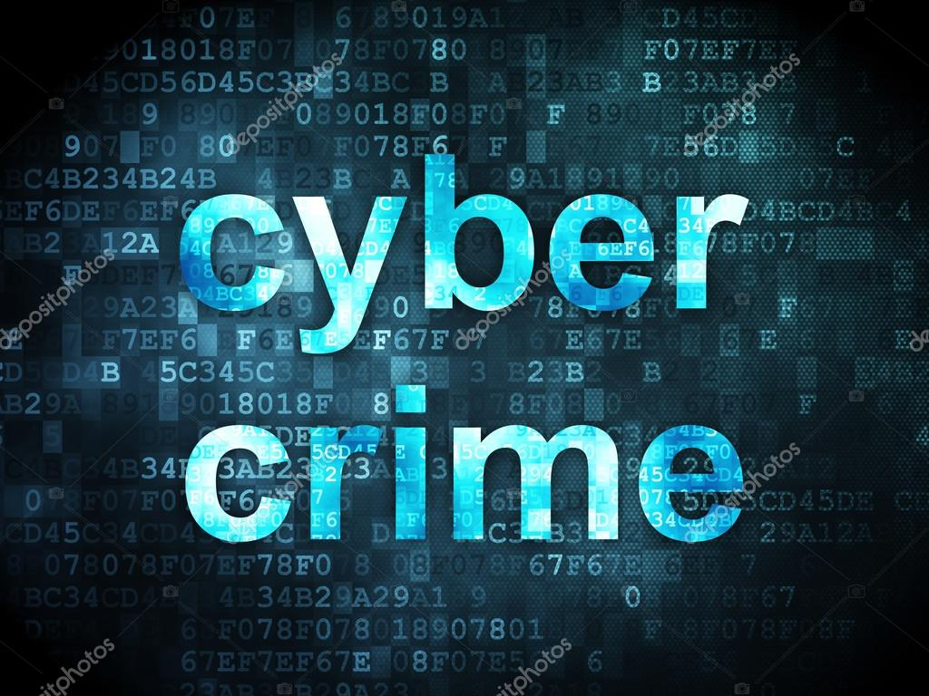
Introduction
Cybercrime is a criminal activity done using computers and the internet.
It includes downloading
Illegal music files to stealing millions of dollars
Non-monetary offenses---creating and disturbing viruses on other computers or posting confidential business information on the internet.

Slide 4

Cybercrime crimes
Cybercrime Crimes may be of many types
Criminals use internet to steal personal identity.
Mostly phishing and pharming use to fake websites.
For example they ask user name, passwords, credit card numbers by creating fake websites.

Slide 5

Cyber crime acts
The first act "COMMON WEALTH CYBERCRIME BILL 2001 "was approved by the parliament on 27 SEP 2001.
A major amendment was made in 2008. It introduced Section 66A which penalized sending "offensive messages". It also introduced Section 69, which gave authorities the power of "interception or monitoring or decryption of any information through any computer resource"

Slide 6
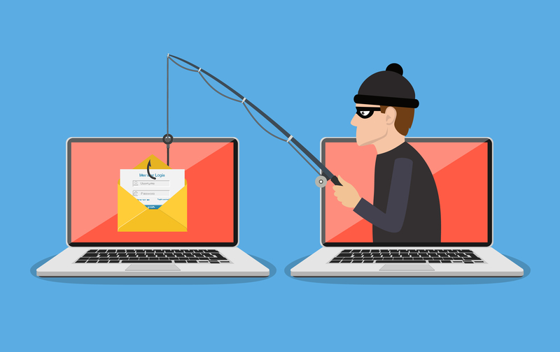
Types cyber crimes
phishing: using fake email messages to get personal information from internet users
misusing personal information (identity theft)
hacking: shutting down or misusing websites or computer networks

Slide 7
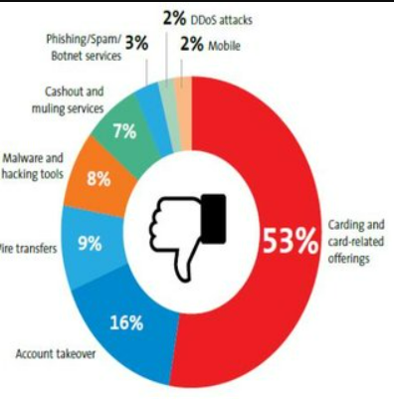
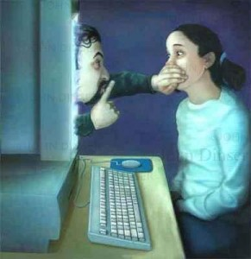
spreading hate and inciting terrorism
distributing child pornography
grooming: making sexual advances to minors.

Slide 8
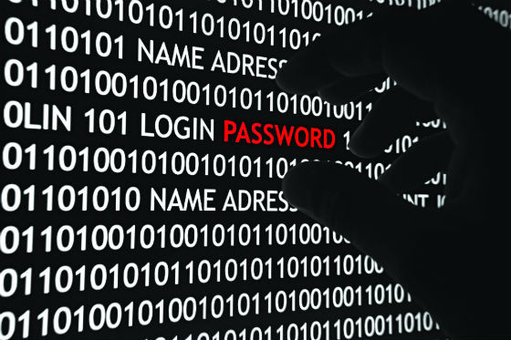
Reasons for cyber crime
Capacity to store data in comparatively small space. Easy to access Complex Negligence Loss of evidence
Cyber criminals Adolescents of age 6-18years
Organized hackers.
Professional hackers/crackers.
Discontented employees.

Slide 9
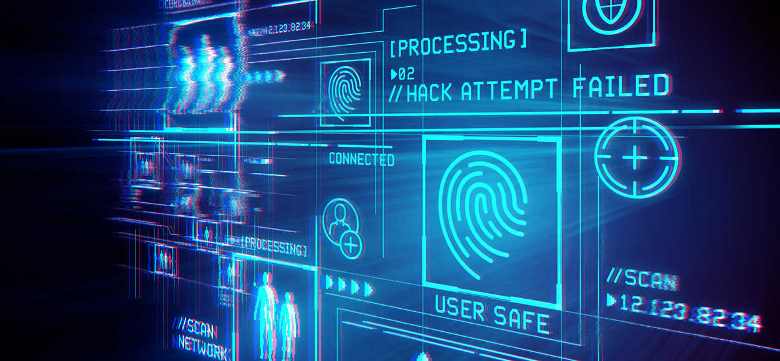
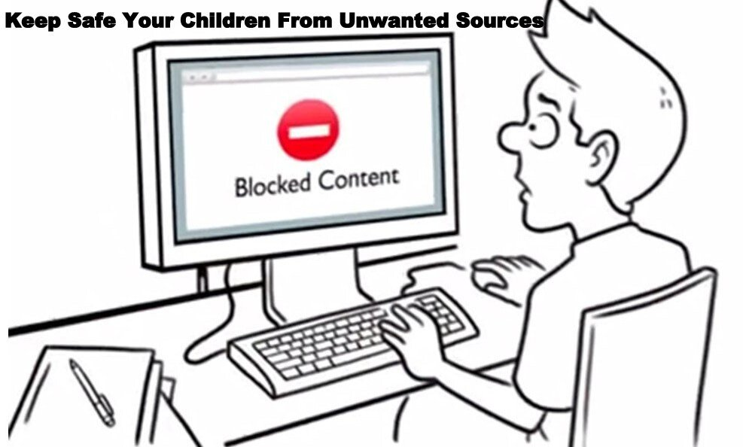
Ways to prevent cyber crime
Use strong passwords
Keep your software updated
Manage your social media settings
Talk to your children about the internet
Take measures to help protect yourself against identity theft
Keep an eye on the kids

Slide 10

Avoid sending photographs.
Always use latest and update anti virus.
Never give your identities to fake websites
Always keep backup volumes.
Use of firewalls may be beneficial

Slide 11
A mode and manner of committing Cyber Crime By unauthorized access to computer
Theft of information contained in electronic form.
Email bombing Data diddling Salami attacks Denial of service attack Virus/worm attacks Logic bombs Trojan attacks Internet time thefts

Slide 12
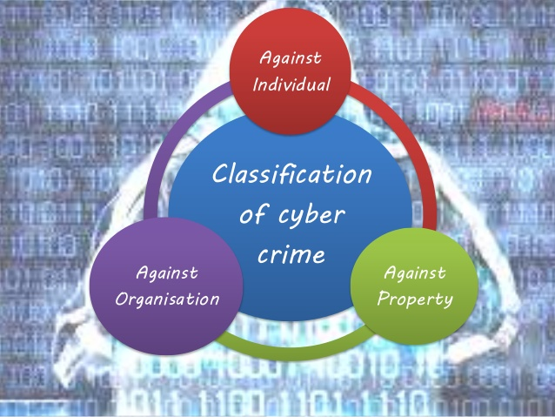
Against individuals
Against organization
Against society

Slide 13

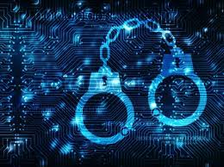
Need of cyber crime investigation police
Digital technology and the internet are providing criminals with new opportunities to commit crime.

Slide 14
It is now essential that police officers have the capability to deal confidently with the cyber element of crimes as it is fast becoming a dominant method in the perpetration of crime. But more than that, it is becoming a part of everything that the police have to deal with because the internet and digital technology are part of most peoples lives now.

Slide 15
Conclusion
Capacity of human mind is unfathomable. Elimination of cyber crime is impossible in cyber space . A main witness is its history . The main possible step is creating awareness in its duties and rights. I would like to conclude with a word of caution for the prolegislation school that provisions of cyber law are not made stringent that it would effect the growth of industry .

Slide 16
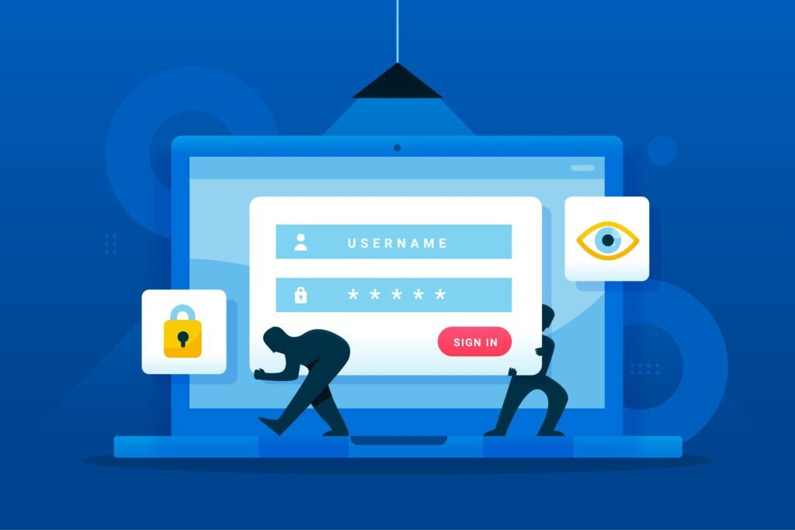
Stop Neglect. Protect before you connect.
THINK BEFORE YOU SHARE YOUR PASSWORDS
DO NOT CLICK ON THE LINKS SHARED BY UNKONWN MESSENGER

Slide 17

THANK YOU
FOR LISTENING

