Slide 1


Network Security
Henric Johnson
Blekinge Institute of Technology, Sweden
www.its.bth.se/staff/hjo/
henric.johnson@bth.se
+46 708 250375

Slide 2
Outline
Attacks, services and mechanisms
Security attacks
Security services
Methods of Defense
A model for Internetwork Security
Internet standards and RFCs

Slide 3
Attacks, Services and Mechanisms
Security Attack: Any action that compromises the security of information.
Security Mechanism: A mechanism that is designed to detect, prevent, or recover from a security attack.
Security Service: A service that enhances the security of data processing systems and information transfers. A security service makes use of one or more security mechanisms.

Slide 4
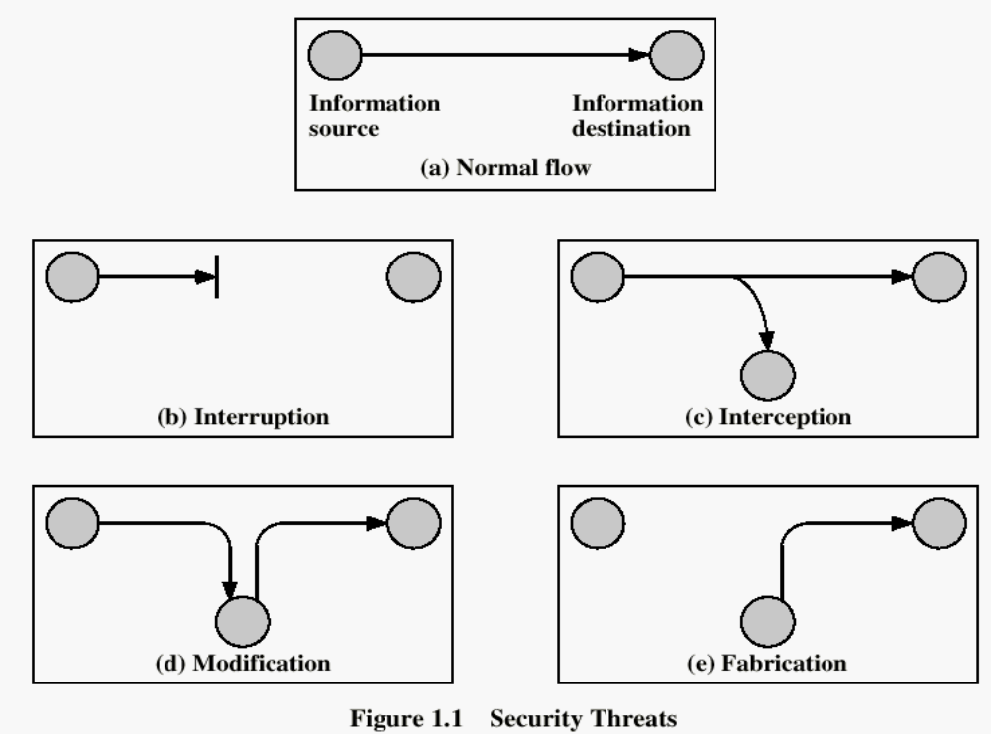
Security Attacks

Slide 5
Security Attacks
Interruption: This is an attack on availability
Interception: This is an attack on confidentiality
Modification: This is an attack on integrity
Fabrication: This is an attack on authenticity

Slide 6
Security Goals
Confidentiality
Integrity
Avalaibility

Slide 7
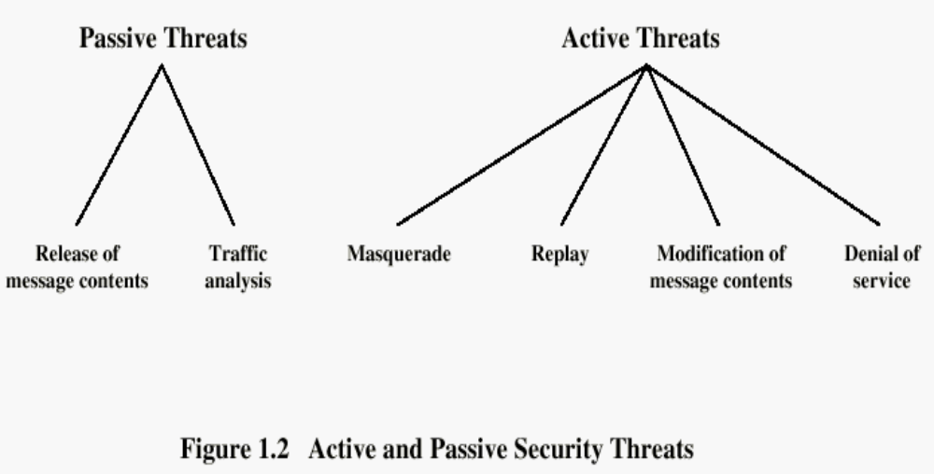

Slide 8
Security Services
Confidentiality (privacy)
Authentication (who created or sent the data)
Integrity (has not been altered)
Non-repudiation (the order is final)
Access control (prevent misuse of resources)
Availability (permanence, non-erasure)
  Denial of Service Attacks
  Virus that deletes files

Slide 9
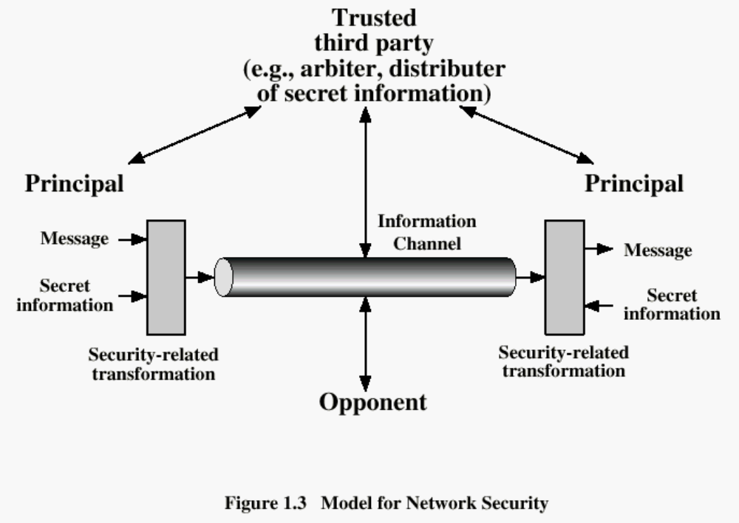

Slide 10
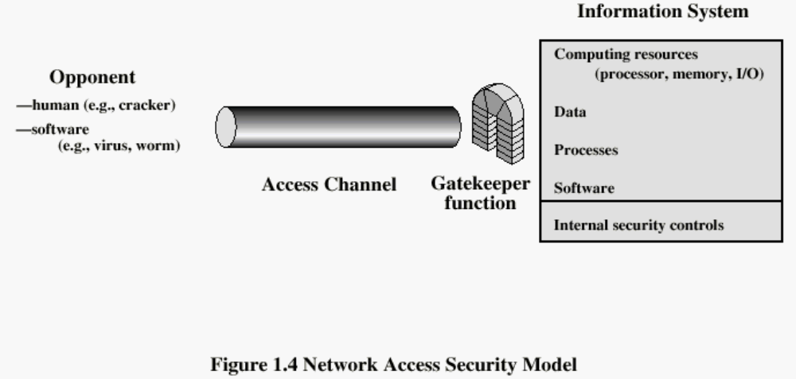

Slide 11
Methods of Defence
Encryption
Software Controls (access limitations in a data base, in operating system protect each user from other users)
Hardware Controls (smartcard)
Policies (frequent changes of passwords)
Physical Controls

Slide 12
Internet standards and RFCs
The Internet society
  Internet Architecture Board (IAB)
  Internet Engineering Task Force (IETF)
  Internet Engineering Steering Group (IESG)

Slide 13
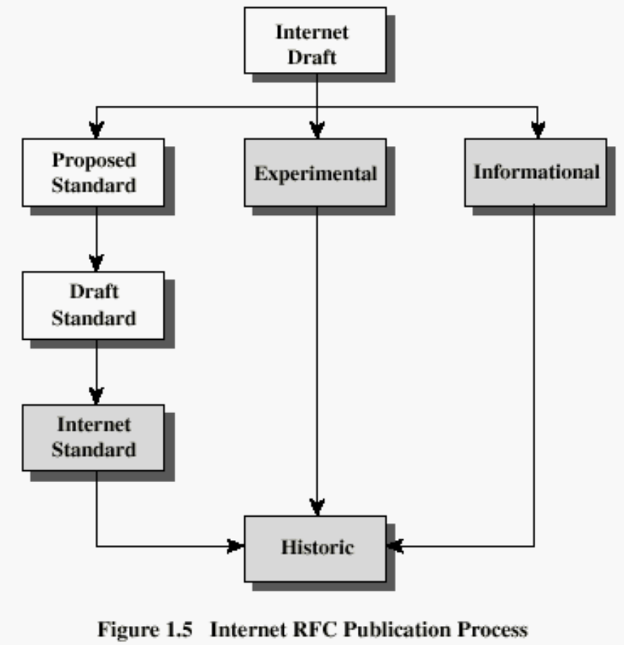
Internet RFC Publication Process

Slide 14
Recommended Reading
Pfleeger, C. Security in Computing. Prentice Hall, 1997.
Mel, H.X. Baker, D. Cryptography Decrypted. Addison Wesley, 2001.

