Slide 1
Identification of the target audience and their characteristics
Made by: Pavel Hanenkov
phanenkov@mail.ru

Slide 2
Predicting audience is important for several reasons:
It’s your income, if you choose wrong you will be a bankrupt
You need to know “parameters” of your target audience to choose wise
Their location, age, income, way of living are one of the most important reasons of choosing a product
It’s hard to predict without using machines now, so Data Science can help with that

Slide 3
Data acquisition and cleaning
All data was collected by my a year ago
It consists of country, age, attitude to pets, friends, appearance, economy, luck, achievements and so on
It all confirmed with links
No duplicates, 30 rows

Slide 4
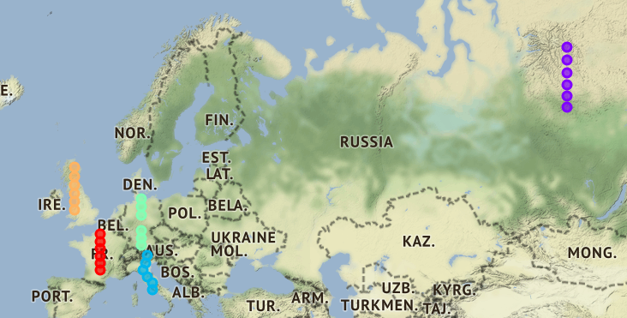
Using map to make it easier understanding the data points (segmentation and clustering)

Slide 5
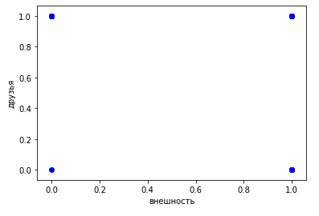
Scatter plot won’t help with analysis as there’re only 4 points
We can’t build a function using these points
So it means that we need to choose another plot to make predictions on it

Slide 6



Linear regression shows low level of variance score which means lack of interconnection between data (different parameters were used)

Slide 7
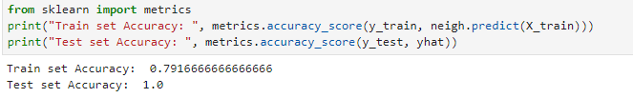
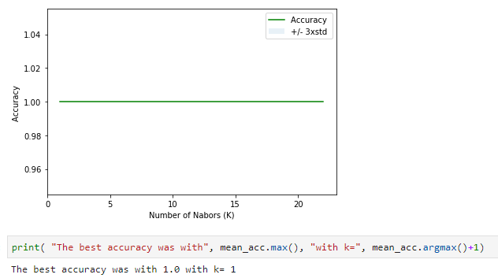
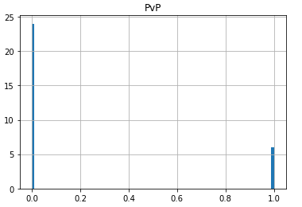
K-Nearest Neighbors technique
shows high level of test set accuracy (1) and good 0.8 train set accuracy
Histogram deals with 0/1 data better, showing everybody attitude to PvP (example)
Because of such a huge accuracy the right K=1

Slide 8

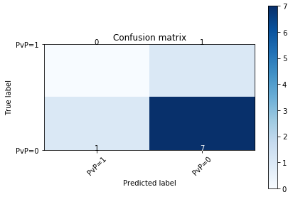
Logistic regression (all parameters are used)
Jaccard index is good
Matrix illustrates right opinion to PvP(example), according to this we can conclude not to use such parameter as most people are ignoring it

Slide 9
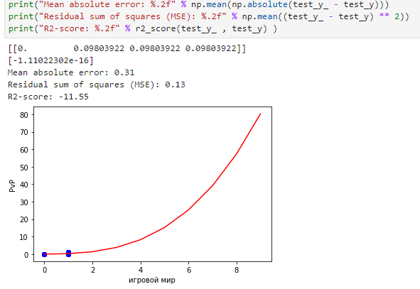
Polynomial regression
Doesn’t have enough points to build a better plot and to predict the values in a better way
Because of that huge R2-score

Slide 10
Conclusion and future directions
Matrix illustrated results the best way, but other tools were not accurate enough.
Maps are cool as illustrating data on the map is always a winning condition.
The problem was in using data which consists of 1/0 information, it's alright if there's only 1 column of 1/0 data and we are going to predict it, but not when all data is fulfilled with it, try to avoid it or add some extra columns.

