Slide 1

ADAMA SCIENCE AND TECHNOLOgies UNIVERSITY
INTERNSHIP REPORT PRESENTATION
NAME : ID:
Egnuma GABISA UGR/23003/13
ABDI SARBESSA UGR/22705/13
NUGUSA WAKWAYA UGR/23469/13
DARARA TESFAYE UGR/22840/13
SUBMISSION DATE 25/SEPT/2024
ADVISOR NAME: Mr. amanuel

Slide 2
DECLARATION
We are 5th year SE and CSE students. Here we declare that this final internship report has been submitted to our University.
The objective of this report is to explain what we did and learned especially integration of the theoretical knowledge what we have been learnt with practical skills, developing interpersonal communication skills, team working skills, leadership skills, work ethics and entrepreneurship skills during internship stay in Visit Oromia. In this company we was spent two months(45 Work Days) in the internship program.

Slide 3
INTRODUCTION TO INTERNSHIP
1
OBJECTIVE OF INTERNSHIP
The objective of the internship program is to enable the interns to experience the practical activities carried out on site and correlate it with the theoretical background gained through learning.
Acquire new learning through challenging and meaningful activities
Apply concepts and skills gained from academic experience to a professional work setting
Built and maintain positive professional relationships
Demonstrate awareness of community and/or organizational issues
Demonstrate professional skills in the workplace
To Gain career knowledge for interns and evaluate career options and goals

Slide 4

General Objective
Objective of Internship
To facilitate reflection on experience
To enhance understanding of academic materials to provide students the opportunity to test their interest in a particular career before permanent commitments are made
To provide students the opportunity to develop attitudes condensing
To effective inter personal relationships to provide students with an in-depth knowledge of the formal
Specific Objective
To provide intensive field experience allowing for hands-on computer work.
To receive an introduction to an organization within the information systems industry
To gain a better understanding of its(computer related work) design and structure
To develop an understanding of an organizations varies management and technical
skills, the communication techniques are the decision-making process

Slide 5

Background Of
Background of Organization
VISIT OROMIA
It is located in Oromia region Finfinne , Bole Sub City
Description of VISIT OROMIA
Oromia Tourism Commission (OTC) is a public organization entrusted with the duty and responsibility to spearhead a strategic and successful execution of the Oromia Sustainable Tourism Master Plan in collaboration and coordination’s with public, private, civil society organizations and host communities in the region and in partner neighbor regions.
Transform Oromia tourism into a vibrant, profitable and sustainable industry;
Develop tourism destinations to fit the needs and requirements of tourists;
Provide data/information on Oromia tourism to the private sector, the government and other bodies; and
Generate resources, establish and manage tourism fund.

Slide 6
Mission of VISIT OROMIA (OTC)
Background of Organization
In collaboration with stakeholders and partners, OTC exists to achieve the featuring of Oromia as top tourist destination in Ethiopia.
Vision of VISIT OROMIA (OTC)
In collaboration with stakeholders and partners, OTC exists to achieve the featuring of Oromia as top tourist destination in Ethiopia.
Main Goal of VISIT OROMIA (OTC)
Under its brand Visit Oromia, the OTC seeks to introduce the world to the beautiful culture, history, and land of the Oromo, a cushitic people residing primarily in the highlands of Ethiopia

Slide 7
Major Duties Given to Us
2
MANAGEMENT, TRAINING, AND EMPLOYEE INFORMATION
Self Learning And Developing Website(Project)
Thoroughly testing the website to verify its functionality, responsiveness, and user experience.
Collaborating with stakeholders within the Visit Oromia.
Designing and implementing various web features using HTML, CSS, JavaScript, PHP, and MySQL.
How Did We Become Oriented With That Responsibility
Via Phone calling/contact
Via online like Telegram
By Face to face with the supervisor(Mr. Roba Muleta).
How did the supervisor help Us
By Providing orientation materials and experiences that familiarize us with the organization’s mission, objectives, and client populations.
By collaborate with us in developing a satisfactory plan for the internship.
By Provide time and honest feedback for each of our practice

Slide 8
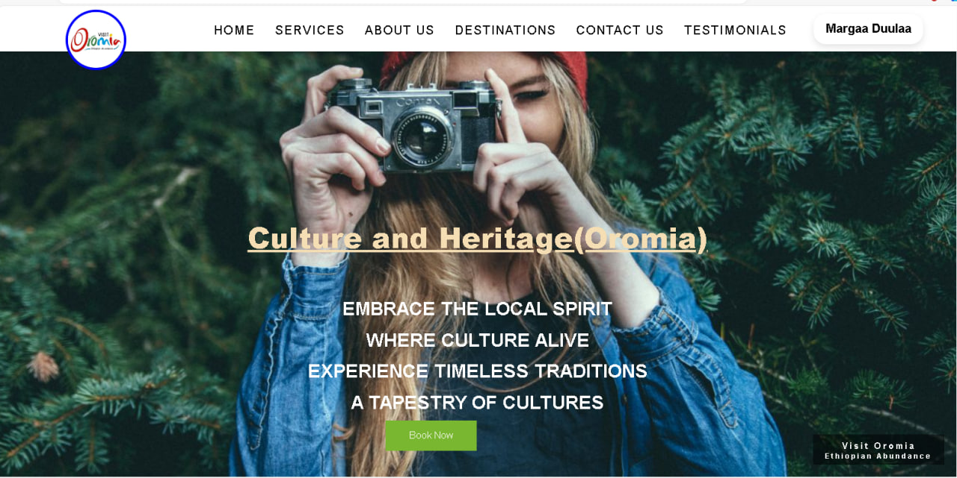
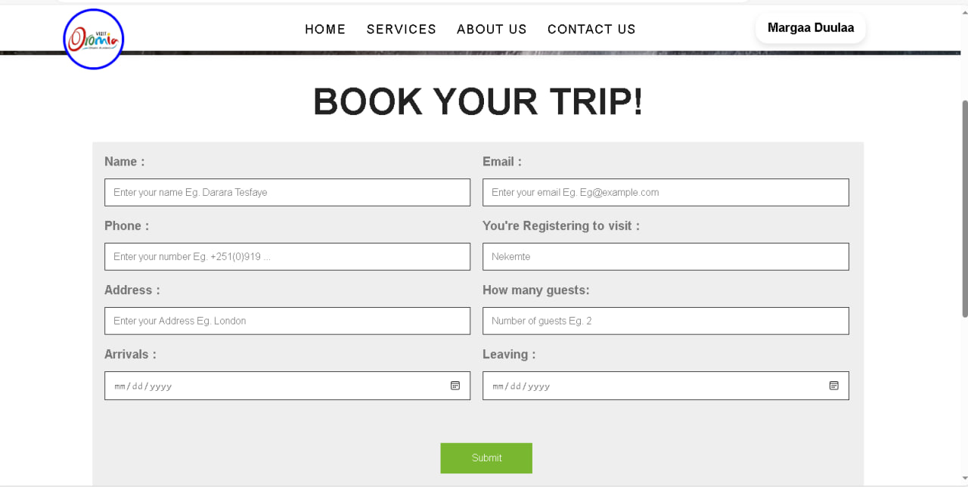
Duties and responsibilities We had during internship
3
SPECIFIC JOB INFORMATION
Orientation and Training
At the beginning of our internship program we had Training sessions on the technologies and tools that would be utilized during our development work, including HTML, CSS, JavaScript, PHP, MySQL, and the XAMPP server.
We received invaluable support from the Visit Oromia’s IT department, which played a crucial role in our orientation and training process.
This duties guidelines should be develop by using HTML, CSS, JavaScript, PHP effectively and The code should be clean with descriptive comments.
Develop Tour and Travel Website

Slide 9
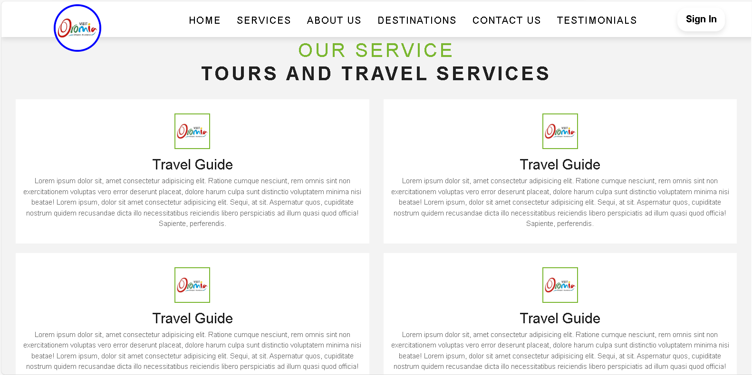
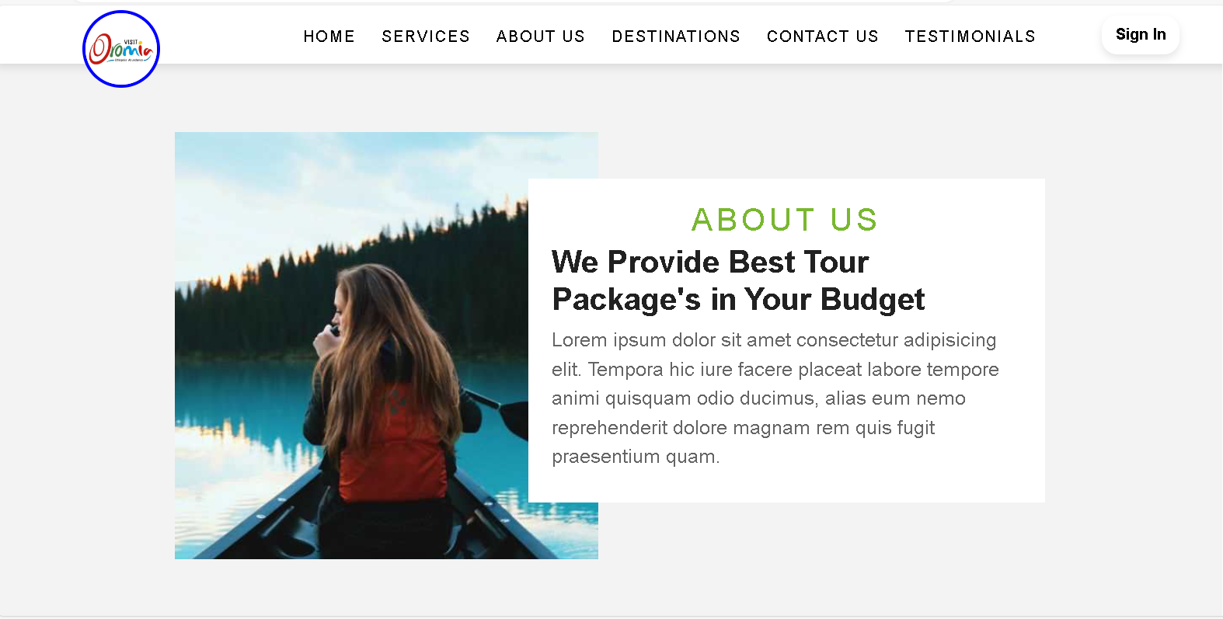
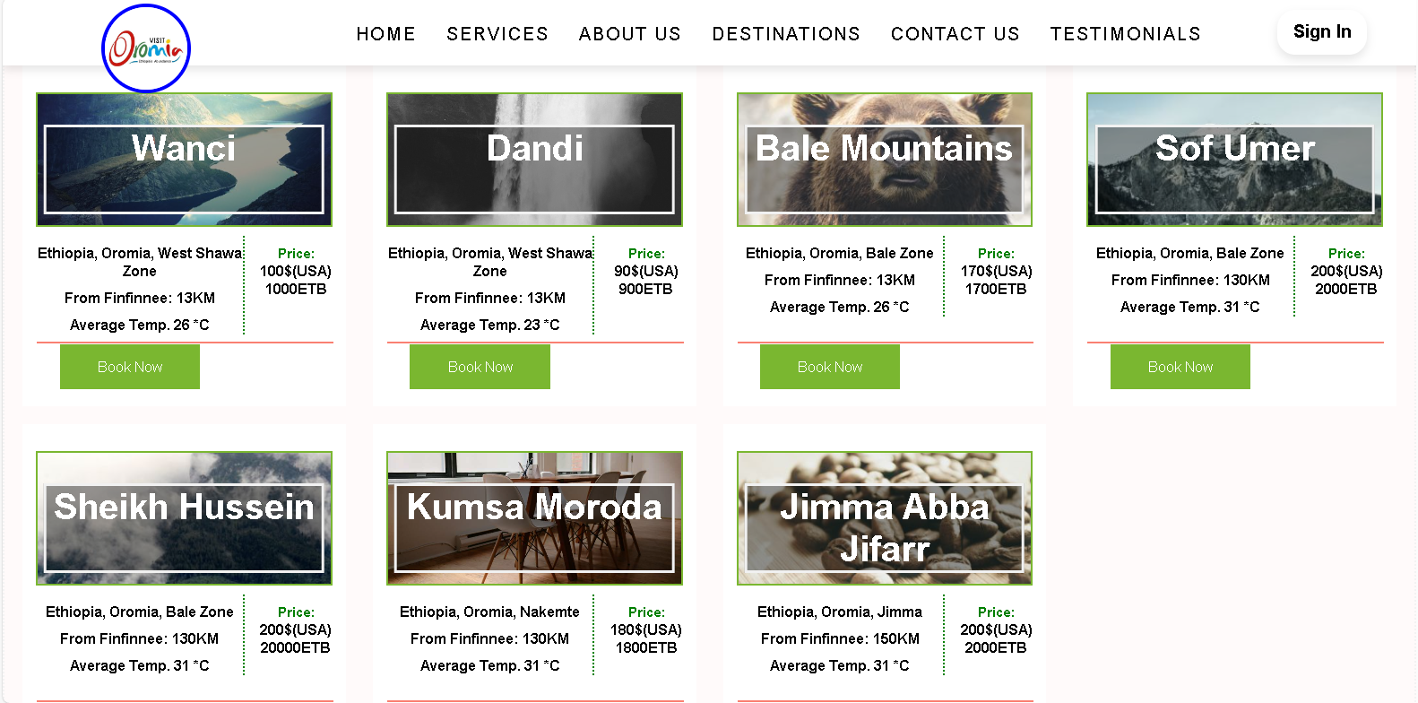
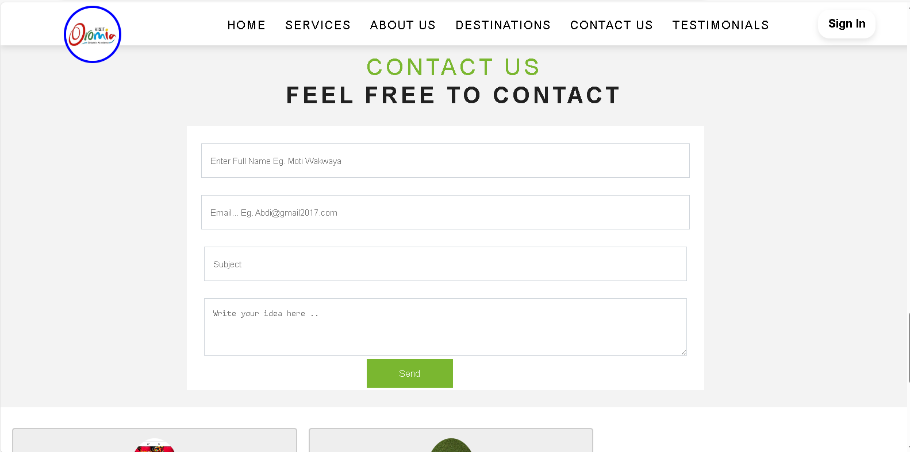
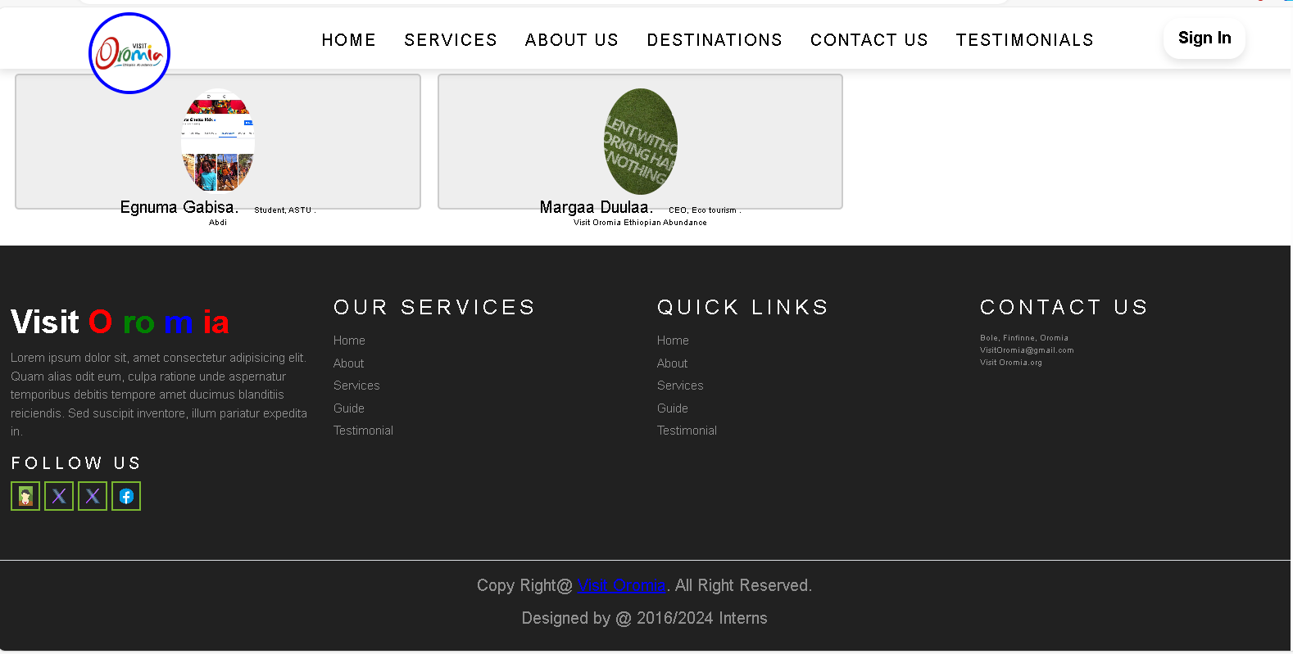
Cont…
Photo of our Project

Slide 10
Other responsibilities and duties We had during internship
Cont d…
Most of our responsibilities are listed on the above discussion, but in addition to that we have been introduced to some of the technical corrections which needs general and basic computer skills like installing new operating system on the computers.
Learning some programming language such as PHP, JavaScript, Python and etc.
Test and improve the official website and the telegram bot of Visit oromia .
Learn and develop skill of web designing or Word press and developing mobile app.
Technical knowledge and skills from my course beneficial for our assignment
We have gained a understanding of web development concepts including responsive design, flow control, and what can go wrong in execution of my program. Another is our coursework covered database management concepts, including SQL queries and relational database design. Another thing is problem solving, logical thinking, honed my skills in teamwork, effective communication and project management.

Slide 11
Relevant research projects We had identify in our activities in the organization
Cont d…
Developing mobile app
They are try to create new technologies.
Web development and Web designing

Slide 12

How did internship fit our career goals
4
REFLECTION AND CONCLUSION
This internship fit with our career goals by providing:
Good inter-personal relationship with co-workers.
Way to implement the theories we learned to practice.
Good information used to enhance our creativity.
Did our career goals changed as a result of the internship?
Yes, this internship helped us to focus on what areas we have to work for the future and it also changed our future career goals.

Slide 13
Our feelings about the importance of this internship
Cont d…
This internship is very important to increase the capacity of the students to fulfill the works they assigned, and to put what they have learned on the university on the ground.
What challenges we faced during the internship?
The distance between work place and home.
New concepts for developing websites like frameworks.
Strength and areas of the improvement
Accepting feedback from our supervisor and improving weak point.
Accepting instructions and doing accordingly.

Slide 14
Cont d…
Showing interest to do more works and not being reckless.
Having time for self- reading and trying to create new website.
Training individually to expand our skill which is related to our field.
Arriving at work place
Areas of improvement
Being late to communicate with co-workers.
Networking

Slide 15
5
RECOMMENDATIONS
Comment with our personal opinion of the company and the internship
Based on the importance of having a good connection and interaction between the supervisor from the company, the student intern, and the advisor from the university, it is evident that these relationships play a crucial role in the success of an internship.
Furthermore, an open and collaborative relationship between all parties involved allows for meaningful discussions, problem-solving, and the exchange of ideas
Recommendations for improving the internship
For the university
We recommend the university to facilitate good placement opportunities for the students needing the internship.

Slide 16
Cont d…
We recommend the university to give the students enough amount of money for students to conduct the internship.
We recommend the university to set enough time for students to select the hosting company/organization if it is their responsibility to choice where to conduct the internship.
For the hosting organization
We recommend that the organization to be willing to accommodate the students for conducting internship.

Slide 17
Cont d…
We recommend the organization to be happy to share the resources as well as the ideas/information to the students/interns.
We recommend the organization to check the attendance every day and give the students some projects to work on.
We recommend the organization to check the students how they are working on the projects or given duties.

Slide 18
Cont d…
Should you consider the company for the future student placement?
YES
We think the organization is a good place for students who want to conduct internship activities. Wr recommend student to go there which have interest on activities related with software development and database related activities.

Slide 19
6
REFERENCE
ASTU (2023), Internship-guideline For Interns 2023
https://www.visitoromia.org
https://www.w3school.com
https://www.google.com
https://www.oromiatourismcommission.et

Slide 20

END OF SLIDE

Slide 21
END OF SLIDE
Thank You !!!

