Slide 1
MIT DormPoll
Team Peanut Butter:
Darius Bopp,
Ron Dentinger,
Nick Guo,
and Claudia Wu
November 7th, 2018

Slide 2
Motivation
Maseeh: Two databases: 1. Poll name, Python File Name, Start and End Time 2. Results Parse Python file with text and poll attributes
Burton Conner: Slips of paper
East Campus: In-person voting, In-person representative voting

Slide 3

Purpose
Modernize MIT Dorm student government polling
Easy-to-access and easy-to-use platform
Standardize polling across all MIT Dorms
Be flexible enough to match each Dorm’s needs

Slide 4
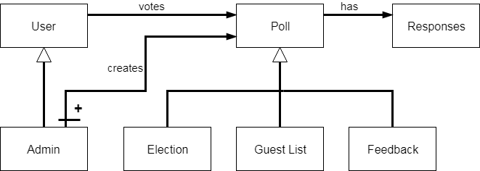
Concept
Admin(s) can create and view responses of poll
Users login to cast votes
Poll types: election, guest list, feedback
Notes:
-User (MIT student, admins) login to cast votes
-With some users acting as admin to create the polls and view responses
-Polls contain: position, list of candidates and lists of users who voted for each candidate, and they can be 1 of 3 types: elections, guest lists, and feedback

