Slide 1
Machine Learning Project
Song Recommender with Spotipy API

Slide 2
The Data
34K Songs
Xxx Songs
Pre-gathered & provided
Added via API calls on playlists
2

Slide 3
Model 1
11 Audio Features
Acousticness
Danceability
Energy
Instrumentalness
Key
Liveness
Loudness
Mode
Speechiness
Tempo
Valence
3

Slide 4
CROWD SOURCE
Model 2
Model 3
Key
Mode
Tempo
Energy
Mode
Tempo
Model 4
Model 5
Danceability
Instrumentality
Valance
Energy
Loudness
Valence
Model 6
Acousticity
Danceability
Speechiness
4

Slide 5
 | Juicy | Stairway to Heaven | Shake it Off | Moonlight Sonata 3rd | Let Down | AVG Score
Model 1 | Press Rewind Soja | Blueprints, of Us, Ori | Remember the Name, Fort Minor | Brooks Was Here, Thomas Newman | Hotel Lobby, Quavo | 1.8
 | 3 | -1 | 4 | 2 | 1
Model 2 | Clara M., Yovo | Bad Friend, Bad Wolves | Copperhead Road, Steve Earl | Nothing Could Keep me Away, Kris Bowers | Anchor, Novo Amor | 2.4
 | 1 | 2 | 3 | 2 | 4
Model 3 | Tom’s Diner, Kevin McKay | Cha Cha Cha, Ana Kirina | GhanaBlack Stars, Kofi Kinaata | Crazu, Naamen | Ewa, Groupo Ofa | 1
 | 1 | 1 | 1 | 1 | 1
Model 4 | Como Yo La Haga, Kaydee Cain | That Love, Leein | Andalouse, Kendji Girac | The Tiki Tiki Tiki Room, Disney | The Distance, Aly & AJ | 3
 | 4 | 2 | 2 | 4 | 3
Model 5 | Ranita, Alpha Blondy | Patience, Eiga | Just As Long As I Got You, Love Committee | Birds In The Woods, JBE Nature Sounds | World War 5, Carnifex | 1.6
 | 2 | 2 | 3 | 0 | 0
Model 6 | Barbie Dangerous, Nicki Minaj | The Sixth Summer, Plave | I Would Find a Way, Big Mountain | Stars Light Up the Water, Comet Blue | You’ll Never Be Alone Again, newshapes | 3.4
 | 5 | 3 | 2 | 3 | 4
5

Slide 6
MODEL 6
Final Model
600 Clusters
6

Slide 7
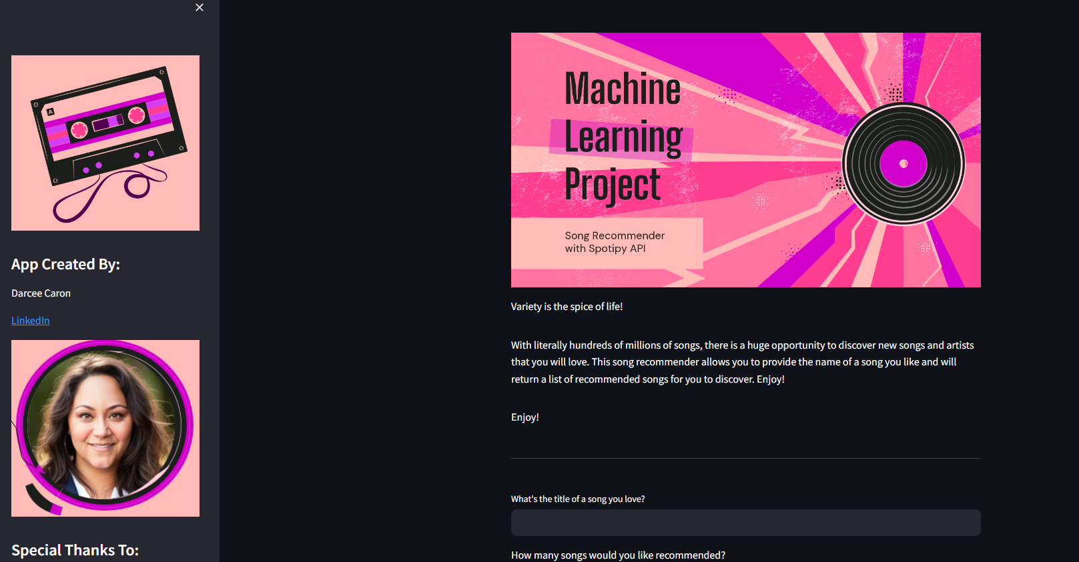
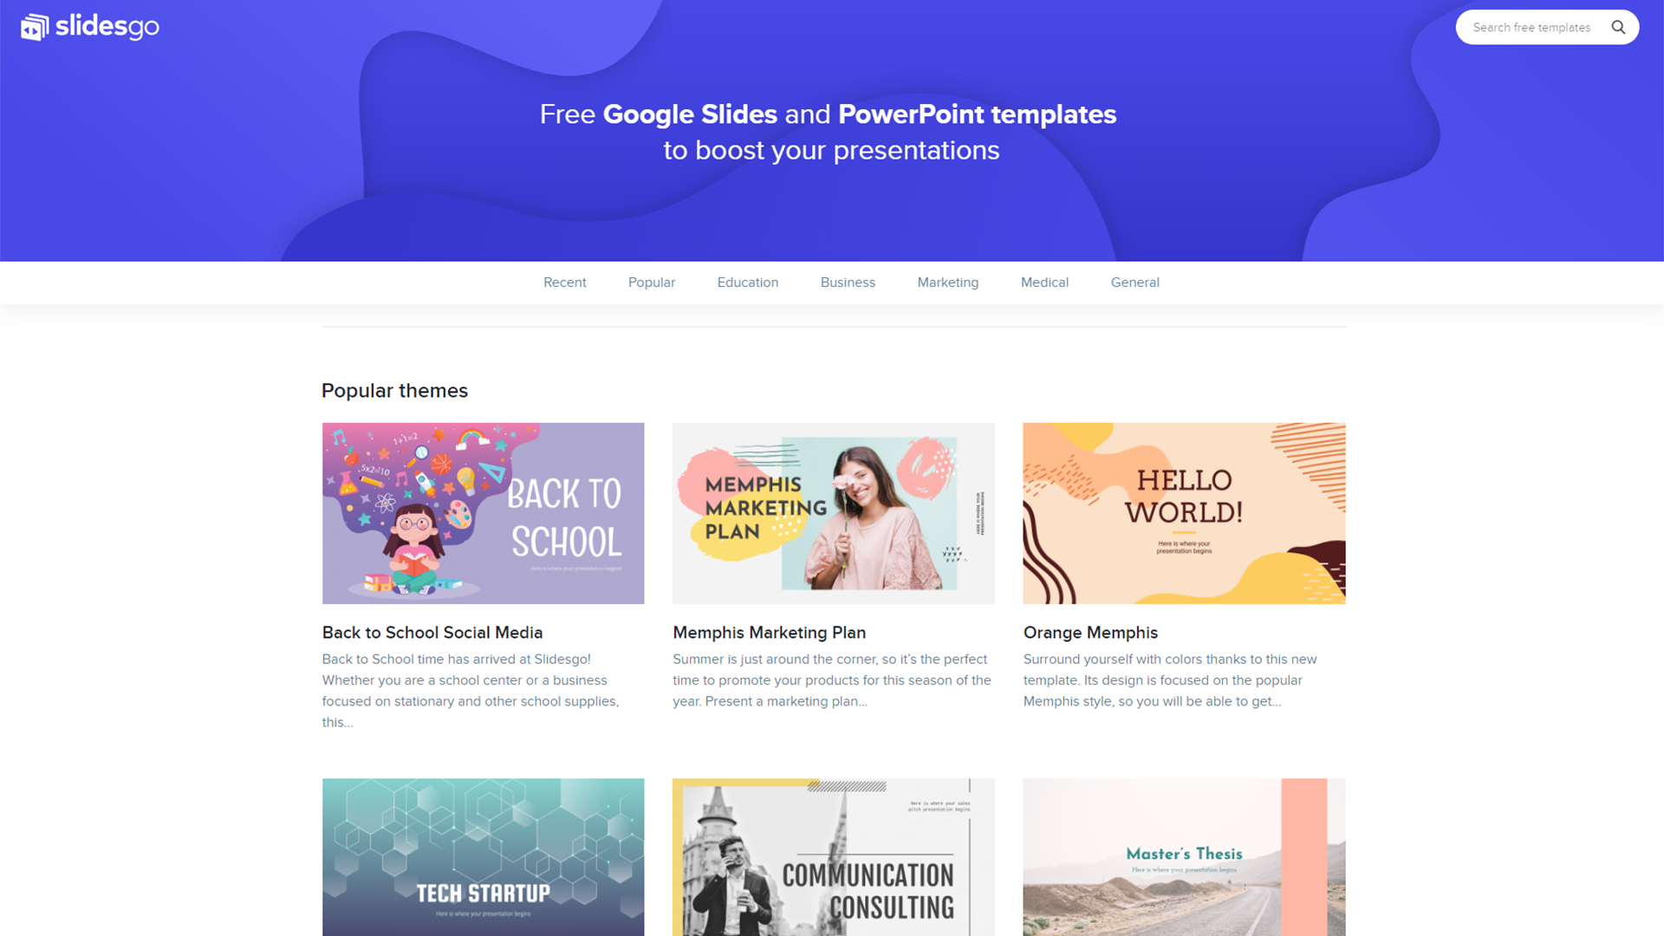
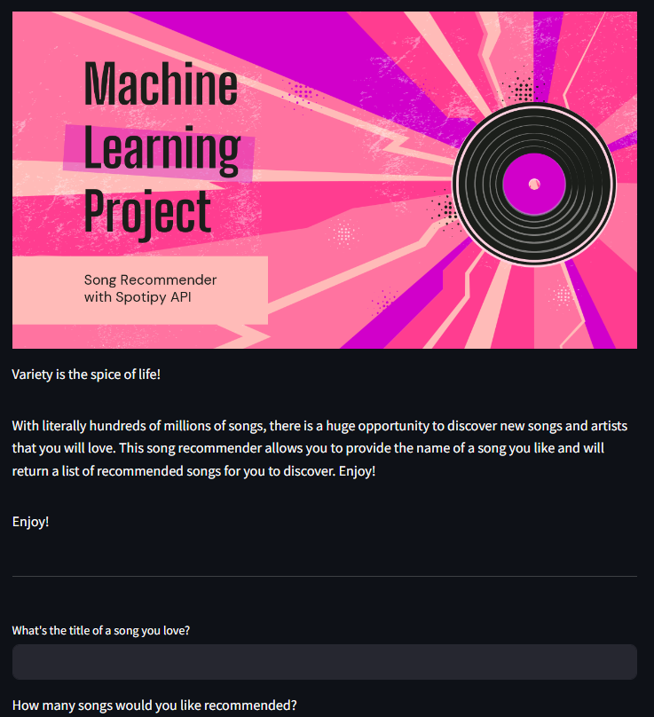

DEMO
Deployed App on Streamlit

Slide 8


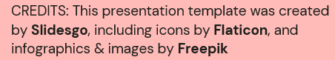
THANKS!
Darcee CARON
darceeanne@gmail.com
Please keep this slide for attribution

