Slide 1
SQL For Data Science
mm/dd - Steve Mortimer, XXX XXXXXX, XXX XXXXXX

Slide 2
Why Learn SQL?
Fundamental data science skill
Ubiquitous - It's everywhere in the data community
SQL teaches you Relational Algebra and Set Theory
Expands Your Computing Power
Ease of Access - You can get started today!

Slide 3
What is a Relational Database?
Key terminology and concepts
Rows represent single items (e.g. an MBA student)
Columns are labeled attributes for each item
(e.g. “Name: Steve”, “School: Darden”, “Year: 2”)
Tables are sets of rows that share the same attributes
(“Students”)
Views are sets of any rows from different tables in response to a query (“Get me all Second-Year Students in Darden”)
Proposed in 1970 by E. F. Codd while working at IBM
Source: Wikipedia

Slide 4
Why Relational Databases?
Key terminology and concepts
Relational data models:
Are very easy to extend
Improve and maintain data integrity
Allow for re-assembling data many different ways without reorganizing the underlying structure
“Normalization” is the extent to which the data replicated into multiple places within the database.
Highly Normalized = Little Redundancy = More Joins
Denormalized = More Redundancy = Less Joins

Slide 5

Getting Started
The AdventureWorks database
AdventureWorks Cycles is a fictitious bicycle manufacturer
Scenarios include:
Manufacturing
Sales
Purchasing
Product Management
Contact Management
Human Resources
Data needs to be hosted on a running database!
AdventureWorks Source: https://github.com/infinuendo/AdventureWorks/tree/master/OLTP/Original

Slide 6
Getting Started
Connecting to the database
Connecting to the database server requires a set of credentials
You will need:
Host - ec2-107-22-169-45.compute-1.amazonaws.com
Port - 5432
Username - rmfenpdczlrtqo
Password - 57a3df647d21f42d4dc029cd951ac7762e1ad440e411dfc8fb7dffb57d82d976
Database Name - d54sjlbs6erhjs
Check the database is running (open your terminal window):
nc -v ec2-107-22-169-45.compute-1.amazonaws.com 5432
HOST
PORT

Slide 7
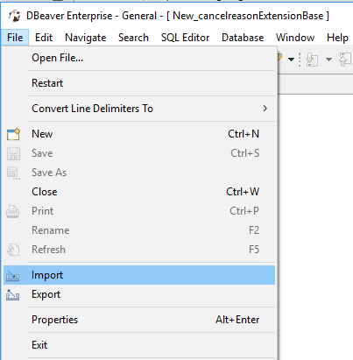
Getting Started
DBeaver - A SQL client
A SQL Client is a program to query databases
First, install DBeaver - http://dbeaver.jkiss.org/download/
Second, download profile (contains connection and SQL scripts)
Third, import the profile into DBeaver
Open up DBeaver -> File -> Import

Slide 8
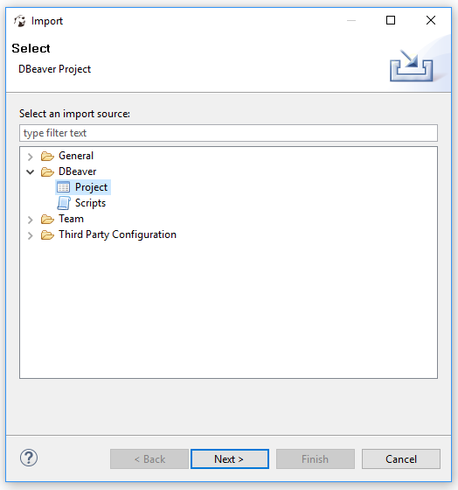
Getting Started
DBeaver - A SQL client (continued)
Next,
Select “Project” as the file type you’d like to import
Click “Next”

Slide 9
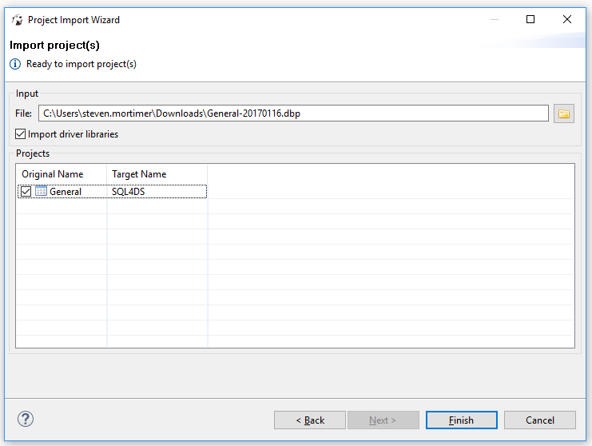
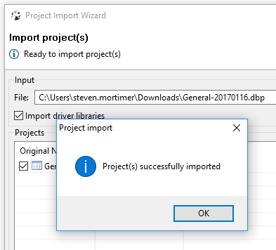
Getting Started
DBeaver - A SQL client (continued)
Next,
Select the .dbp file that you downloaded
Ensure that “Import driver libraries” is checked
Ensure the Target Name is “SQL4DS”
Click “Finish”

Slide 10
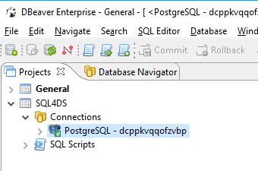
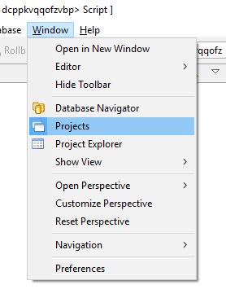
Getting Started
DBeaver - A SQL client (continued)
Click on SQL4DS Project. You should see a connection “PostgreSQL” with green check.
If you do not see a “Projects” tab, go to “Window” -> “Projects”

Slide 11
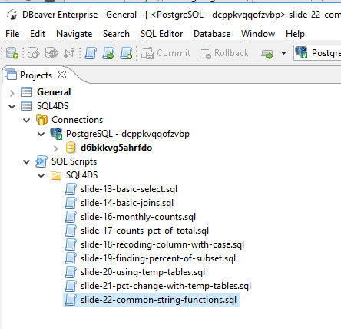
Getting Started
DBeaver - A SQL client (continued)
If you click on arrow to expand the “SQL Scripts” you will see scripts and folders of scripts that are part of your profile.
There is a folder called “SQL4DS” with all scripts for this presentation

Slide 12
Getting Started Checklist
Do you have all the necessary tools?
PostgreSQL (Database)
Do you have connection credentials?
Can you confirm connection via “nc” or “telnet”?
DBeaver (SQL Client)
Installed?
Do you have project or connection profile?
Can you connect to database?
Can you see scripts? Do they execute?

Slide 13
The SQL Basics
SELECT, FROM, WHERE
The basic outline of a SQL query is SELECT, FROM, WHERE
SQL is declarative, just tell the database what you want! But…
it can get messy so format your queries to be easy to read.
See the SQL Style Guidelines Cheatsheet
SELECT productid , name , listprice FROM product WHERE productnumber = 'LO-C100' ;

Slide 14
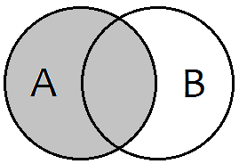
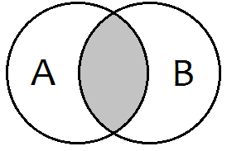
The SQL Basics
JOINs - LEFT JOIN and INNER JOIN
A “JOIN” connects data from 2 or more tables (similar to VLOOKUP)
LEFT JOIN
SELECT COUNT(*) -- 504 records
FROM product p
LEFT JOIN production.productcategory as pc
ON p.productsubcategoryid = pc.productcategoryid
;
INNER JOIN
SELECT COUNT(*) -- 105 records
FROM product p
INNER JOIN productcategory as pc
ON p.productsubcategoryid = pc.productcategoryid
;

Slide 15
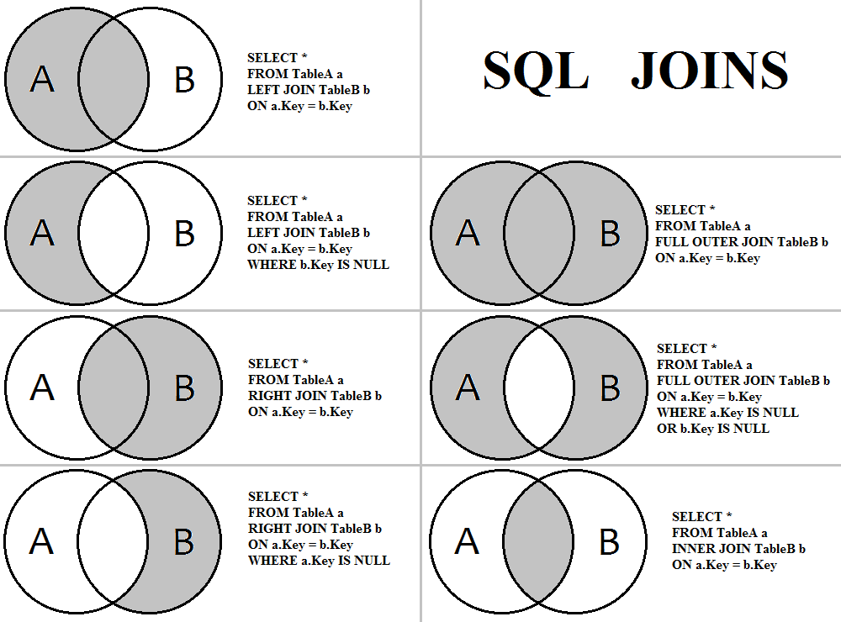
The SQL Basics
The JOINs cheatsheet

Slide 16
Find Out Count of Transactions per Month
The GROUP BY statement
SELECT p.name , COUNT(*) AS total FROM transactionhistory th INNER JOIN product p ON th.productid = p.productid WHERE TO_CHAR(transactiondate, 'YYYY-MM') = ‘2017-01' GROUP BY p.name ;
Count by month for all months in 2017.
Don’t copy/paste the query above! GROUP BY month!
SELECT TO_CHAR(th.transactiondate, 'YYYY-MM') AS month , p.name , COUNT(*) AS total FROM transactionhistory th INNER JOIN product p ON th.productid = p.productid WHERE DATE_PART('year', transactiondate) = ‘2017' GROUP BY month, p.name ;

Slide 17
Find Out Distribution of Products by Category
Divide by a total count to get the proportion of total
SELECT pc.name AS category
, COUNT(p.productid)
, CAST(COUNT(p.productid) AS decimal) / (
SELECT COUNT(*) FROM production.product) AS pct
FROM product p
INNER JOIN productcategory pc
ON p.productsubcategoryid = pc.productcategoryid
GROUP BY category
;
Be careful! Always inspect your results!!
SELECT pc.name AS category
, COUNT(p.productid)
, CAST(COUNT(p.productid) AS decimal) / (
SELECT COUNT(*) FROM production.product) AS pct
FROM product p
LEFT JOIN productcategory pc
ON p.productsubcategoryid = pc.productcategoryid
GROUP BY category
;

Slide 18
Recoding a Column with CASE
The CASE statement
“CASE” follows WHEN-THEN-ELSE logic to change values, here we rename bikes and components to “Core”.
SELECT
p.name , CASE WHEN pc.name = 'Bikes' OR pc.name = 'Components' THEN 'Core' ELSE 'Non-Core' END AS finance_category FROM product p
LEFT JOIN productcategory pc
ON p.productsubcategoryid = pc.productcategoryid
;

Slide 19
Find Out What Percent of Products are “Core”
Convert a column to 0s and 1s and then the average is the proportion of 1s!
SELECT
AVG(core_indicator) AS pct_core FROM product p
LEFT JOIN (
SELECT productcategoryid , CASE WHEN name = 'Bikes' OR name = 'Components' THEN 1 ELSE 0 END AS core_indicator FROM productcategory
) pc
ON p.productsubcategoryid = pc.productcategoryid
;
Note: The product table is LEFT JOIN’ed to a “subquery”. A subquery is its own query that is part of a larger query.

Slide 20
Using Temp Tables
Smaller, separate tables to make large queries more manageable
WITH t AS ( SELECT productid , TO_CHAR(transactiondate, 'YYYY-MM') AS month FROM transactionhistory WHERE DATE_PART('year', transactiondate) = ‘2017' ) , t2 AS ( SELECT t.*, p.name FROM t INNER JOIN product p ON t.productid = p.productid ) SELECT month, name, COUNT(*) AS total FROM t2 GROUP BY month, name ORDER BY month, name ;

Slide 21
Find Out the Percent Change Month over Month
The LAG() function
, monthly AS ( SELECT month, COUNT(*) AS total
FROM t2
GROUP BY month
ORDER BY month )
, lagged AS ( SELECT month , total , LAG(total) OVER (ORDER BY month) AS prior_month FROM monthly
)
SELECT month, total, prior_month,
(total::float - prior_month) / prior_month AS pct_diff
FROM lagged
;

Slide 22
Manipulate Strings and Find via Fuzzy Match
Text columns can be modified and searched as needed
SELECT name AS original , LENGTH(name) AS str_length , UPPER(name) AS str_upper , SUBSTRING(name, 1, 3) AS str_sub , REPLACE(name, 'a', 'zzz') AS str_replace , CONCAT('PREFIX_', name) AS str_concat FROM product WHERE productnumber LIKE 'LO%' ;
LENGTH, UPPER, SUBSTRING, REPLACE, CONCAT will modify a column. LIKE will perform a fuzzy match

Slide 23
Resources
Follow these links for more information on learning SQL
W3Schools - http://www.w3schools.com/sql/
Hacker Rank - https://www.hackerrank.com/domains/sql/select
SQL Zoo - http://sqlzoo.net/wiki/AdventureWorks
Codecademy - https://www.codecademy.com/learn/learn-sql
Other Data Science Club Members
Experienced Professionals are all around you!

Slide 24
Questions?
In Person - Ask Now!
Via Email -
Club Inbox - DataScienceClub@darden.virginia.edu
Steve Mortimer - MortimerS19@darden.virginia.edu

