Slide 1
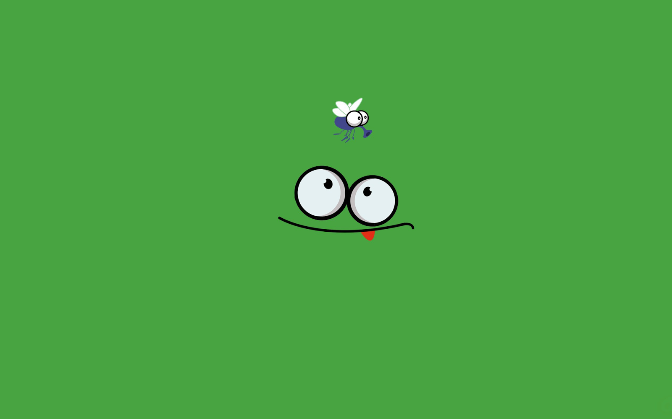
FROGGER
A FR
G
STORY

Slide 2
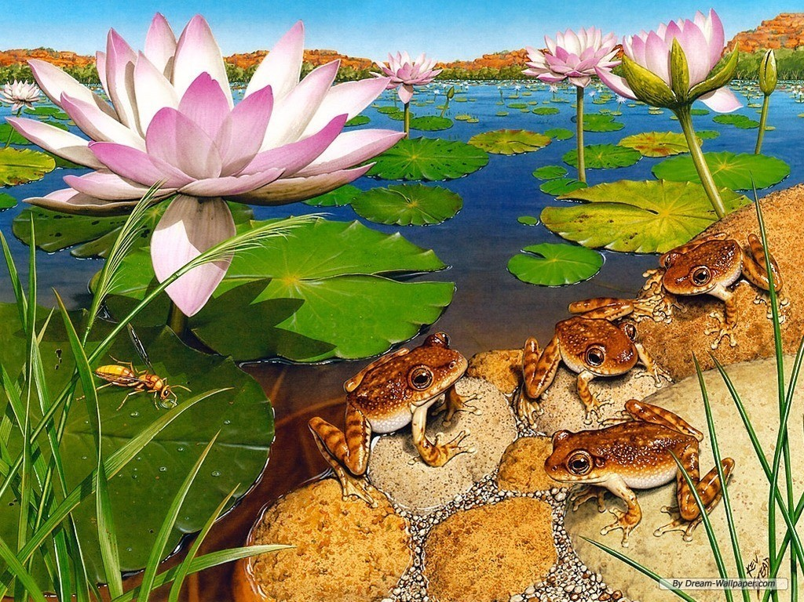
ONCE UPON A TIME… IN A BEAUTIFUL AND PEACEFUL POND THERE LIVED A CUUUTE LITTLE FROG

Slide 3
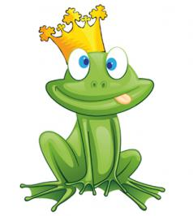
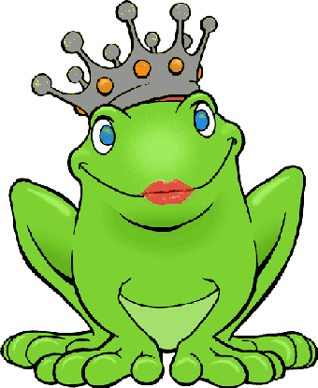
OUR HERO… OR HEROINE
WELL… WE LEAVE IT UP TO
YOU TO DECIDE …..
IF HE WAS A PRINCE
OR A PRINCESS….
A DAZZLING BEAUTY

Slide 4

ONE BEAUTIFUL NIGHT, ATTRACTED BY THE CITY LIGHTS, HE OR SHE LEFT THE TRANQUIL POND AND GET LOST IN THE BIG CITY

Slide 5
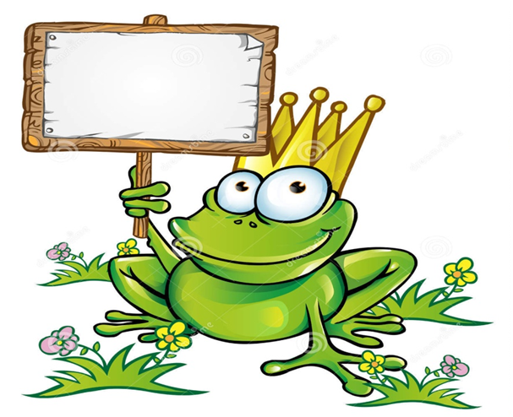


HELP
BELIEVE IT OR NOT…
…
BUT YOU CAN HELP
THIS CUTE FROGGIE GET BACK TO THE SWEET, SWEET HOME…

Slide 6
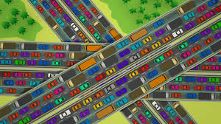
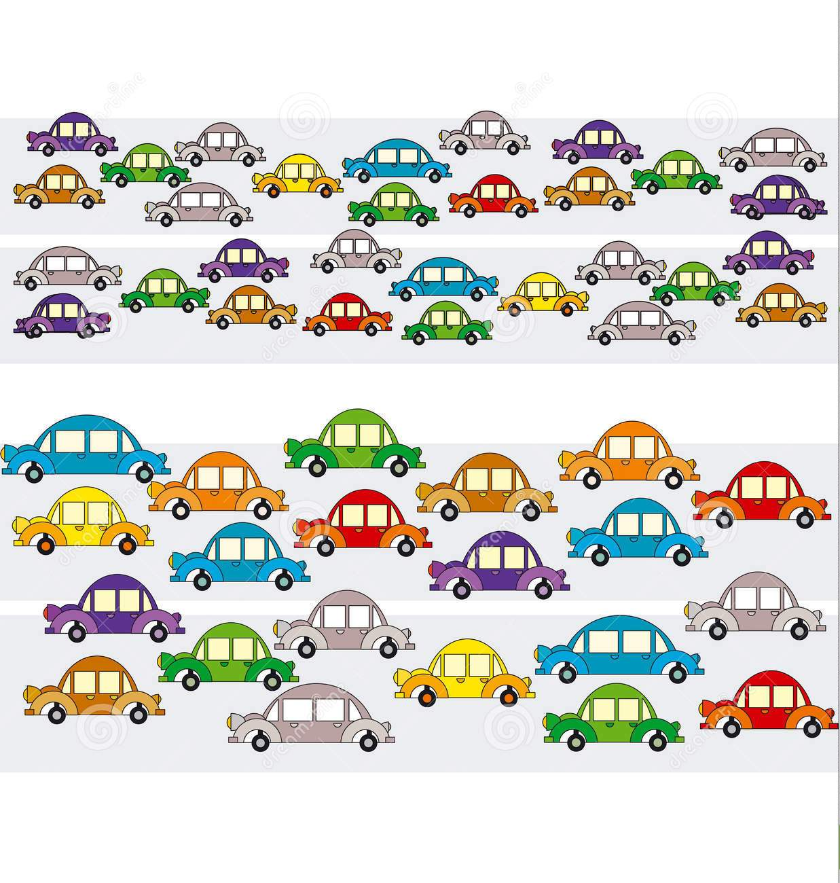
JUST NAVIGATE THE FROGGIE
THROUGH
THE JUNGLE OF
THE NIGHTMARE
CITY TRAFFIC

Slide 7
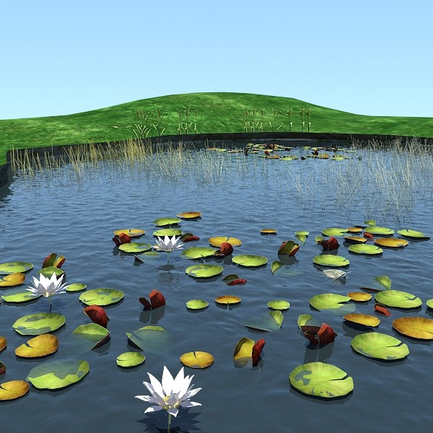

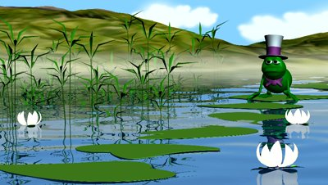
TO THE LIFE HE OR SHE KNOWS…
SO THAT
THE FROGGIE
CAN
COME BACK

Slide 8


HAPPY END

