Slide 1
TECH TITANS
SIH 2026 · PS SIH26044
The Challenge
AvsarAI
SkillBridge
AvsarAI graduates lack a structured bridge connecting academic skills to industry demand, internships, and verified placement pathways.
The Opportunity
An AI-powered platform that maps skills, detects gaps, and matches students to AvsarAI industry opportunities—end to end.
AI-Powered Academia–Industry Collaboration for Skills, Internships & Placement
Ministry of AvsarAI | Smart India Hackathon 2026 | Problem Statement ID: SIH26044
The Impact
Stronger academia–industry collaboration, data-driven curriculum alignment, and an accelerated internship-to-placement pipeline for the AvsarAI ecosystem.

Slide 2


TECH TITANS
SOLUTION OVERVIEW
From Classroom Skills to AvsarAI Careers
4 Core Innovations
AI Matches
AI Internship Recommendation Engine
Verified, portable skill credentials tailored specifically for AvsarAI professionals—spanning Ayurveda, Yoga, Unani, Siddha, and Homeopathy. Blockchain-ready for tamper-proof verification.
Curriculum-aligned opportunity matching that goes beyond keyword search—recommending roles based on verified skills, detected gaps, and academic context.
Academia–Industry Skill Gap Mapping
Company Recruiter Portal
Real-time demand-supply alignment dashboard enabling institutions to evolve curricula based on live industry signals and sector-wide competency data.
Recruiters can post opportunities in one place and quickly discover qualified AvsarAI talent. The portal streamlines hiring with a simple view of matched candidates and open roles.

Slide 3
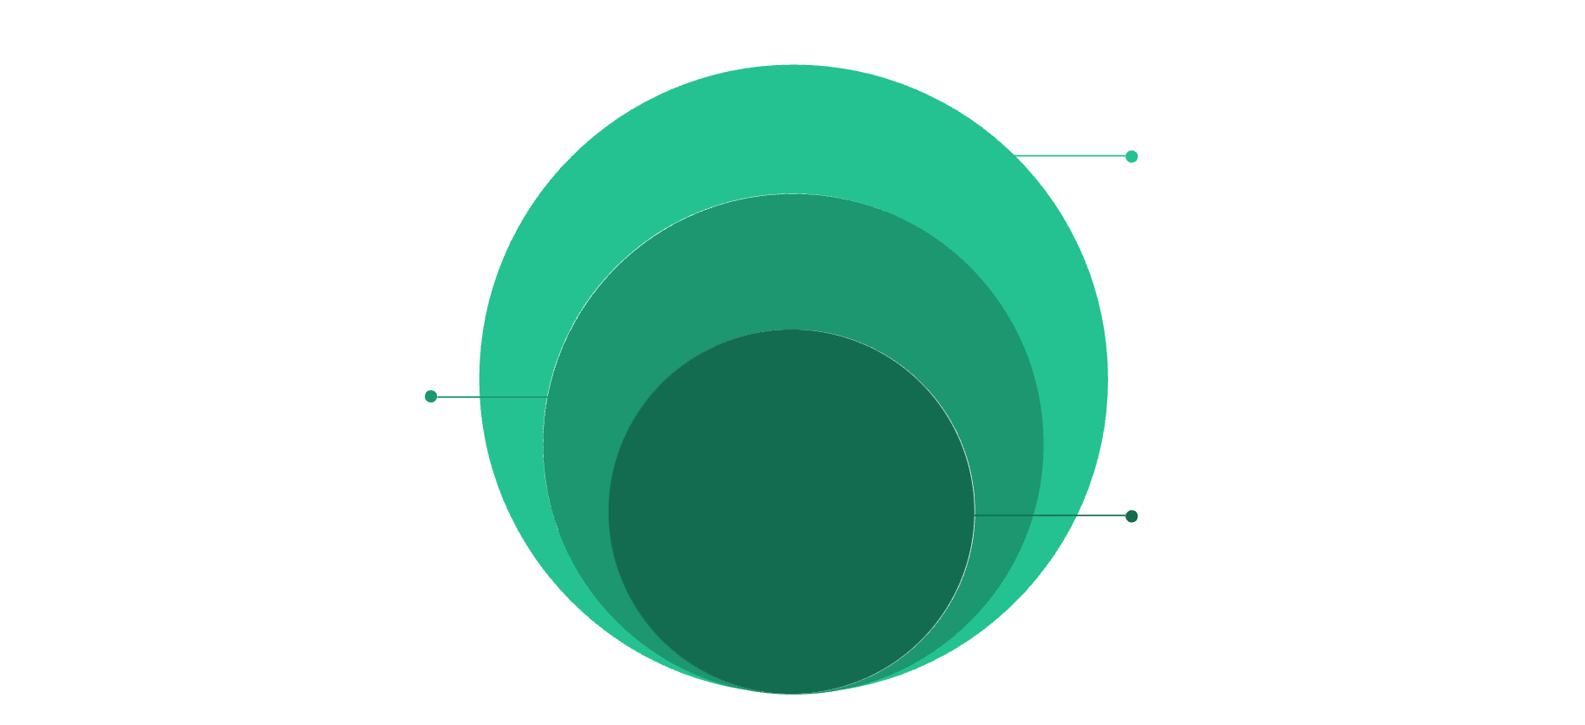




TECH TITANS
TECHNICAL ARCHITECTURE
How the Intelligent Platform Works
Platform Architecture — End-to-End Data Flow
Technology Stack
Interface & Outputs
dashboards, recommendations, tracking
Frontend
Backend
Data Layer
Profiles, resumes, skills, curriculum, industry requirements
Core AI Engine
Skill mapping, gap analysis, opportunity matching
Database
AI / ML
The platform follows a clean separation of concerns—raw profile and curriculum data feeds the AI Intelligence Engine, which produces actionable outputs including internship recommendations, mentor pairings, and personalized learning paths. All outputs are tracked through a unified analytics dashboard.

Slide 4

TECH TITANS
FEASIBILITY & DIFFERENTIATION
Why It Is Feasible & Different
Feasibility Pillars
What Makes AvsarAI SkillBridge Different
Modular Web-Based Architecture
Skill-Gap Based Matching
Tech Assignment
Deployable on standard government cloud environments with minimal setup overhead.
Students complete technical assignments to verify skills
and demonstrate readiness through practical evaluation.
Internships recommended based on detected learning gaps—not keyword overlap or arbitrary filters.

Slide 5


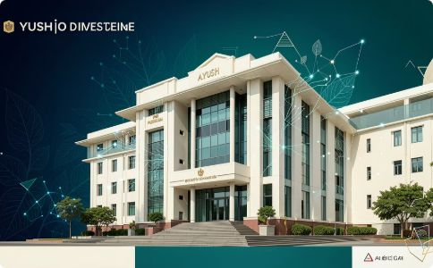
TECH TITANS
ECOSYSTEM IMPACT
Connecting the Complete AvsarAI Career Ecosystem
STUDENTS ↔ INDUSTRY ↔ MINISTRY
Students
Industry
AvsarAI Ecosystem
Find internships aligned to curriculum and skill level
Bridge skill gaps and earn portable, verified credentials
Find skill-matched AvsarAI talent with verified credentials
Post internships and projects to a targeted pool
Strengthen academia–industry collaboration at scale
Enable data-driven curriculum and policy reform

Slide 6
TECH TITANS
ROADMAP
Building the AvsarAI Talent Pipeline
01
02
Phase 1 - Discover
Phase 2 - Assess
Identify & Profile Talent
Measure Readiness
Student profile
Resume/skills extraction
Academic details
Career interests
Technical/aptitude/soft-skill assessments
Skill-gap analysis
Talent/readiness score
03
04
Phase 3 - Develop
Phase 4 - Connect
Build Missing Skills
Industry → Internship → Placement
Personalized course recommendations
Projects & certifications
Progress tracking
Skill-gap closure
AI-matched internships
Company shortlisting
Internship performance
Placement opportunities
SIH 2026 | PS SIH26044 | Ministry of AvsarAI
Connect Skills. Create Opportunities. Build AvsarAI Careers.

