Slide 1

Main app methodology
By uncle rat

Slide 2
Agenda
How to use this document
Preperation
Exploring the requests
Parameter analysis
Broken Access Control
SQLi
Business Logic Vulnerabilities
SSRF
OS Command injection
CSRF
Finding more endpoints

Slide 3
How to use this document

Slide 4
How to use this document
Use this document with the video for the main app methodology
First go through the intracies of bug bounties section, don't skip this
Make note of what parameters are tested for what vulnerabilities
Explore the vulnerabilities in their own sections
Practice your methodology to develop an intuition
Re-read this document
Imagine all the ways in which we can create impact with these vulnerabilties

Slide 5
Preperation

Slide 6
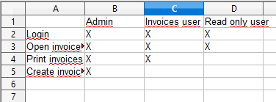
Preperation
Manually explore your target
At least a couple of hours
Uncle rat says: 8 hours +
Keep Burp suite open in the background
Scope set properly
Will later on be used to explore the requests
Make a mindmap of the functionality
Take note of the privilege levels

Slide 7

Preperation
Read any manual you can find – Public info is never out of scope, so google!
Register your accounts
While you do use an XSS attack vector in every possible field
• Triggers integration issues if existent
Also SSTI
Ex. <img src=x>’”>${{7*7}}
This will test for HTML injection
This will test for JS context XSS
This will test for HTML tag attribute injection
This will test for SSTI
This will test for CSTI

Slide 8
Exploring the requests

Slide 9
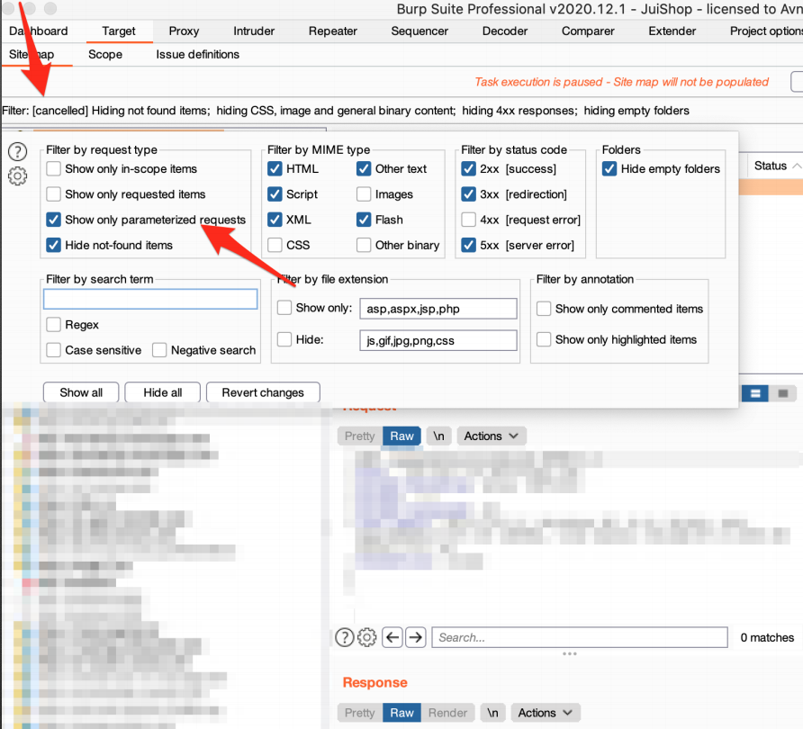
Exploring the requests
Burp: Filter on all requests with parameters
Study each request and parameter
Think of what it does
Think of how to break it functionally
Does our bug have security impact if we find any?

Slide 10
Parameter analysis

Slide 11
Parameter analysis
CSRF tokens should be checked
JWT tokens should be checked
Any URL that redirects people, even partial or in files (import) should be checked
We have to test for BAC and IDOR if we see functions we should not be able to execute as a certain user
Captcha’s can be bypassed
Files that are gotten from local system LFI or remote system RFI
SQLi but in weaker form for every CRUD action
XXE in SVG,XML,DOCX,…
Template injections via automated checks if you suspect templating engines

Slide 12
Parameter analysis
URLs that resolve get checked for SSRF
Every parameter gets checked for command injection
Admin panels do not mean the end, try to bypass them

Slide 13
Issue types

Slide 14
Issue types
CSRF:
Check if the token is present on any form it should be
Server checks if the token length is correct
Server checks if parameter is there
Server accepts empty parameter
Server accepts responds without CSRF token
Token is not session bound

Slide 15
Issue types
JWT:
None-signing algorithm is allowed
Secret is leaked somewhere
Server never checks secret
Secret is easily guessable or brute-forceable

Slide 16
Issue types
Open redirect bypass:
evil.com/expected.com
Javascript openRedirects
Hidden link open redirects
Using // to bypass
https:evil.com (browser might correct this, filter might not catch it)
/\ to bypass
%00 to bypass (null byte)
@ to bypass
Parameter pollution (adding the same parameter twice)

Slide 17
Issue types
BAC
Test higher Priv functions should not be able to be executed by lower Priv user
Test ALL user levels
Test with authorise
S Functions via developer console
Copy and paste of URL
IDOR
Test between ALL tenants (companies hosted on one server/database. Can also be divisions of companies)
Test with authorise
JS Functions via developer console
Copy and paste of URL

Slide 18
Issue types
Captcha bypasses
Try change request method
Remove the captcha param from the request
leave param empty
Fill in random value

Slide 19
Issue types
LFI
Using // to bypass
/\ to bypass
\\
%00 to bypass (null byte)
@ to bypass
URL encoding
double encodings

Slide 20
Issue types
RFI
Using // to bypass
/\ to bypass
\\
%00 to bypass (null byte)
@ to bypass
URL encoding
double encodings

Slide 21
Issue types
SQLi:
‘“ to trigger
SQLmap
XXE:
SVG files (images), DOCX/XLSX, SOAP, anything XML that renders
Blind SSRF, file exfiltration, command exec

Slide 22
Issue types
Template injections (CSTI/SST)
- ${7*7}
- If resolves, what templating engine
- Try exploit by looking at manuals
URL encode special chars ({}*)
HTML entities
Double encodings

Slide 23
Issue types
SSRF
SSRF against server itself
SSRF against other servers on the network
Command injection
Test every single parameter
Make a list of commands + command separators for target OS
Admin panel bypass
Try referr header
Easy username/pass
Directory brute forcing for unprotected pages

Slide 24
Broken Access Control

Slide 25
Broken Access Control
Some Terms
Account = Organisation such as google for example
User = Person such as an employee
Preperation
Create 2 accounts
Invite at least 2 users per account
Test for
IDOR
Between 2 accounts
Between 2 users within 1 account

Slide 26
Broken Access Control
Test for
BAC
Between all users from all privilege levels
Within 1 account
Within 2 users from different accounts
Use tools
Authorize
Built for BAC testing
Has more speciliased settings
Auto repeater
Less specialised
Can be customised further

Slide 27
SQL Injection

Slide 28
SQL Injection
Test
Every database read or write
Basic check
Enter ' and " wherever you can
If you get a SQL error, run SQLmap
Advanced check
Investigate DB systems and build wordlist

Slide 29
Business Logic Vulnerabilities

Slide 30
Business Logic Vulnerabilities
Whatever the manual tells you not to do, do it
Mess with every single parameter and analyse results
Look for the developer restraints and try to look for edge values
I.E. if the developer wants us to rate from 1 to 5
Try 0
Try 6
Try –1
Try a
Try ...
Mess with the order of requests
Copy parameters from the response to the request to see if they can be changed

Slide 31
Server Side Request Forgery

Slide 32
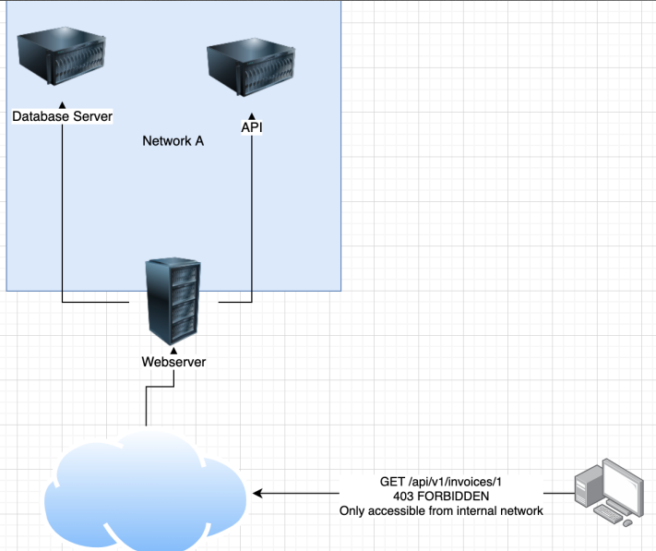
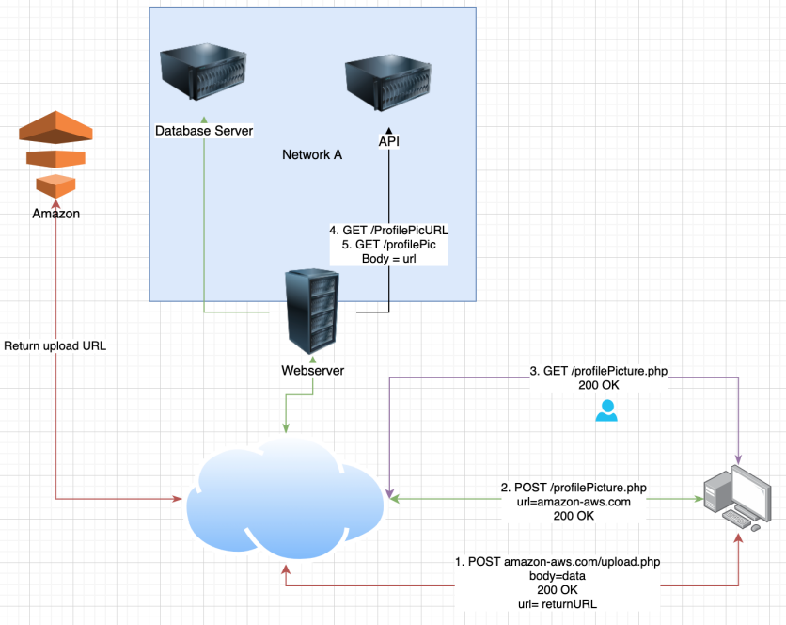
Server Side Request Forgery

Slide 33
Server Side Request Forgery
SSRF gives us access to internal servers we should not be able to access
test
any URL that gets resolved by the server and that we can control
Partial URLs in the body instead of a full URL
URLs within data files such as XML files or CSV files (import functionality)
The referer header can sometimes contain SSRF defects
Test for
SSRF against the server itself
SSRF against other backend systems
Blind SSRF
Requires extensive knowledge of the network or brute forcing

Slide 34
OS Command injection

Slide 35

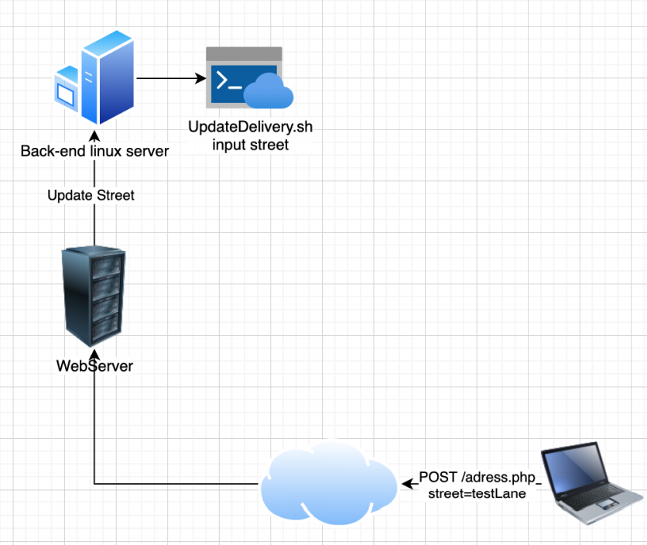
OS Command injection

Slide 36
OS Command injection
Input sometimes gets sent to back-end sh scripts
This input needs to be properly sanitised
The filtering is often blacklist based
If developer forgets one thing on blacklist, we have an entry point
Test
Combine all command separators with all commands to make list
Encode the list
Test every single parameter
Tool: Burp intruder + self created list

Slide 37
CSRF

Slide 38
CSRF
Test using
match and replace
Autorepeater plugin in burp
CSRF scanner burp

Slide 39
CSRF
Match and replace
Add a match and replace rule
Type: Request body
Match: “CSRF=*” (replace this value with how your target does CSRF tokens)
Replace: “CSRF=“ << SEE NEXT SLIDE
Regex match: True

Slide 40
CSRF
Test techniques
Remove the CSRF token from requests
Replace the CSRF token with a random value (for example 1)
Replace the CSRF token with a random token of the same restraints
Leave CSRF Parameter empty
Use a CSRF token that has been used before
See if you can request a CSRF by executing the call manually and use that token for the request

Slide 41
Finding more endpoints

Slide 42
Finding more endpoints
Javascript analysis
Wayback URLs
Google dorking
API documentation

